Slide 1
Countable AND UNCOUNTABLE QUANTIFIERS

Slide 2
QUANTIFIERS ARE USED TO GIVE A NUMBER OR AMOUNT OF SOMETHING
COUNTABLE:
A/AN (=1) –> AN APPLE
MANY –> MANY APPLES
(a) FEW –> A FEW APPLES
UNCOUNTABLE: MUCH –> MUCH WATER (a) LITTLE –> A LITTLE WATER

Slide 3
QUANTIFIERS
FOR
COUNTABLE AND UNCOUNTABLE NOUNS
PLURAL COUNTABLES + UNCOUNTABLES:
SOME: I need some help! / There are some problems.
ANY: They haven’t got any money. / Are there any people in the room?
A lot of / lots of: The kids had lots of questions. / She drank a lot of water after the run.
Plenty of: I searched plenty of websites. / We need plenty of time to do it.

Slide 4
Some words can be countable and uncountable
Uncountable Countable
Light light(s)
Time time(s)
Wood woods
Hair hair(s)
Some words are uncountable in English (but not in Polish)
Furniture
Bread
Information

Slide 5
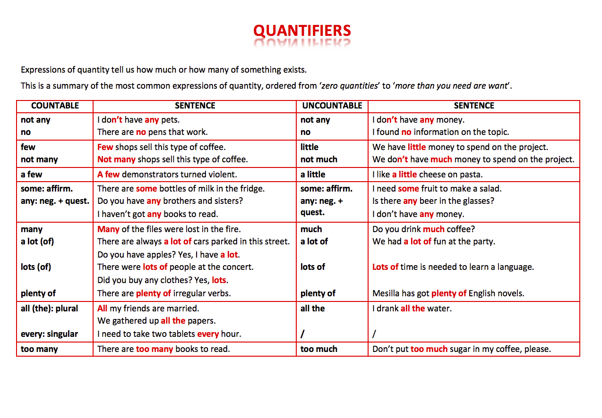

Slide 6


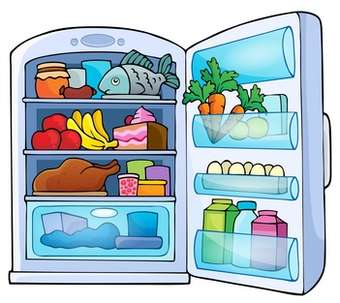








any
lots of
little
much
no
few
a(n)
milk
many
some

Slide 7


click the right word to complete the sentence
lots of
many
much
some
any
no
little
few
milk
a(n)
There is ____ empty water bottle.
an

Slide 8
click the right word to complete the sentence
lots of
many
much
some
any
no
little
few
milk
a(n)
There isn’t _______ cake left.
much

Slide 9
click the right word to complete the sentence
lots of
many
much
some
any
no
little
few
milk
a(n)
There are only a ______ onions.
few

Slide 10
click the right word to complete the sentence
lots of
many
much
some
any
no
little
few
milk
a(n)
How _______ eggs are there?
many

Slide 11
click the right word to complete the sentence
lots of
many
much
some
any
no
little
few
milk
a(n)
There is ____ butter in the fridge.
no

Slide 12
click the right word to complete the sentence
lots of
many
much
some
any
no
little
few
milk
a(n)
There aren’t _____ mushrooms.
any

Slide 13
click the right word to complete the sentence
lots of
many
much
some
any
no
little
few
milk
a(n)
There is only a ______ orange juice.
little

Slide 14
click the right word to complete the sentence
lots of
many
much
some
any
no
little
few
milk
a(n)
There is _______ milk in the fridge.
lots of

Slide 15
click the right word to complete the sentence
lots of
many
much
some
any
no
little
few
milk
a(n)
Is there _____ ham?
any

Slide 16
click the right word to complete the sentence
lots of
many
much
some
any
no
little
few
milk
a(n)
Would you like ______ ham?
some

Slide 17
click the right word to complete the sentence
lots of
many
much
some
any
no
little
few
milk
a(n)
There is ____ small sausage.
a

Slide 18
click the right word to complete the sentence
lots of
many
much
some
any
no
little
few
milk
a(n)
There isn’t _____ beef.
any

Slide 19
click the right word to complete the sentence
lots of
many
much
some
any
no
little
few
milk
a(n)
How_______ fish is there?
much

Slide 20
click the right word to complete the sentence
lots of
many
much
some
any
no
little
few
milk
a(n)
There are ________ food containers.
lots of

Slide 21
click the right word to complete the sentence
lots of
many
much
some
any
no
little
few
milk
a(n)
There is a _______ cheese.
little

Slide 22
click the right word to complete the sentence
lots of
many
much
some
any
no
little
few
milk
a(n)
There are ______ apples and bananas.
some

Slide 23
click the right word to complete the sentence
lots of
many
much
some
any
no
little
few
milk
a(n)
There aren’t _______ carrots.
many

Slide 24
click the right word to complete the sentence
lots of
many
much
some
any
no
little
few
milk
a(n)
There are only a ______ strawberries.
few

Slide 25

click the right word to complete the sentence
lots of
many
much
some
any
no
little
few
milk
a(n)
There is ____ roast chicken.
a

