Slide 1
Physics Report : Carbon Nanotubes
Submitted by:
Section:
Admission No. :
Submitted to:
(School of Computer & Engineering)

Slide 2
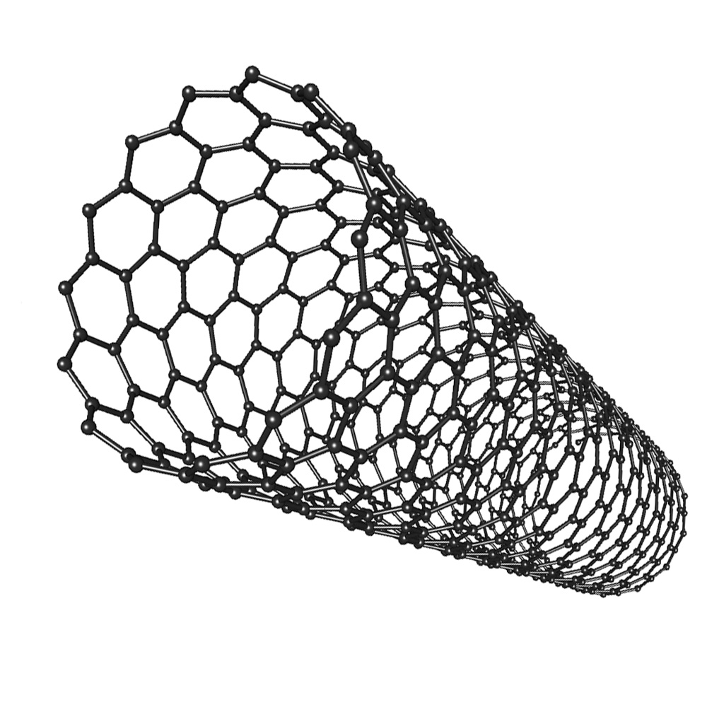
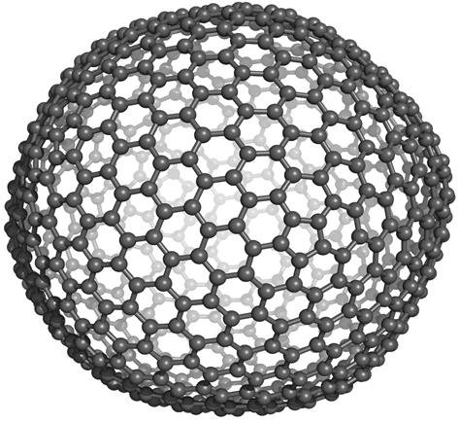
Introduction
A carbon nanotube is an allotrope of carbon with structure of a hollow tube made up of carbon of nanoscale diameter.
Before 1991, only two main allotropes of carbon were known then in 1991, a Japanese physicist, Sumio Lizima invented CNT.
In short, it is represented as CNTs. Carbon nanotubes are also called buckytube because of their similarity to spherically structed carbon allotrope, Buckminster fullerene.
Notes:
Allotrope: is a different form of the same element in which the atoms are bonded in a unique patterns, giving rise to different physical and chemical properties
Nano: 10 power -9

Slide 3
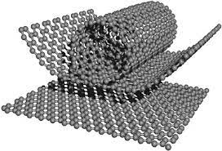
Formation & Structure
Nanotubes are formed by folding or rolling two-dimensional graphite into a cylindrical shape structure and they are hollow from inside.
The diameter of the nanotube is around 1-3 nanometers and it’s length generally goes to a few micrometers.
In short, we can say that carbon nan (CNT) is a folded form of the two-dimensional graphene sheet.

Slide 4
Properties
CNT (carbon nanotubes) exhibit extraordinary mechanical properties.
Carbon nanotubes are stiff. They are as stiff as a diamond (the hardest natural material in nature).
Carbon nanotubes have a high thermal capacity. Generally, it is twenty times stronger than steel. Therefore, it does not expand on heating like that of steel. Therefore carbon nanotubes are used in making bridges and aircrafts material.
In carbon nanotubes, each carbon atom is surrounded by three other carbon atoms through covalent bonds. These carbon-carbon covalent bonds form lattices in the shape of hexagons.
Carbon nanotubes are elastic and good conductors of heat and electrical conductivity
Carbon nanotubes are chemically neutral. So, they are chemically stable. Therefore, carbon nanotubes resist corrosion.

Slide 5
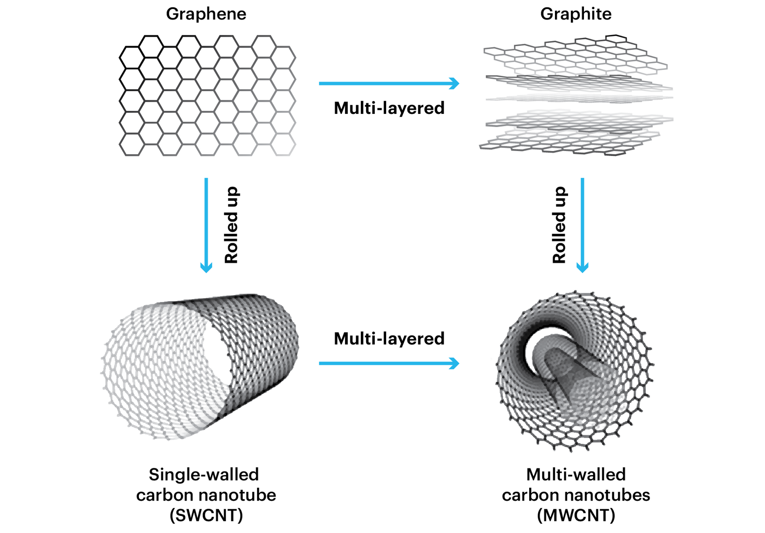
Types of Carbon Nanotubes

Slide 6
Single-walled Carbon nanotubes
Single-walled Carbon Nanotubes- it is represented as SWCNT. The Single-walled Carbon nanotubes exist in a 1-d structure.
Properties of Single-walled CNT
The diameter of Single-walled Carbon nanotubes is 2nm.
The length of Single-walled Carbon nanotubes is around 2 micrometers.
They exist in a one-dimensional structure. Therefore, it is also known as a nanowire.
Their band gap varies from 0-2 electron volts (eV).
They show conductivity like a semiconductor. Therefore, they exhibit both metallic and semi-conductivity behavior.

Slide 7
Multi-walled Carbon nanotubes
It is represented as MWCNT. It is composed of several nested carbon nanotubes. This type of nanotubes has two diameters, one is known as outer diameter and another one is known as inner diameter.
Properties of Multi-walled Carbon Nanotubes
The outer diameter of Multi-walled Carbon nanotubes is around 2-20 nanometres.
The inner diameter of Multi-walled Carbon nanotubes is 1-3 nm.
The length of Multi-walled Carbon nanotubes is around 5-6 micrometres.

Slide 8
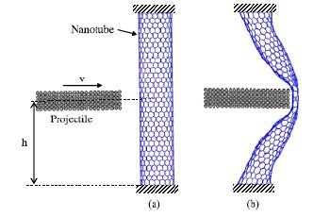
Applications
Carbon nanotubes are used to make bullet- proof jackets.
- they stop bullets from penetrating by dissipating force over an area larger than the bullet.

Slide 9
Breast cancer tumor destruction:
- nanotubes are used to destroy breast cancer tumors. They are placed with an antibody. The antibody along with nanotubes is attracted to the proteins of cancer cells in the body and nanotubes absorb the laser beam killing the tumor.
Windmill blades:
- buckytubes are used in the windmill blades because of their low weight . It increases the efficiency of the windmill and helps to produce more electricity at a faster rate.
Aircraft stress reduction:
- nanotubes are also used in aircraft and spacecraft bodies to reduce the weight and stress of the various components
Filtration:
- nanotubes are used to separate particles of size greater than the diameter of carbon nanotubes during filtration through them.
- they can also be used to trap smaller sized ions from a solution.

Slide 10
References
www.vedantu.com
www.britannica.com
www.wikipedia.com

Slide 11


