Slide 1
Navigation (Routing)
TECH45DEGREE

Slide 2
Vaadin Navigation
Vaadin Navigation is a key part of the Vaadin framework, responsible for controlling how users move between views (pages or components) within a Vaadin application.
In Vaadin, navigation is usually URL-based and allows users to access different views directly by URL, making it helpful for both single-page applications (SPA) and multi-page applications.

Slide 3
Routing and Views
Routes: Vaadin maps URLs to specific views through routes. You can define routes by annotating views with @Route, specifying the URL path.
Views: Each view is typically a Java class that extends Component or Composite, representing a single page or UI section within the app.

Slide 4
Navigation
Via Links

Slide 5
Server Side Navigation
Server Side Navigation
Server side navigation can be done by using code such as UI.navigate() methods.

Slide 6
Router Links
Router Links
Router Link is a component with <a> tag used for navigation. The page is updated in place without full page reload, and it update the URL of the page in the browser.

Slide 7
Standard Links (Anchor)
Standard Links (Anchor)
In Vaadin, "standard links" generally refer to traditional HTML anchor (<a href=“/aboutUs”>) elements rather than Vaadin's RouterLink. These links are used for navigating to any path.

Slide 8
Navigation Life Cycle
In Vaadin, the navigation lifecycle is the process by which a user moves between views or pages in a Vaadin application. Vaadin's router controls this navigation by determining which component to display based on the URL path. In Vaadin we have different navigation life cycles.
BeforeLeaveEvent
BeforeEnterEvent
AfterNavigationEvent

Slide 9
Before Leave Event
BeforeLeaveEvent is first event in navigation life cycle.
The BeforeLeaveEvent in Vaadin is a navigation lifecycle event triggered right before a user leaves a view. This event provides an opportunity to control or validate the navigation process, such as confirming unsaved changes or performing any cleanup operations before the user exits the current view.

Slide 10
Before Enter Event
BeforeEnterEvent is second event in navigation life cycle.
The BeforeEnterEvent in Vaadin is triggered right before a user navigates to a view, allowing you to manage access, validate, or prepare data before the view is displayed.

Slide 11
After Navigation Event
AfterNavigationEvent is third event in navigation life cycle.
The AfterNavigationEvent in Vaadin is a navigation lifecycle event triggered immediately after a user has successfully navigated to a new view. This event allows you to perform actions after the view is fully loaded and visible, such as updating UI elements, setting focus, or logging navigation events.

Slide 12
Passing Data
In Vaadin, user can pass data through routing in different ways.
Route Param
Query Param
Route Templates

Slide 13
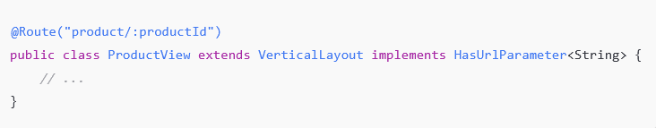
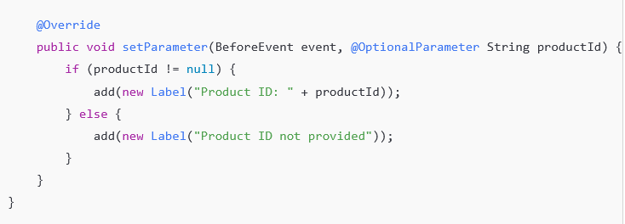
Route Parameters
In Vaadin, you can use routing parameters to pass values within URLs, allowing you to navigate between views with context-specific data. Vaadin Flow, the Java framework for building Vaadin applications, provides a way to define these parameters directly in the route.

Slide 14
Optional Route Parameters
Optional parameters are single parameters in a URL that may or may not be present. They are commonly used when you want to add flexibility by allowing users to omit certain segments in the URL path.
Usage: Define an optional parameter by using the @OptionalParameter annotation in the setParameter method of a class that implements HasUrlParameter.
Behavior: If the optional parameter is missing from the URL, Vaadin will still route to the view but will pass a null value or an empty parameter.
URL Examples:
/product/123 — Passes 123 as productId.
/product — No productId is provided, and it’s handled as null.

Slide 15
Wildcard Route Parameters
Wildcard parameters are used to capture multiple path segments after a specific route. They are useful for handling flexible or unknown URL depths, where you might not know how many segments are coming after the base route.
Usage: Implemented by using HasUrlParameter<String>, which captures all segments after the base path.
Behavior: Wildcard parameters allow any number of additional path segments, capturing them in a list so they can be processed dynamically.
URL Examples:
/files/documents/reports/2024 — pathSegments will contain ["documents", "reports", "2024"].
/files/reports — pathSegments will contain ["reports"].
/files — pathSegments will be empty.

Slide 16
Query Parameters
Query parameters are key-value pairs appended to the end of a URL after a ? symbol. They are used to pass data to the server or application without changing the primary URL path. In Vaadin, query parameters are commonly used to filter, sort, or provide additional context to the view or component that’s being loaded.
Structure of Query Parameters
http://example.com/view?param1=value1&param2=value2

Slide 17
When to Use Query Parameters
Filtering or Sorting Data: E.g., /products?sort=price&category=electronics.
Pagination: E.g., /articles?page=2&size=20.
Searching: E.g., /search?query=vaadin.
Passing Additional Information: When additional context is needed without changing the route itself.

Slide 18
Route Templates
In Vaadin, Route Templates allow you to create flexible routes by using parameters and placeholders within the URL paths. They provide a way to define routes that can accept variable parts, enabling dynamic navigation within your Vaadin application.

Slide 19
Defining Route Templates
Route template parameters must use the following syntax.
:parameter_name[modifier][(regex)]
parameter_name is the name of the parameter whose value to retrieve when a URL matching the template is resolved on the server. It must be prefixed by a colon (:).
user/:userID? ([0-9]{1-9}*)/edit
modifier is optional and may be one of the following:
? denotes an optional parameter which might be missing from the URL being resolved;
* denotes a wildcard parameter which can be used only as the last segment in the template, resolving all segment values at the end of the URL.

Slide 20
Route Alias
@RouteAlias is used to create multiple paths to same view.

Slide 21
Router Layouts and Nested Router targets
Parent Routes
Nested Routes

Slide 22
What Are Parent and Nested Routes?
Parent Routes:
These are top-level routes that serve as entry points or main categories in your application.
Typically represent main views or layouts.
Example: A dashboard, or an admin panel.
Nested Routes:
These are child routes that depend on a parent route and often represent subsections or detailed views within the parent.
Nested routes inherit the layout of their parent, enabling shared components like headers, sidebars, or footers.
Example: A reports page or settings page under a dashboard.

Slide 23
Why Do We Need Parent and Nested Routes?
E-commerce Application:
Parent route: /products
Nested routes: /products/details, /products/reviews
Admin Dashboard:
Parent route: /dashboard
Nested routes: /dashboard/users, /dashboard/settings
Educational Platform:
Parent route: /courses
Nested routes: /courses/list, /courses/details

Slide 24
Dynamic Operation on Routes
Page Title
Registering Routes
Routes Alias
Setting Parent Layout
Get Avalible Routes
Removing Routes

