Slide 1
Willson Financial Database Design Solution
Group-2

Slide 2

01
Nima Memarzadeh: Python scripting for generating reports.
02
Brian Preston: Refining the presentation and group coordination.
Group Introduction
03
Anton DeCesare: Drafting and initial presentation structure.
04
Brett Fuller: Database design and ERD updates.
05
Samir Rodriguez: Data population and testing.

Slide 3

Case Study Overview
Willson Financial Overview
Willson Financial, founded by Jake and Ned Willson, provides financial advisory services to a diverse community in New Mexico, including ranchers, farmers, and retirees.
Challenges
Managing growing client data, ensuring compliance with SEC regulations, and generating actionable insights for decision-making are significant challenges.
Proposed Solution
Our goal was to create a robust database system supporting streamlined operations, enhanced decision-making, and scalable infrastructure for future demands.

Slide 4
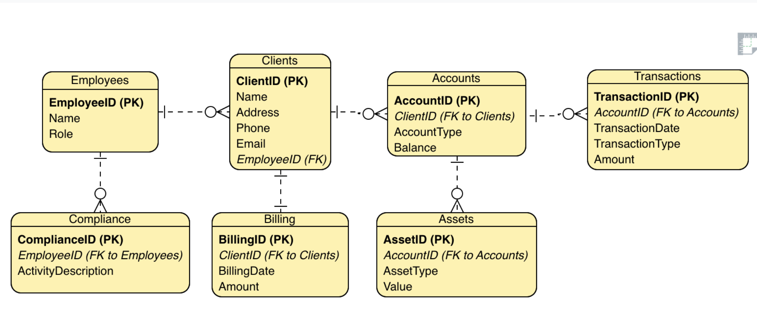
Finalized ERD

Slide 5
Reports Generated
Clients Added in the Last Six Months
High-Transaction Clients
Average Asset Value Per Client
Compliance Reports by Employee
Monitor client growth trends. Example: 'June: 5 clients, July: 7 clients.'
Identify clients with >10 transactions in a single month. Example: 'Alice Smith: 12 transactions in December 2024.'
Calculate the average asset value for each client.
Track the total number of compliance actions completed by each employee.

Slide 6
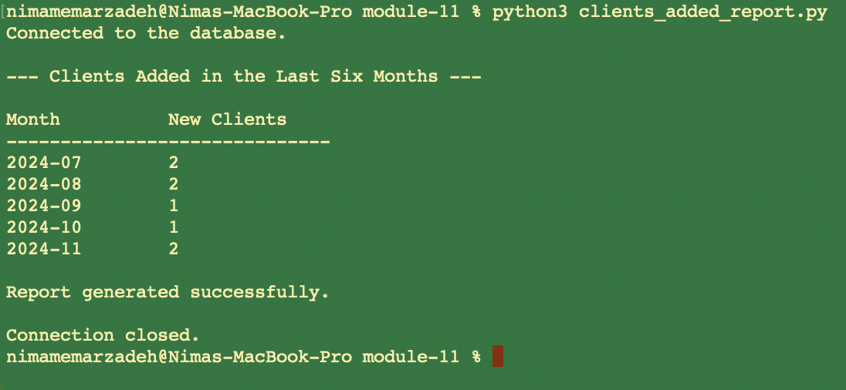
Clients Added in the Last Six Months

Slide 7
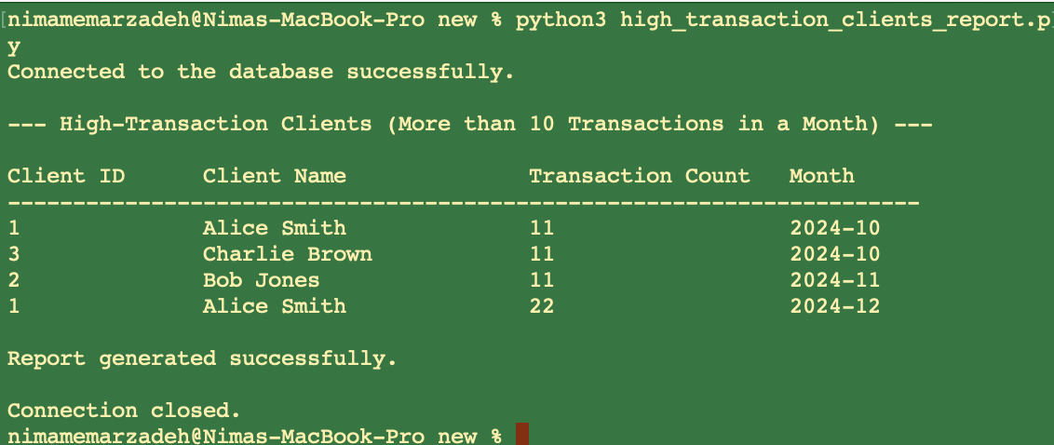
High-Transaction Clients

Slide 8
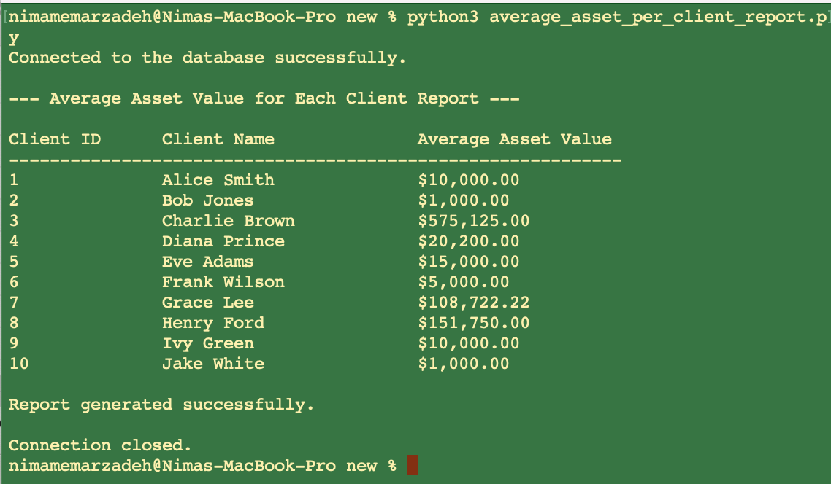
Average Asset Value Per Client

Slide 9
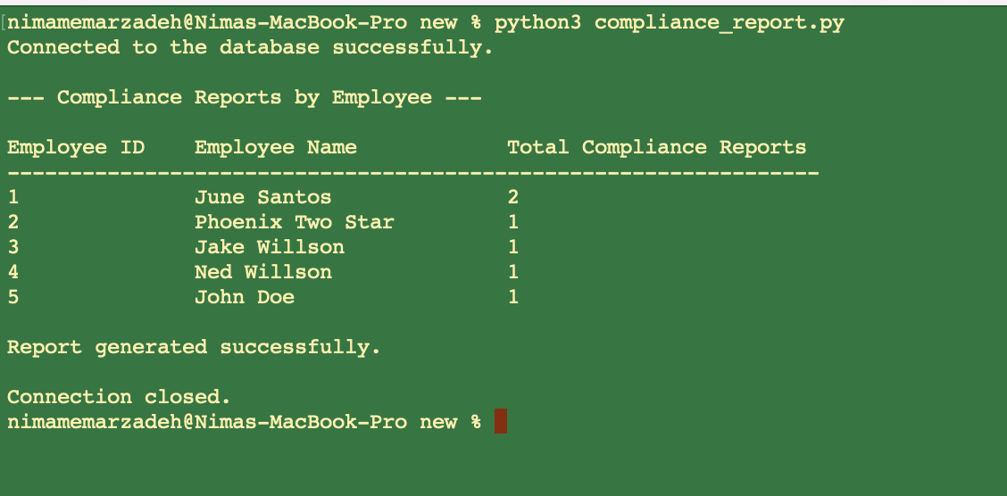
Reports by Employee

Slide 10
Assumptions
Each client has unique personal details, such as name and contact information.
All transactions are digital and timestamped for accuracy.
Billing cycles follow calendar months for consistent financial reporting.
Assets are categorized by type (e.g., real estate, stocks) and linked to specific accounts.
High-transaction clients are defined as those with >10 transactions in a single month.
Data constraints ensure consistency and integrity throughout the system.

Slide 11
Database Scalability and Compliance
How does our solution align with your expectations?
Conclusion
Our robust database solution equips Willson Financial to manage operations efficiently, meet compliance standards, and deliver detailed insights. We welcome feedback on scalability and adaptability.

