Slide 1
Fine-tuning a Large Language Model
Requirements, Costs, and ROI

Slide 2
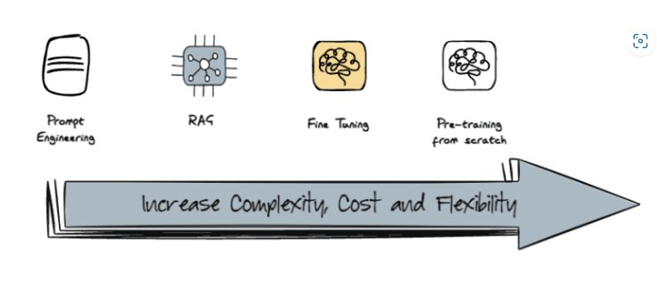
Fine-Tuning
Definition: Process of adapting a pre-trained LLM to a specific task or domain by continuing its training on a smaller, task-specific dataset.

Slide 3
Fine-Tuning Benefit
Improved Performance: Enhanced accuracy and relevance for specific tasks.
Customization: Tailored to domain-specific language and nuances.
Efficiency: Reduces the need for manual intervention and corrections.
Competitive Advantage: Offers unique capabilities that can differentiate products and services.

Slide 4
Fine-Tuning Drawback
High Costs: Significant investment required for data, compute resources, and expertise.
Data Dependency: Requires high-quality, task-specific datasets, which can be challenging to acquire.
Complexity: Needs specialized knowledge in machine learning and natural language processing.
Hard to adaptive: Fine-Tuned model is fixed with its data-flow and architecture.
Maintenance: Ongoing need for updates and re-training as new data becomes available.

Slide 5
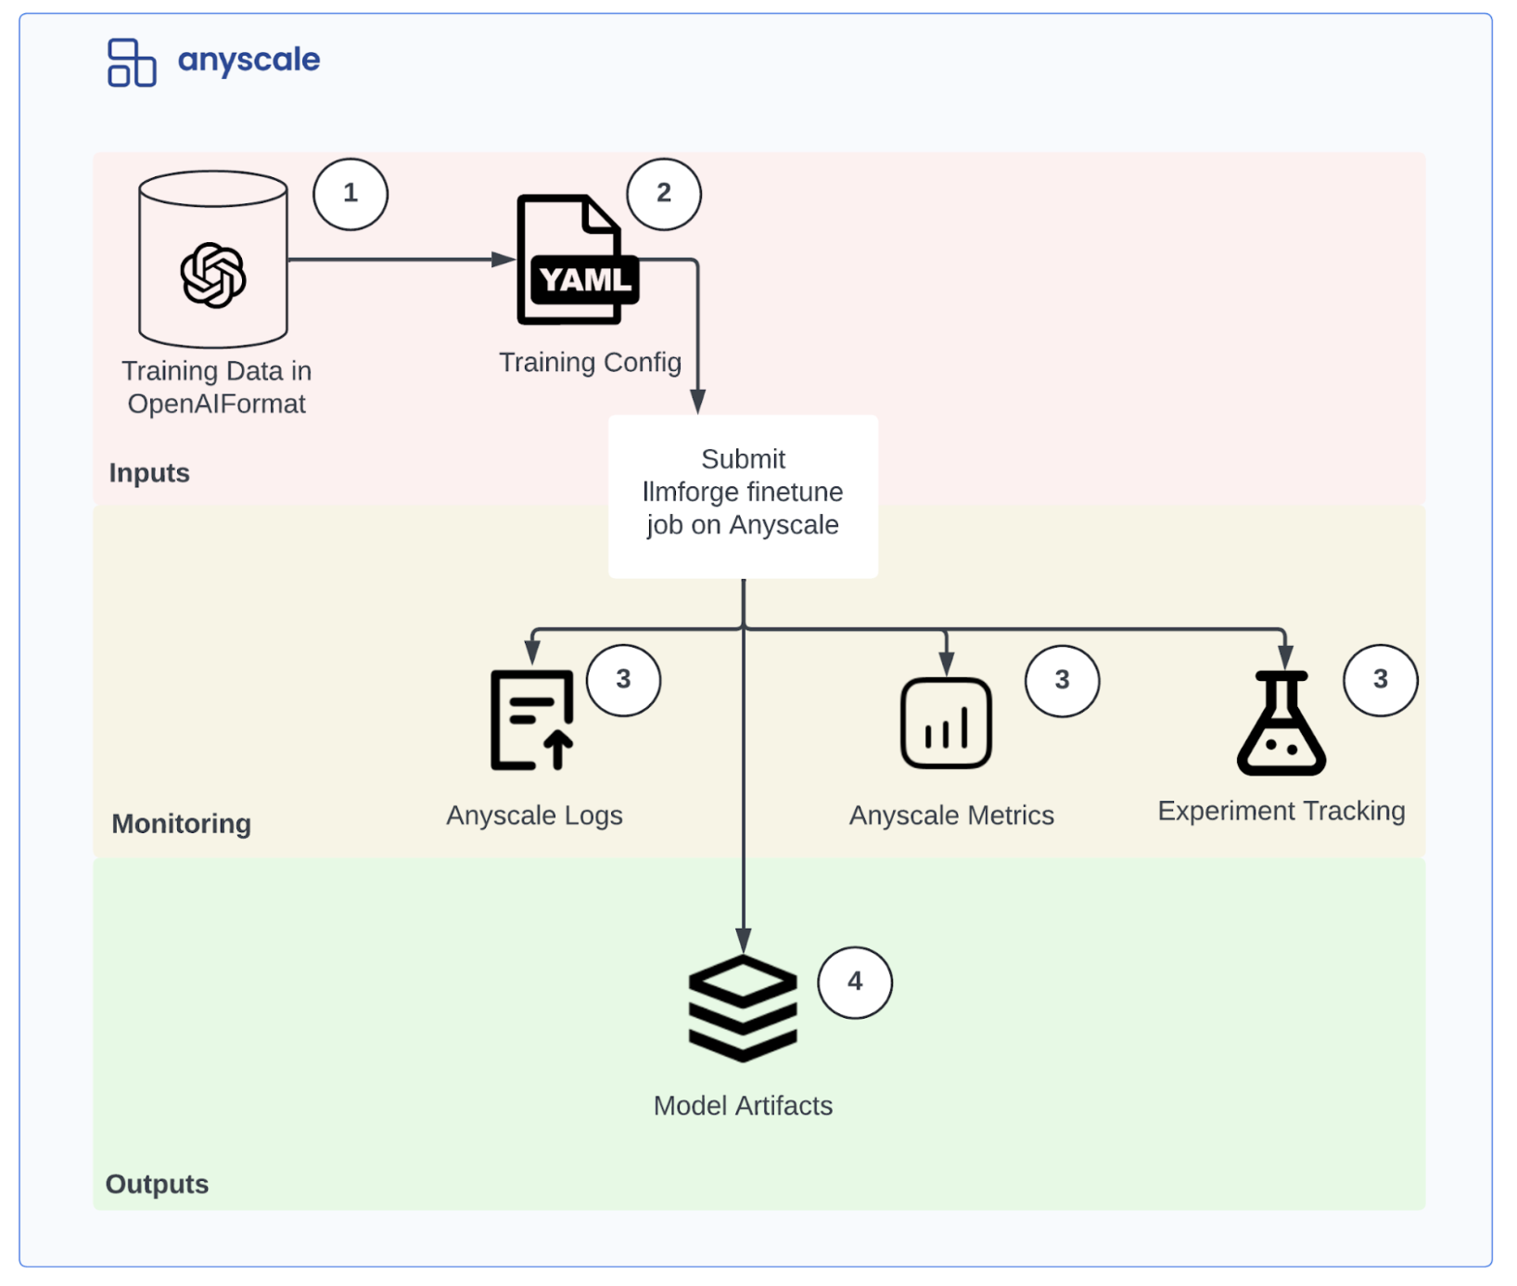
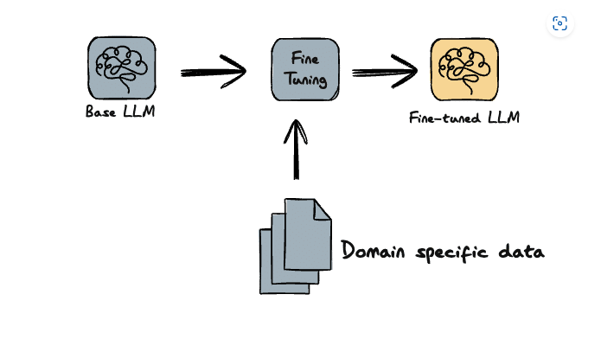
Fine-Tuning Steps

Slide 6
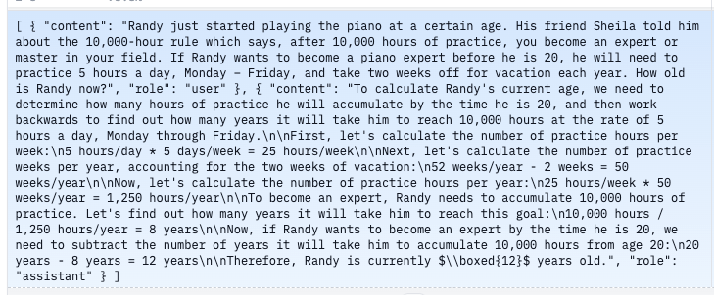
Requirement for Fine-Tuning
Data
High-quality, task-specific dataset.
Required re-format into Training Samples with special token.

Slide 7
Requirement for Fine-Tuning
Data
Adequate volume of data for training and validation: minimums of 2000 – 5000 examples sample for effective fine-tuning.
If Fine-Tuning for domain-specific application, required at least 10 000 of examples necessary to achieve good performance. [1] [2]
There are technique to gain more datasource.
Synthetic data source << unreliable for enterprise
Few-Shot learning << Heavily influence by the capability of the model. Required > 50B parameter model.

Slide 8
Requirement for Fine-Tuning
Training Compute Resources
Powerful GPUs/TPUs (NO CPU) 20 – more GPU memory for training.
High EBS bandwidth > 5 for data input (ETL).
NVIDIA H100, NVIDIA A100, …
Sufficient memory for evaluation, checkpoint
After training Compute Resources
GPUs/TPU for hosting the model. Based on model, 16 – more for inference.
Powerful bandwidth from inference.
> 9 for better connections with multiple users.
Sufficient Memory and Storage,
Memory for inferences, ...
Model weight and parameters
Training Dataset,...

Slide 9
Requirement for Fine-Tuning
Expertise:
Knowledge in machine learning and natural language processing
Experience with LLM framework (e.g., Hugging Face Transformers, vLLM, llama.pp).
Software:
Expertise in Deep Learning framework (e.g., Pytorch, Tensorflow)
Know Data pre-processing and augmentation tools.

Slide 10
Cost and Time
Data Collection and Preparation
Cost of acquiring or creating a dataset: Based on employee's salary and time to pre-processing fine-tuning dataset.
Collecting - EDA - Data annotation and labelling – Feature Extractions
Estimate 3000$ - 5000$ for 2 Data Scientist for 2 weeks

Slide 11
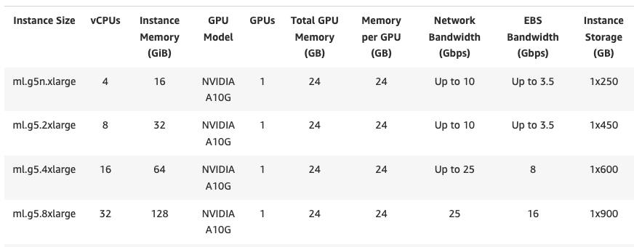
Cost and Time
Training Compute Resources
Cloud Computing costs (cheapest options for training 7-8B parameters)

Slide 12
Cost and Time
Training Compute Resources
Cloud Computing costs (cheapest options for training 7-8B parameters)
With dataset about 5000 samples – 10000 samples
With QLora4 Technique takes 1.5 hours of training for 8 batches. >> reduce models sizes for faster training >> heavily reduce Accuracy.
With Lora Technique takes ~ 5 hours of training for 8 batches >> only train a small pieces of the model >> only for small custom task.
With Full Parameter Training takes 7 hours of training for 8 batches.

Slide 13
Cost and Time
Training Compute Resources
Cloud Computing costs (cheapest options for training 7-8B parameters)
With dataset about 5000 samples – 10000 samples
With QLora4 Technique takes 1.5 * 2.03 = $3.045
With Lora Technique takes 5 * 2.03 = $10.15
With Full Parameter Training takes 7 * 2.03 = $14.21
This is only for 1 takes, fine-tuning not always work the first time
Estimate 10 times more iterative:
QLora: $30.45
Lora: $101.5
Full Parameter Training: $142.1

Slide 14
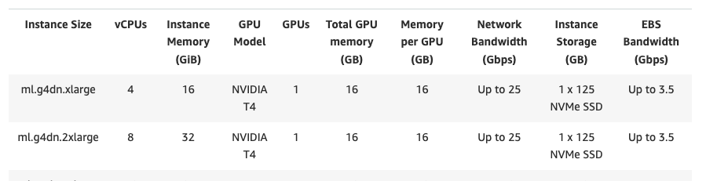
Cost and Time
Inference Compute Resources
Cloud Computing costs (cheapest options for training 7-8B parameters)

Slide 15
Cost and Time
Inference Compute Resource - Must always on, for accessibilty
1 month = ~ 30 days ~ 720 hours ~ $720 for 1 instance
The prices above does not include scenario of scaling for multiple users and cost for AWS infrastructure for Storages, API.
~ $1000 per month

Slide 16
Cost and Time
Expertise and Software:
Currently does not have sufficient workforces
Only 2 valid data scientist for that have expertise in LLM, training, Fine-tuning.
Other projects with Client.
=> More time consuming to train and deploy than usual.
=> Delay more x1.5 ~ 1.7 times than usual. (salary, cloud cost, etc...)
=> Expense cost * 1.5 ~ 1.7 times than usual.

Slide 17
Comparing with Current workflow
Cost Category | Fine-Tuning Approach | Prompt-Engineering + RAG Approach
Data Collection | $3000 - $5000 | $1500 - $3000
Training Compute Resource | $100 - $150 | No cost
Inference Compute Resource | $1000 - $1500 | Based on token output $5 per person ($250 for 50 employees)
Infrastucture cost (Vector Database, API, ..) | $200 - $250 | $200 - $250
Total Estimated Cost per Production Model | $3300 - $6900 | $1950 - $3500

Slide 18
Comparing with Current workflow
Cost Category | Fine-Tuning Approach | Prompt-Engineering + RAG Approach
Data Preparation | 2 weeks | 2 weeks
Data Processing | 2 weeks | 1 weeks
Training Time | 1 weeks | 2-3 days
Infrastucture setup Time (Vector Database, API, ..) | 20 hours | 1 hour
Total Estimated Time per Production Model | 5 weeks 20 hours | 3 week 3 days 1 hour

Slide 19
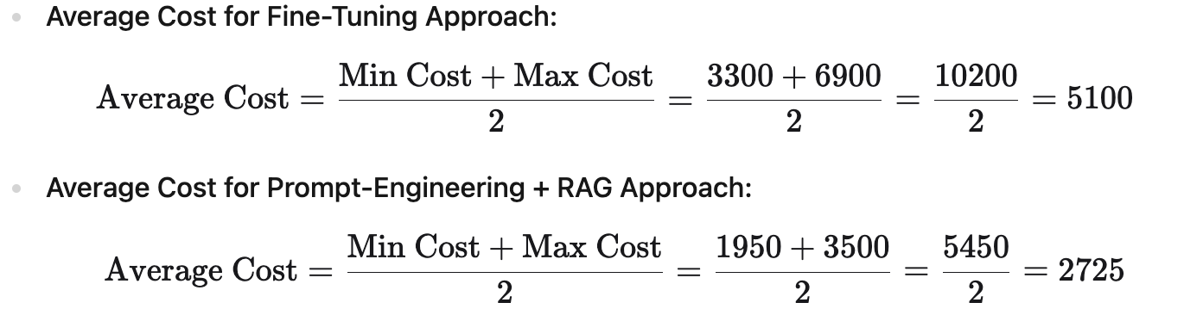
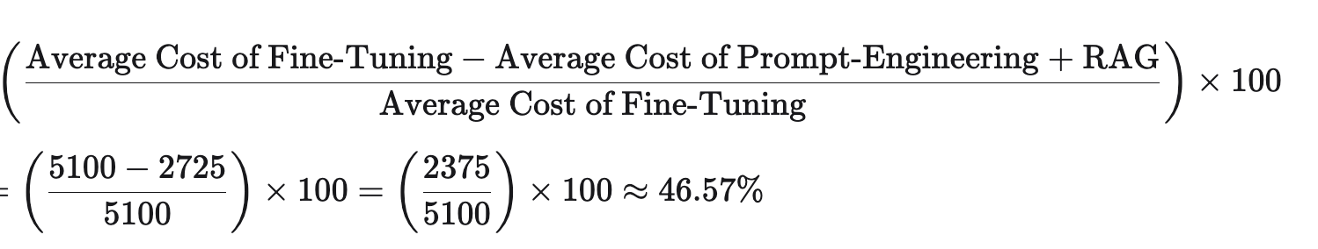
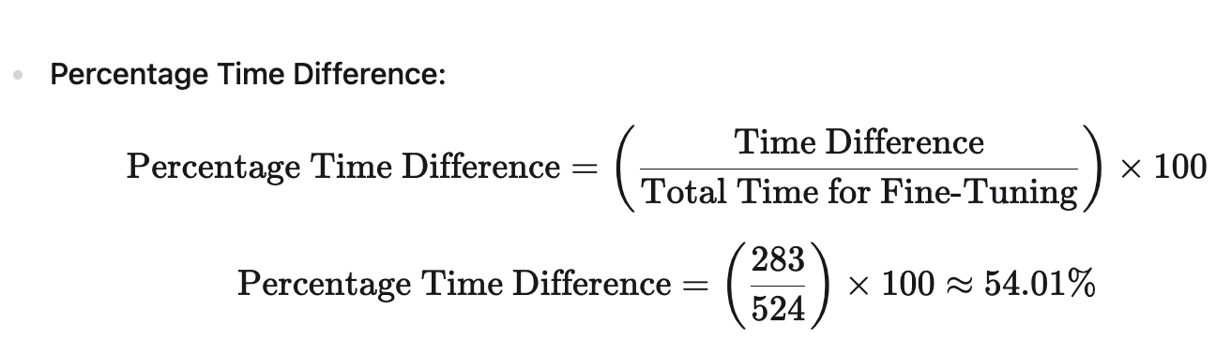
Comparing with Current Workflow

Slide 20
Comparing with Current Workflow
Compute the percentage difference
=> Prompt-Engineering + RAG Approach is CHEAPER 46.57% than Fine-Tuning Approach. => Prompt-Engineering + RAG Approach save 54.01% time than Fine-Tuning Approach For effectiveness, it cannot be sure that Fine-Tuning Approach is much better than Prompt Engineering + RAG. It is depend on which, who, and what use cases.

