Slide 1
Selenium Python

Slide 2
What is Python
High level OOPL
Dynamic typing
Extensive support libraries
Cross-platform
Multiple Programming Paradigms

Slide 3
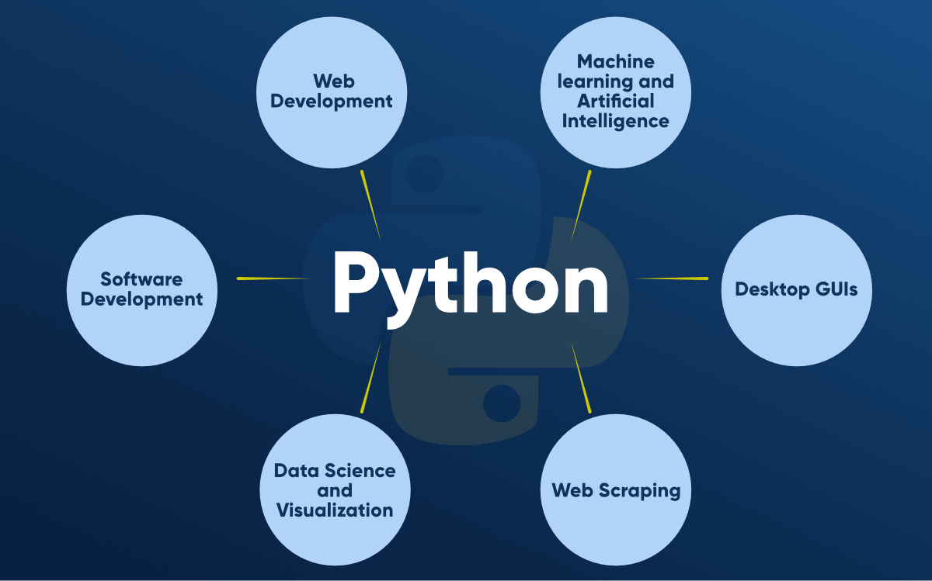
Application areas

Slide 4
Interpreter or compiler?

Slide 5
Python Virtual Environment
A virtual environment is a tool that helps to keep dependencies required by different projects separate by creating isolated python virtual environments for them.
Isolate different projects and versions
Base interpreter will be considered in the venv and the system python version will be reflected in the virtual environment

Slide 6
Venv commands
Create Virtual environment
python -m venv <ProjectName>
Activate venv
<ProjectPath>/Scripts/Activate.bat
Deactivate venv
Deactivate
Delete venv
rmdir <projectName> /s
Freeze package
pip freeze
use Requirement.txt
pip install -r <retuirement text file path>
use venv with site pachages
python -m venv <project name> --system-site-packages

Slide 7
Selenium Python Installation
Install Python into the system and add PATH variable
Open CMD and enterr the below command
pip install selenium
Go to Chromedriver release page and find the latest version of the driver for your platform and download it.
Extract the .exe file and paste under SCRIPT folder in Python path

Slide 8
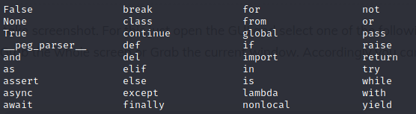
Python Keywords
Keywords are reserved words in python.
Cannot use keyword as a variable name, function name or any other identifiers.
Keywords are case sensitive and there are 36 keywords in python 3.9
Notes:
Cmd-->python3(linux), python(windows)-->enter
Python Evn,
Help()
Keywords

Slide 9
Python Identifiers
Identifiers refers to the name of variable, class, functions, lists etc. Created by programmers.
Long sequence of letters(a-z & A-Z) and numbers(0-9) .
No special character except underscore(_) can be used as an identifiers.
Keyword should not be used as identifier name .
Python is case sensitive so using case is significant.
First character of an identifier can be letter, underscore(_) but not digit.
Notes:
Eg: global=1 , a@ = 0
o/p : syntax error: Invalid Error
python is a case-sensitive language. This means, Variable and variable are not the same.
Always give the identifiers a name that makes sense. While c = 10 is a valid name, writing count = 10 would make more sense, and it would be easier to figure out what it represents when you look at your code after a long gap.
Multiple words can be separated using an underscore, like this_is_a_long_variable

Slide 10
Python Literals
Python Literals can be defined as data that is given in a variable or constant.
String literals
X = ‘abc’ OR y = “1234”
Numeric literals
a = 10 , b = 10.5 , c= 0o201 , d = 3.14j
Boolean literals
True OR False
Special literals
None
Literal collection
List, Tuples, Dictionary, Set
Notes:
"Aman" , '12345'
Stringline - text1='hello'
Multiline - text1='hello\
user'
print(text1)
Multiline = str2='''''welcome
to
SSSIT'''
print str2
#Float Literal : float_1 = 100.5 float_2 = 1.5e2
#Complex Literal a = 5+3.14j print(x, y, z, u)
print(float_1, float_2) print(a, a.imag, a.real)
None : define null objects and variables
print(print("Hello, World!"))

Slide 11
Python Variables
Variable is a name of the memory location where data is stored, act as a container that holds data which can be changed later though out programming.
In python, we don't need to specify the type of variable because python is a infer language.
Variable names can be group of both letter and digit, but they have to begin with a letter or an underscore (_).
Recommended to use lowercase letters for the variable name.
eg: a = 10, a=b=c=10,20,30
Notes:
A = 50 , b =50
The variable b refers to the same object that a points to because Python does not create another object.
python manages memory efficiently if we assign the same variable to two different values.
Object Identity
In Python, every created object identifies uniquely in Python. Python provides the guaranteed that no two objects will have the same identifier. The built-in id() function, is used to identify the object identifier.
Local variable and global variable
Del(<variable>)

Slide 12
Python Comments
Single lined comment :
# This is single line comment
Multi lined comment :
“”” This
is Multiline
comment “””

Slide 13
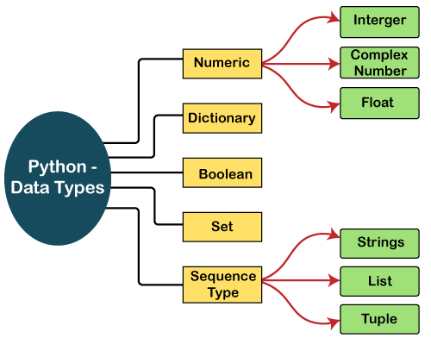
Data types in python
Variables can hold values, and every value has a data-type.
Python is a dynamically typed language; hence we do not need to define the type of the variable while declaring it. The interpreter implicitly binds the value with its type.
Notes:
Text Type: str
Numeric Types: int, float, complex
Sequence Types: list, tuple, range
Mapping Type: dict
Set Types: set, frozenset
Boolean Type: bool
Binary Types: bytes, bytearray, memoryview
Command : type(<var>)

Slide 14
Python Numbers (Data type)
Integers, floating point numbers and complex numbers falls under Python numbers category. They are defined as int, float and complex class in Python.
Integers can be of any length, it is only limited by the memory available.
A floating point number is accurate up to 15 decimal places. Integer and floating points are separated by decimal points. 1 is integer, 1.0 is floating point number.
Complex numbers are written in the form, x + yj, where x is the real part and y is the imaginary part
Notes:
a = 5
print("The type of a", type(a))
b = 40.5
print("The type of b", type(b))
c = 1+3j
print("The type of c", type(c))
print(" c is a complex number", isinstance(1+3j,complex))

Slide 15
Python List (Data type)
List is an ordered sequence of items.
All the items in a list do not need to be of the same type.
Lists are mutable,meaning, value of elements of a list can be altered.
Declaring a list is pretty straight forward. Items separated by commas are enclosed within brackets [ ]
a = [1, 2.2, 'python']
We can use the slicing operator [ ] to extract an item or a range of items from a list. Index starts form 0 in Python.
e.g: a = [5,10,15,20,25,30,35,40]
# a[2] = 15
Notes:
list1 = [1, "hi", "Python", 2]
#Checking type of given list
print(type(list1))
#Printing the list1
print (list1)
# List slicing
print (list1[3:])
# List slicing
print (list1[0:2])
# List Concatenation using + operator
print (list1 + list1)
# List repetation using * operator
print (list1 * 3)

Slide 16
Python Tuples (Data type)
Tuple is an ordered sequence of items same as list.
The only difference is that tuples are immutable. Tuples once created cannot be modified.
It is defined within parentheses () where items are separated by commas.
t = (5,'program', 1+3j)
We can use the slicing operator [] to extract items but we cannot change its value.
t = (5,'program', 1+3j)
# t[1] = 'program'
Notes:
tup = ("hi", "Python", 2)
# Checking type of tup
print (type(tup))
#Printing the tuple # print (tup)
# Tuple slicing print (tup[1:]) print (tup[0:1])
# Tuple concatenation using + operator
print (tup + tup)
# Tuple repatation using * operator
print (tup * 3)
# Adding value to tup. It will throw an error.
t[2] = "hi"

Slide 17
Python Strings (Data type)
String is sequence of Unicode characters.
We can use single quotes or double quotes to represent strings.
Multi-line strings can be denoted using triple quotes, ''' or """.
s = "This is a string"
s = '''a multiline
Like list and tuple, slicing operator [ ] can be used with string. Strings are immutable.
s = 'Hello world!'
# s[4] = 'o'
Notes:
str1 = 'hello javatpoint' #string str1
str2 = ' how are you' #string str2
print (str1[0:2]) #printing first two character using slice operator
print (str1[4]) #printing 4th character of the string
print (str1*2) #printing the string twice
print (str1 + str2) #printing the concatenation of str1 and str2

Slide 18
Python Set (Data type)
Set is an unordered collection of unique items.
Set is defined by values separated by comma inside braces { }. Items in a set are not ordered.
We can perform set operations like union, intersection on two sets.
Set have unique values. They eliminate duplicates.
Since, set are unordered collection, indexing has no meaning. Hence the slicing operator [] does not work.
a = {5,2,3,1,4}
print("a = ", a) , #print(type(a))
Notes:
# Creating Empty set
set1 = set()
set2 = {'James', 2, 3,'Python'}
#Printing Set value
print(set2)
# Adding element to the set
set2.add(10)
print(set2)
#Removing element from the set
set2.remove(2)
print(set2)

Slide 19
Python Dictionary (Data type)
Dictionary is an unordered collection of key-value pairs.
It is generally used when we have a huge amount of data. Dictionaries are optimized for retrieving data. We must know the key to retrieve the value.
In Python, dictionaries are defined within braces {} with each item being a pair in the form key:value. Key and value can be of any type.
d = {1:'value','key':2}
print(type(d)) #print("d[1] = ", d[1]);
Notes:
d = {1:'Jimmy', 2:'Alex', 3:'john', 4:'mike'}
# Printing dictionary
print (d)
# Accesing value using keys
print("1st name is "+d[1])
print("2nd name is "+ d[4])
print (d.keys())
print (d.values())

Slide 20
Conversion between Data Type
We can convert between different data types by using different type conversion functions like int(), float(), str() etc.
Notes:
casting

