Slide 1
Magento positive CART FLOW TEST
Automated test and deployment pipeline
Ilija Krstić
Belgrade Serbia, 17/11/2023

Slide 2
00
00
The deployment pipeline
POM
00
00
Resulting reports
Variable handling
00
00
Data organization
Intercepts and their effects
00
00
User session
Final spec file

Slide 3
THE DEPLOYMENT PIPELINE
I chose mochawesome as my reporter and integrated it into github actions.
After every push or pull request, a new test run is initiated and its results are published to github pages.
This avoids the use of Cypress Cloud, which can be costly.
There are other alternatives, including hosting our own dashboard and report collection service, like Sorry Cypress.

Slide 4
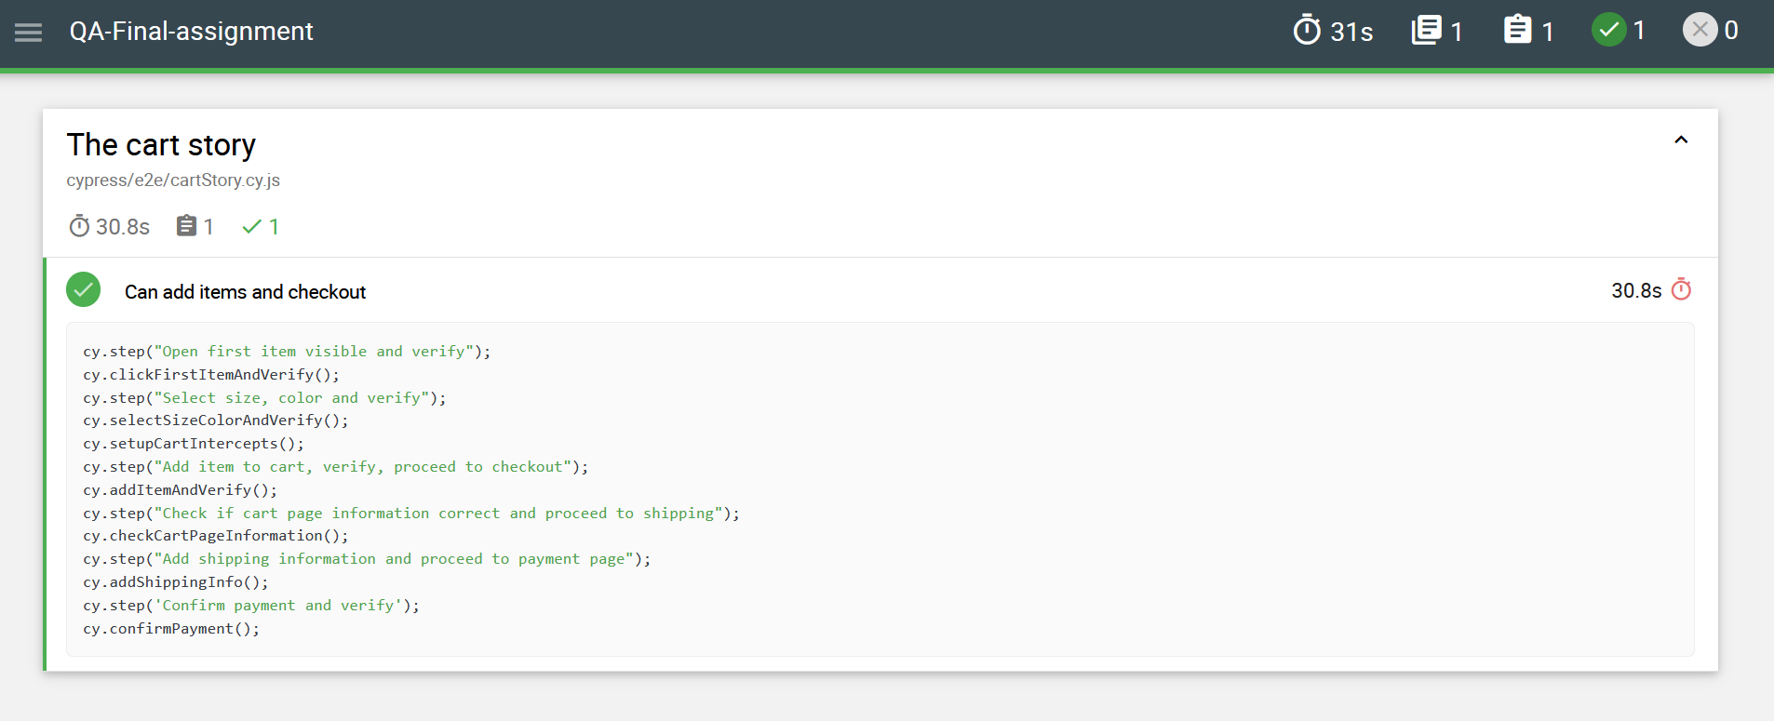
RESULTING REPORTS
Below is an example of a report published to github pages.

Slide 5
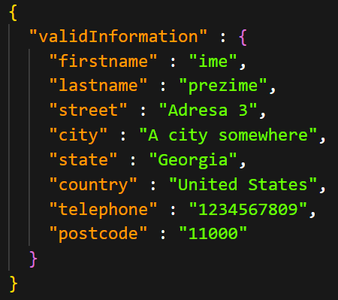
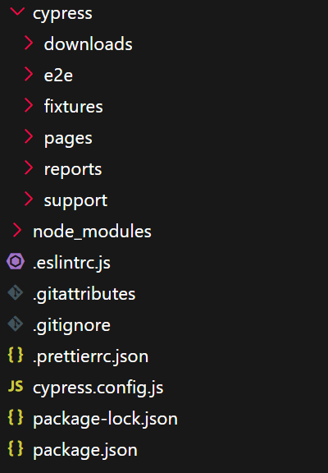
Data organization
All static data used can be found in the fixtures folder, an example is provided below, along with the folder structure.

Slide 6
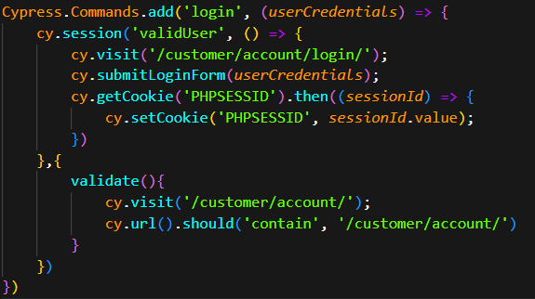
User session
User sessions are stored and validated after every test, below is one custom command that handles a part of this.

Slide 7
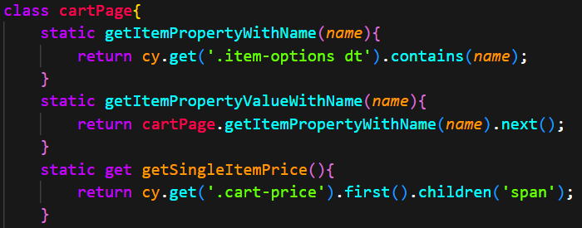
POM (Page object model)
As per best practice, all cy.get() calls are placed in POMs for ease of maintenance and reuse.
Below is an excerpt from the cartPage POM.

Slide 8
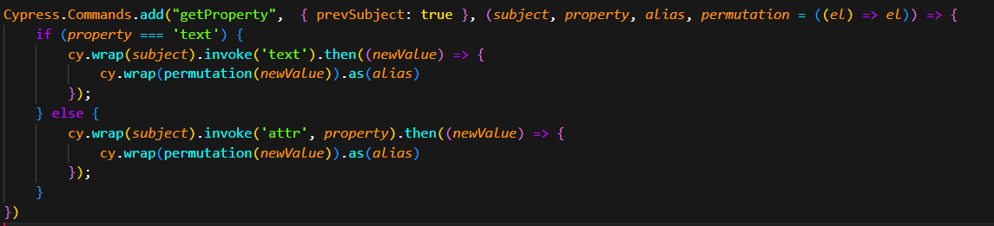
Variable handling
Test automation eventually calls for the use of variables, here, I’ve handled them with wrappers and aliases.
Below is a custom command that gets the requested property of the element it’s chained off of and makes it globally available under desired alias.

Slide 9
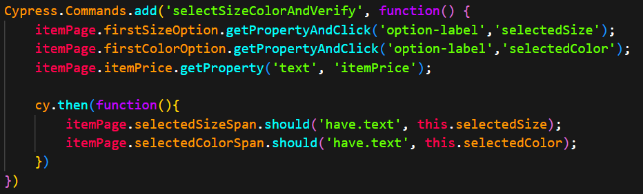
Variable handling
Below is an example command showing the ease of use of this approach as well as its reusability.

Slide 10
Intercepts and their effects
As the application under test uses a proper backend and data is persisted, intercepts mostly serve the purpose of stubbing data for testing display functionality and confirming expected status codes.
The application is PHP based and makes very few requests.
Most of the requests it does make, including login requests, receive HTML as their response.

Slide 11
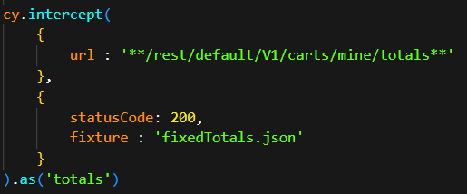
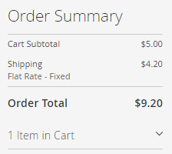
Intercepts and their effects
Below is an example intercept I used to stub out data regarding cart totals and it’s effect.

Slide 12
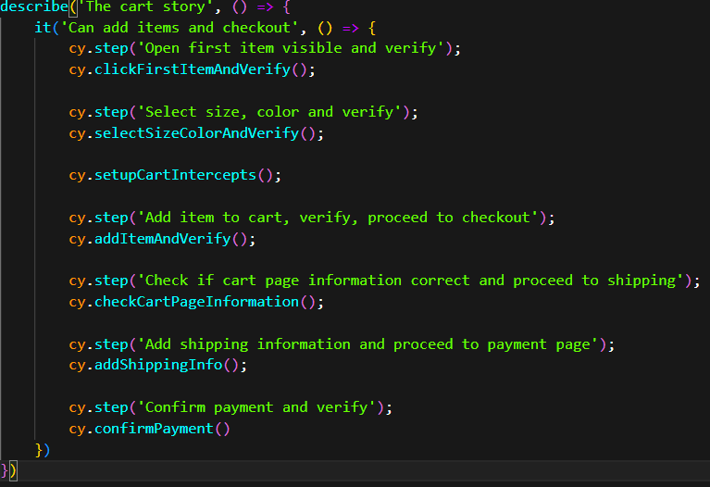
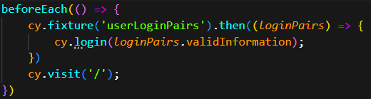
Final spec file
The end result of following best practices is a nice, readable and comprehensive spec file.

Slide 13

Questions

Slide 14
THANK YOU

