Slide 1
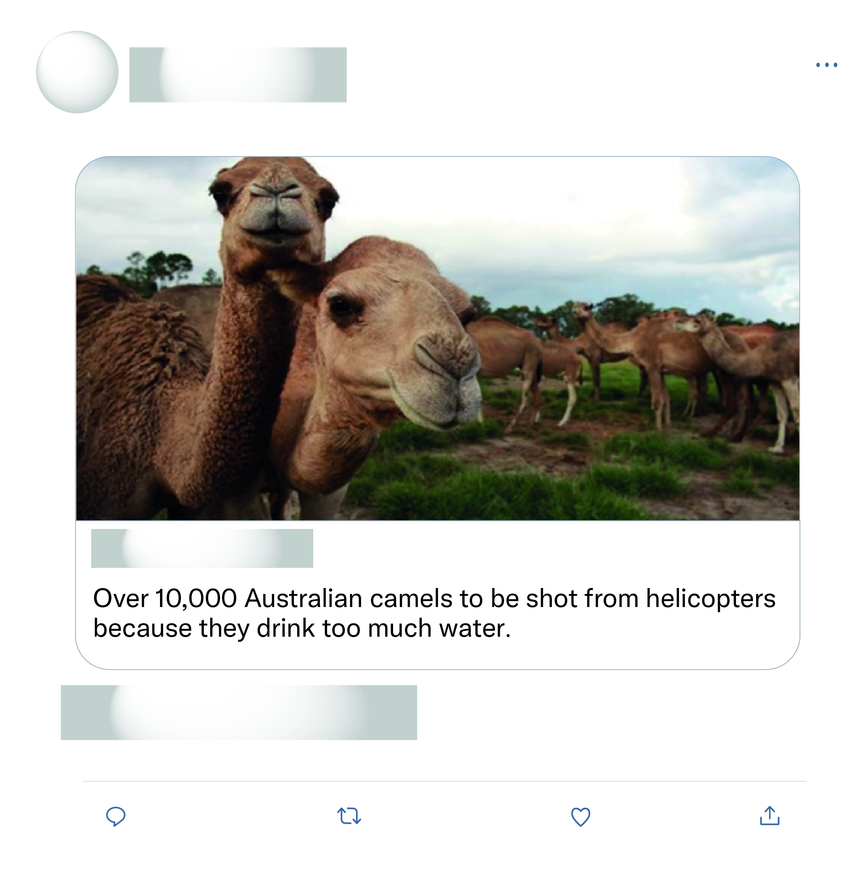







That's all the experts sat down and discussed as the solution wow what a productive move nothing else just killing more animals again after half a billion have died what a move.
This is just absolute nonsense!

Slide 2
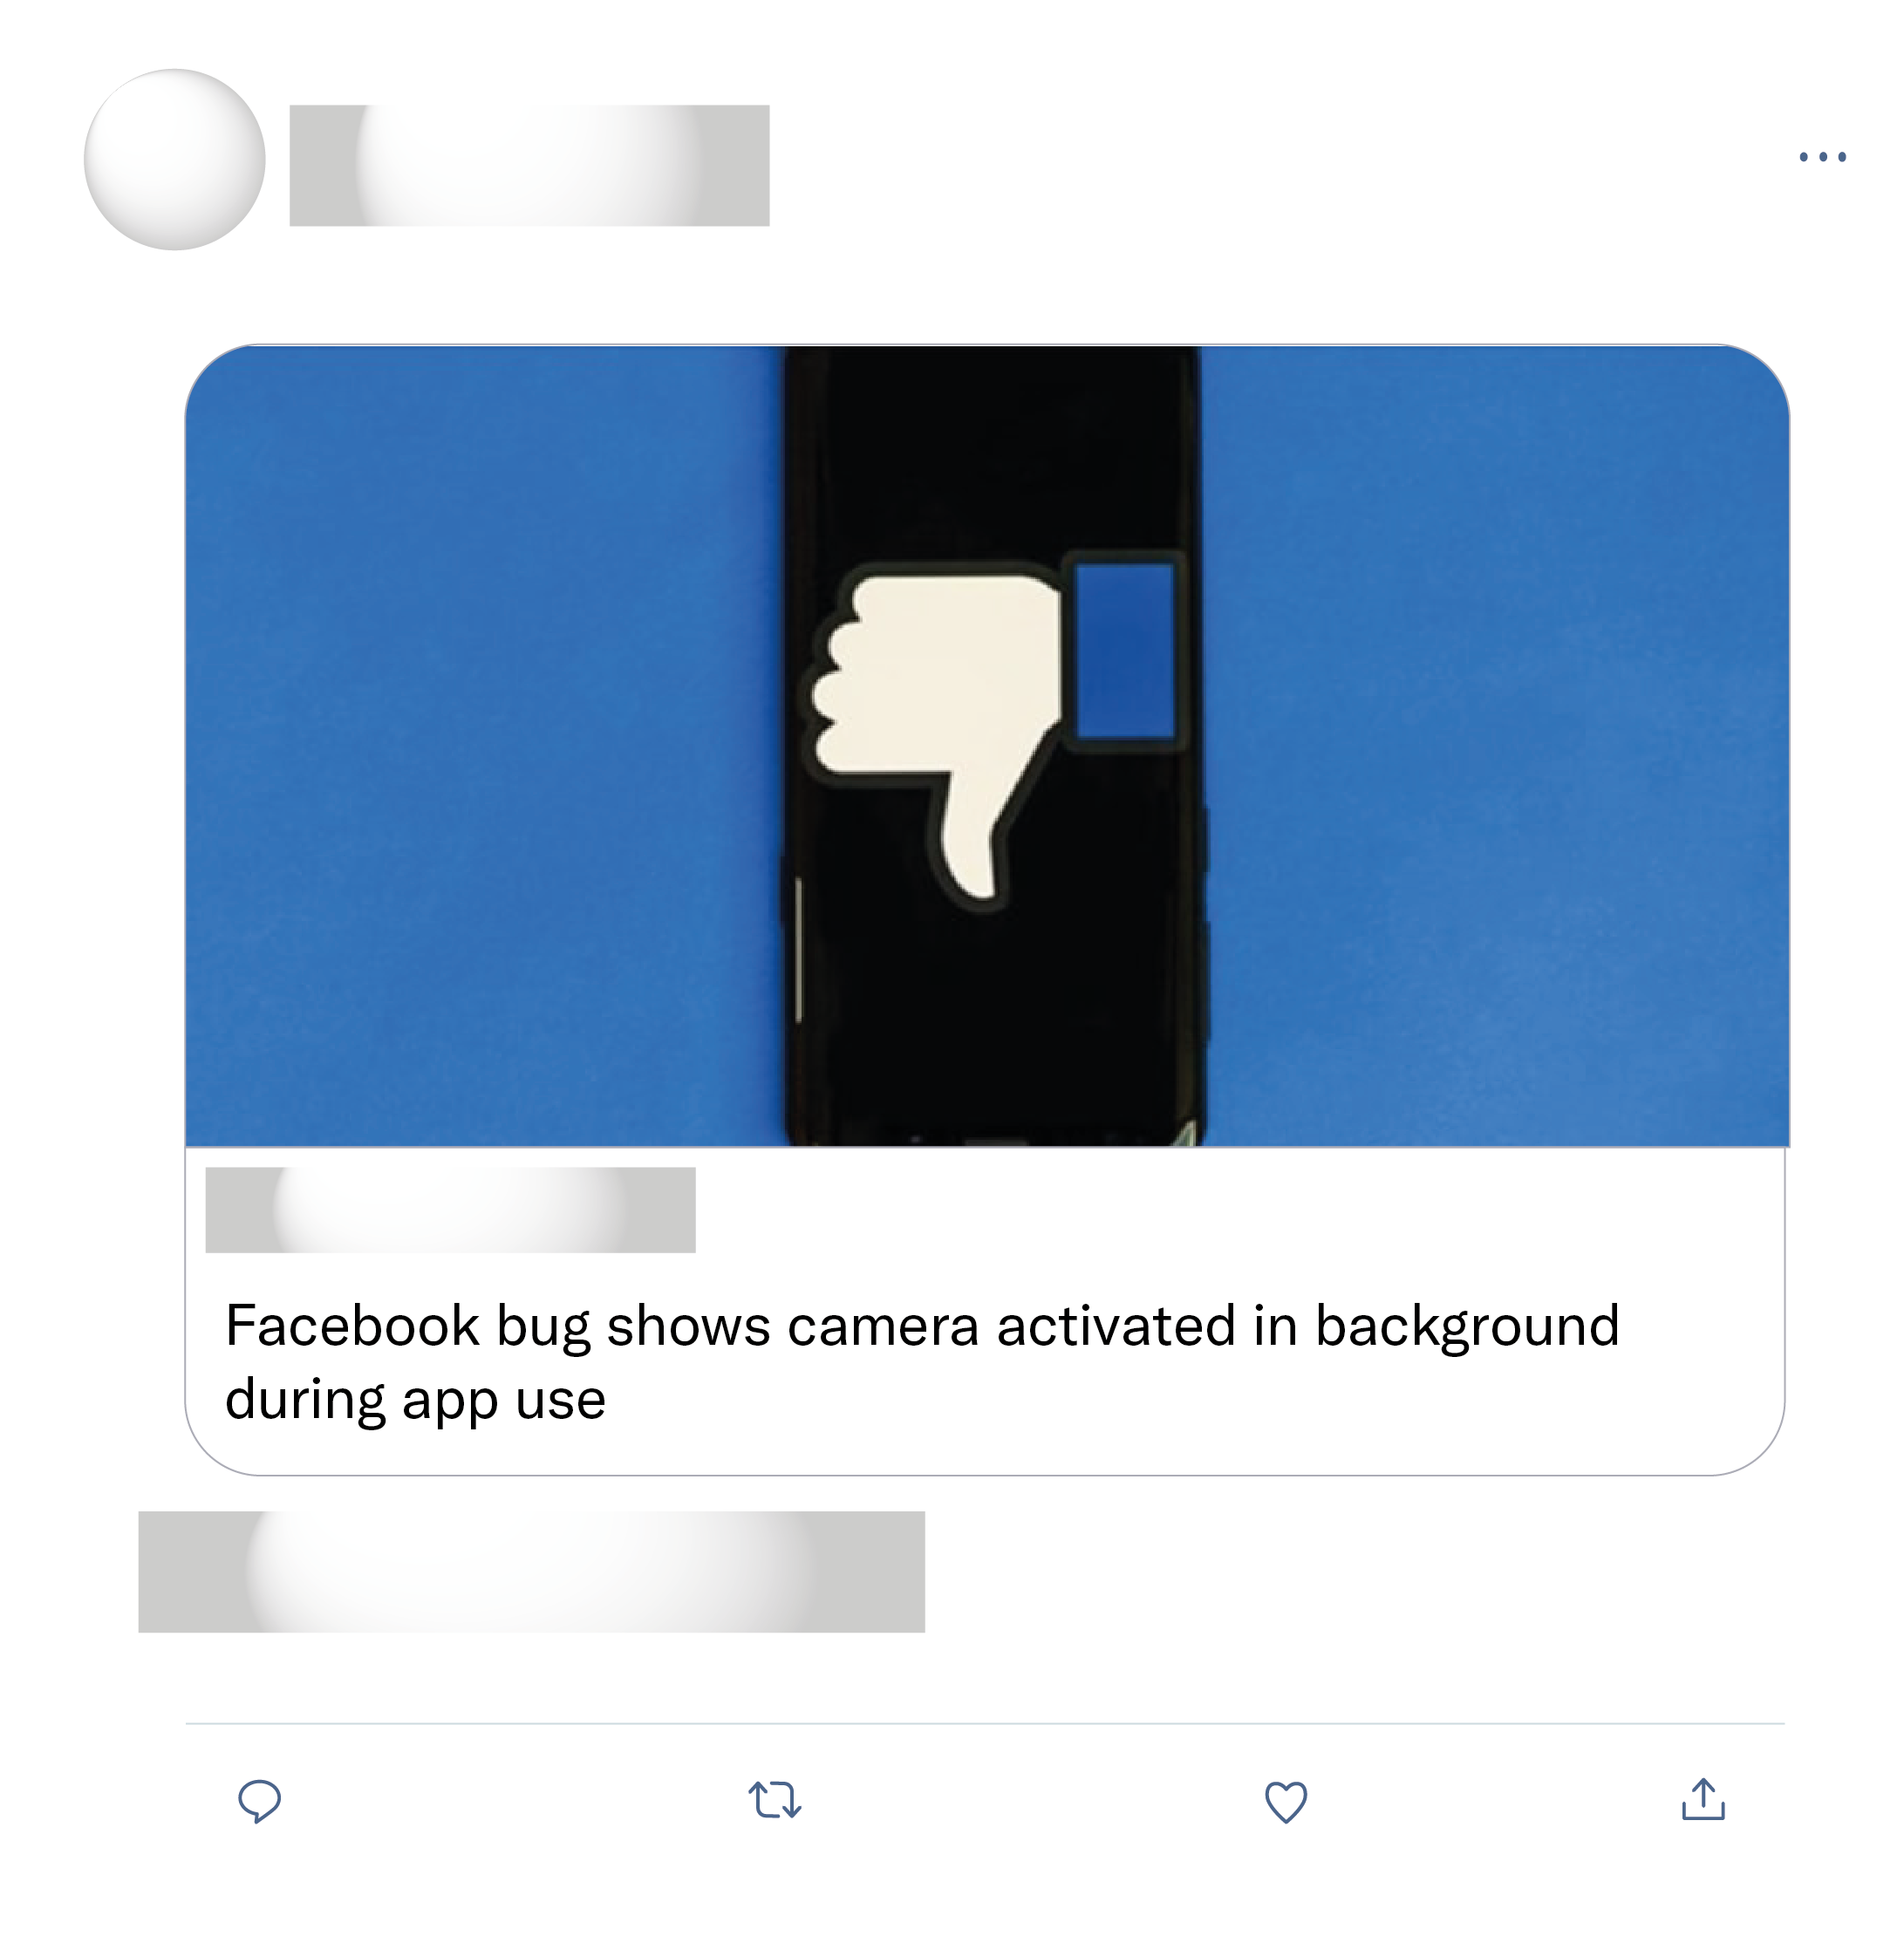
It's how Facebook accesses your camera and microphone... This is proof that they are accessing your back camera. They may also be accessing the front camera. If they process that through a facial recognition they could see your actual reaction to posts.
This is exactly why I will never have Facebook on my phone and I deny permission to access Photos/Camera/Microphone to almost every app where I don’t explicotly need it for some reason.
Makes it hard to be believe the "no, we're not listening to your conversations and using that for ads" claim.
Tried to replicate this on my phone. And nothing! Seems like fake news.

