Slide 1
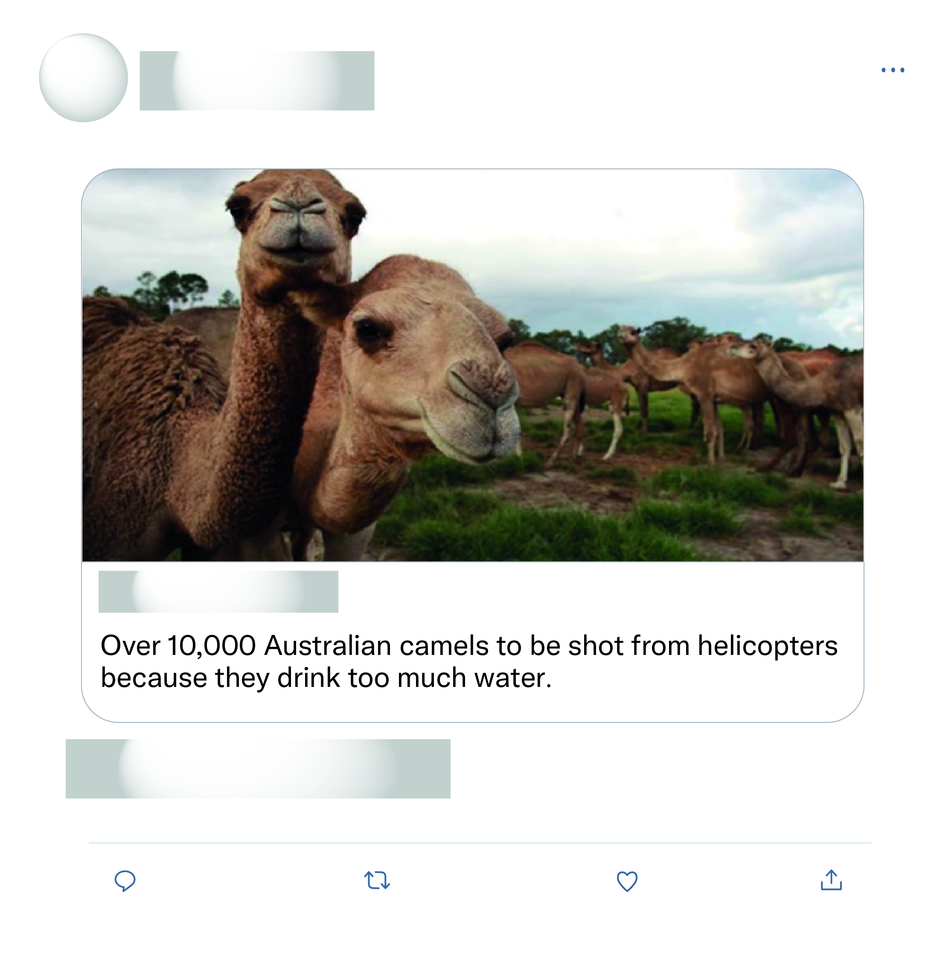







That's all the experts sat down and discussed as the solution wow what a productive move nothing else just killing more animals again after half a billion have died what a move.
This is just absolute nonsense!

Slide 2
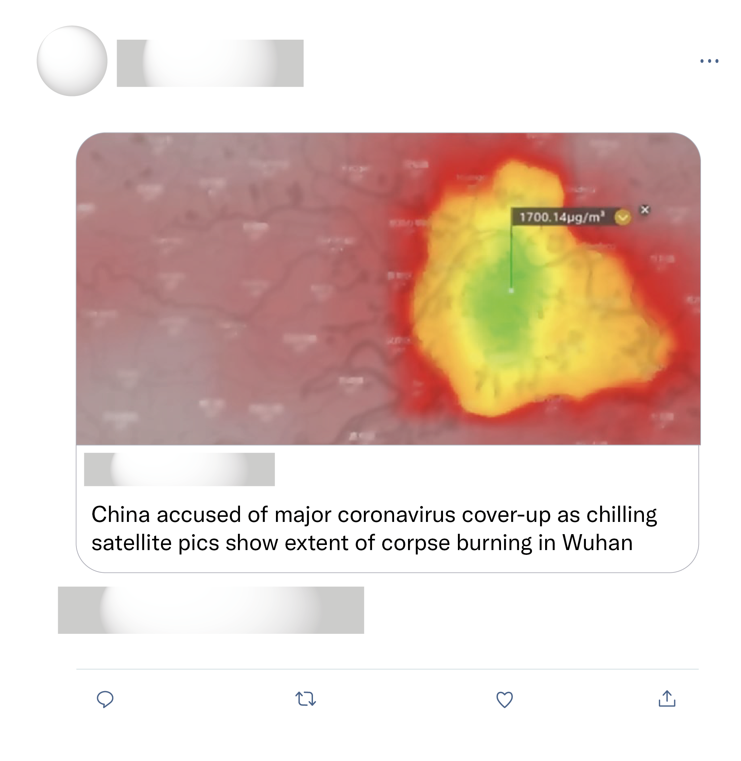
Scary scenario and quite plausible. Chinese leaders and medical authorities appear to be hiding the truth when it comes to deaths and the spread of this Coronavirus.
People, please stop spreading fake news. Atleast some of you should be smarter than this.
So incredibly sad. I can‘t even begin to imagine all the horror these poor people are witnessing, heartbreaking. It is just beyond words to express.
How horrible. My heart literally hurts.

