Slide 1








That's all the experts sat down and discussed as the solution wow what a productive move nothing else just killing more animals again after half a billion have died what a move.
This is just absolute nonsense!

Slide 2
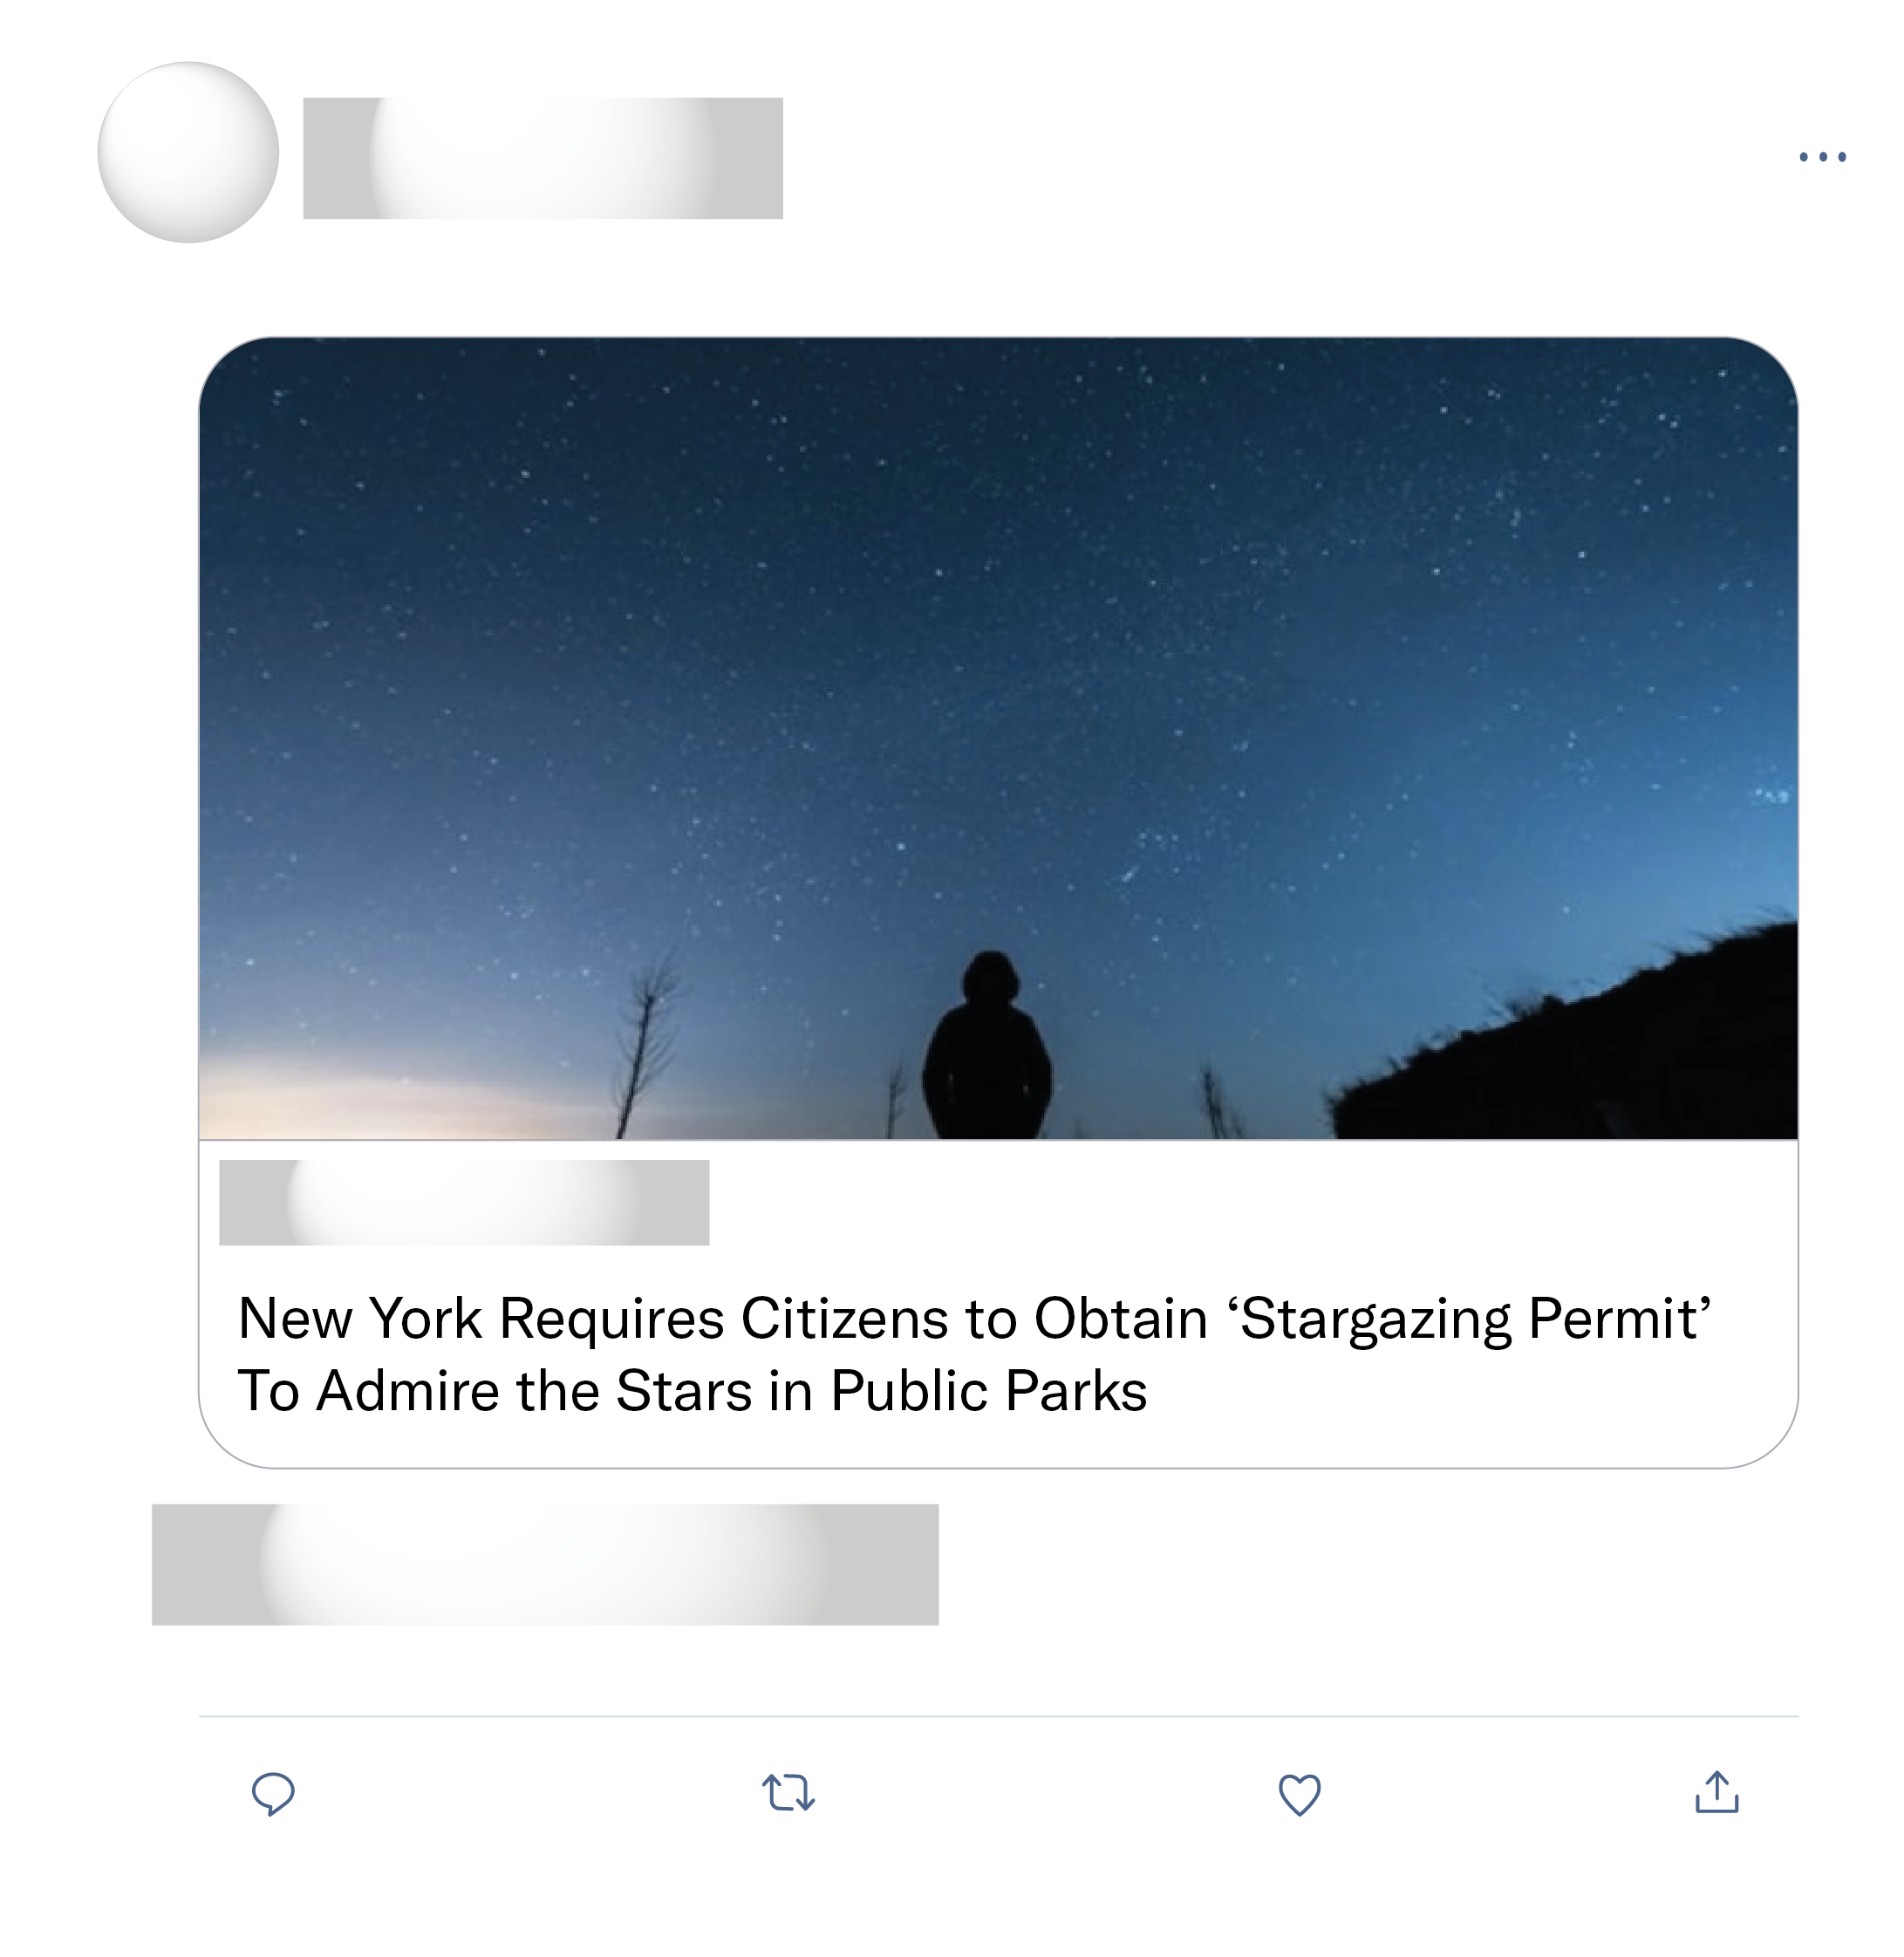
I checked the Parks & Recreation website and this appears to be totally a thing. You actually need a permit for stargazing. I... I have no words. That's the most absurd thing I've ever seen.
Suspicious. This seems a little far fetched. Fake news?
Seriously ?!? Why do you need this ? What country, state, or county made restrictions on the stars ?
You're supposed to be smart. Maybe learn what this permit is for before saying some emotionally charged false bs.

