Slide 1
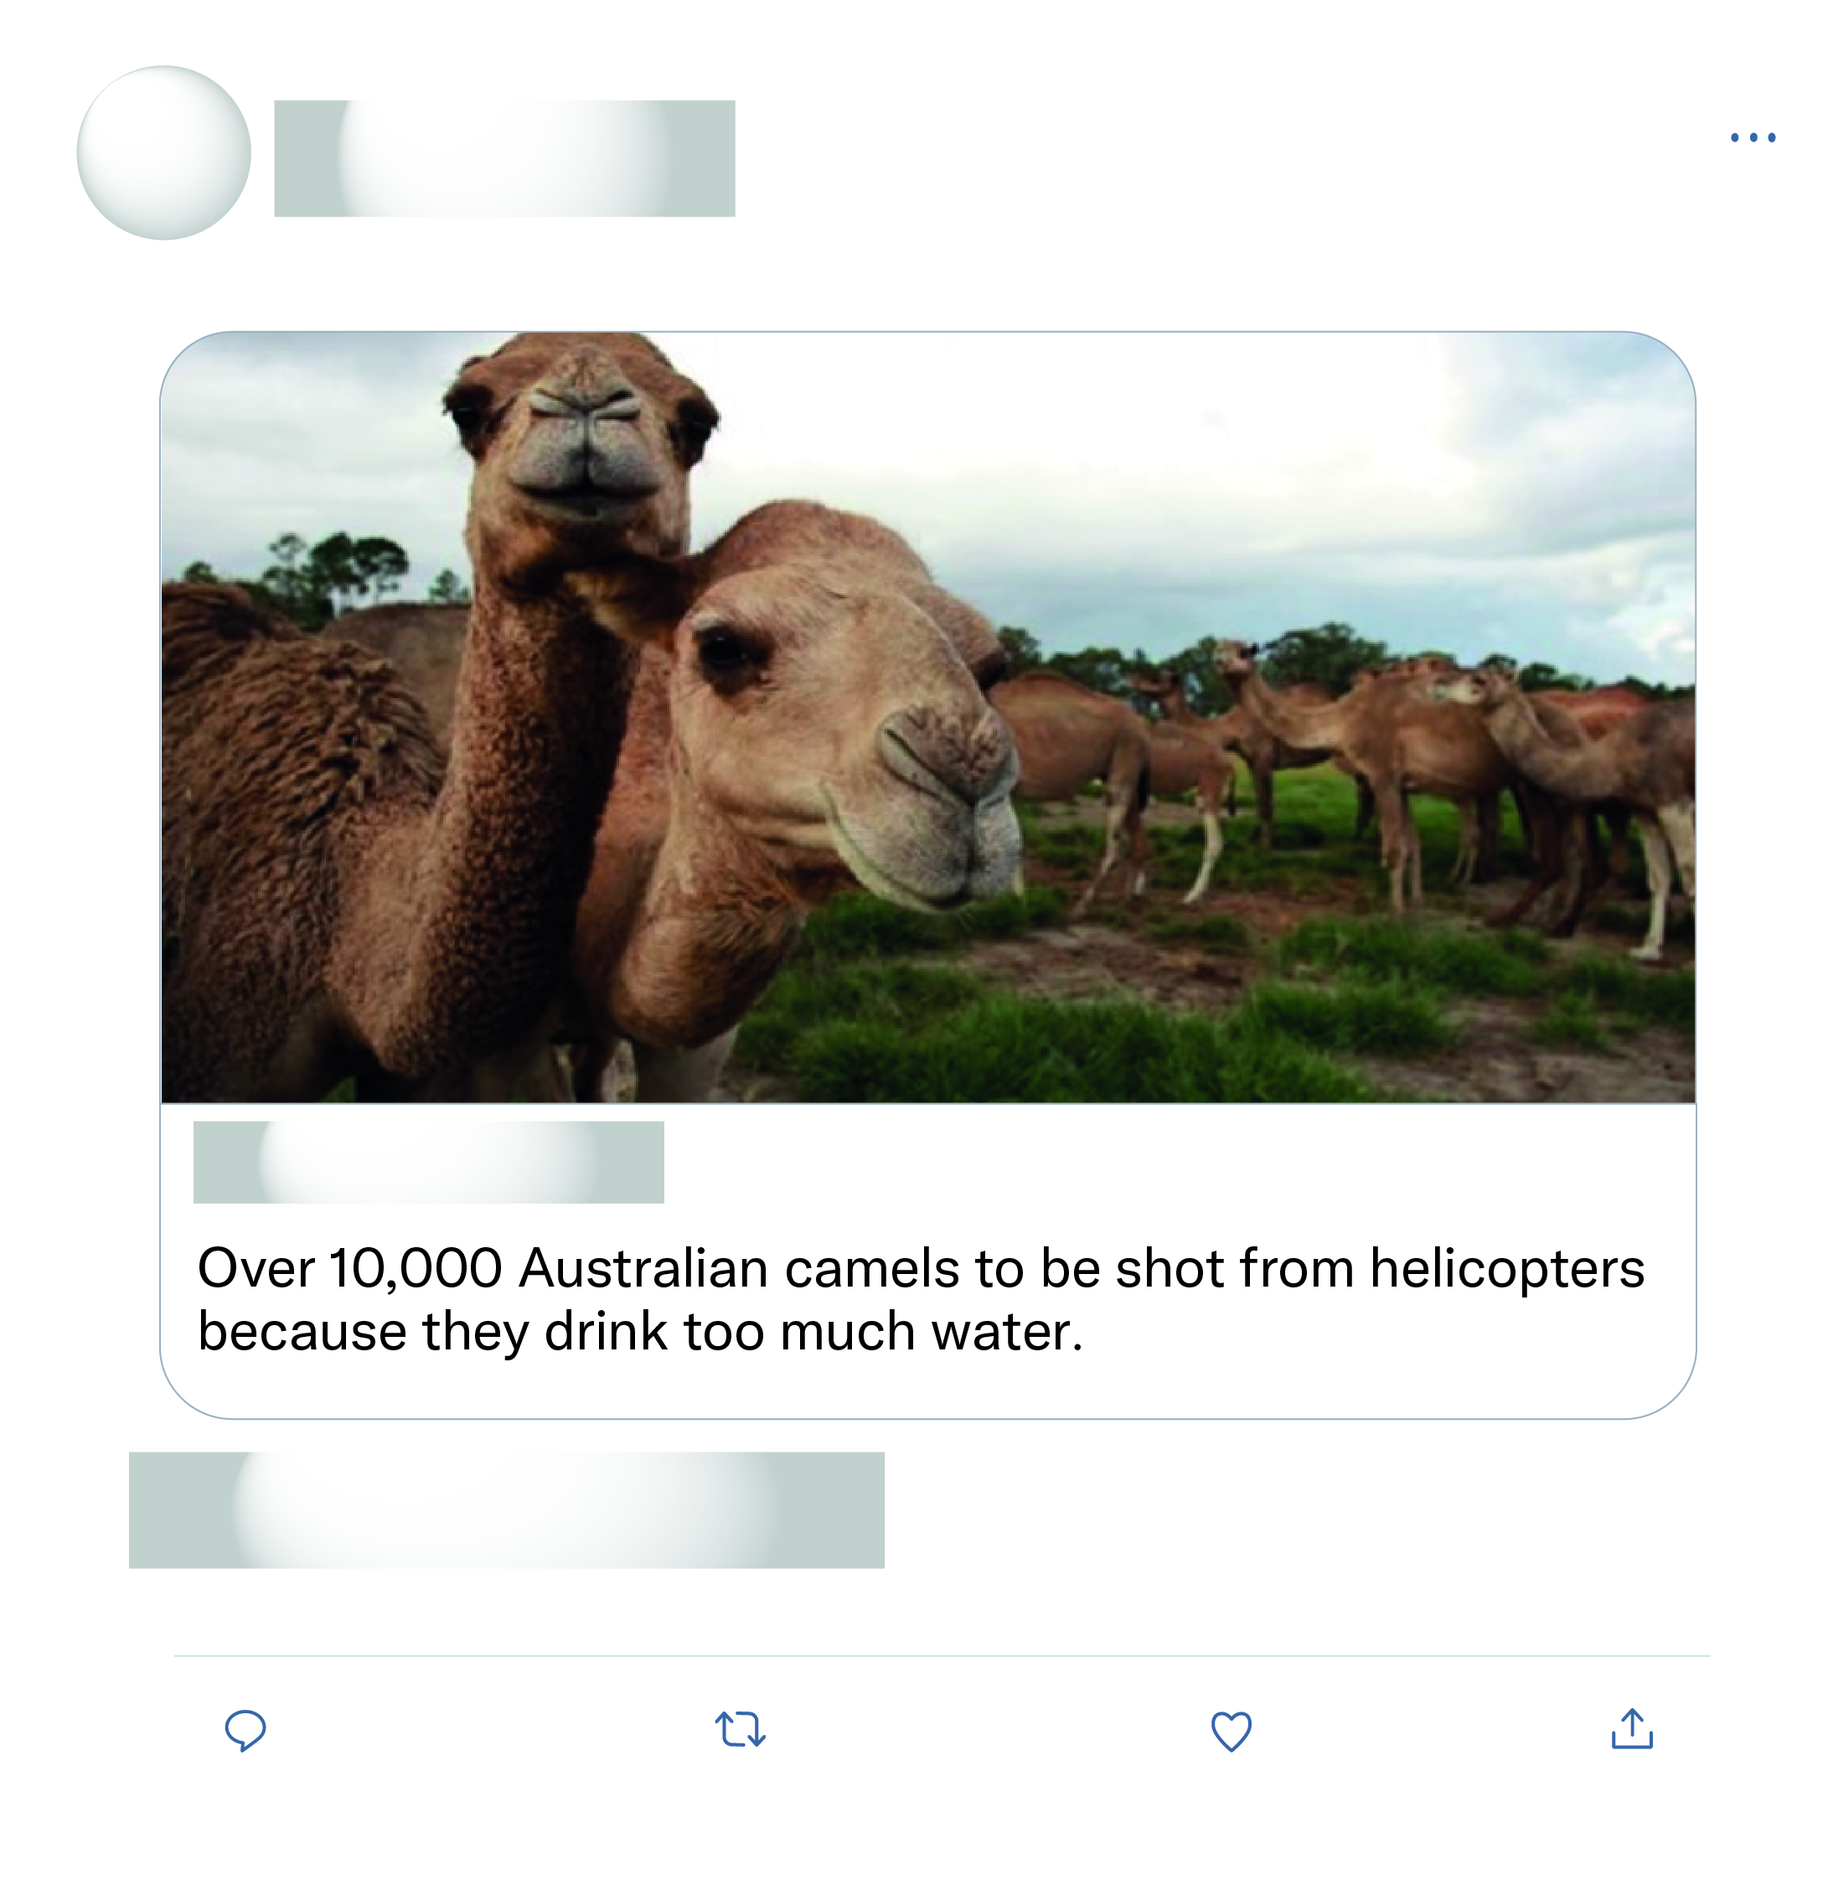







That's all the experts sat down and discussed as the solution wow what a productive move nothing else just killing more animals again after half a billion have died what a move.
This is just absolute nonsense!

Slide 2
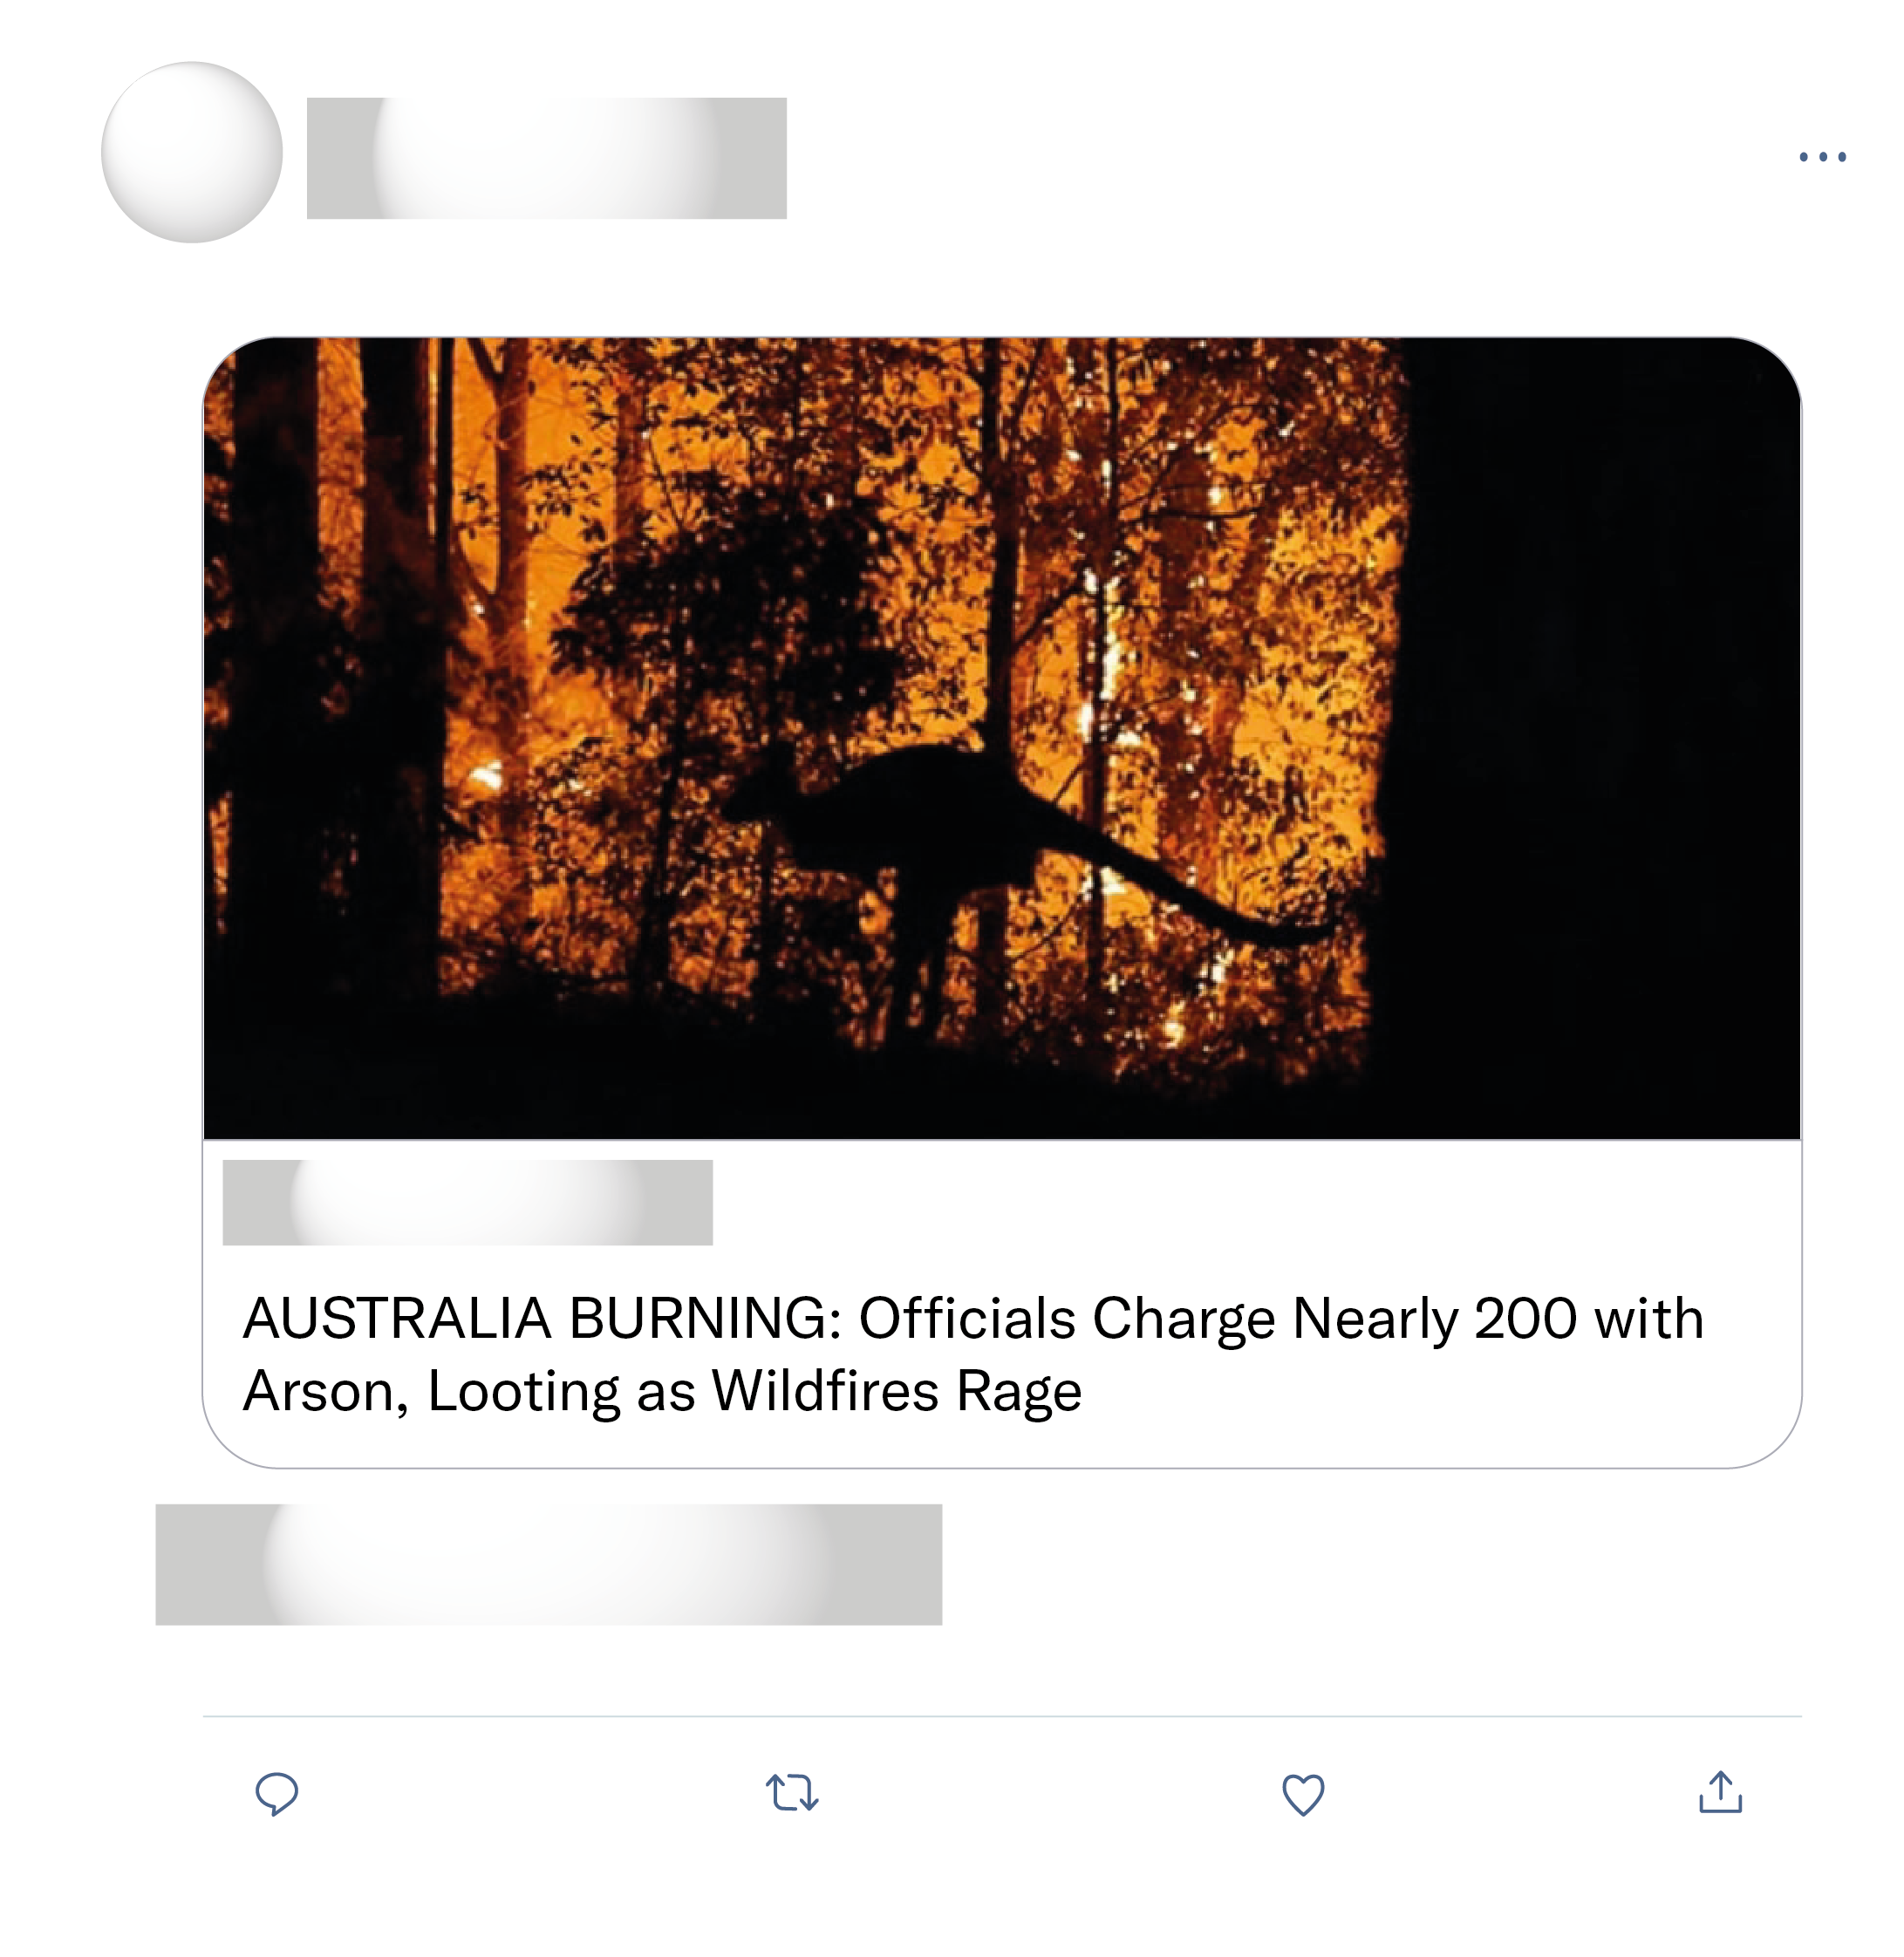
Terribly sad and harrowing ordeal for the beautiful Australian land, animals, and residents! The destruction and harm the degenerates are causing is reprehensible! Hope they are brought to justice and pay hefty fines.
The arson rumors have been debunked by the Australian authorities.
Hannity is lying again. 24 people have been charged with arson. The 'nearly 200' figure includes people warned for offenses like using machinery during a fire ban.
Thank You for presenting this. There has been vitriol and hatred thrown all one way during this crisis. Many media types refuse to acknowledge this because it doesn’t fit their agenda and narrative.

