Slide 1
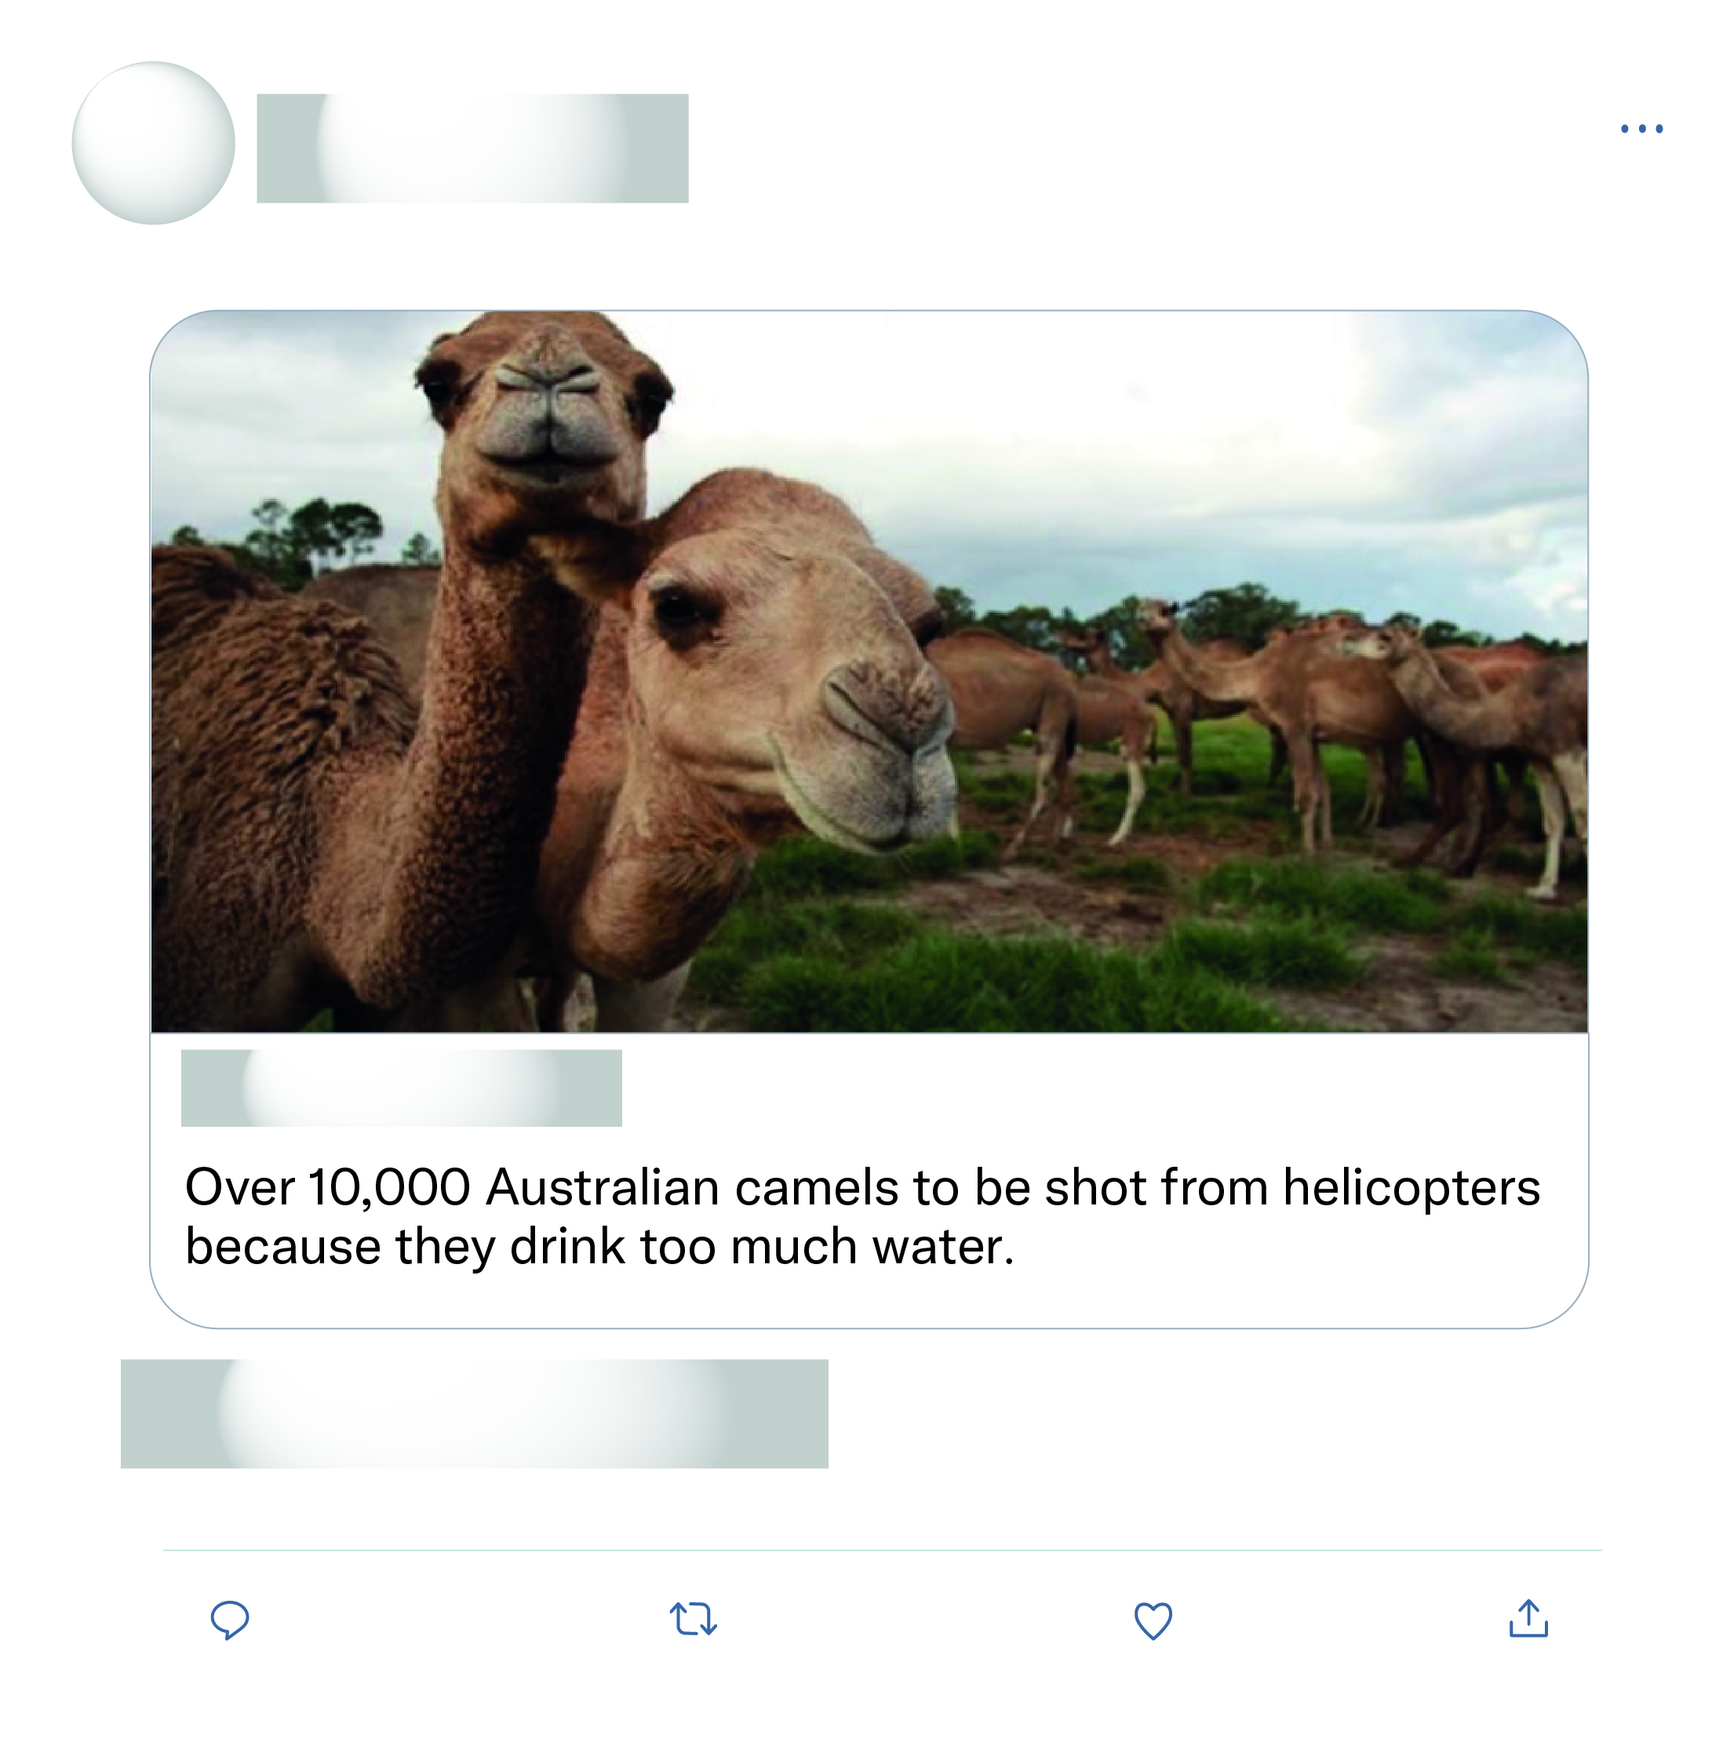







That's all the experts sat down and discussed as the solution wow what a productive move nothing else just killing more animals again after half a billion have died what a move.
This is just absolute nonsense!

Slide 2
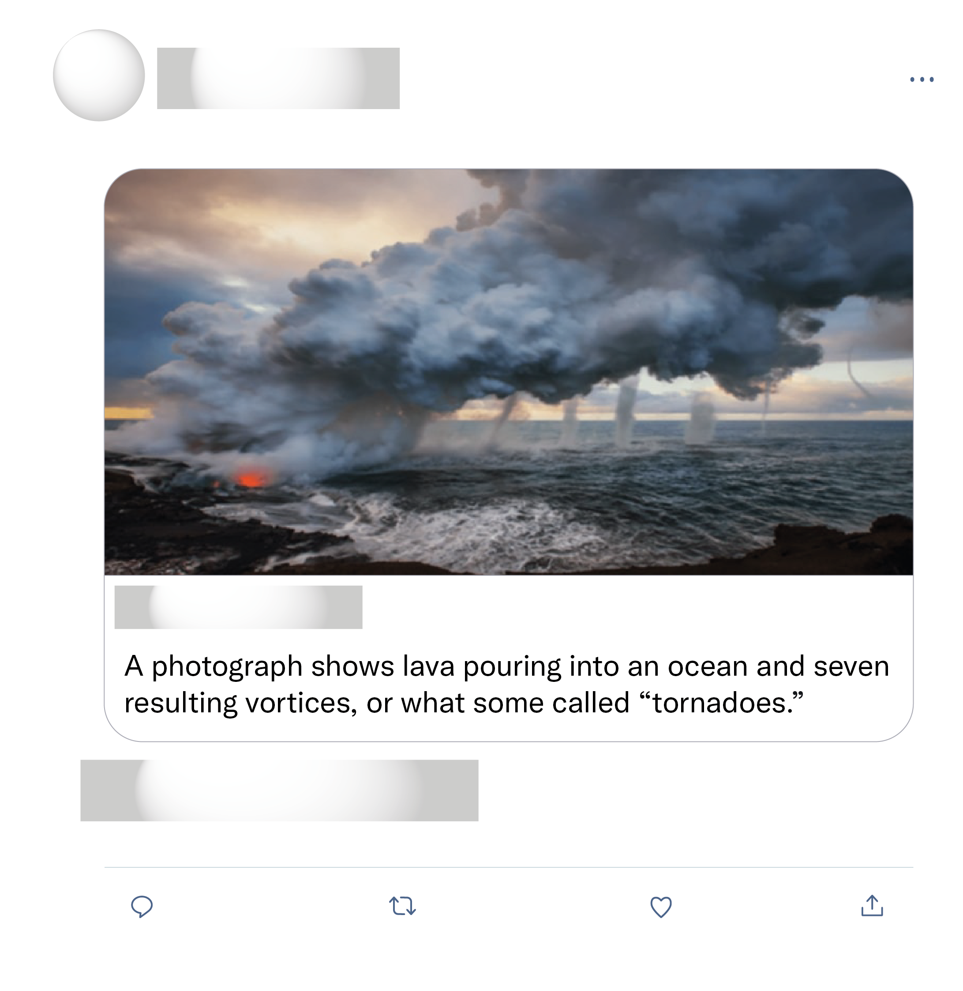
A very original moment captured !!! Wow I'm speechless, just in love with your photo ^^
Oh come on, this has to be edited... right?
This is not real! But excellent photoshopping skills.
Fake photo.

