Slide 1
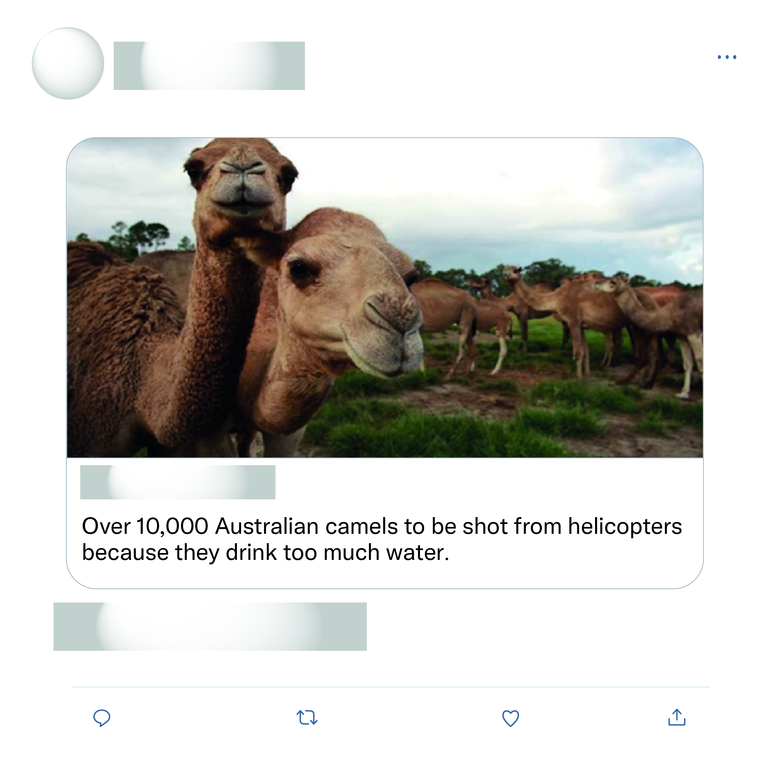







That's all the experts sat down and discussed as the solution wow what a productive move nothing else just killing more animals again after half a billion have died what a move.
This is just absolute nonsense!

Slide 2
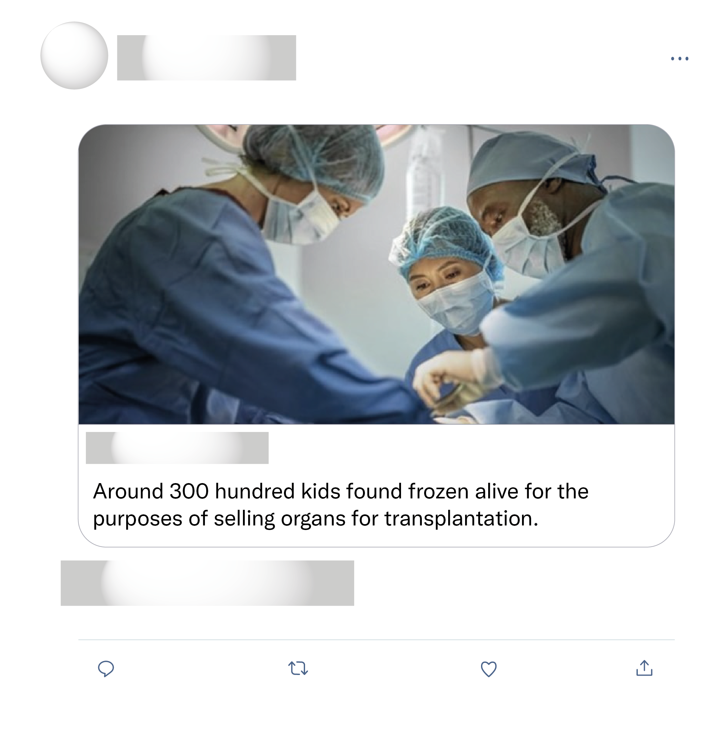

Don't be fooled. This is fake. Misinformation so people discount any future claims which may be true.
Worst thing I have ever seen. What is going on seriously? :?
This is so horrific but you know the people who do this don't feel a thing for their victims, it's hard to imagine being able to do that
How in the world can people do these things and sleep at night? There is a special kind of hell they must be living in. #HumanTrafficking

