Slide 1








That's all the experts sat down and discussed as the solution wow what a productive move nothing else just killing more animals again after half a billion have died what a move.
This is just absolute nonsense!

Slide 2
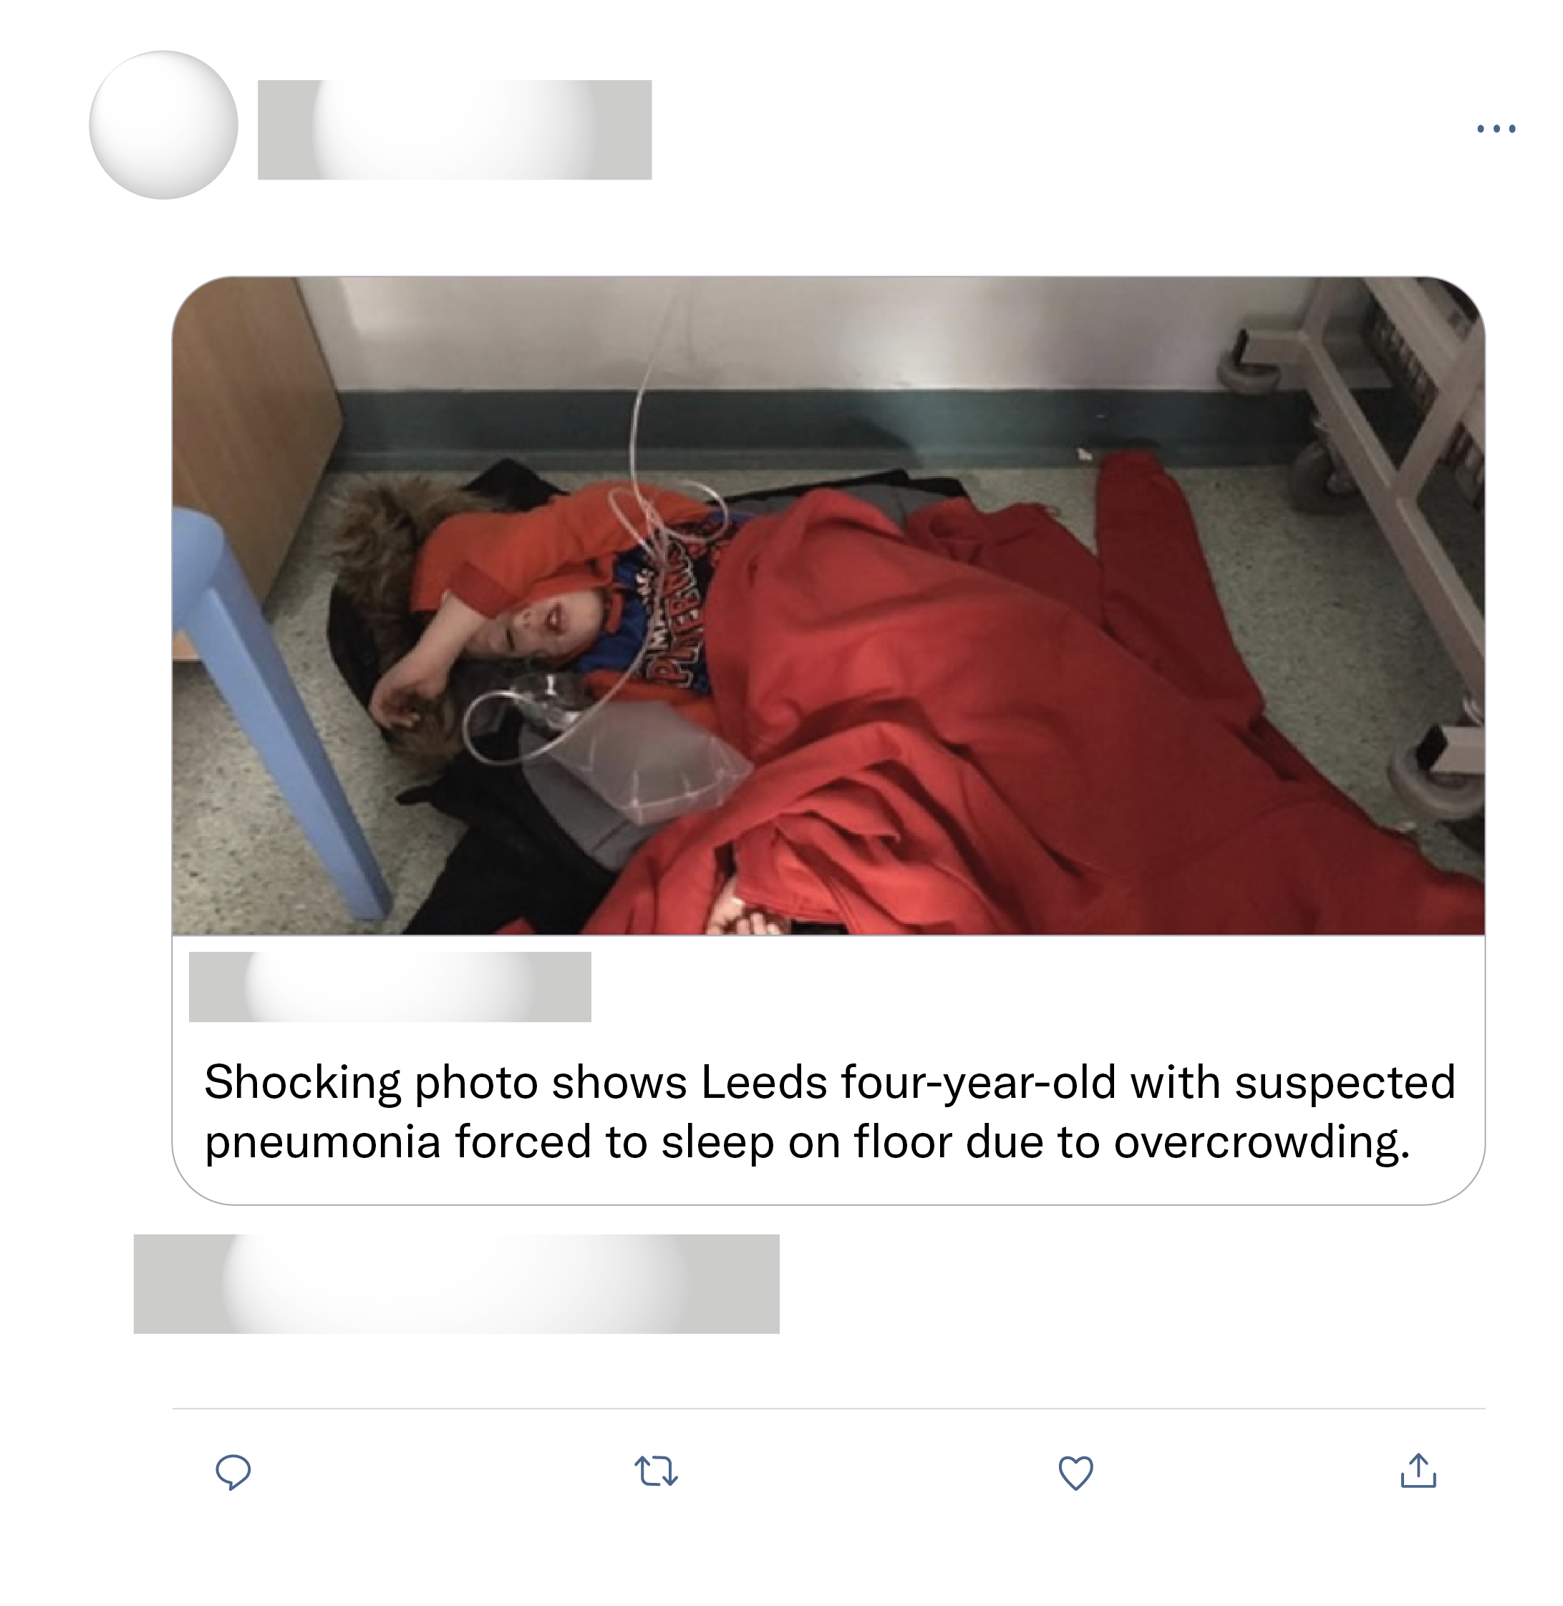
Already been proven to be fake news. He was given a chair but the mother thought he was better on the floor and also managed to get a professional photographer Ben Lack to take the photo.
Not just happening in Yorkshire, Lincolnshire too. I took my mum to A&E Boston 6 weeks ago and we were in there for 12 hours. It's awful there must have been 100 people waiting to be treated and 7 ambulances out side with patients in them!!!
That happened to my son at 7 weeks old. He had bronchitis and we where left on a corridor in children’s assessment ward outside the toilets for 9 hours!
Stop spreading lies.

