Slide 1







Fortunately that’s not what the report says. It means Koalas are endangered, not gone yet!
This is not true!

Slide 2
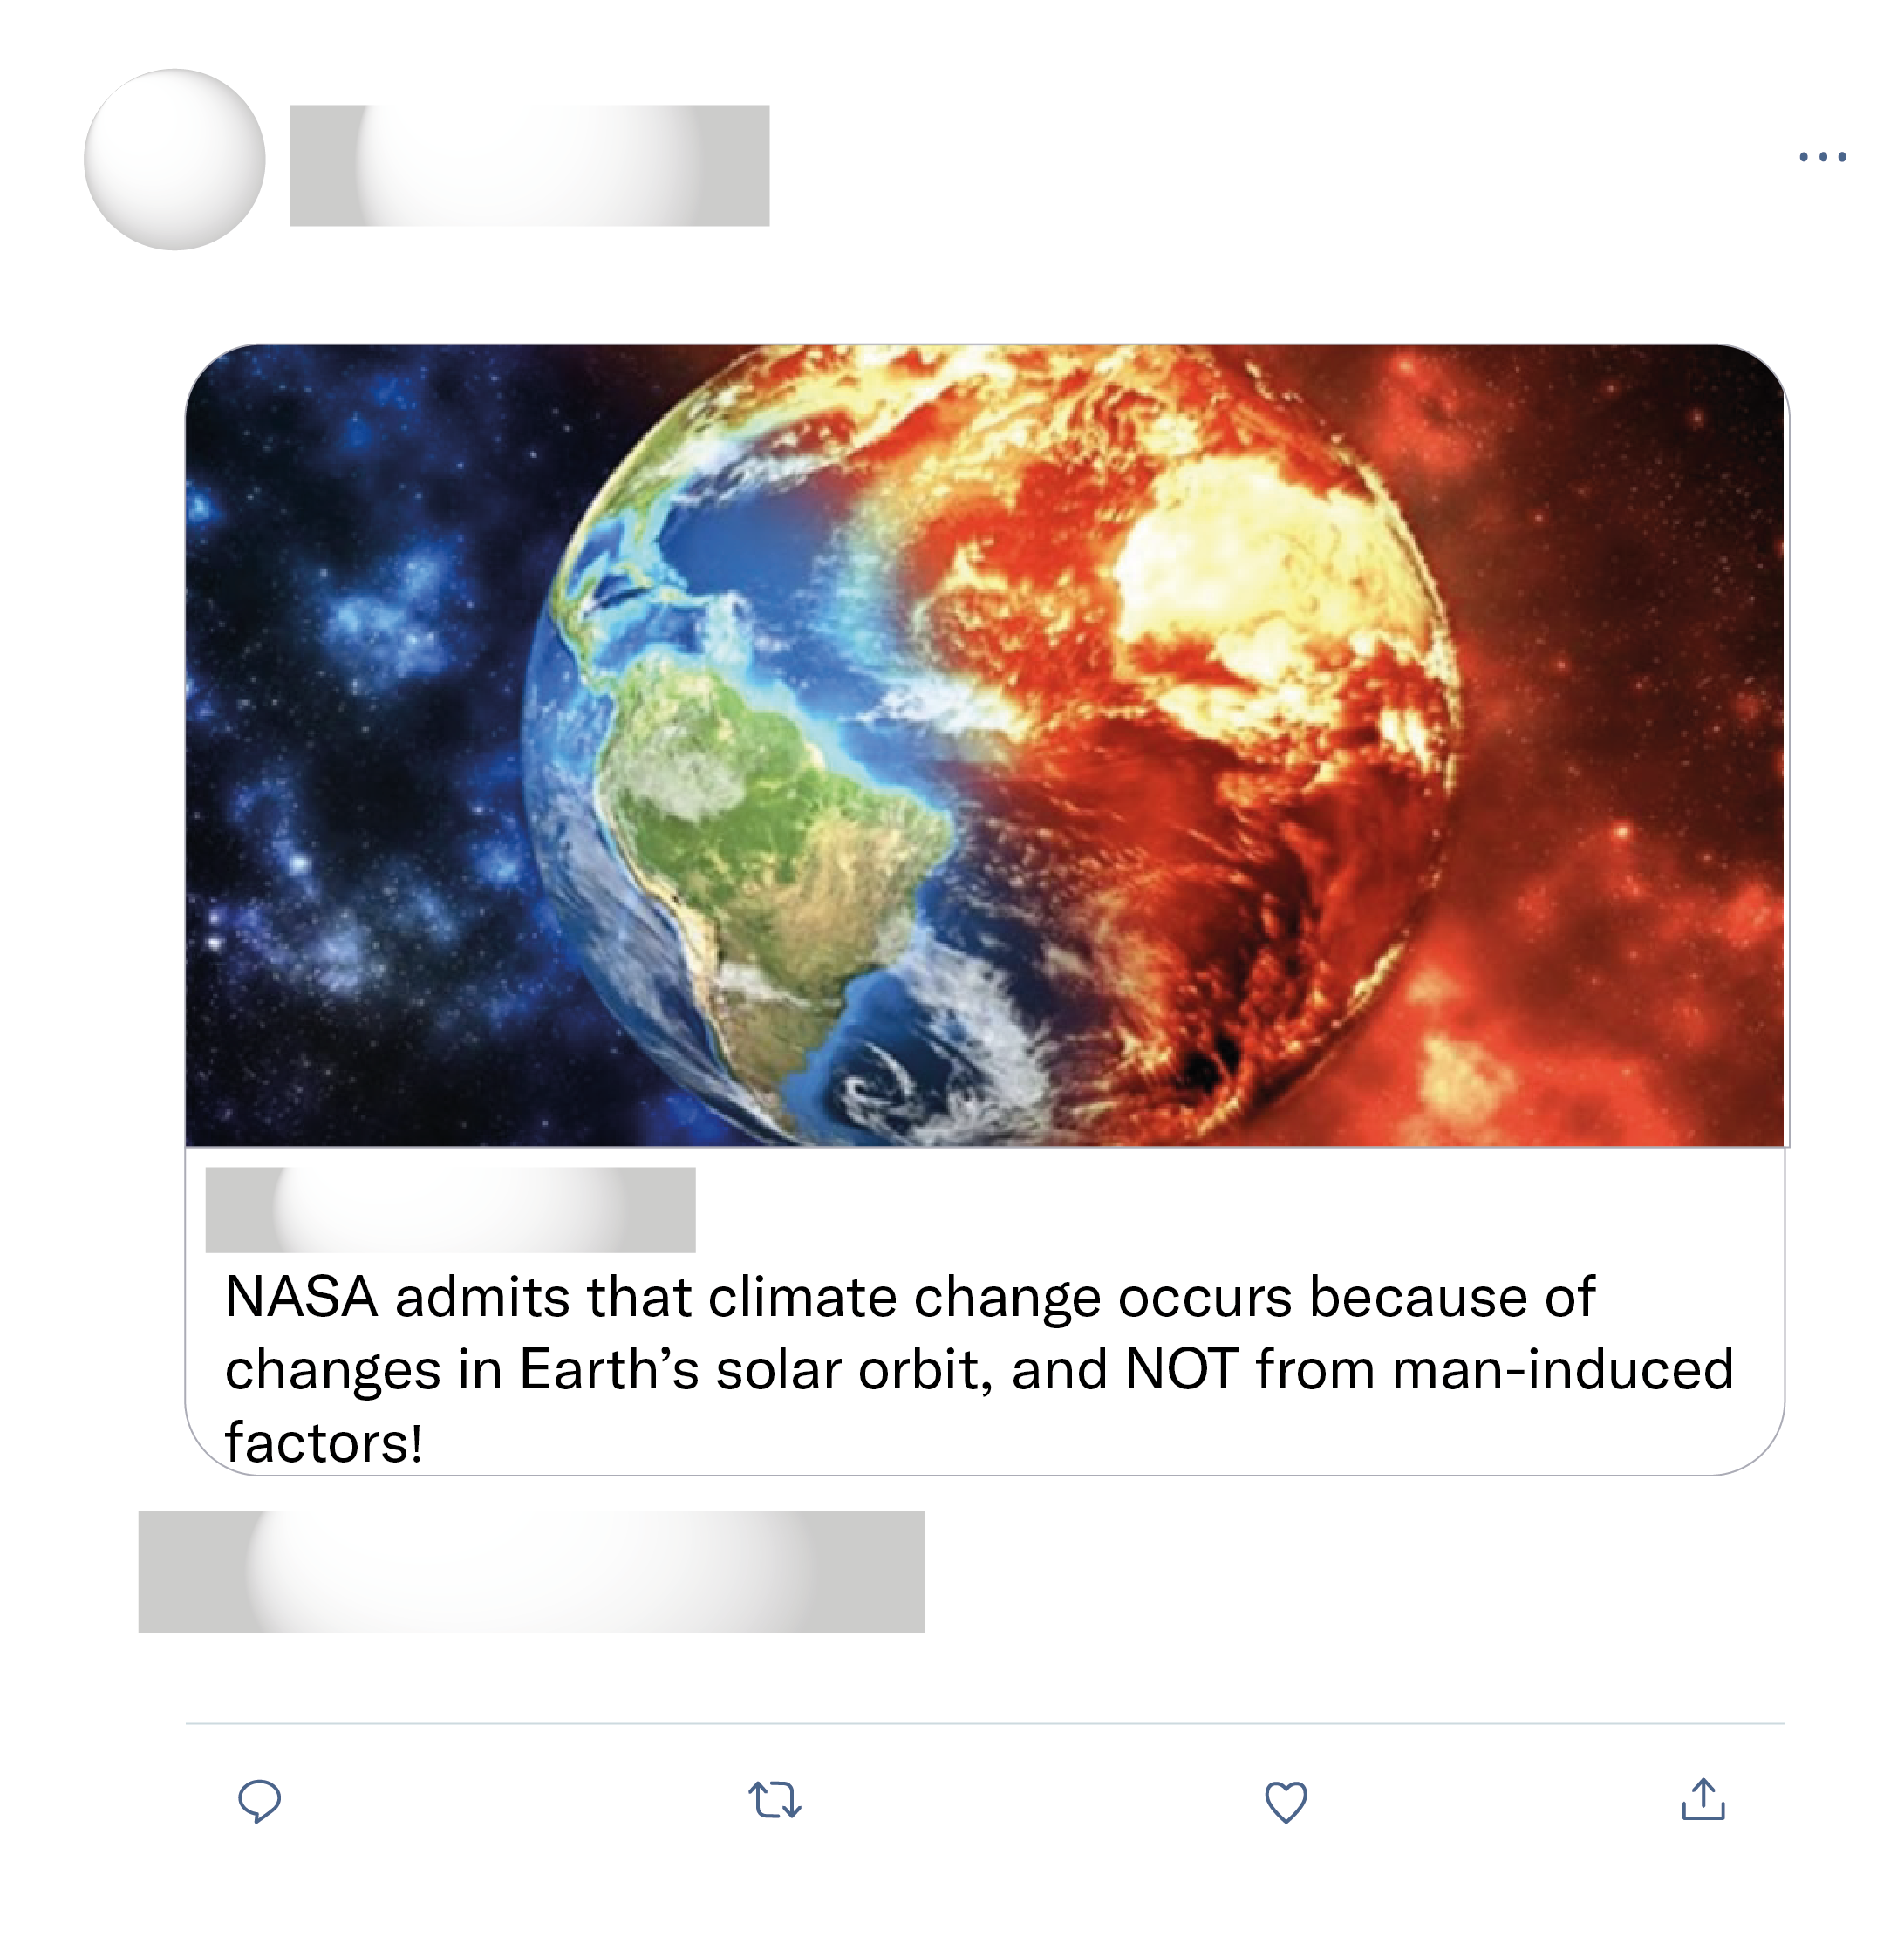
Listen, this entire article is bullshit and horribly right wing biased. if you’re in the comments section, please forget everything you have just read.
Climate change started 4.5 billion years ago and will continue 4.5 billion plus more. When humans become extinct as all things become eventually, the earth will continue to have climate change without effects from humans.
Complete lie. Nasa says right on their website it's not true. Look up "nasa climate change solar orbit"

Slide 3

Well ironed uniform & polished shoes. Mechanics during WWII. Long live the queen!

