Slide 1







Fortunately that’s not what the report says. It means Koalas are endangered, not gone yet!
This is not true!

Slide 2
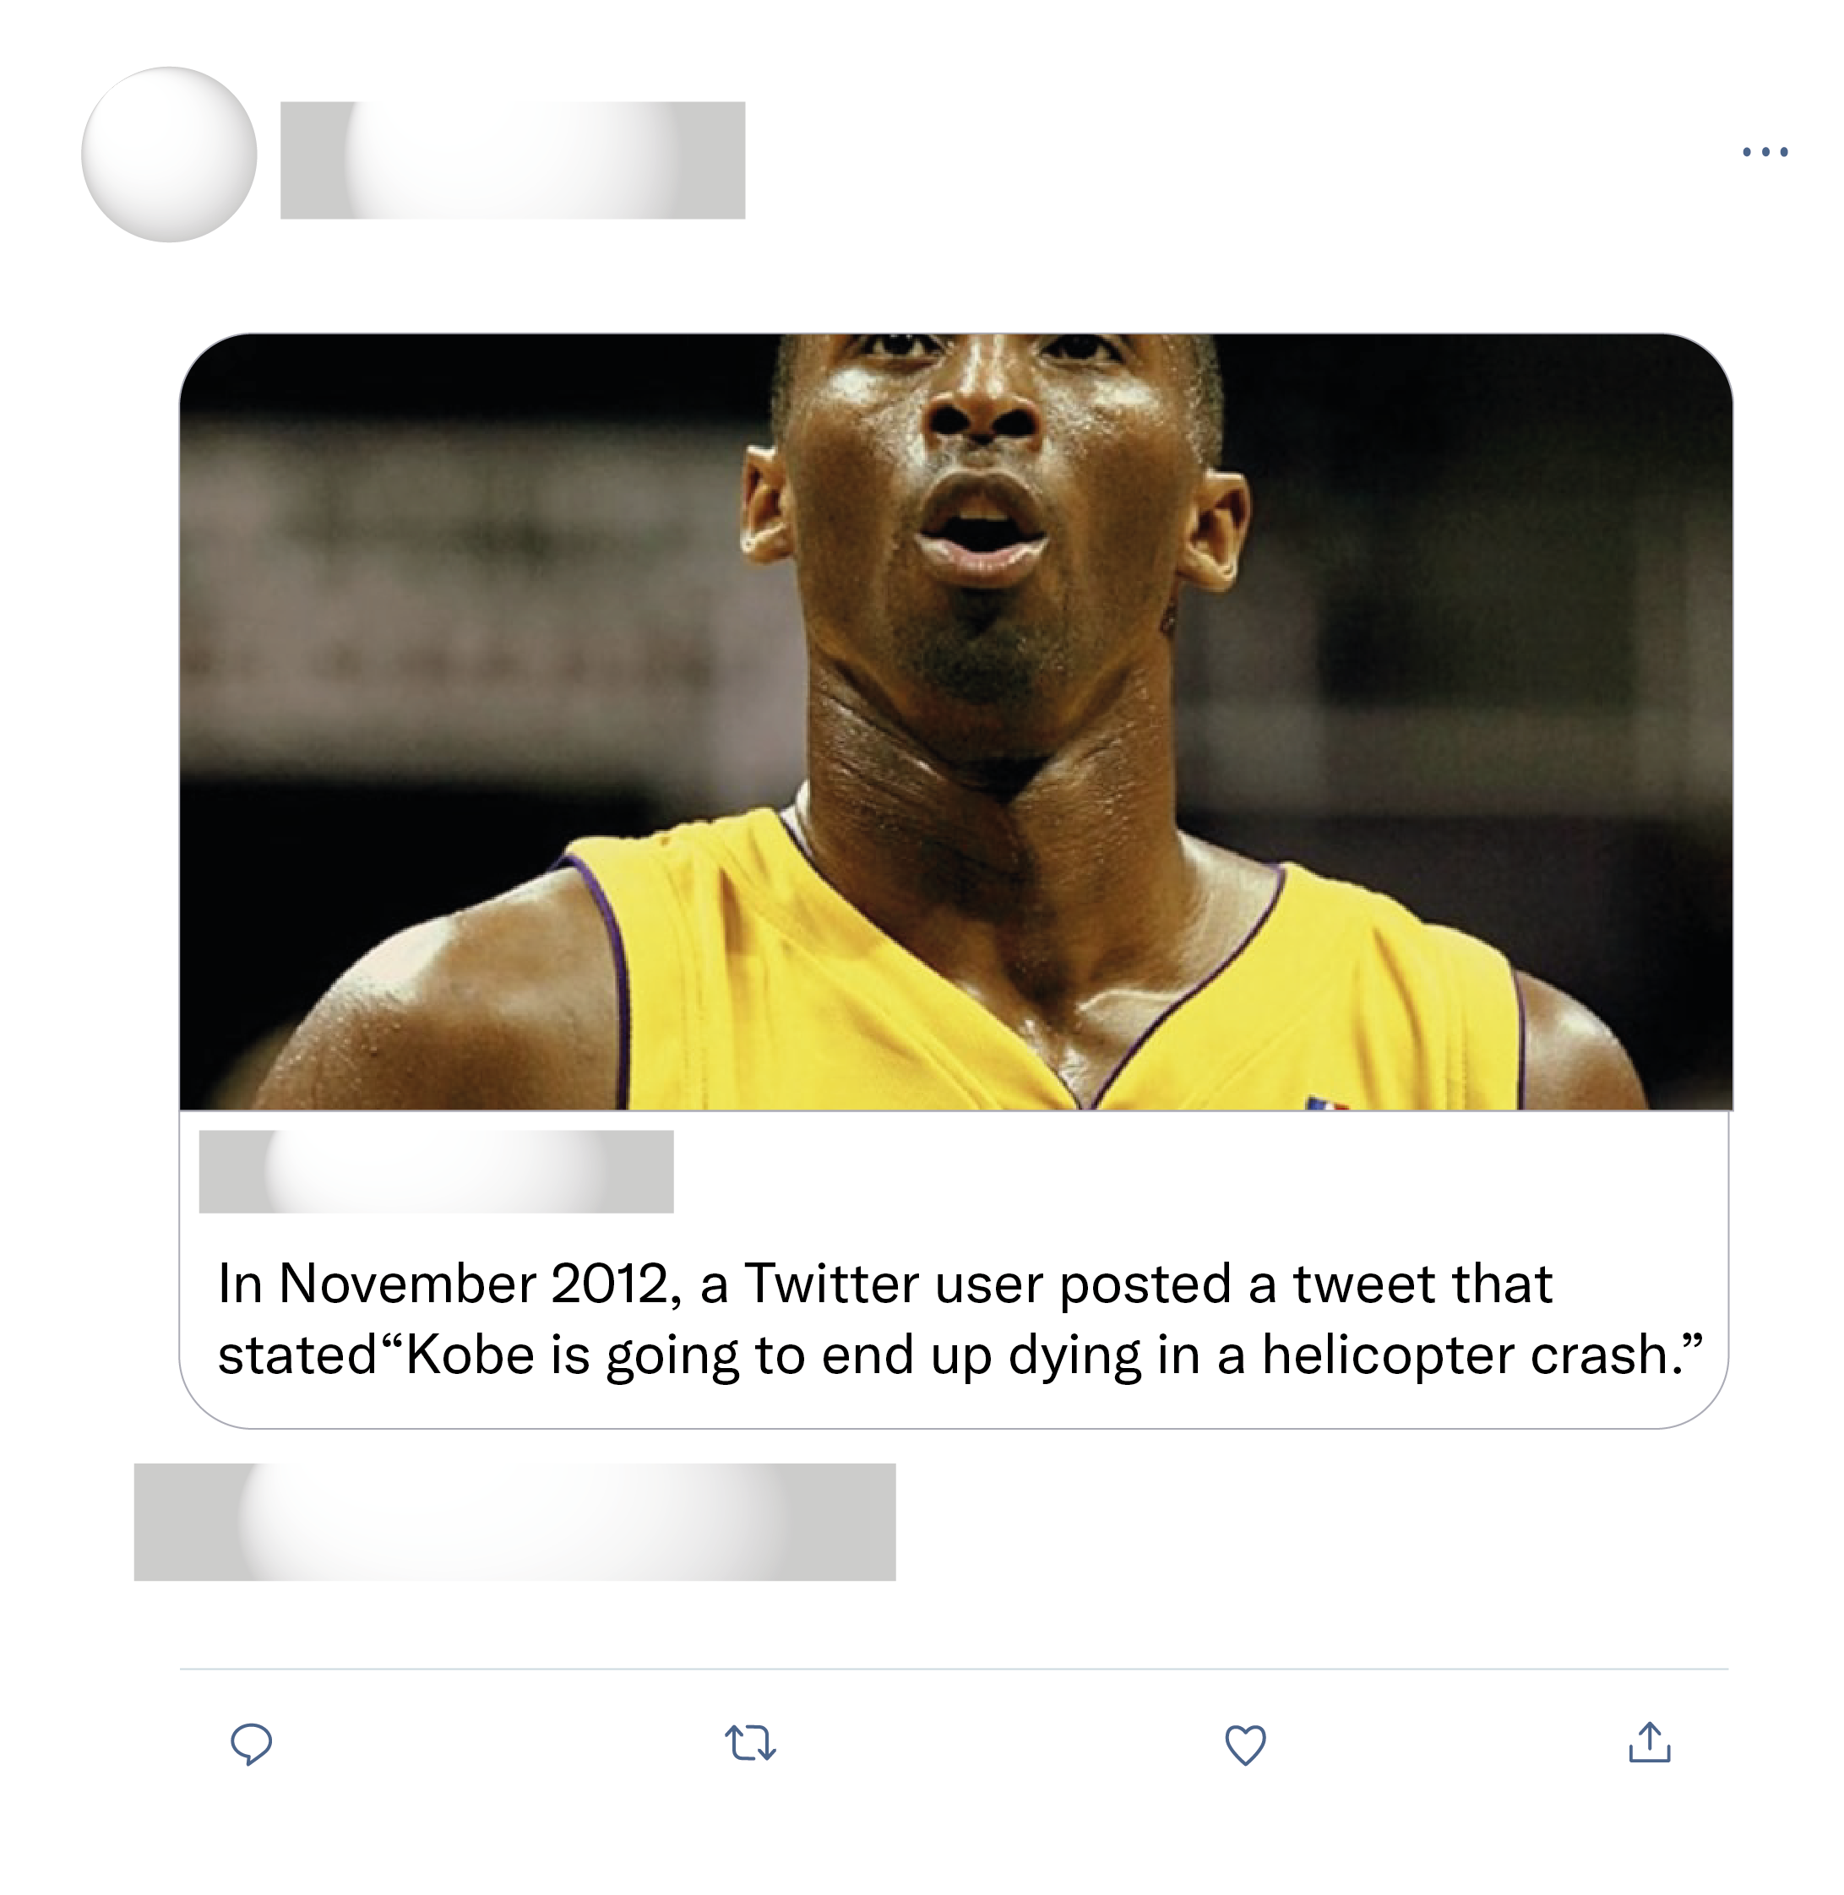
Carbon v2.5?? This is fake and disrespectful. Honestly the things people will do for clout
Carbon 2.5 is known to change the date of tweets lol this is fake
Quick thread for anyone questioning the legitimacy of this tweet: it is real. Twitter does not have an API that allows for changing post dates (or changing tweets in anyway). Tweets are immutable once posted.

Slide 3
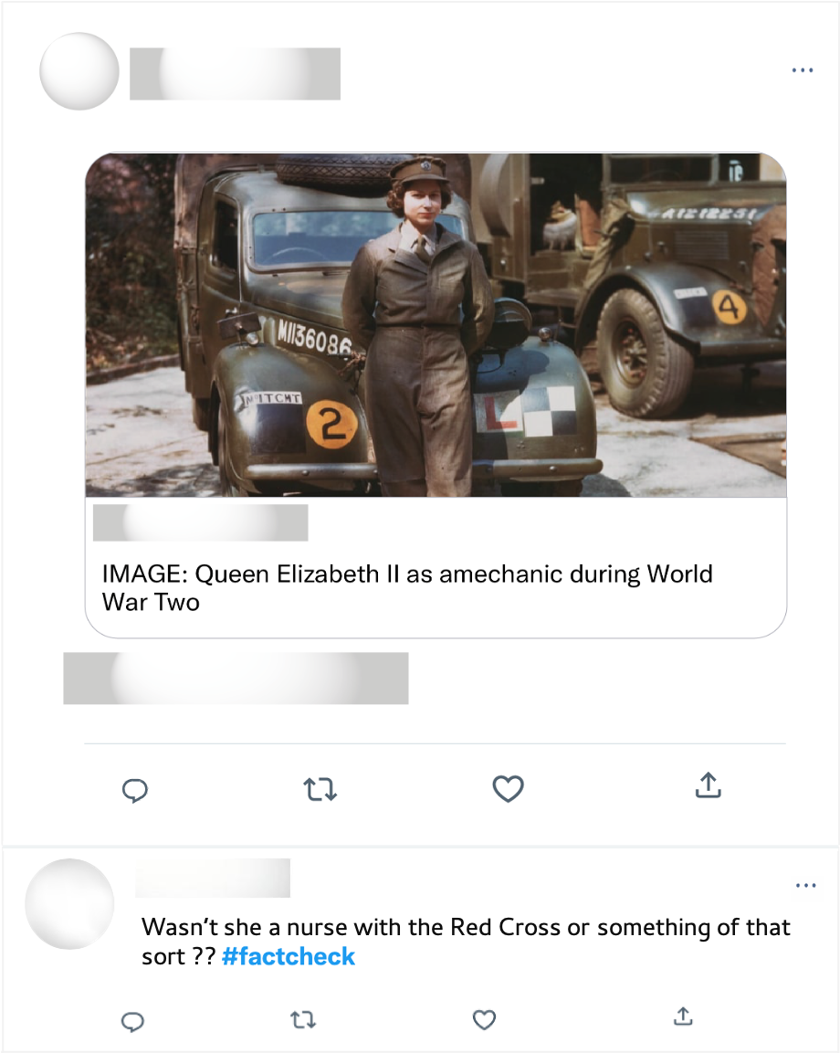
Well ironed uniform & polished shoes. Mechanics during WWII. Long live the queen!

