Slide 1







Fortunately that’s not what the report says. It means Koalas are endangered, not gone yet!
This is not true!

Slide 2
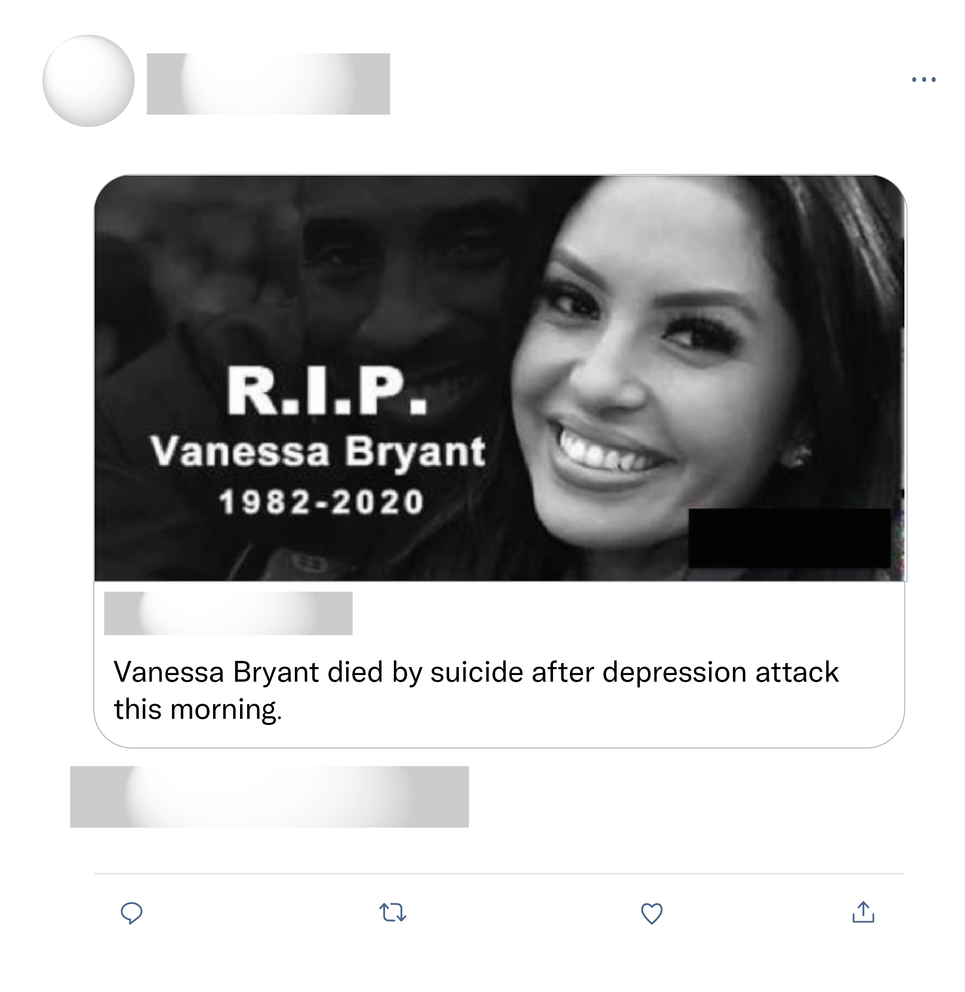

If you're gonna spread fake news at least make it believable 😂😭😭
She is not dead! Why are you doing this?
Fake news. Can't believe people would go to such lengths to go viral.

Slide 3
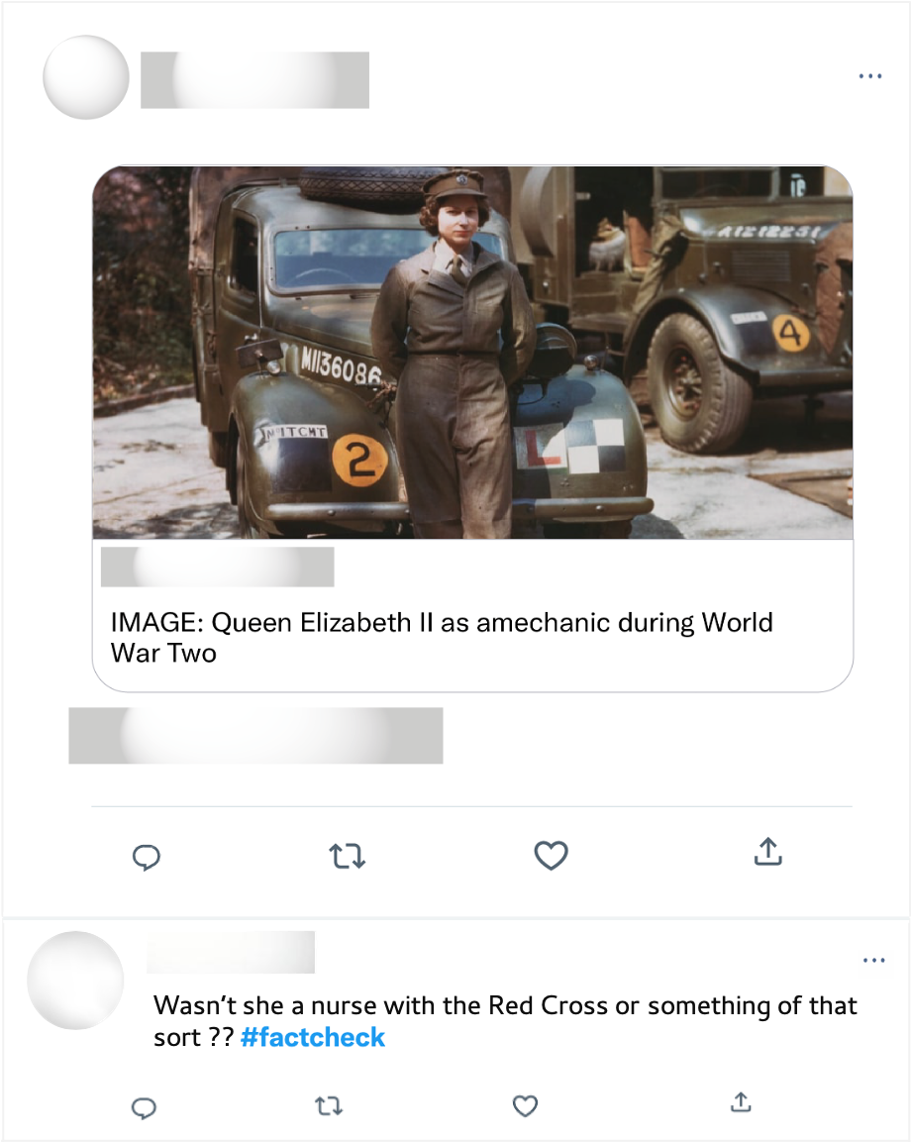
Well ironed uniform & polished shoes. Mechanics during WWII. Long live the queen!

