Slide 1







Fortunately that’s not what the report says. It means Koalas are endangered, not gone yet!
This is not true!

Slide 2
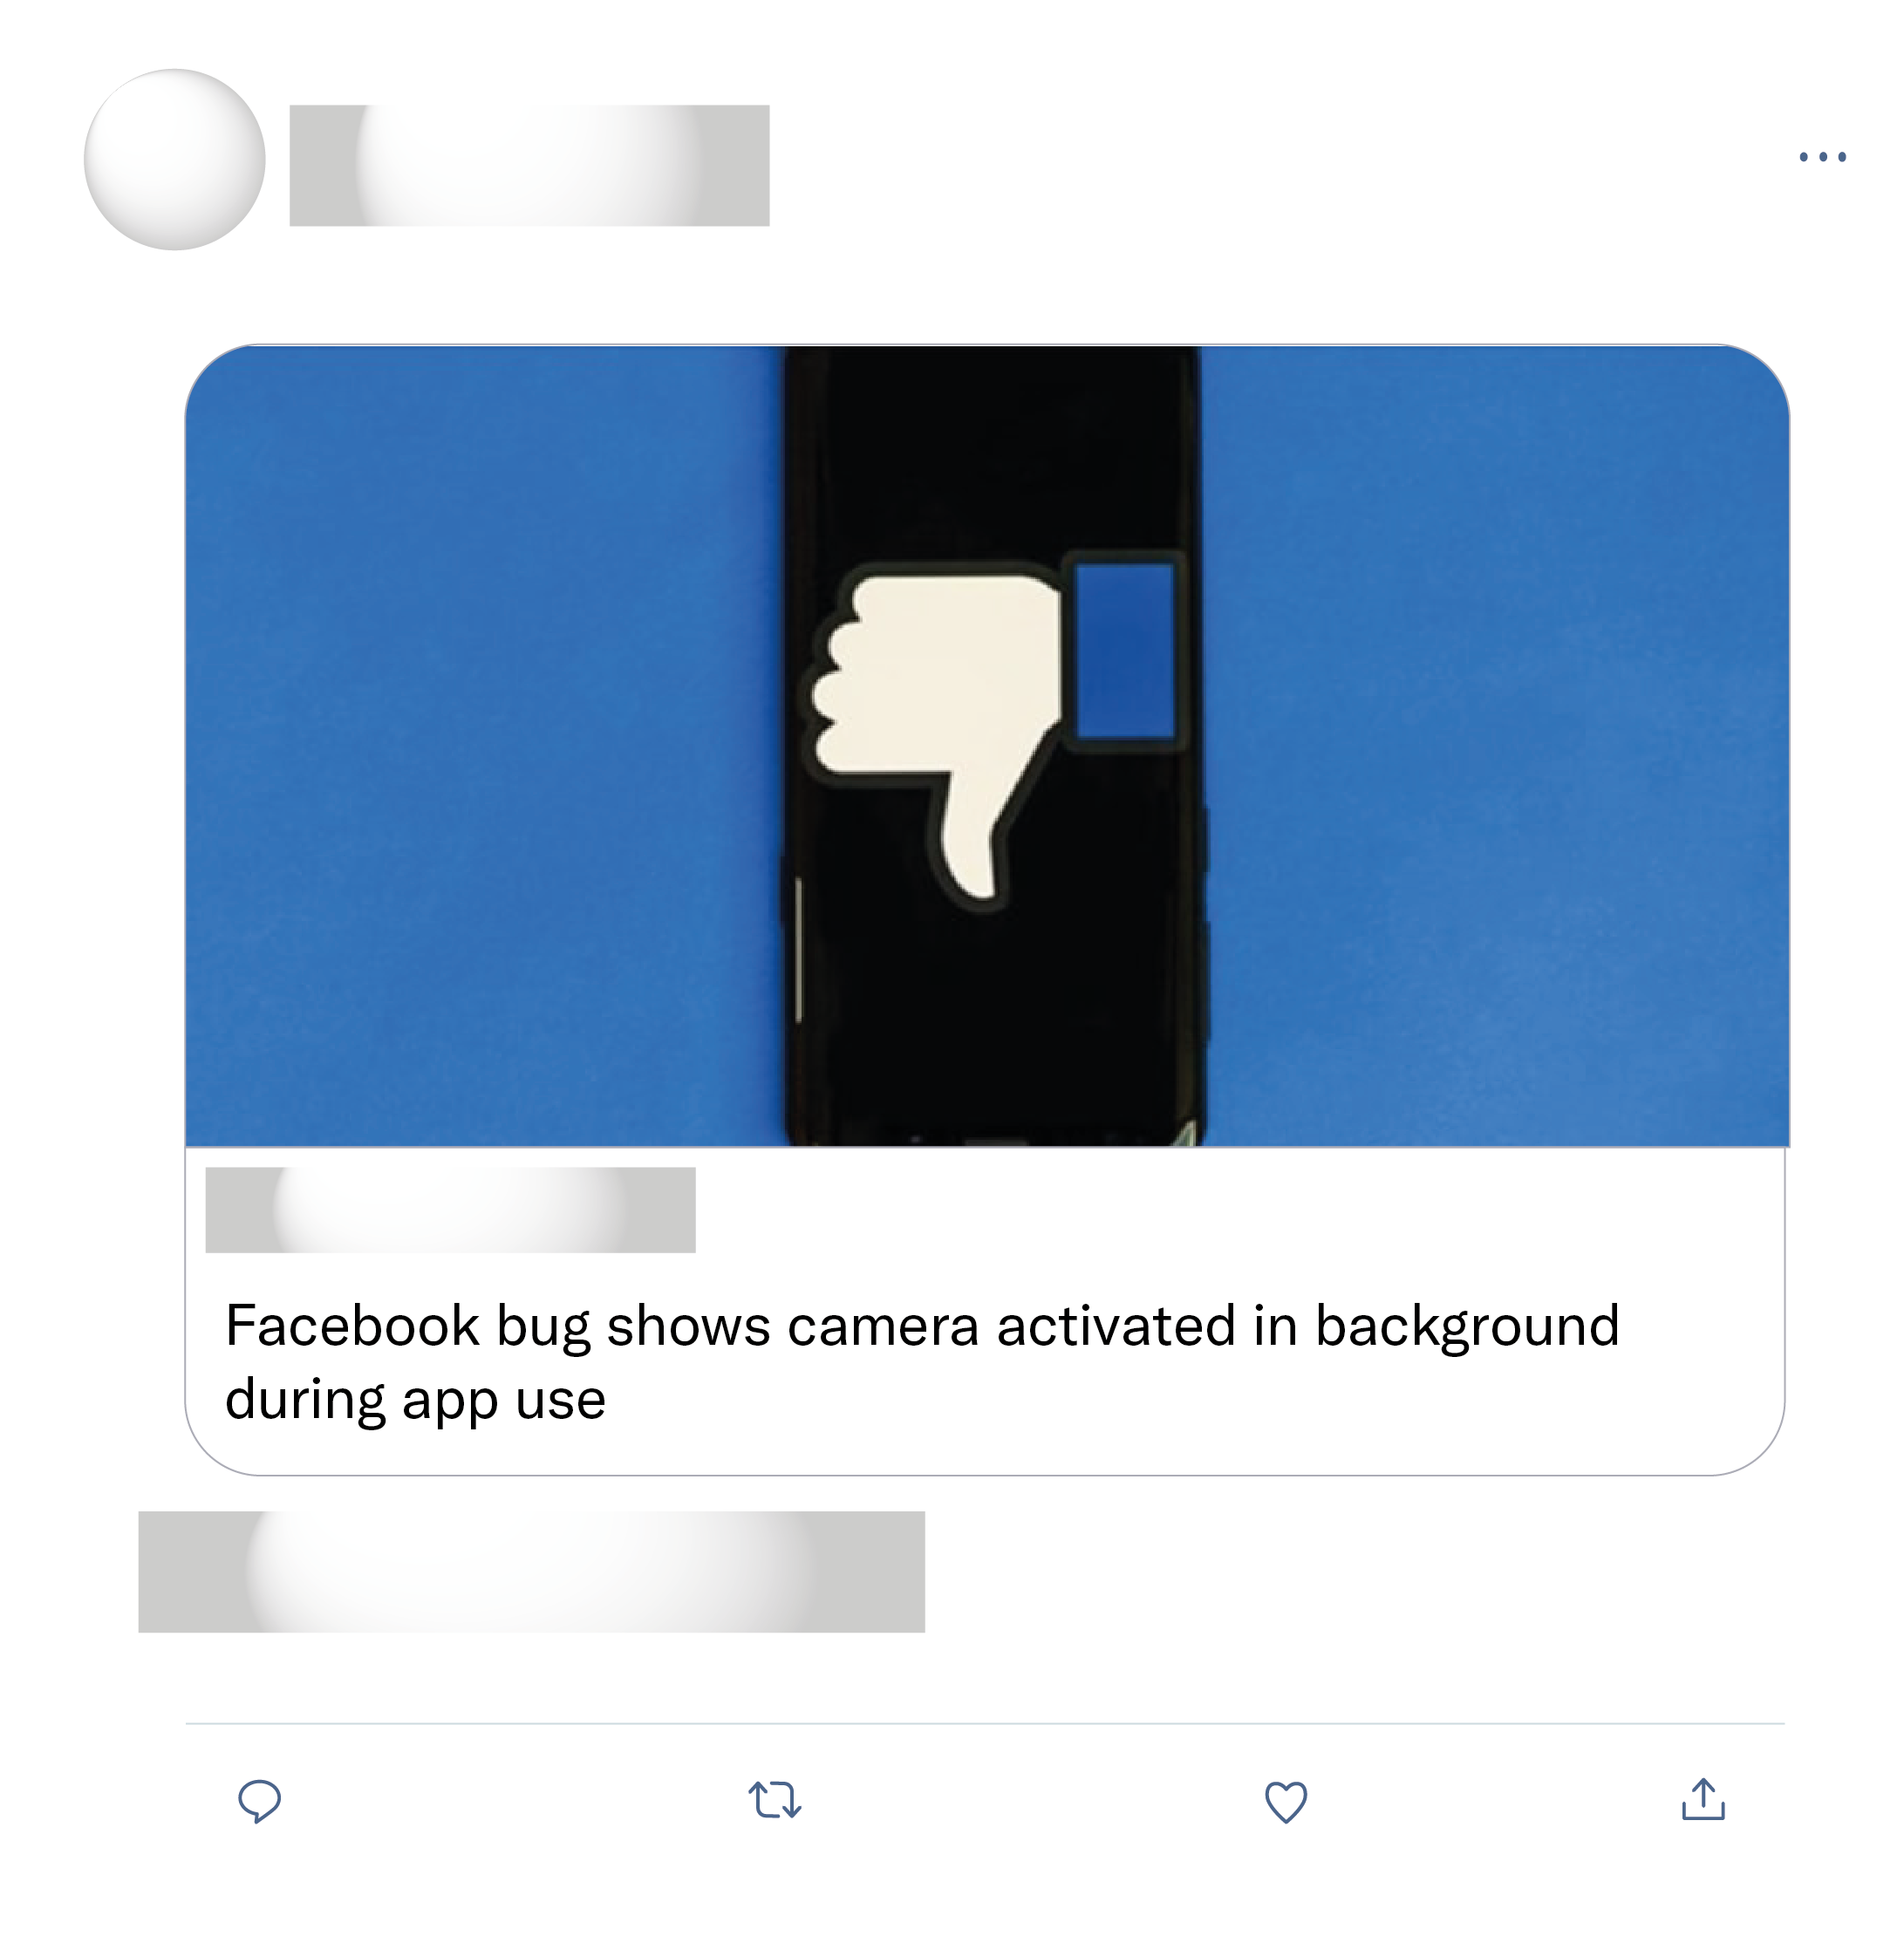
It's how Facebook accesses your camera and microphone... This is proof that they are accessing your back camera. They may also be accessing the front camera. If they process that through a facial recognition they could see your actual reaction to posts.
This is exactly why I will never have Facebook on my phone and I deny permission to access Photos/Camera/Microphone to almost every app where I don’t explicotly need it for some reason.
Makes it hard to be believe the "no, we're not listening to your conversations and using that for ads" claim.
It happens to me when watching videos on facebook app. When the video ends and I try to return to the news feed, the camera of my phone is visibly open.

Slide 3

Well ironed uniform & polished shoes. Mechanics during WWII. Long live the queen!

