Slide 1







Fortunately that’s not what the report says. It means Koalas are endangered, not gone yet!
This is not true!

Slide 2
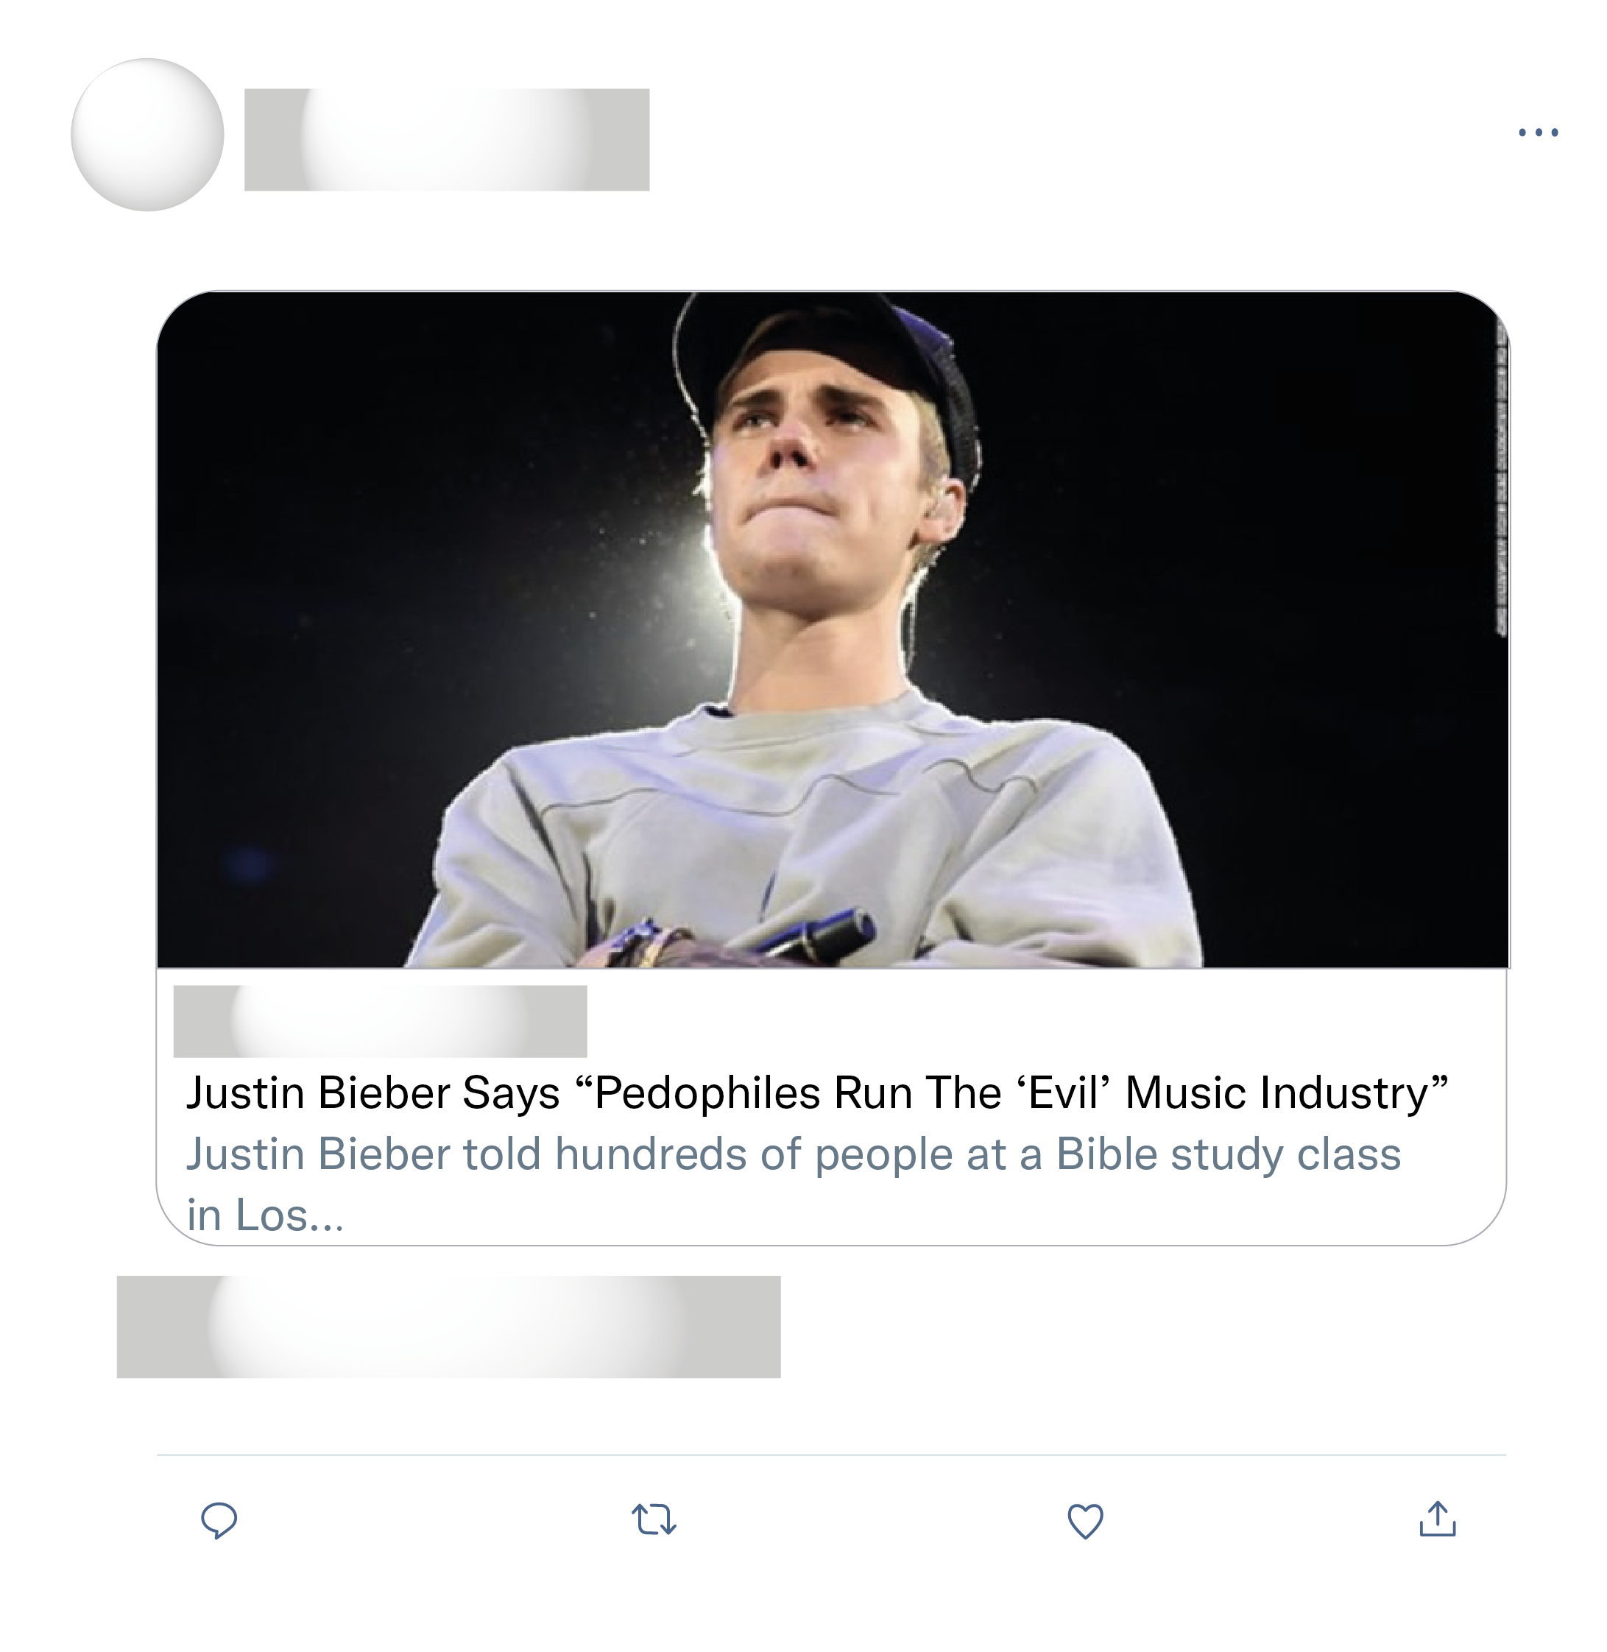
We believe you Justin!...THANK YOU for coming forward, this IS happening from Hollywood to George Town. The power elite believe they are entitled to rape, torture and yes...kill children.. We are watching!
Pray for him. I also am thankful he made it out alive .
Justin's final judgement with God is looking much better, God bless him for fleeing the evil cabal.
Unfortunately, this is not sourced. Can't be believed. Does this type of behaviour exist in Hollywood? yes absolutely! but this interview is fake!

Slide 3
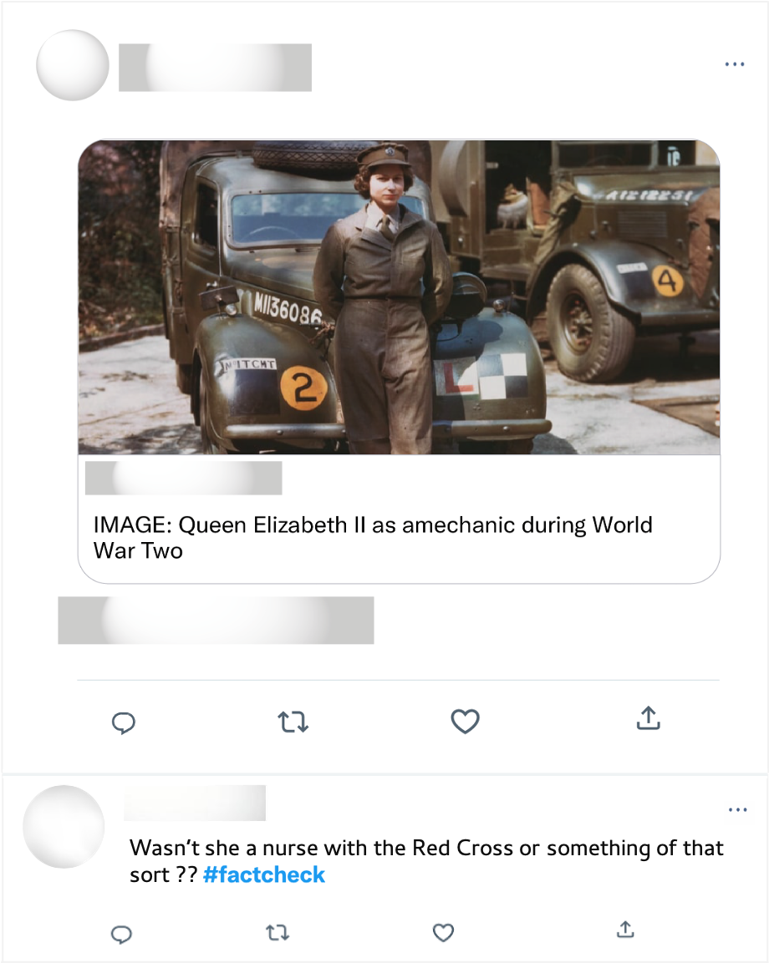
Well ironed uniform & polished shoes. Mechanics during WWII. Long live the queen!

