Slide 1
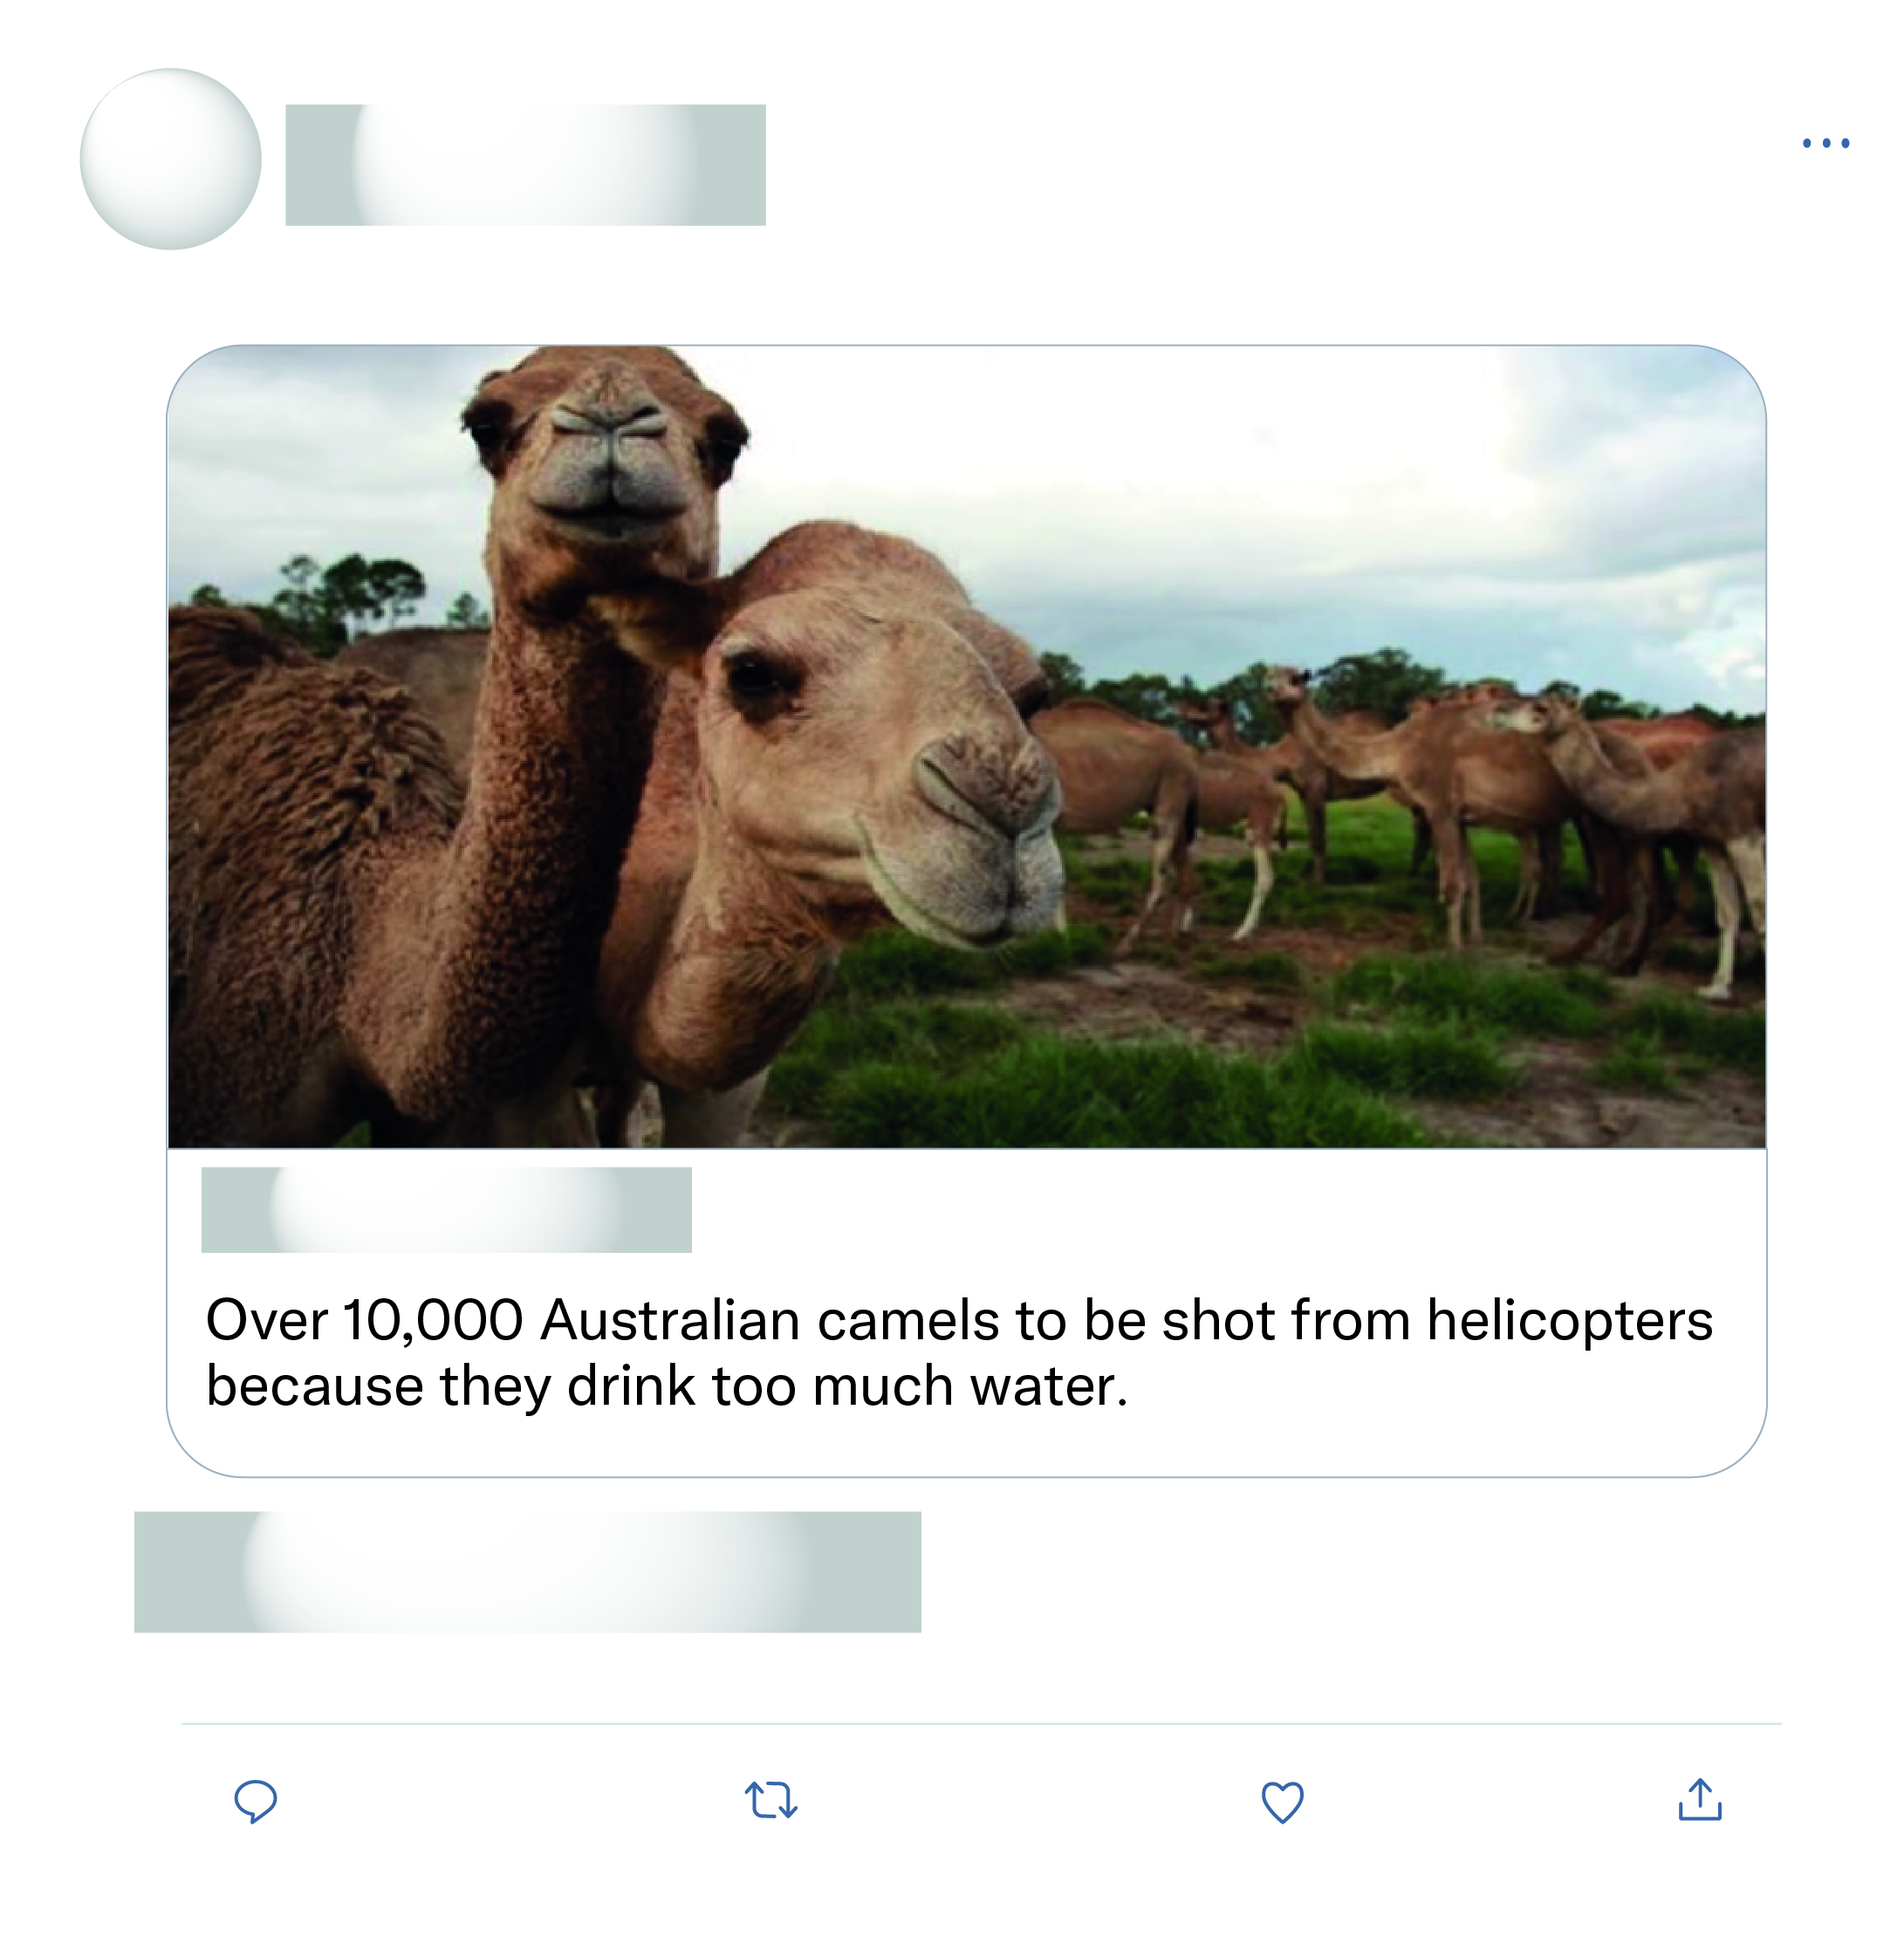







That's all the experts sat down and discussed as the solution wow what a productive move nothing else just killing more animals again after half a billion have died what a move.
This is just absolute nonsense!

Slide 2
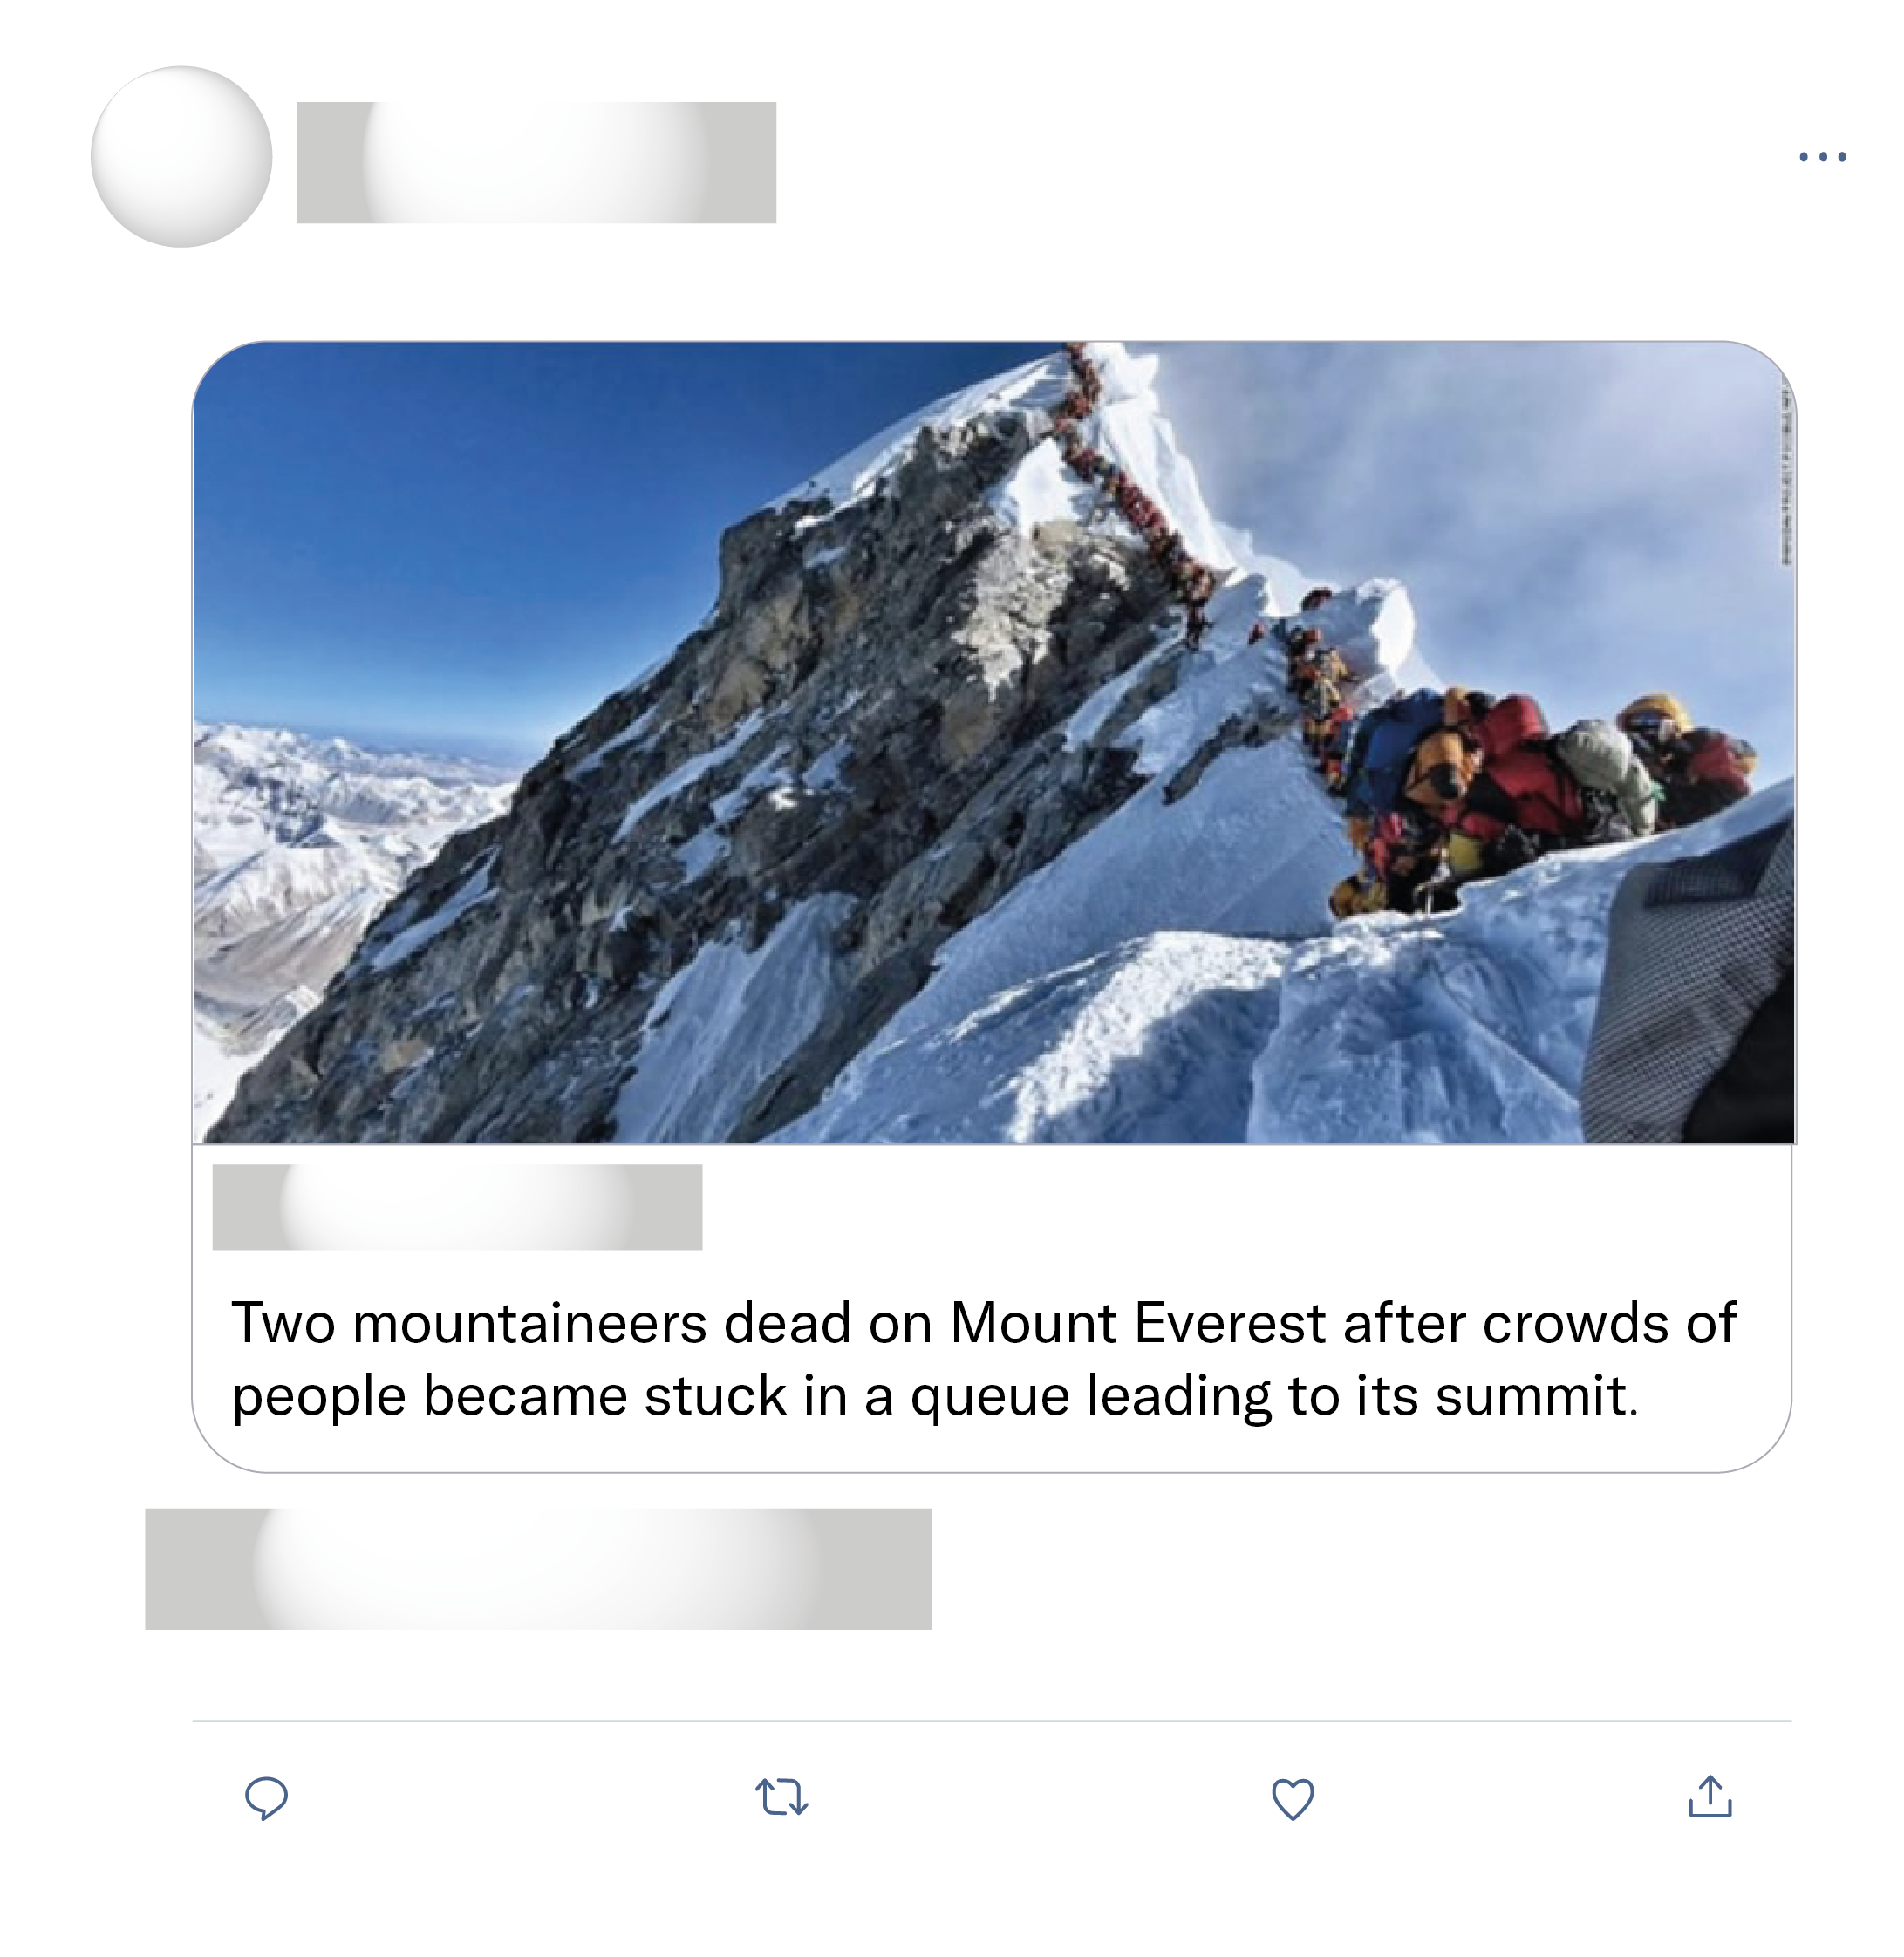

That is so sad. To see the greatest personal human achievement reduced to the level of a theme park leaves me without words.
This is by far the worst mountaineering photo I have ever seen. And the scariest. And the dumbest. And the most disgusting.
Chill out people! This photo is fake :D Good editing skills!
Great, now we have to wait in line to get to the top of
too?

