Slide 1
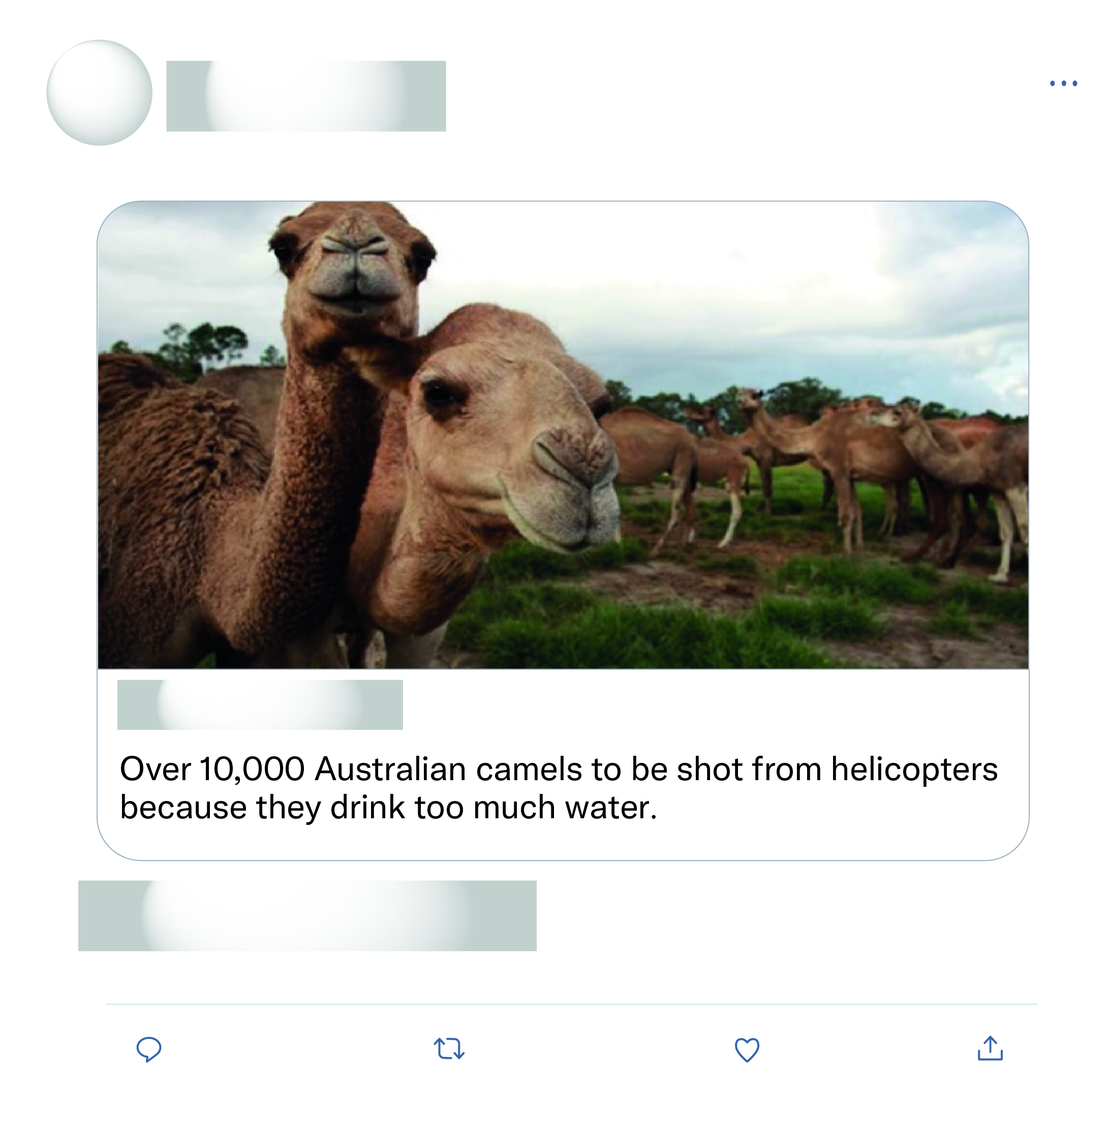







That's all the experts sat down and discussed as the solution wow what a productive move nothing else just killing more animals again after half a billion have died what a move.
This is just absolute nonsense!

Slide 2
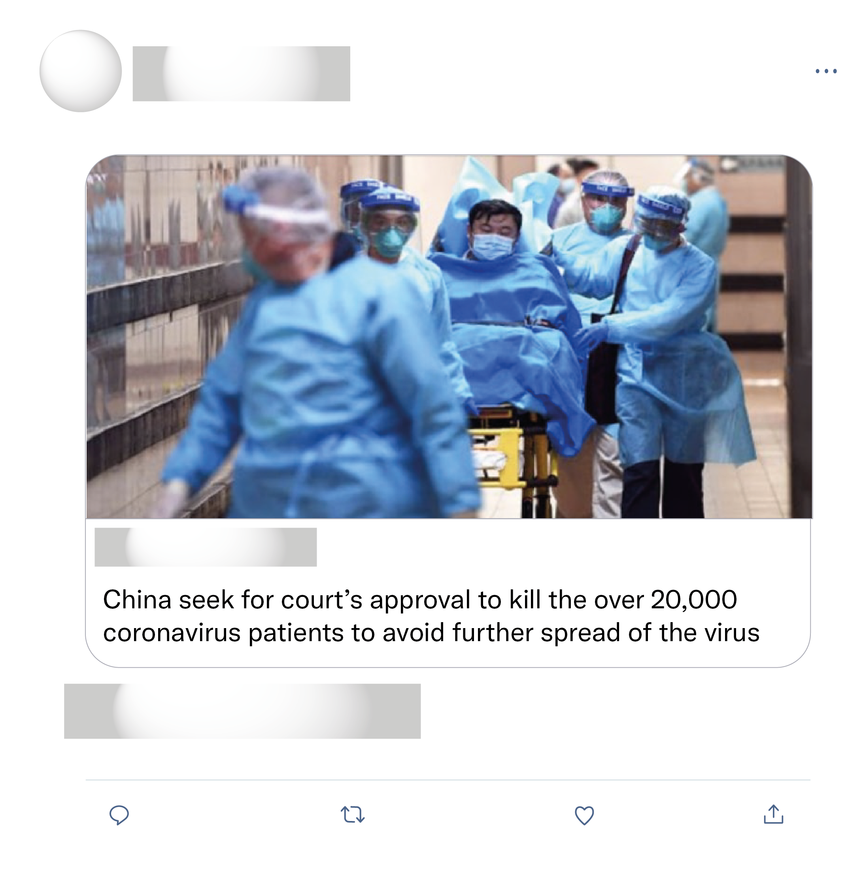
What is very clear is that, as pointed out by health and policy experts and clinicians around the world, China’s leaders are failing their people.
China is again engaging in tactics that prove nothing but ignorant amateurs at work, furthering the breakage of the social bonds that keep a society together under stress.
There is no evidence to support its claim. Misinformation!
Not believeable or the world would be in an outrage and there would be a riot with pitchforks and it'd be all over the news.

