Slide 1
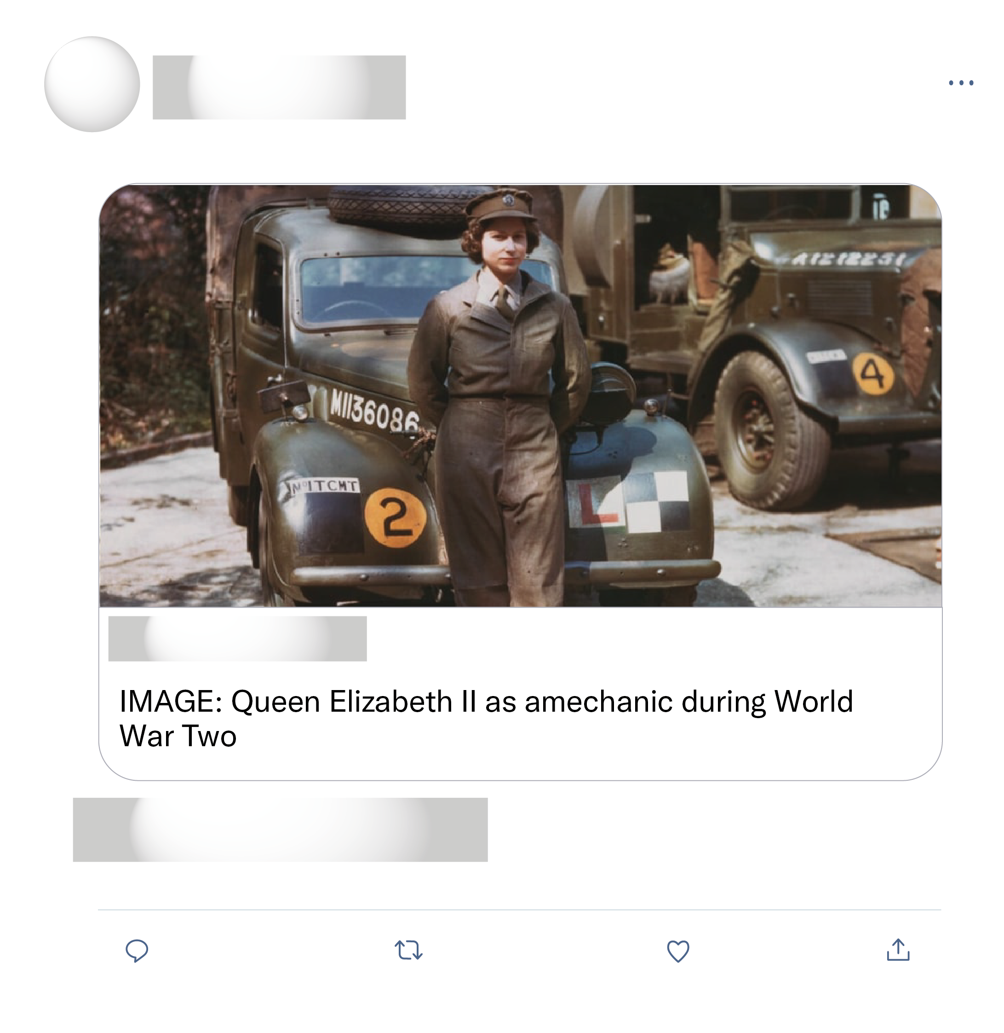








This is really deeply disturbing sad 😢 I can’t believe this is America and how careless ppl are. We need a wake up call and reach out to someone in need.
It’s a fake tweet. Photo was from 2013 in Toronto. No reports of deaths in Chicago.

Slide 2

A little girl went to meet a guy she meet on TikTok and she has not been seen since it is so very sad
I don't know anything about Tik Tok, but when you accept cookies to gain access to, or download an app....you are pretty much giving out ALL your personal information.
Noooooooooooooio I love this app to Seth well I will miss you tic toc you will be missed 😭😭😭😭😭😭😭😭😭

Slide 3
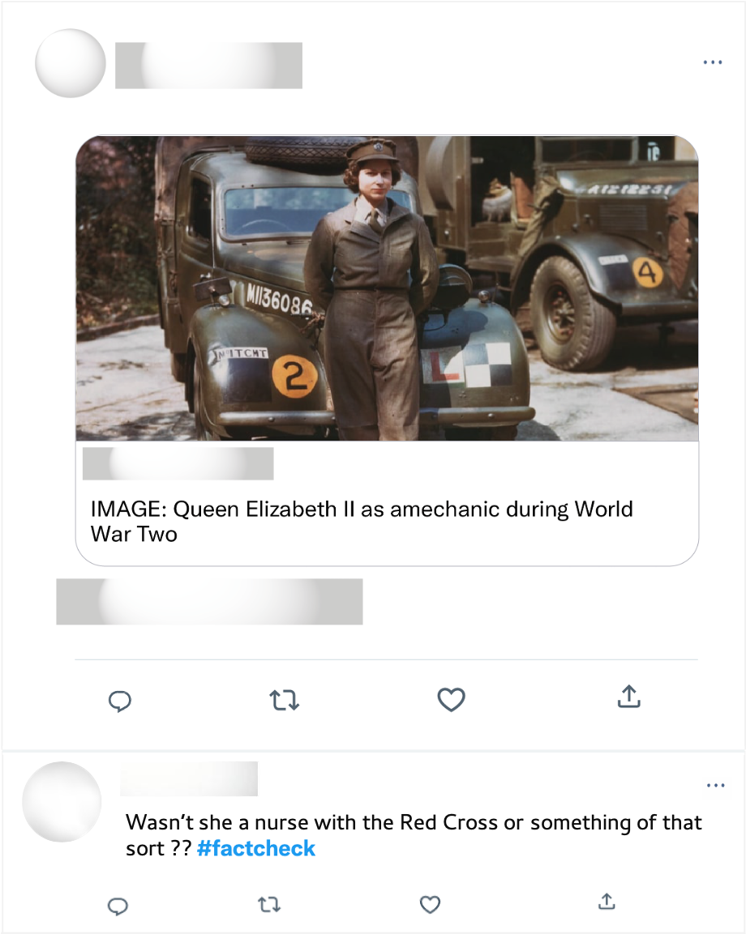
Well ironed uniform & polished shoes. Mechanics during WWII. Long live the queen!

