Slide 1







Fortunately that’s not what the report says. It means Koalas are endangered, not gone yet!
This is not true!

Slide 2
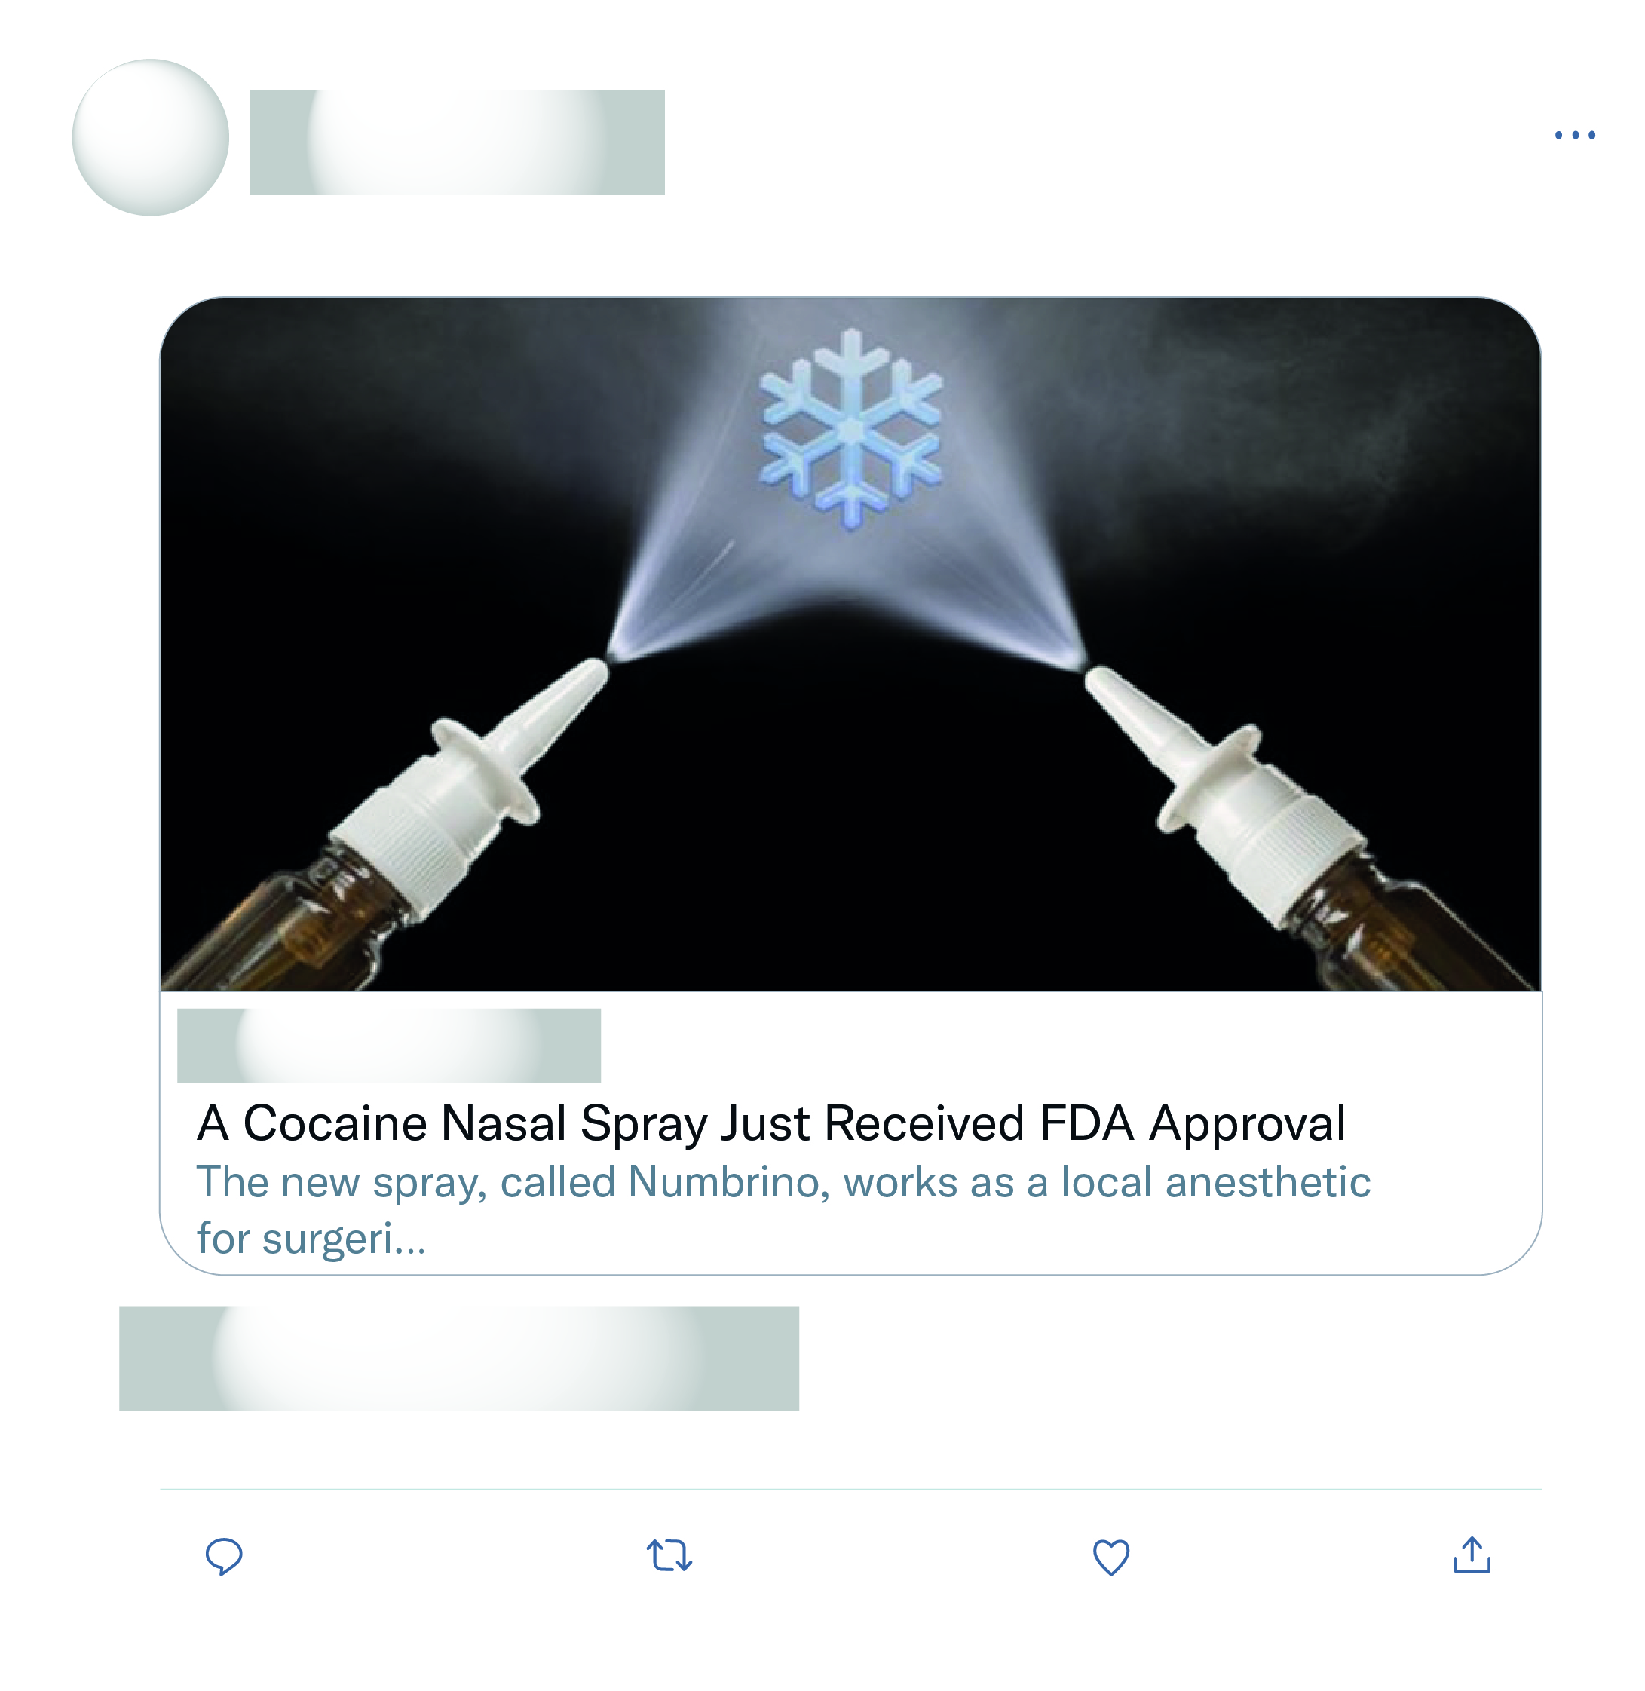
So, there you have it: The US government recognizes cocaine as a legit medicine, but cannabis is still considered as dangerous and useless as heroin.
Not surprising! Generations ago they used cocaine to help with a multitude of things.
Well, yeah, that's what all those "Schedules" were suppose to do. Coke has a medicinal value, it's not its fault that they put some other stuff in the schedule 1

Slide 3
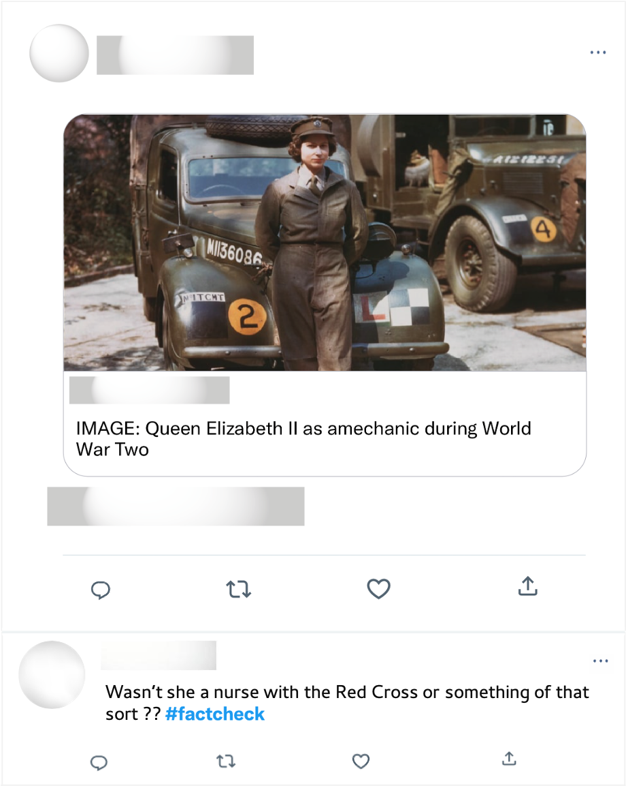
Well ironed uniform & polished shoes. Mechanics during WWII. Long live the queen!

