Slide 1







Fortunately that’s not what the report says. It means Koalas are endangered, not gone yet!
This is not true!

Slide 2
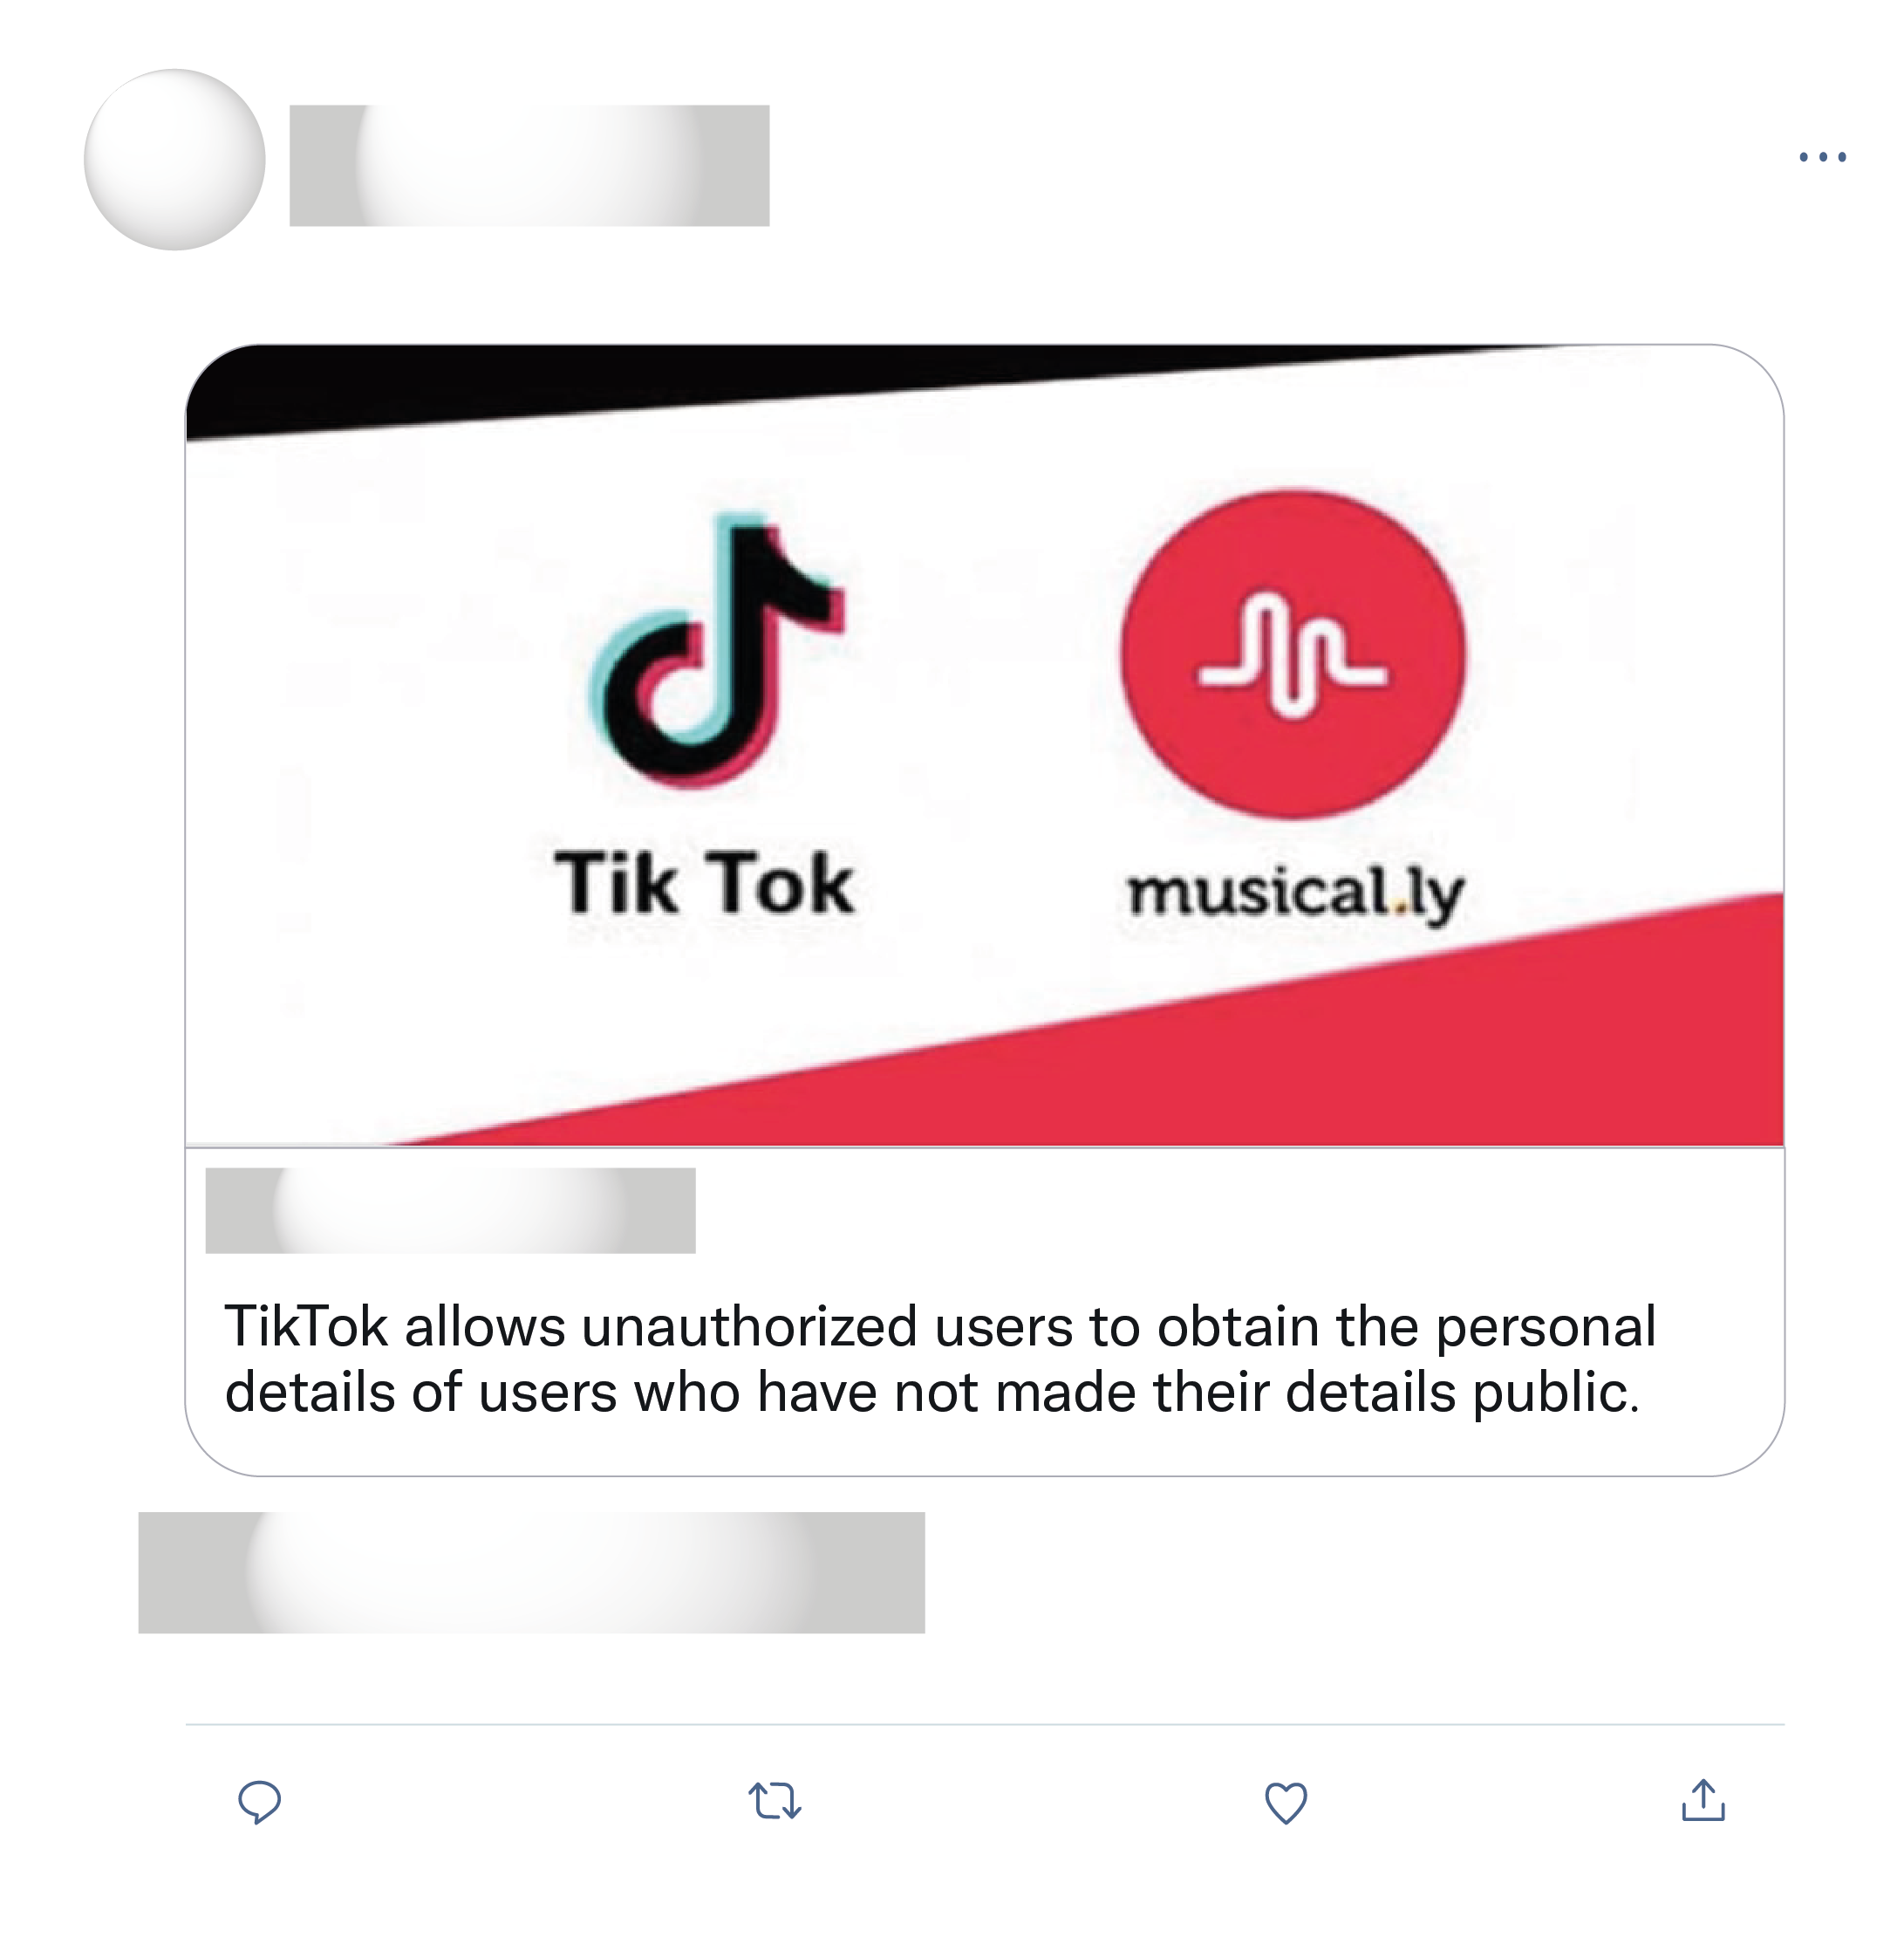
A little girl went to meet a guy she meet on TikTok and she has not been seen since it is so very sad
I don't know anything about Tik Tok, but when you accept cookies to gain access to, or download an app....you are pretty much giving out ALL your personal information.
Do people not research before reposting these things? The is fake news as in not true, a hoax.

Slide 3
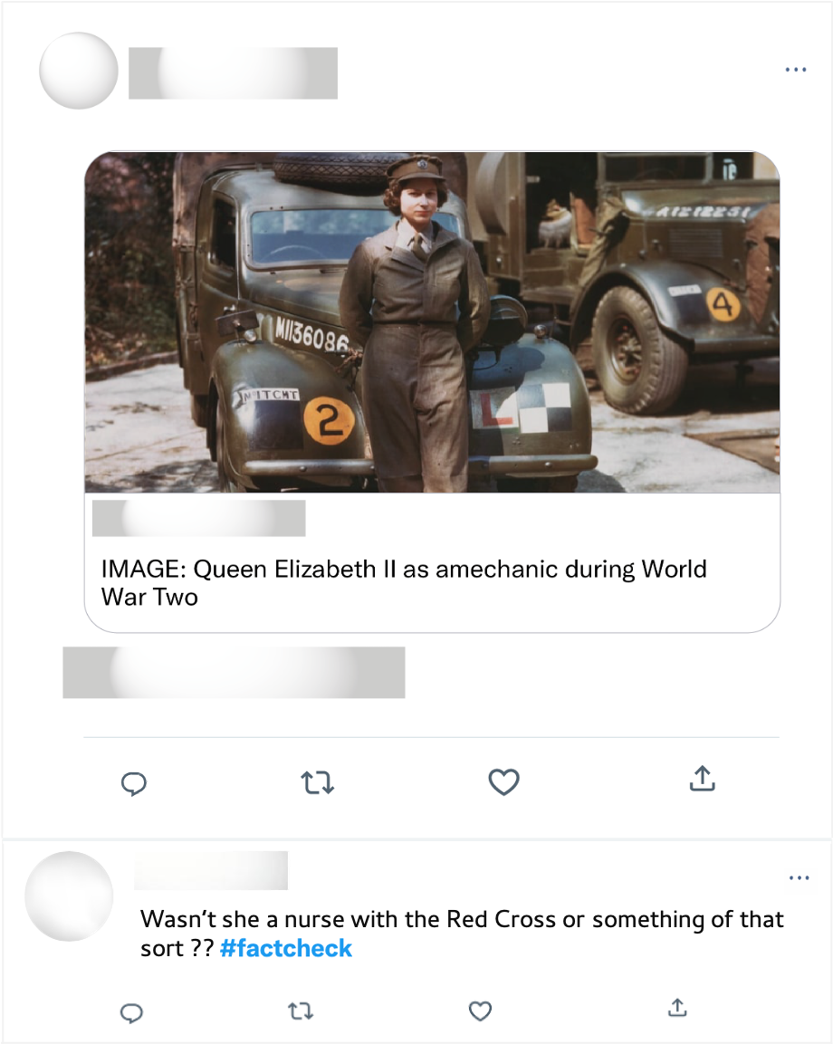
Well ironed uniform & polished shoes. Mechanics during WWII. Long live the queen!

