Slide 1







Fortunately that’s not what the report says. It means Koalas are endangered, not gone yet!
This is not true!

Slide 2
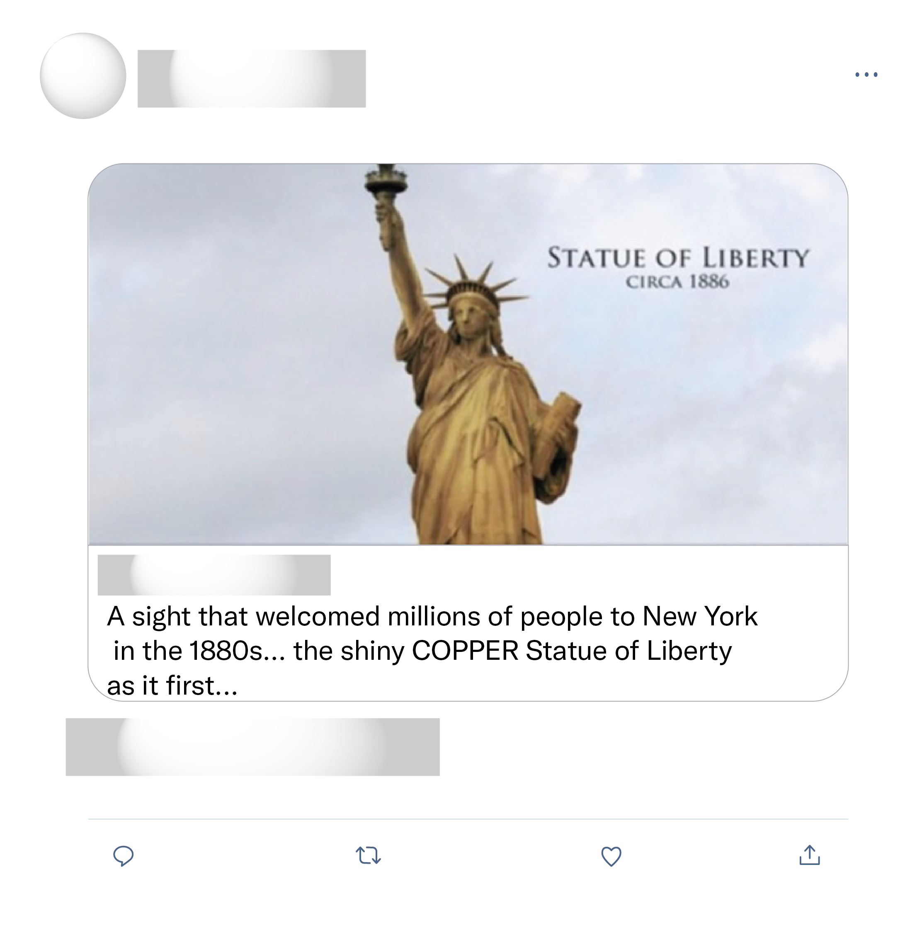
Wow, I'm a New Yorker, born & raised, & have never seen a picture of Lady Liberty in the original copper colour! That must be what she looked like when my great grandparents arrived at Ellis Island.
Oh yeah it was due to picture alteration, in simple terms... photoshopped
I thought that everyone knew this (ever since schooldays ).

Slide 3
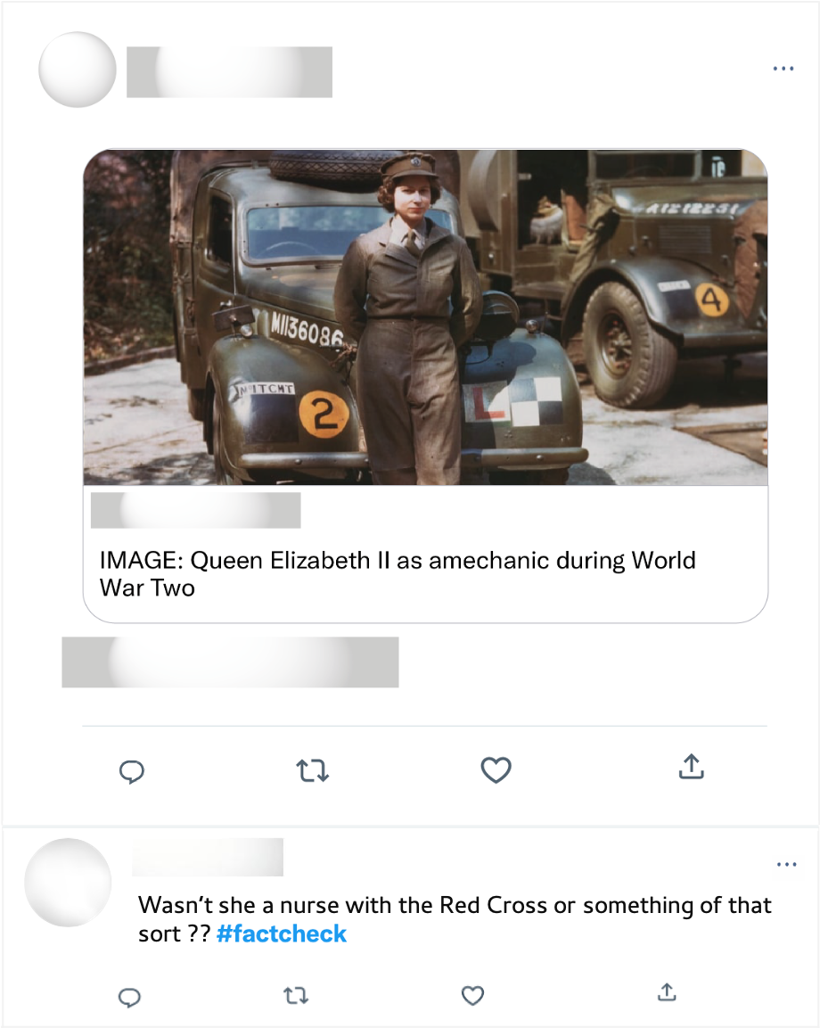
Well ironed uniform & polished shoes. Mechanics during WWII. Long live the queen!

