Slide 1







Fortunately that’s not what the report says. It means Koalas are endangered, not gone yet!
This is not true!

Slide 2
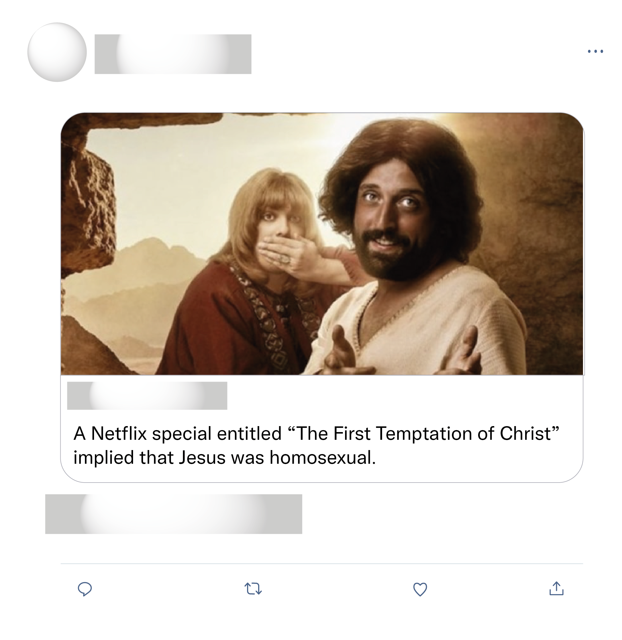
Don't believe everything you read on the internet.
I just canceled my subscription with Netflix after about 15 years with them, due to this trash. It was the last straw. Buh bye, Netflix. See you never.
They wouldn’t dare do this with other faiths!!

Slide 3

Well ironed uniform & polished shoes. Mechanics during WWII. Long live the queen!

