Slide 1
Project Enigma

Slide 2

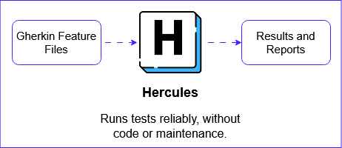
Using AI as your Automation Agent
Multi agent testing framework
Natural English language instructions
End-to-End testing

Slide 3
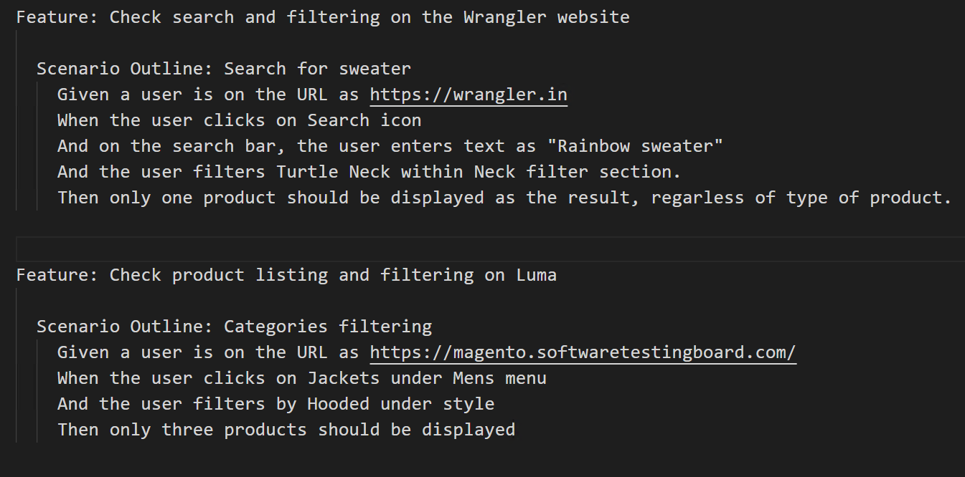
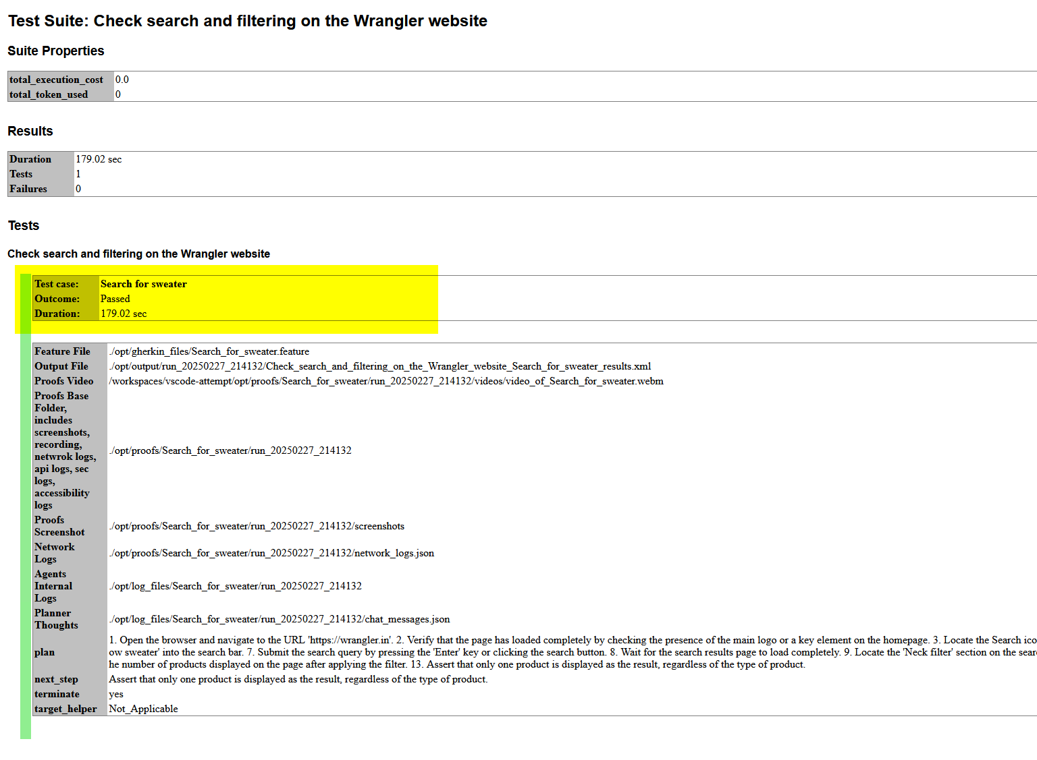
Hercules – Use cases

Slide 4
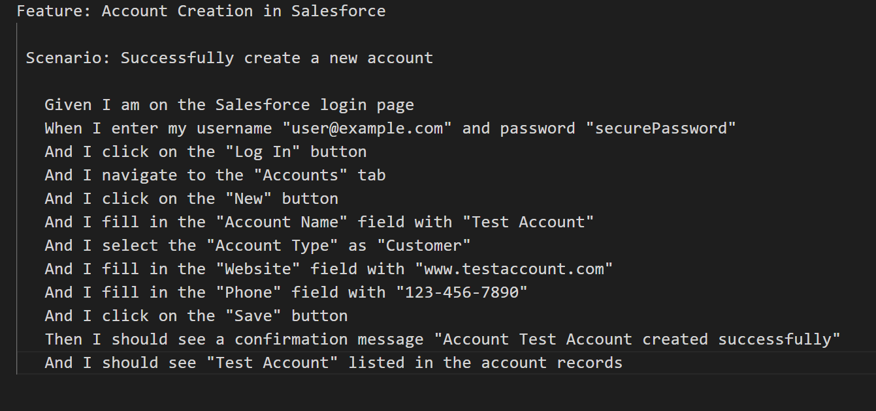
Hercules – Use cases

Slide 5
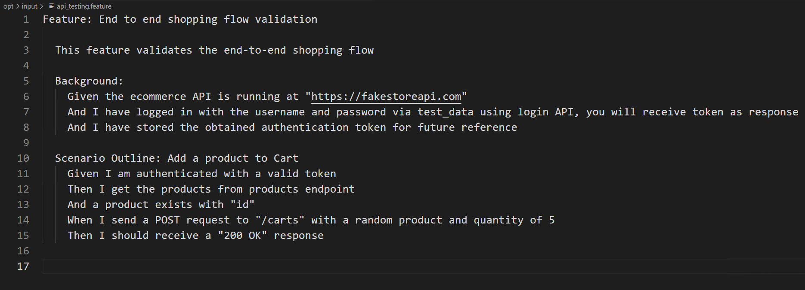
Hercules – API Testing

Slide 6
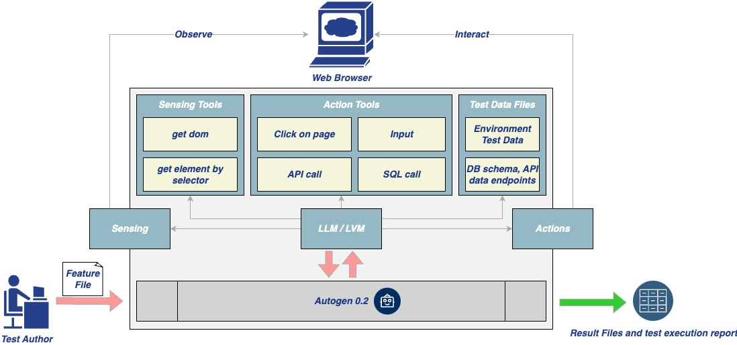

Hercules – Architecture

Slide 7
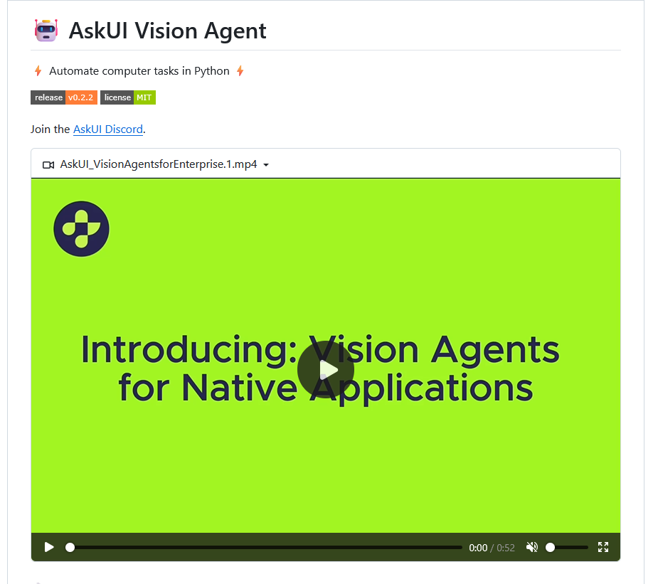
Vision Agent
Vision based automation
Great for legacy application automation
Facilitate Appium / Winapp Driver

