Slide 1
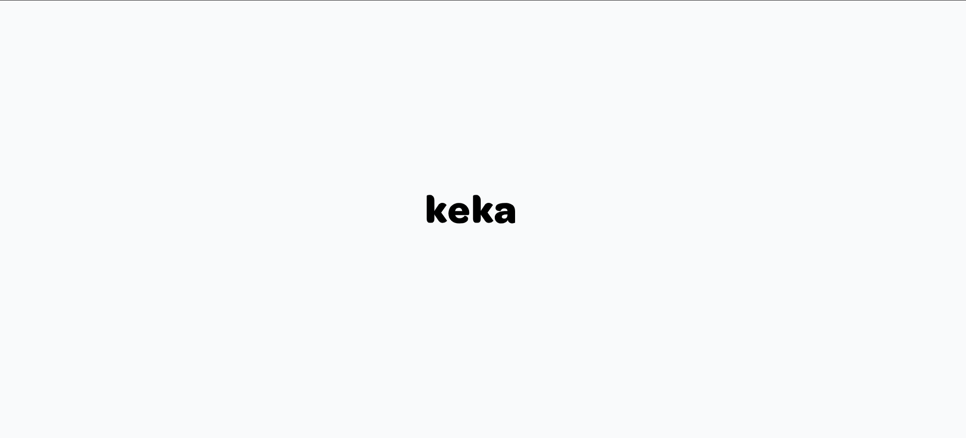
Keka Employee Experience Platform

Slide 2
Purpose and Scope
This Standard Operating Procedure (SOP) provides comprehensive guidelines for employees to effectively utilize the Keka Employee Experience Platform for managing various workplace functions including attendance, leave management, expense reimbursement, payroll access, and team collaboration.
System Overview
Keka is a comprehensive employee experience platform that enables users to access finances, apply for leaves, reimburse expenses, praise teammates, and perform various other HR-related functions through a mobile application interface.

Slide 3
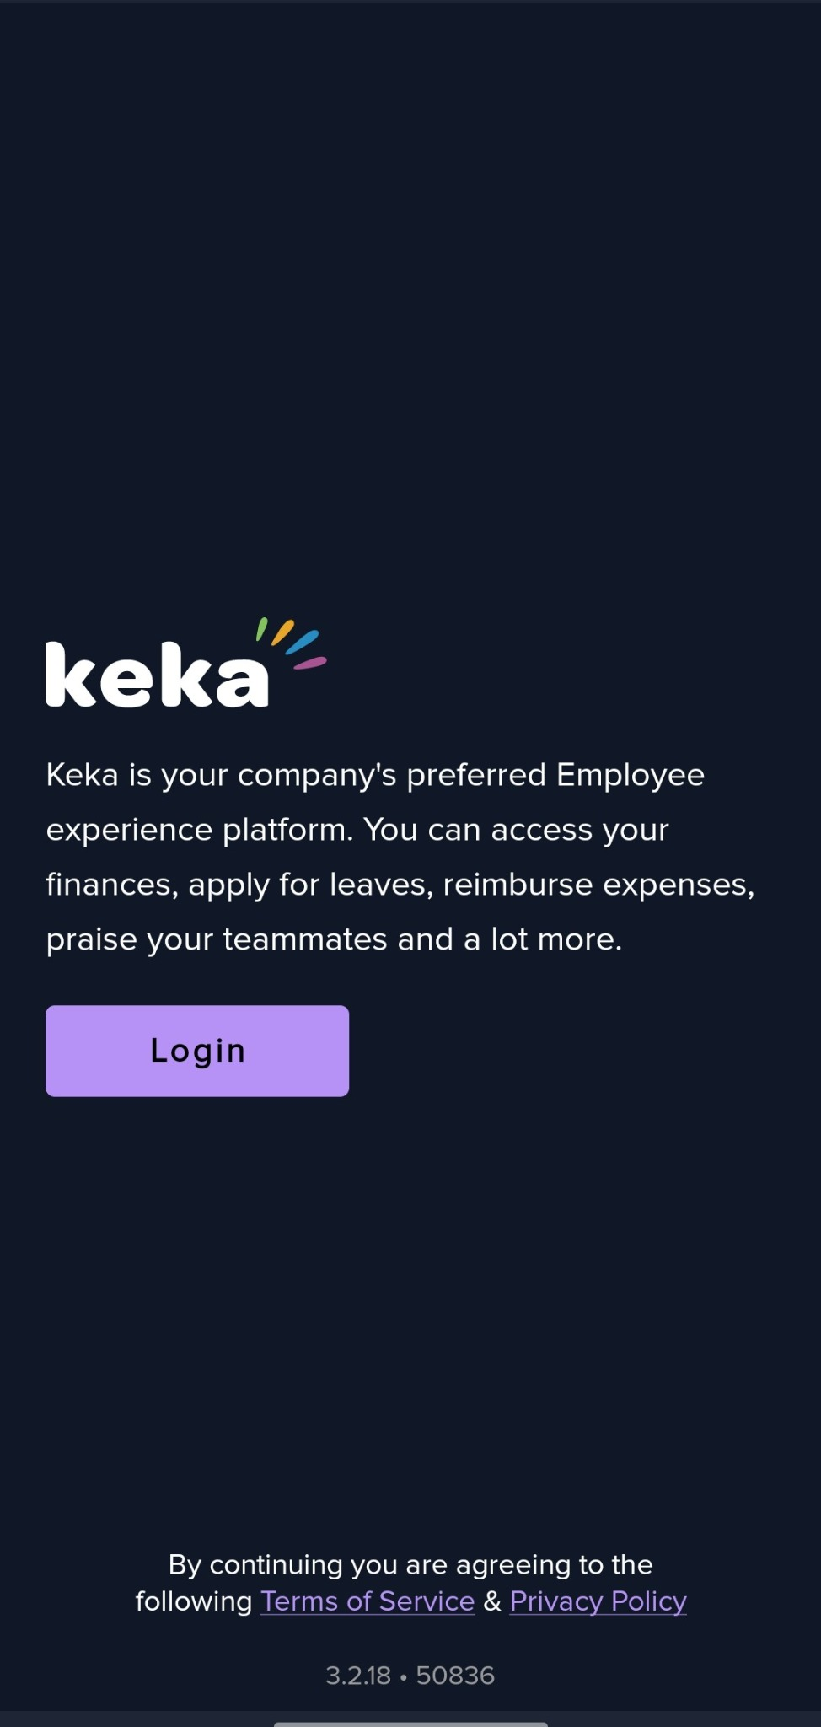
Launch the Keka App
Access the Keka platform through the designated mobile application
Ensure you have the correct company URL.

Slide 4
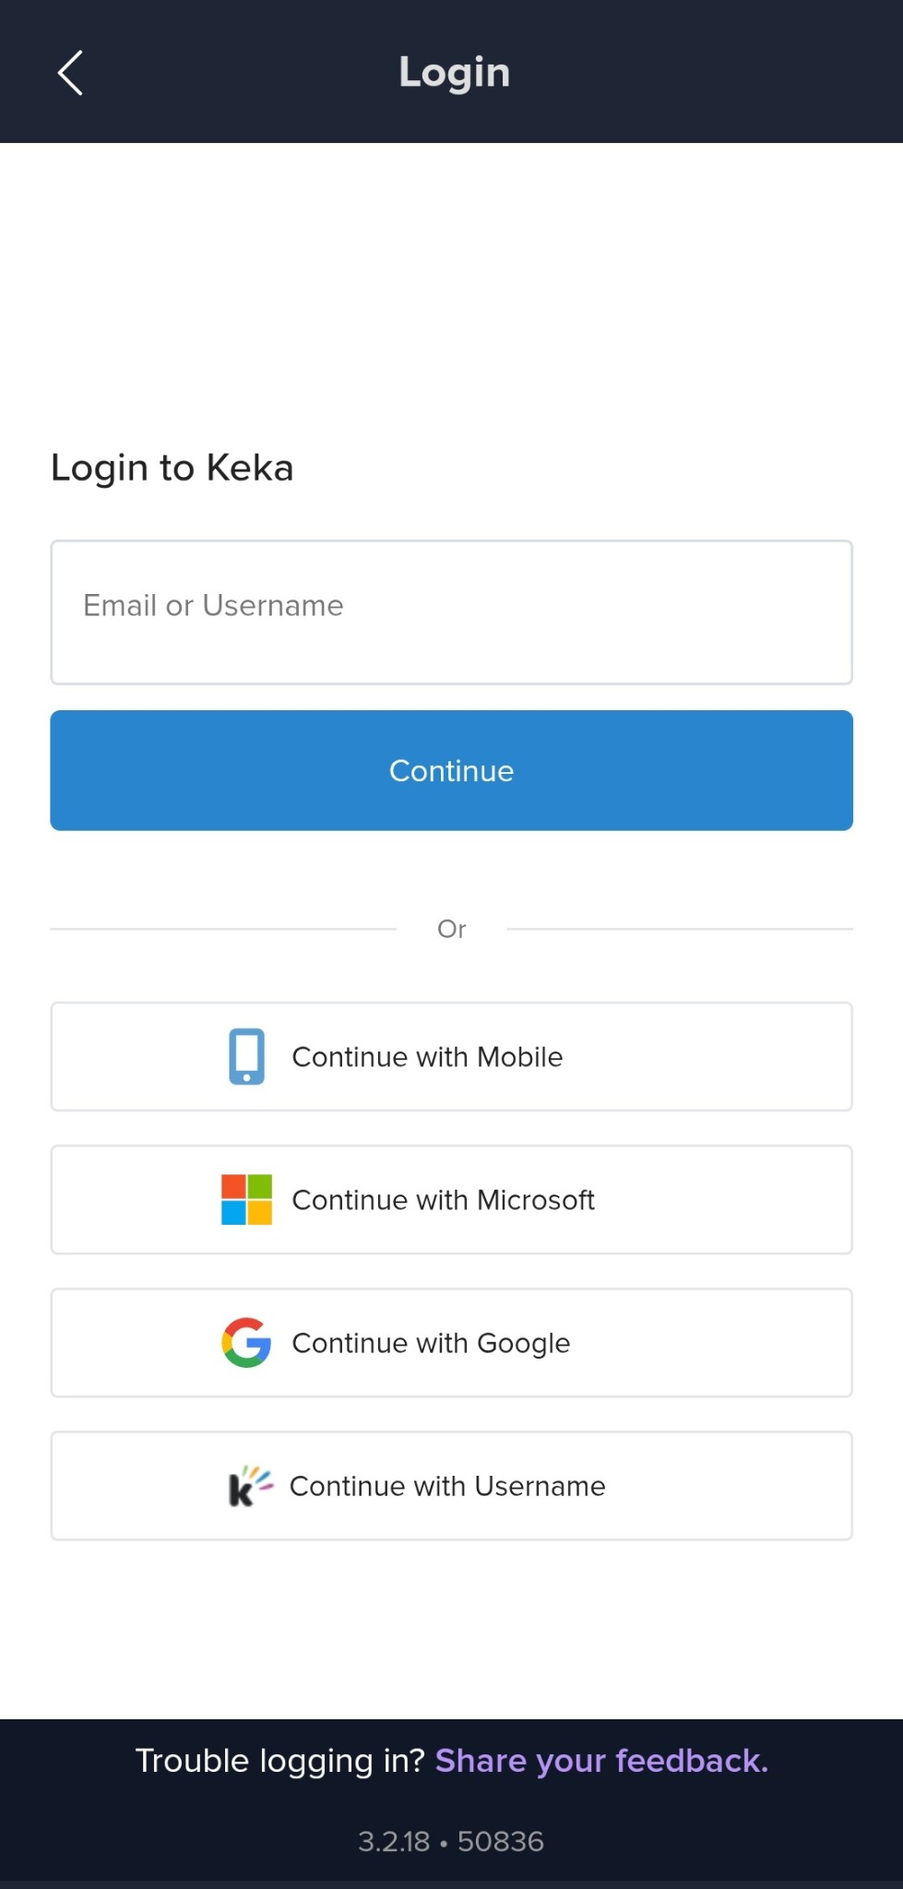
Initiate Login
Login Authentication The system provides multiple authentication methods:
Email/Username Login
Mobile Number Authentication
Third-Party Authentication
  Microsoft accounts ("Continue with Microsoft")
  Google accounts ("Continue with Google")
  Username-based login ("Continue with Username")

Slide 5
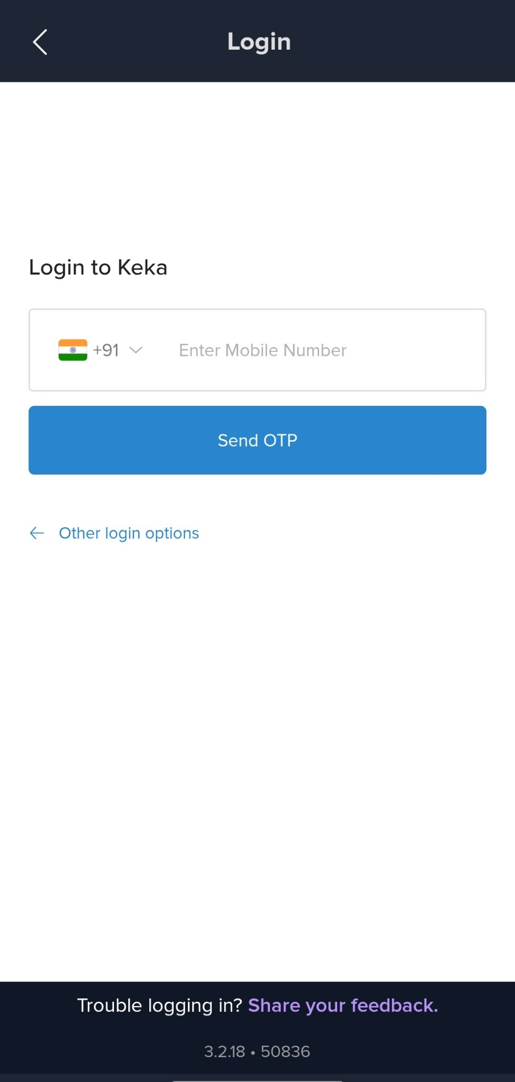
Log in with Mobile Number
Select **Continue with Mobile**
  Enter your registered mobile number, then tap **Send OTP**.
  Enter the One‑Time Password (OTP) received via SMS to authenticate.

Slide 6
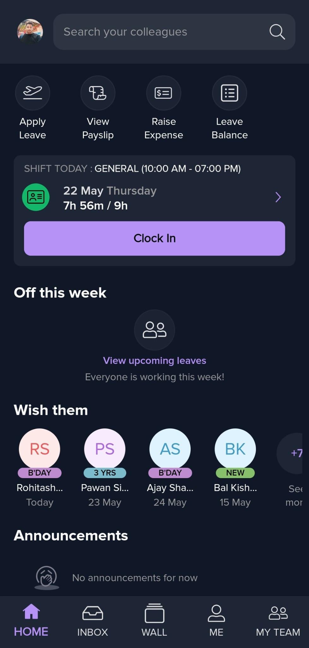
Home Dashboard
Upon successful authentication,
Dashboard Components
Personal profile information and search functionality
Quick access buttons for primary functions
Current shift information and clock-in capabilities
Team updates and announcements section.
Primary Function Buttons
Apply Leave - Aircraft icon for leave application processes
View Pay slip - Document icon for accessing salary information
Raise Expense - Card icon for expense reimbursement submissions
Leave Balance - List icon for viewing available leave credits

Slide 7
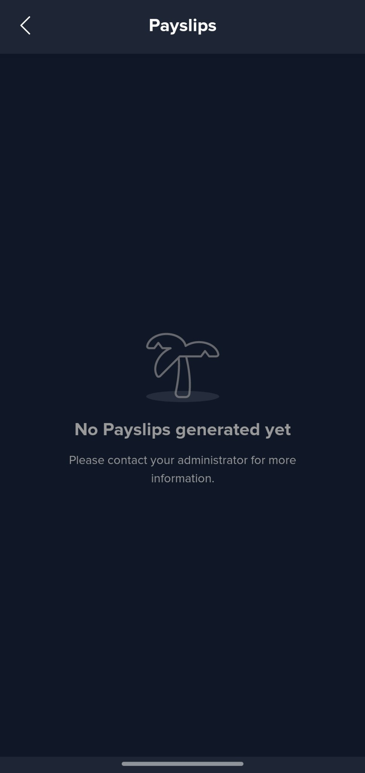
View Pay Slip
Pay slip Retrieval:
Navigate to "View Pay slip" from the main dashboard
If no pay slips are available, the system displays "No Pay slips generated yet“
Contact your administrator if pay slips should be available but are not displayed

Slide 8
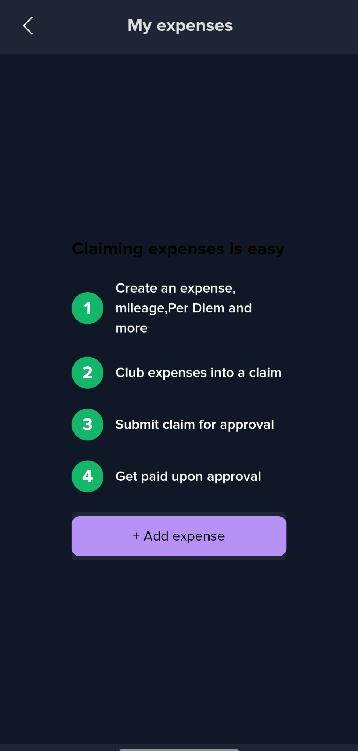
Submit an Expense
Create Expense - Create individual expenses, mileage claims, per diem allowances, and other eligible expenses
Club Expenses - Group related expenses into a single claim for processing efficiency
Submit for Approval
Submit the compiled claim to designated approvers for review
Get Paid: Receive payment upon approval of the expense claim
Adding New Expenses
  Use the "+ Add expense" button to create new entries
  Ensure all required documentation is properly attached
  Follow company policies for expense categories and limits
  Maintain accurate records for audit purposes

Slide 9
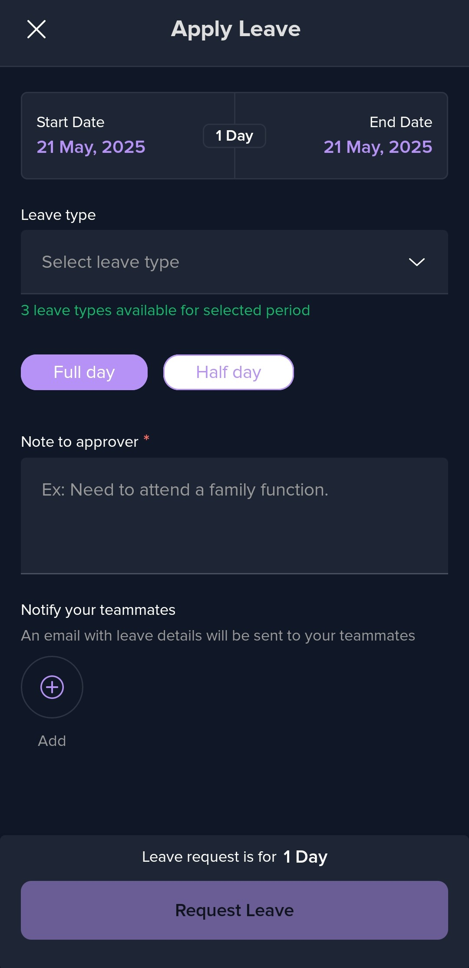
Apply Leave
Leave Application Process
  Navigate to the "Apply Leave" section from the main dashboard
  Select the appropriate leave type from available categories
  Specify the required dates and duration
  Submit the application for managerial approval
  Monitor application status through the system

Slide 10
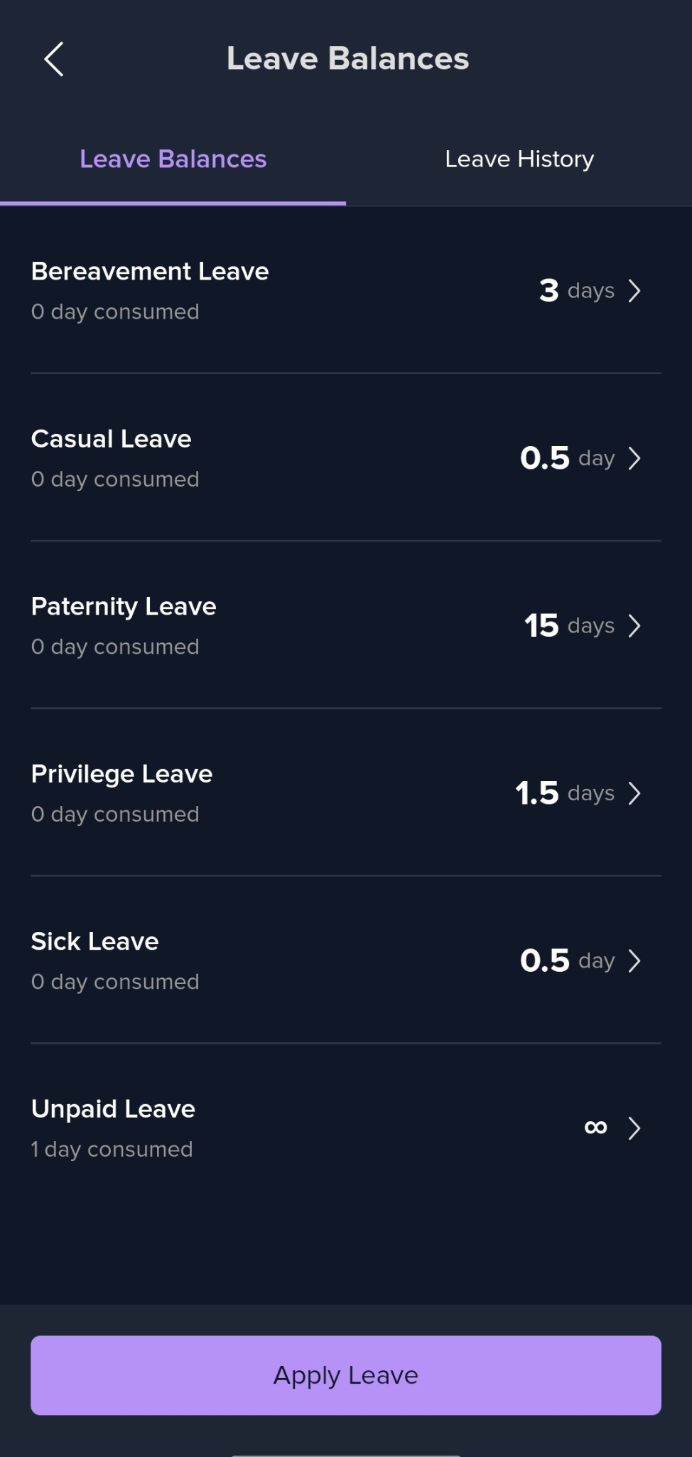
Viewing Leave Balances
Access the Leave Balance section to review:
  Bereavement Leave: 3 days available, 0 days consumed
  Casual Leave: 0.5 days available, 0 days consumed
  Paternity Leave: 15 days available, 0 days consumed
  Privilege Leave: 1.5 days available, 0 days consumed
  Sick Leave: 0.5 days available, 0 days consumed
  Unpaid Leave: Unlimited (∞), 1 day consumed

Slide 11
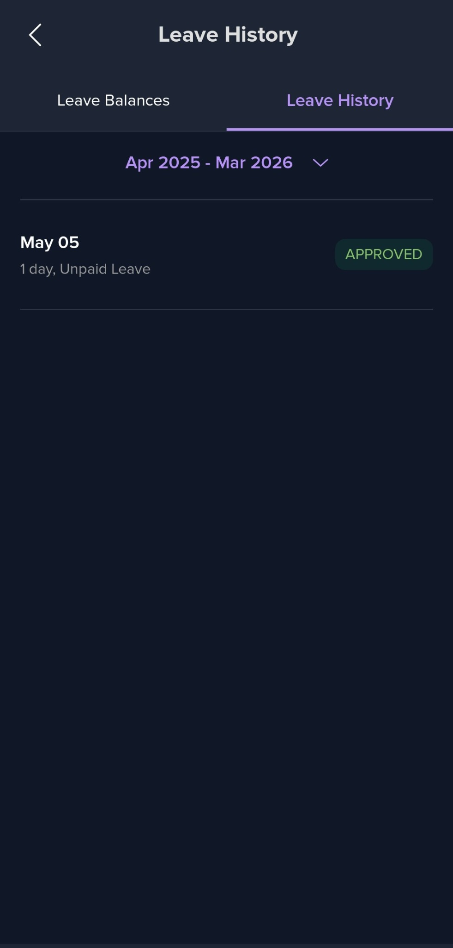
Review Leave History
Access "Leave History" tab to view past applications
Review applications by date range (e.g., "Apr 2025 - Mar 2026")
Check approval status (e.g., "APPROVED" for May 05 Unpaid Leave)

Slide 12
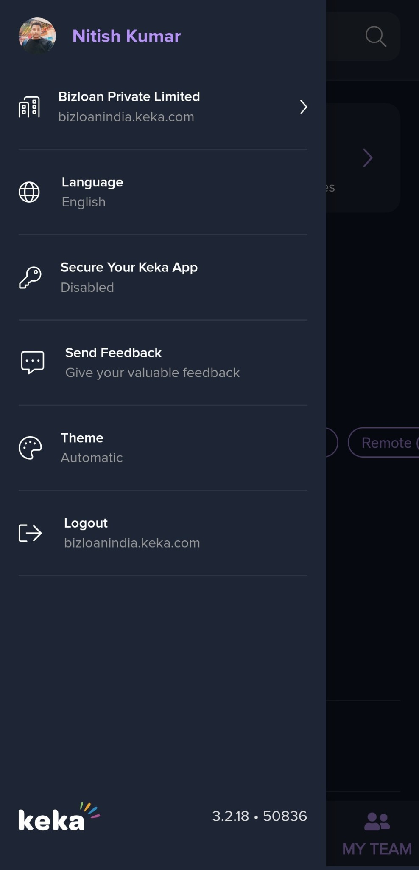
Access Profile & Logout
Configuration Options
  Company Information: Bizloan Private Limited
  Language Settings: English (default)
  Theme Preferences: Automatic mode
  URL Access: bizloanindia.keka.com

