Slide 2
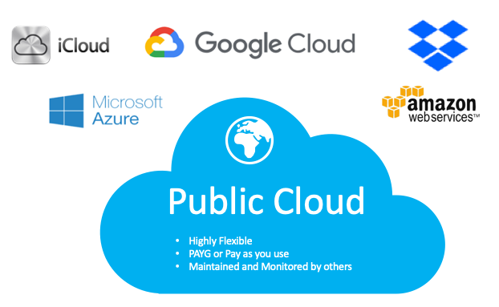
Public Cloud
The cloud infrastructure is provisioned for open use by general public. It may be owned / managed / operated by a business, academic or organization or combination of them. It exists on the premises of cloud provider.

Slide 3
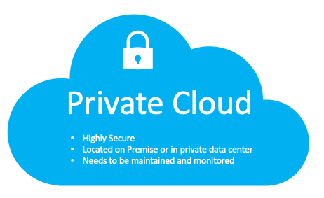
Private Cloud
The cloud infrastructure is provisioned for exclusive use by a single organization comprising multiple consumers (e,g., business units).
It may be owned / managed / operated by the organization or a third party or combination of them.
It may exist on / off the premises.
Works the same way as public cloud, but the services are provided to internal business units instead of to external public enterprises

Slide 4
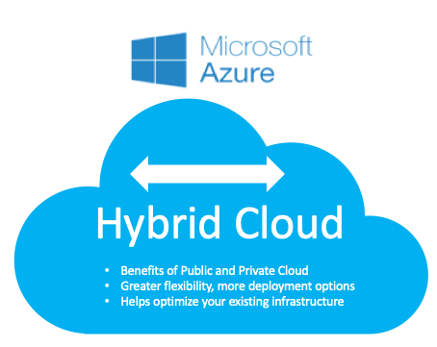
Hybrid Cloud
A Hybrid cloud computing model includes a mix of premises, private cloud and third-party public cloud services with orchestration between the two platforms, giving the client the best of the two solutions
By allowing data and applications to move between private and public clouds, a hybrid cloud gives your business greater flexibility, more deployment options, and helps optimize your existing infrastructure, security, and compliance.

Slide 5
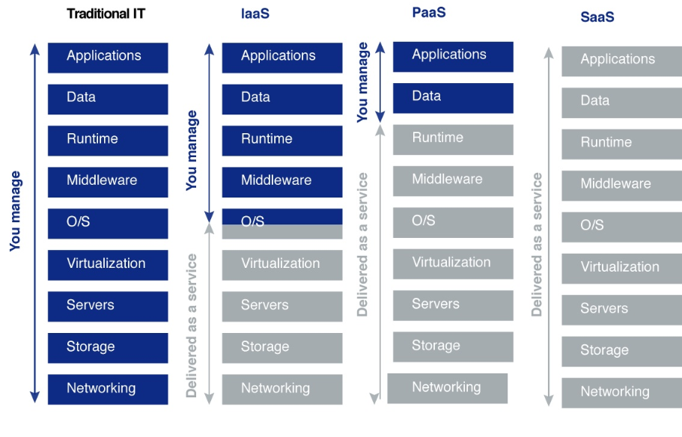

Slide 6
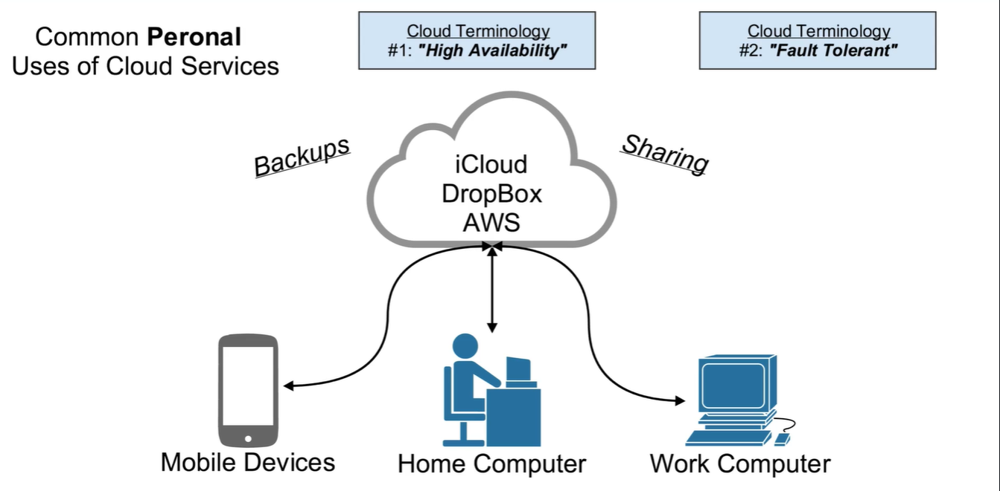

Slide 7
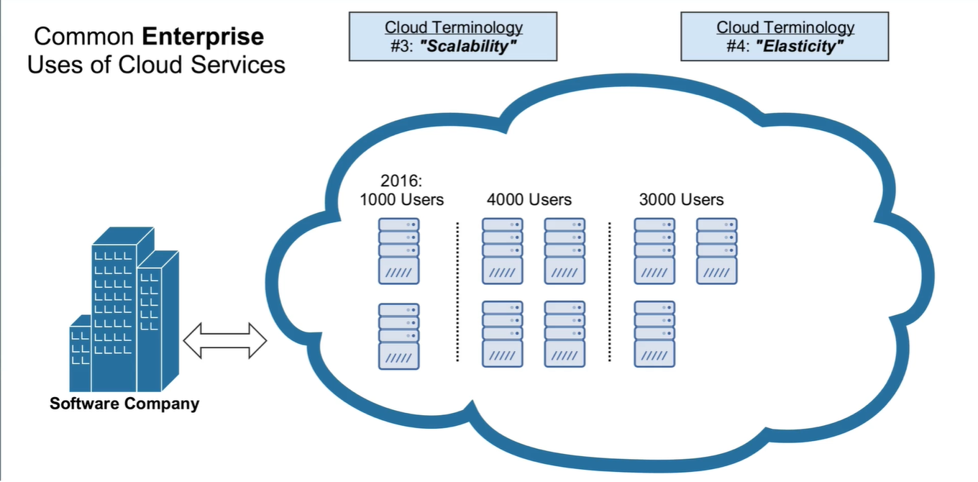

Slide 8
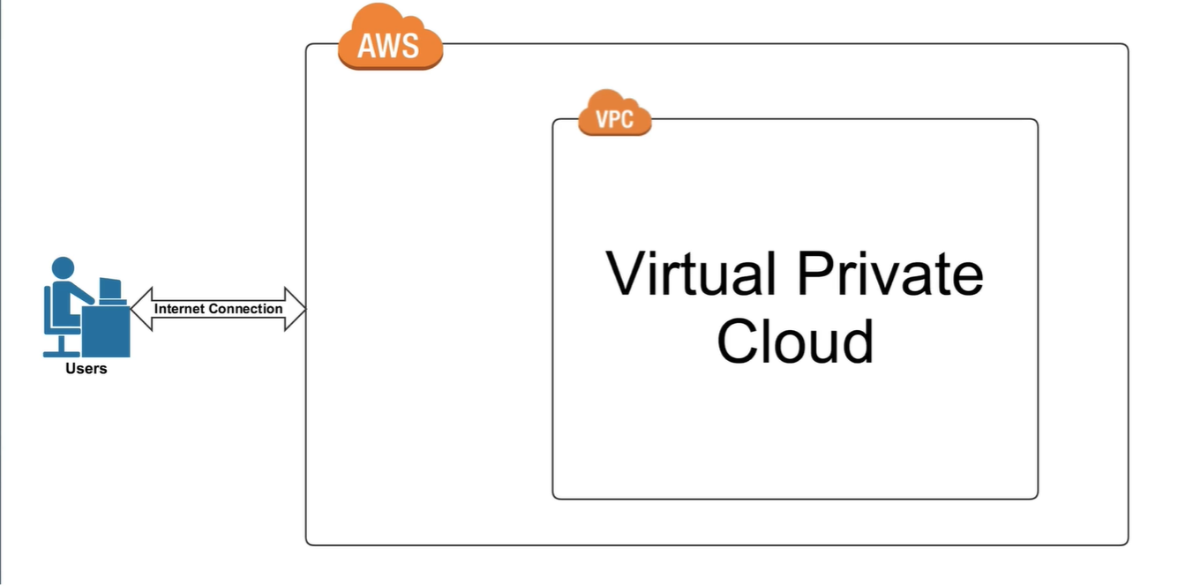

Slide 9
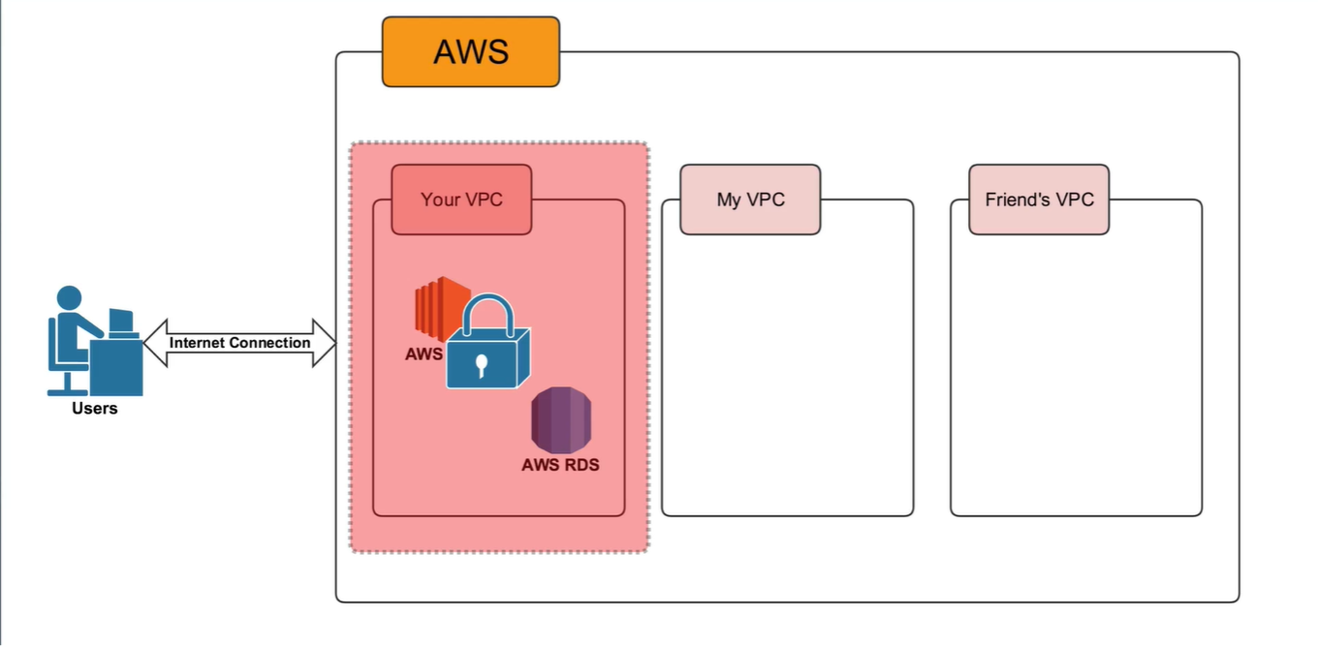

Slide 10
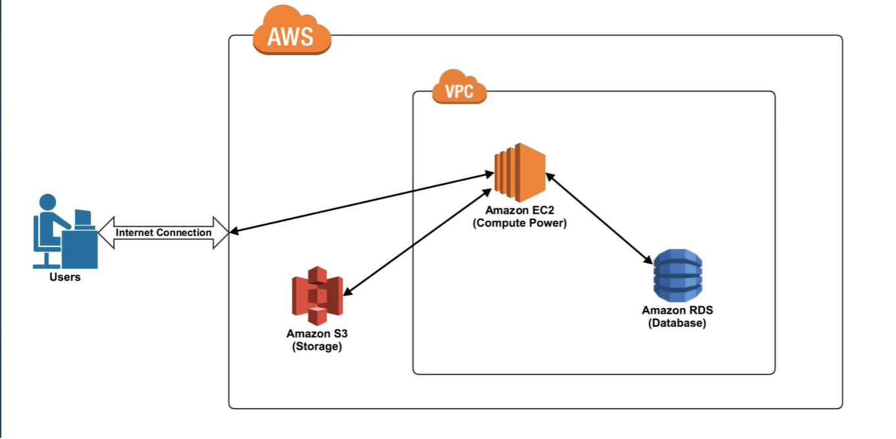

Slide 11
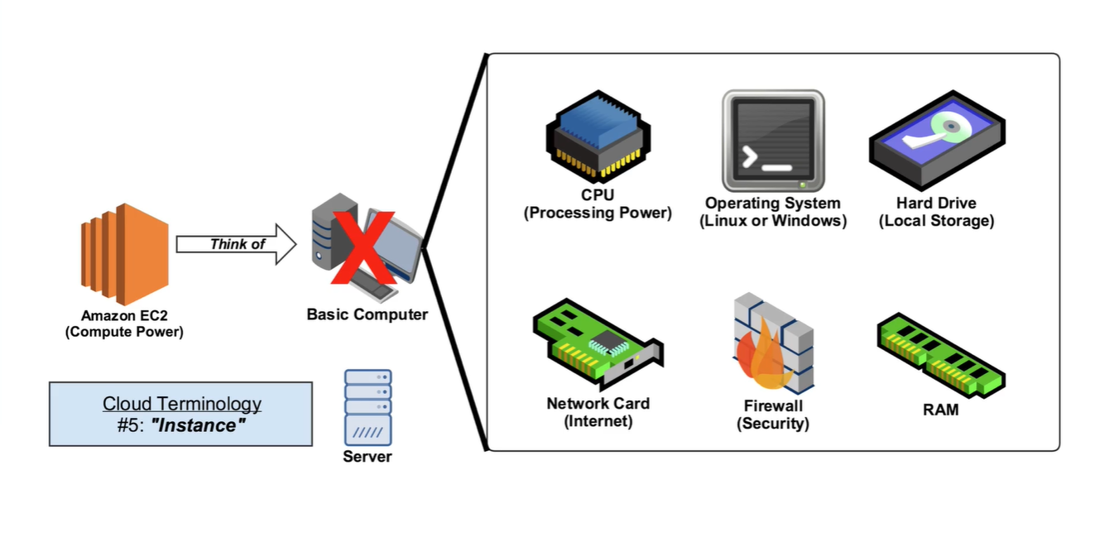

Slide 12
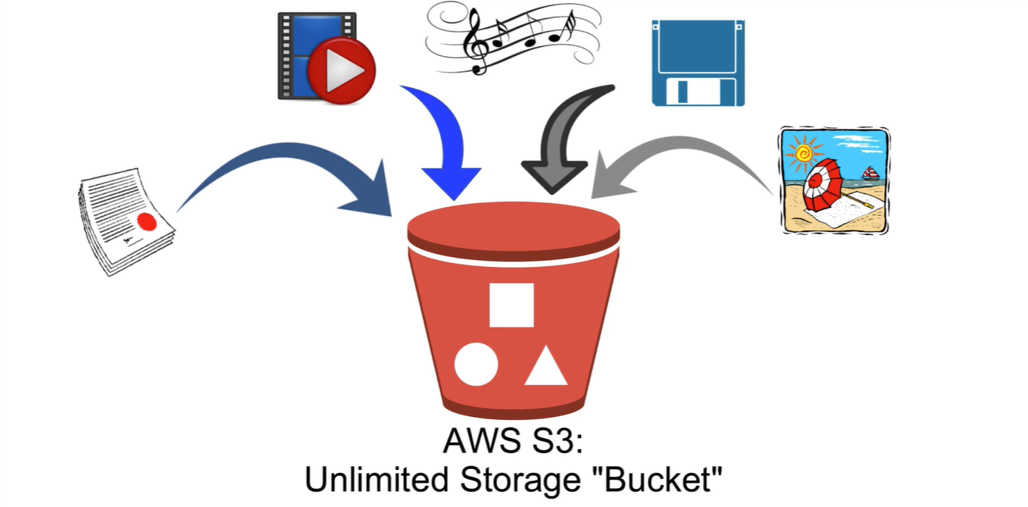

Slide 13
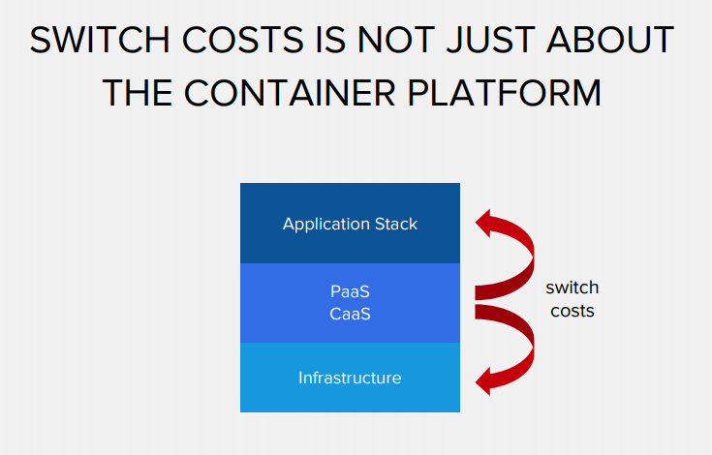
Containers

Slide 14
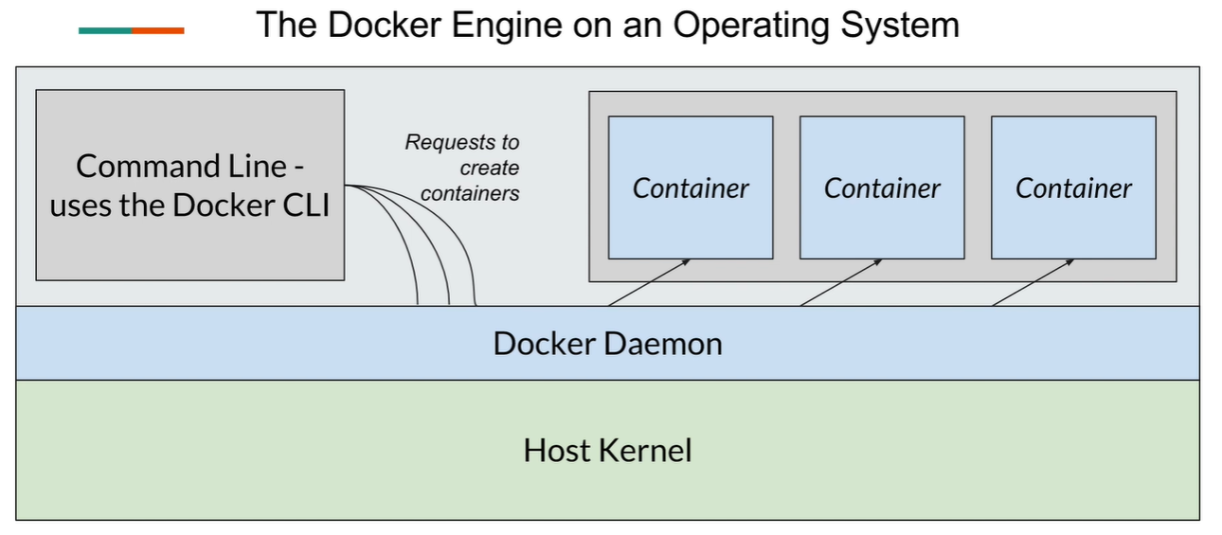
Docker Container & Docker Engine

Slide 15
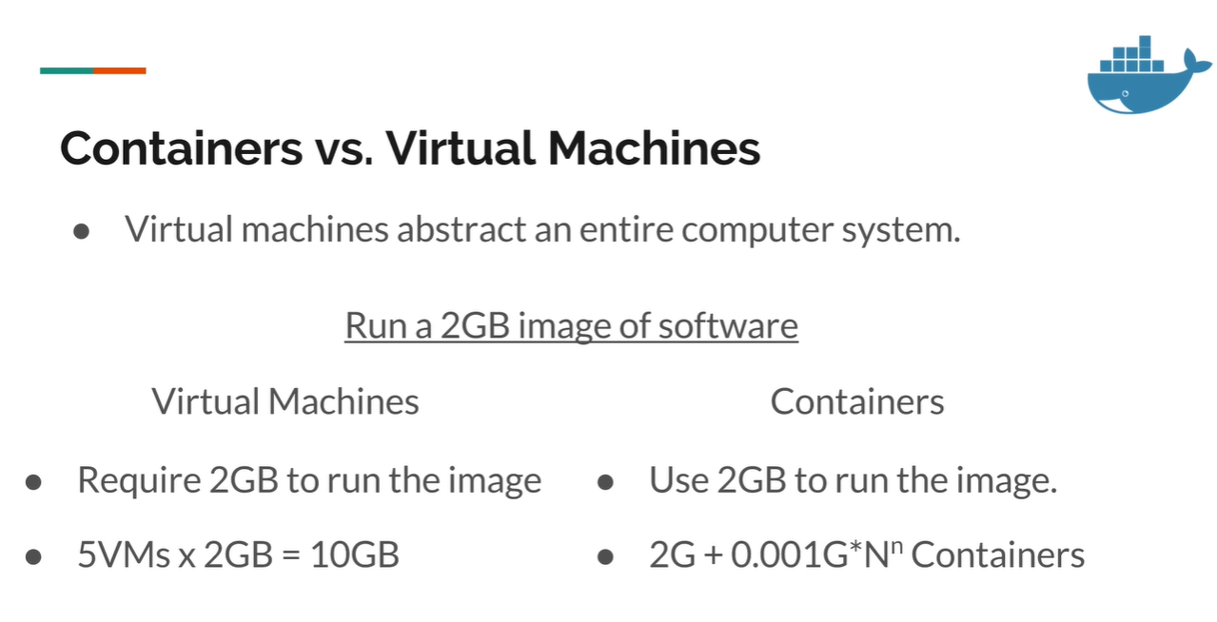

Slide 16
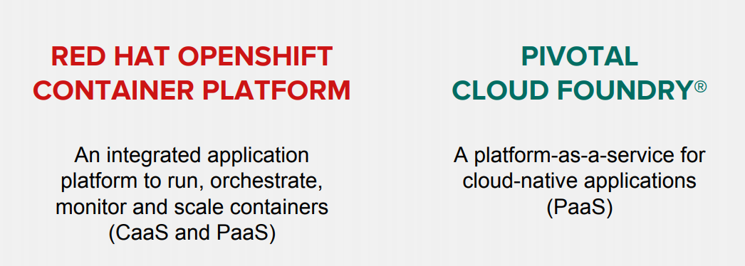

Slide 17
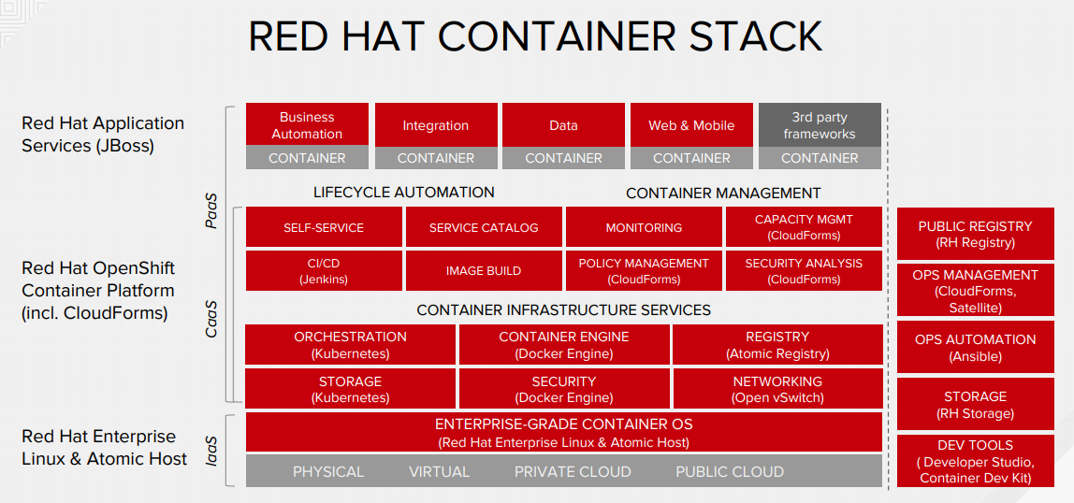

Slide 18
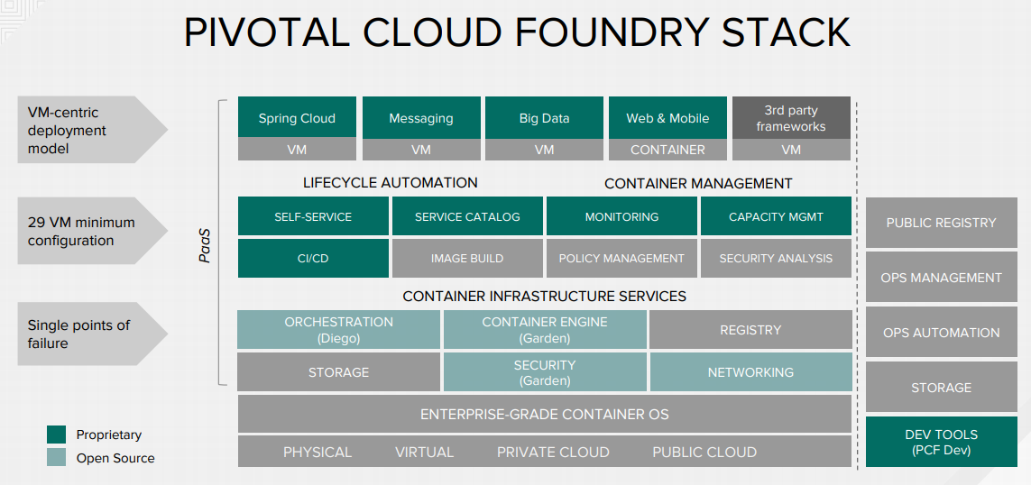

Slide 19
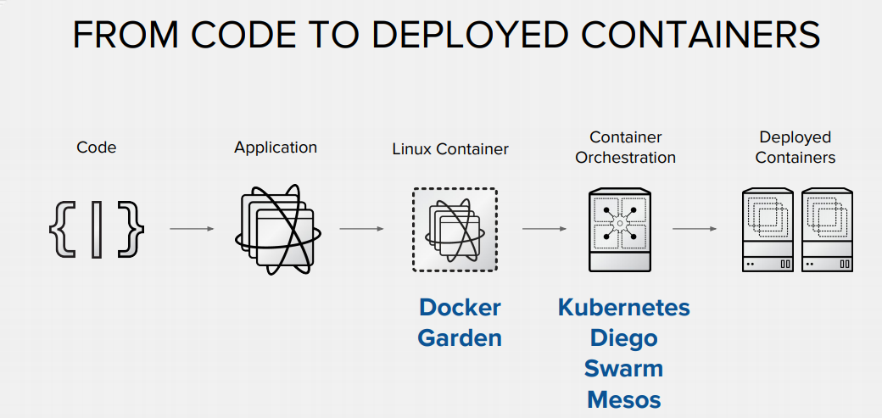

Slide 20
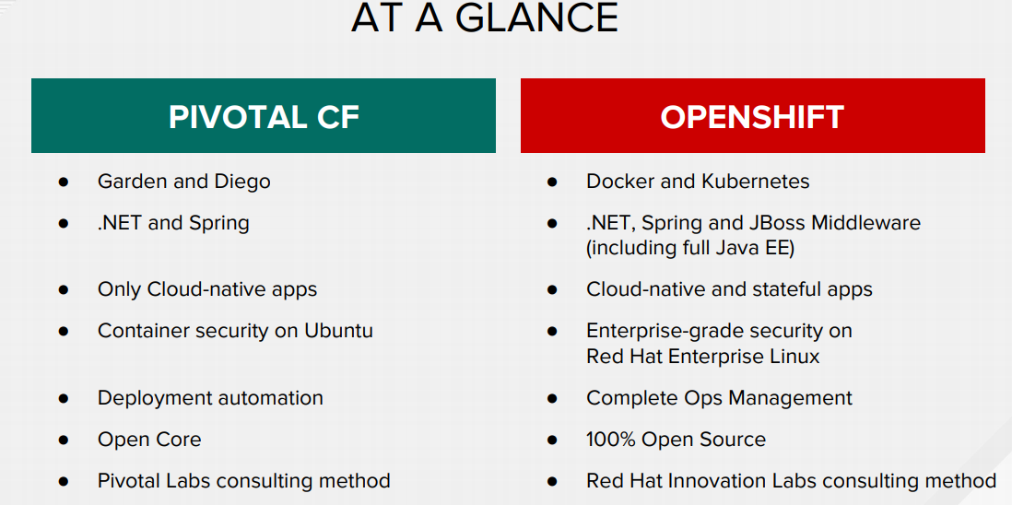

Slide 21
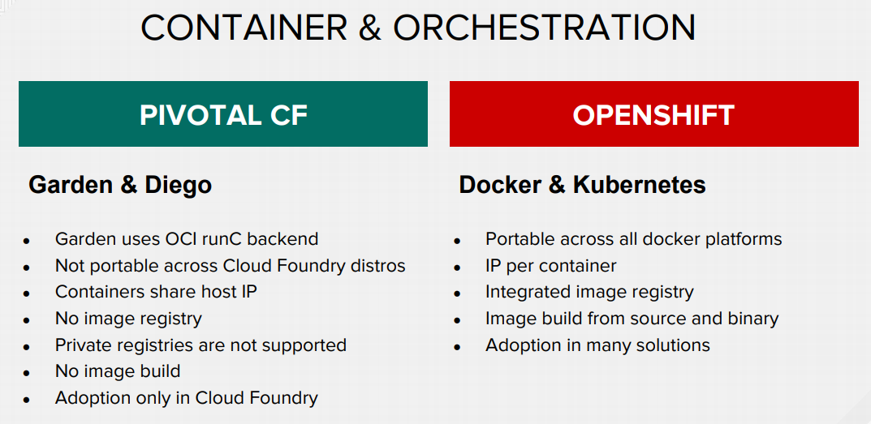

Slide 22
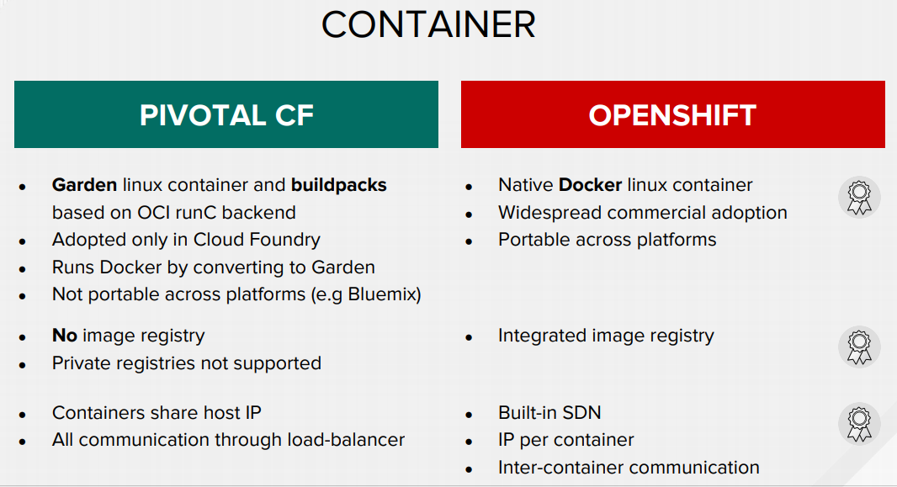

Slide 23
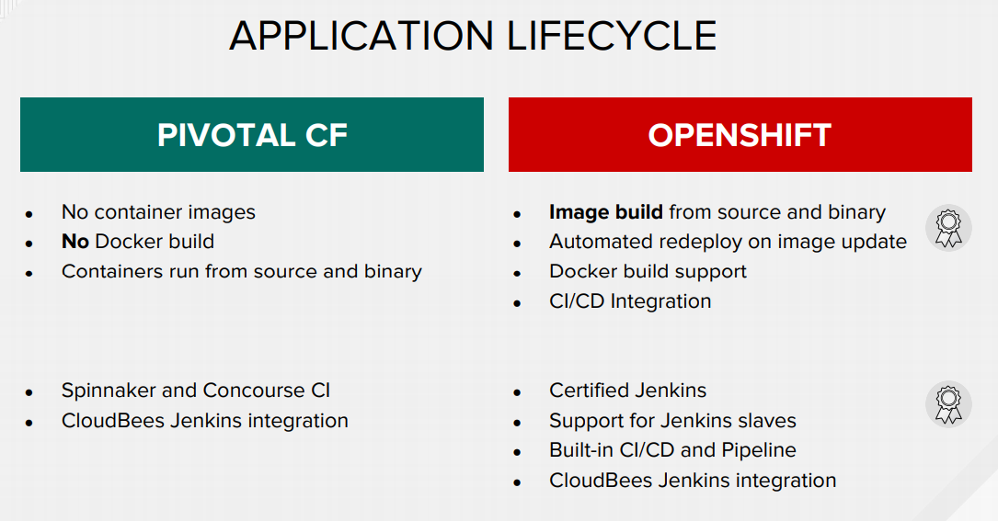

Slide 24
