Slide 1

Introduction to Big Data: Spark & AWS
Presented by Techboom
2019-03-22

Slide 2
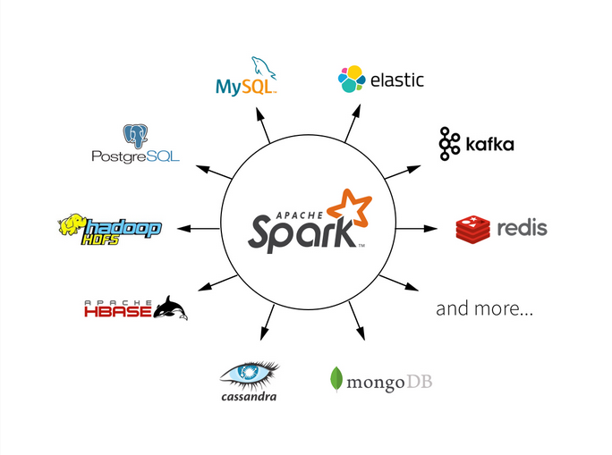
Just Another Buzzword?

Slide 3
Covered Topics
What is big data?
Object Storage: Amazon S3 & Competitors
Hadoop/HDFS
Managed Hadoop: Amazon EMR
Apache Spark

Slide 4

Our team…

Slide 5
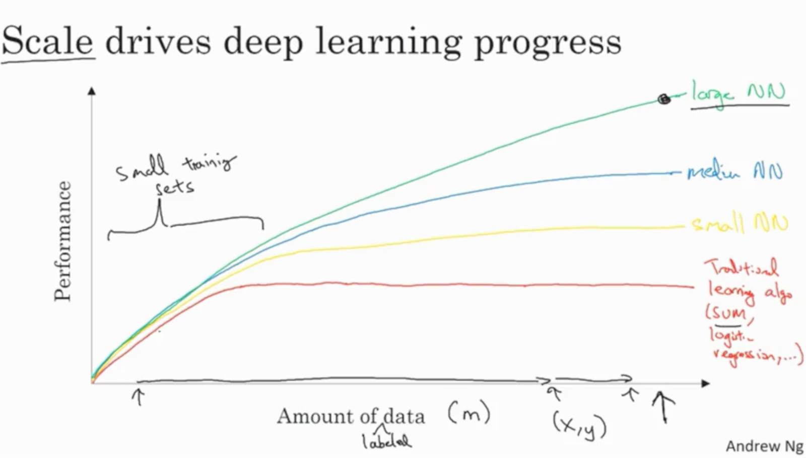
How Big is Big?

Slide 6
Characteristics of Big Data
Grows by many GB (or TB) per day
Can be unstructured or semi-structured
JSON
HTML
CSV
Text
Mix of valuable information and noise

Slide 7
Examples
Twitter Data Exported as JSON
Log files from an application with many users
Large collection of raw image files
All of the posts on your favorite Subreddit

Slide 8

The Data Lake

Slide 9



Popular Object Stores

Slide 10
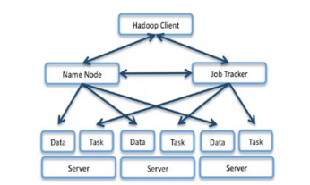

Hadoop Distributed File System

Slide 11



Managed Hadoop on the Cloud

Slide 12
Amazon Elastic MapReduce
“Amazon EMR is a managed cluster platform that simplifies running big data frameworks, such as Apache Hadoop and Apache Spark, on AWS to process and analyze vast amounts of data.”

Slide 13
Review
Which of the following can be considered “unstructured data”?
CSV Files
JSON Files
A MySQL Database Table
A Config File Formatted in YAML

Slide 14

And Now for the Main Event…

Slide 15
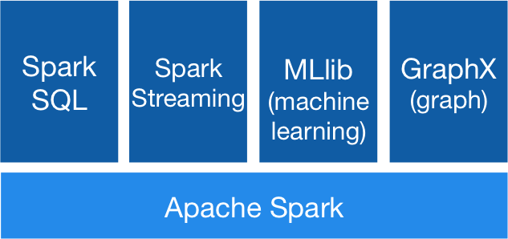
What is Spark?
Apache Spark™ is a unified analytics engine for large-scale data processing.

Slide 16




Supported Languages

Slide 17
DataSets, DataFrames, and RDDs
RDD = Resilient Distributed Dataset
Allows you to manipulate a distributed collection of data
DataFrame
Like an RDD, but with named columns
DataSet
Newer version of DataFrames
In Python, there is no difference with DataFrame

Slide 18

Demo

