Slide 1
Introduction to Smart Contract Development
Nik Kalyani

Slide 2

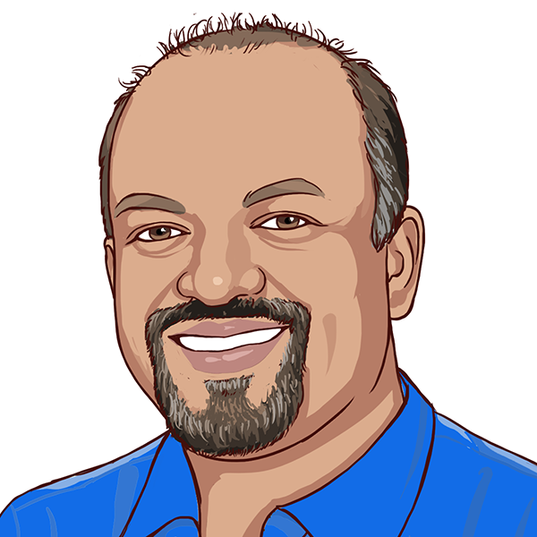



NIK KALYANI
Co-founder/CTO

Slide 3
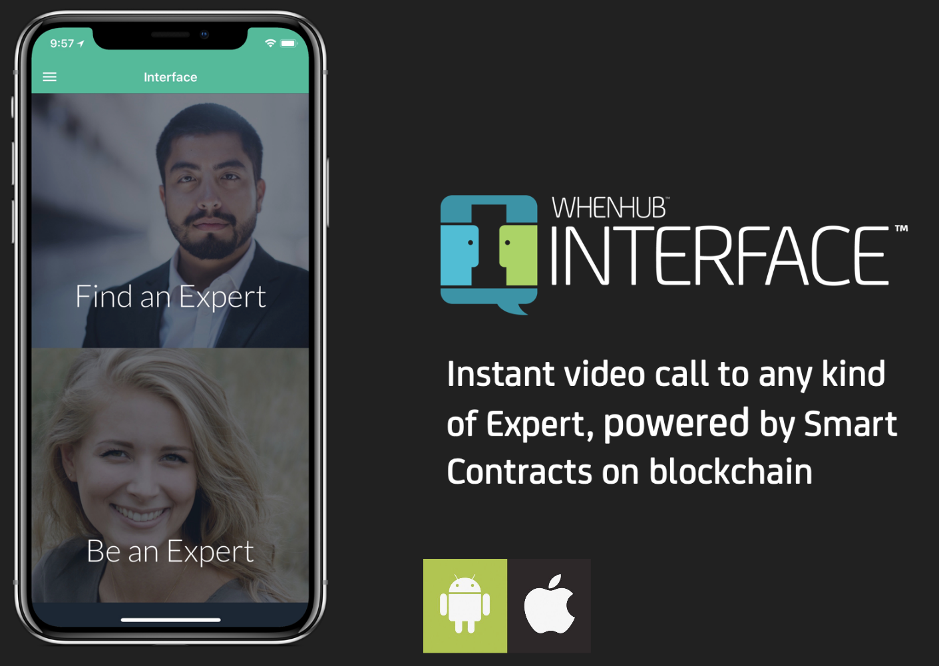
interface.whenhub.com

Slide 4
CODE & SOCIAL MEDIA
https://github.com/techbubble/buildstarter
@techbubble
#buildstarter

Slide 5
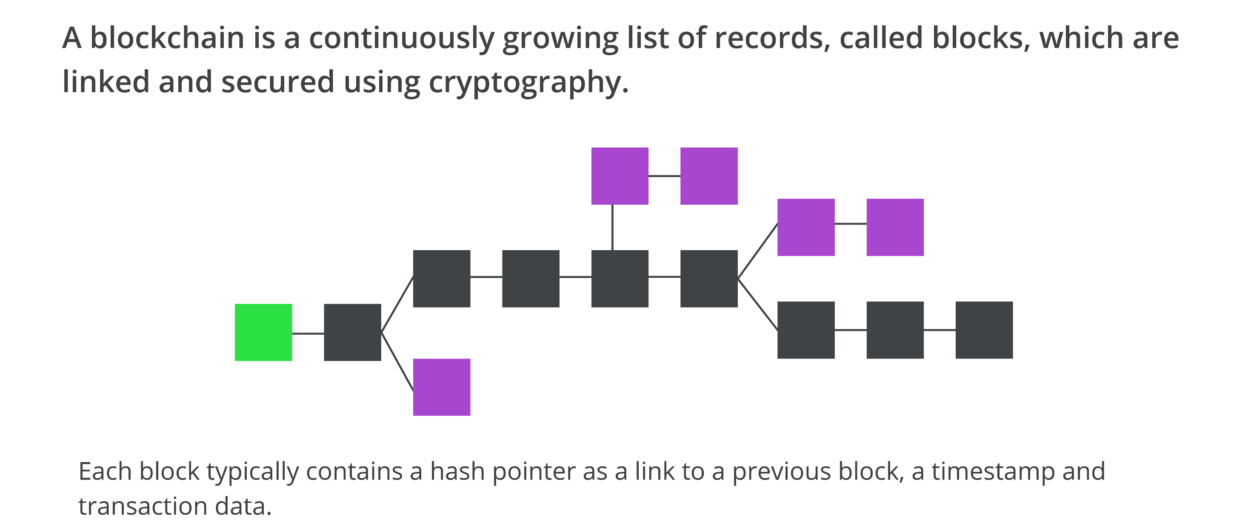
BLOCKCHAIN

Slide 6
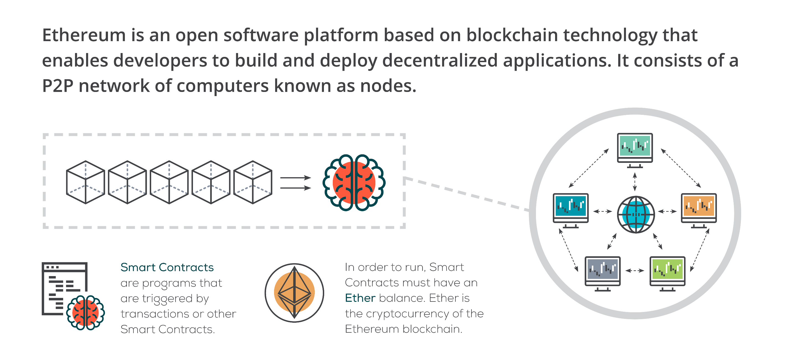
ETHEREUM

Slide 7
BUILDSTARTER
Like Kickstarter, but for Open Source where the community funds features with cryptocurrency that that team should build
Anyone can propose a feature for a small registration fee by calling “register”
Features have a funding goal and funding deadline
Anyone can call “fund” and contribute toward the funding goal
When the funding deadline passes, two possibilities exist:
Funding goal met or exceeded – Anyone can call “settle” and transfer funds to the owner of the feature
Funding goal not met – Anyone who contributed can call “refund” and get their funds back

Slide 8
WORKFLOW
Develop and Test with Local Blockchain
Deploy and Test with Ropsten Blockchain
Deploy and Test with Mainnet Blockchain

Slide 9
SMART CONTRACT
TRUFFLE
Solidity Source Code
Ganache
Mocha
Chai

Slide 10
DAPP (DECENTRALIZED APP)
METAMASK
HTML/CSS/JS
Ganache
Web3JS

