Slide 1
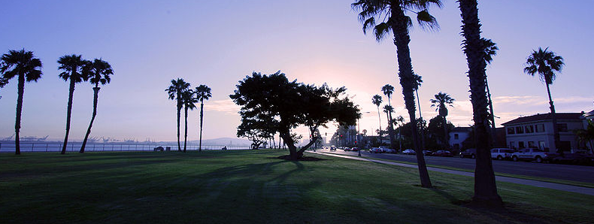
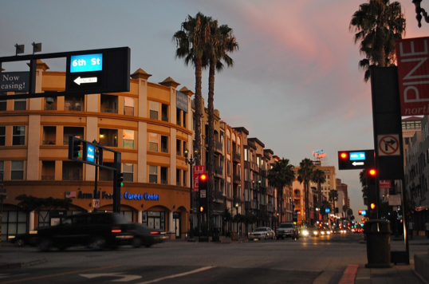
The amazing city of Long Beach
By: Krystal Zavala
Picture in the public domain

Slide 2
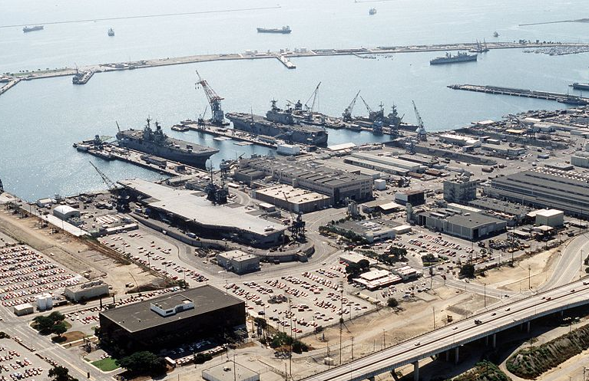
History… Past
Cabrillo found the area “long beach” after Columbus came to America
Native Americans used smoke signals it was called “The Bay of smokes”.
Manuel Nieto was granted a ranch.
Camera Operator: PH2 R.J. DAVIS

Slide 3
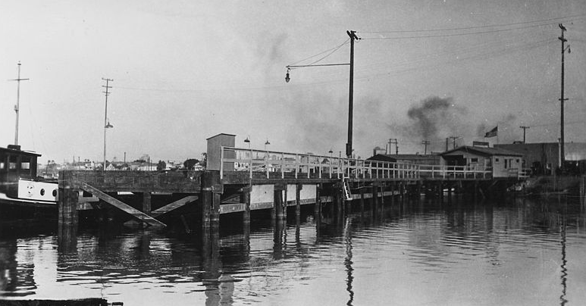
History… Past continued
Nieto sold Los Cerritos to john temple in 1843
Temple sold the land to the Bixby's in 1866
It was sold in 1880 and named it “Wilmore” city.
In 1888 it was incorporated into the city of Long Beach.
Unknownwikidata:Q4233718 or not provided

Slide 4
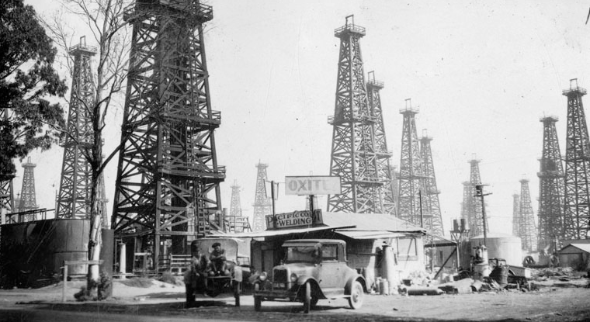
Recent History
In 1933, Long Beach was devastated by an earthquake .
Oil was discovered in 1921 on signal hill
1984 The LA Olympics held several events in Long Beach.
Unknownwikidata:Q4233718

Slide 5
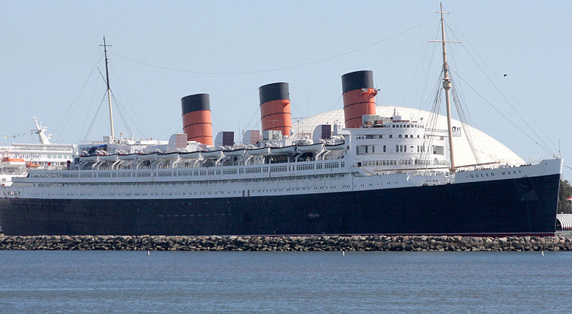
Queen Mary
A ship that was bigger and more powerful than the titanic
Began her life in 1930
Held the record for the fastest- crossings.
in 1967, the queen Mary was sold to the city of long beach.
RMS_Queen_Mary_at_Long_Beach_Harbor.jpg: David Lofink from Anaheim
derivative work: Altair78 (talk)

Slide 6
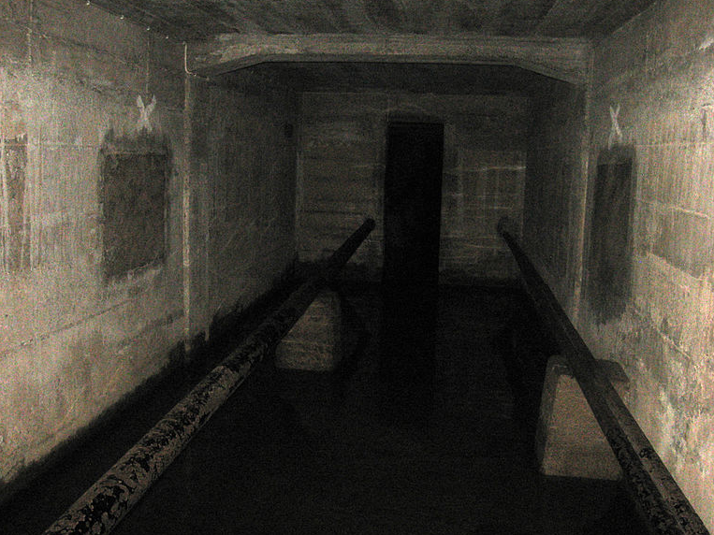
Queen Mary… Hauntings
150 know spirits lurking upon the ship
at lease 49 reported deaths
"Door 13” smashed at least two men to death
Crisco 1492

Slide 7
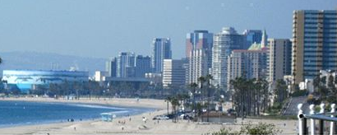
Attractions
Beaches
Grand prix
Veterans memorial
Pike
Belmont Shore
Aquarium
Art museums
Rancho Los Cerritos
Rancho Los Alamitos
Cambodia Town
LB Symphony
Pyramid At LB State
Carpenter Center
isoy, Matthew Field, Clinton Steeds, Regular Daddy, Los Angeles

Slide 8
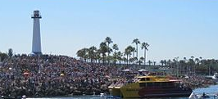
Interesting Facts
7th largest city
Long beach was officially a city in 1888
Named one of the best cities for people to live.
isoy, Matthew Field, Clinton Steeds, Regular Daddy, Los Angeles

