Slide 1

Vrinda Store Sales Data Analysis (2022)
Excel-Based Sales Dashboard & Business Insights
DATA ANALYST PORTFOLIO
MICROSOFT EXCEL
Created by Deepak Rathour

Slide 2
Project Overview
This project analyzes the full-year 2022 sales data of Vrinda Store using Microsoft Excel. The goal was to transform raw transactional data into a structured, interactive dashboard that reveals meaningful patterns in customer behavior, regional performance, and channel effectiveness — enabling data-driven decision-making for business stakeholders.
What Was Analyzed
Project Deliverables
Annual sales trends across all product categories
Customer demographics: age, gender, and location
Order fulfillment status and delivery performance
E-commerce platform channel performance
Data Cleaning
Pivot Tables
Interactive Dashboard
Business Insights

Slide 3







Project Objectives
Seven focused objectives guided this analysis — from measuring overall sales performance to generating targeted recommendations for marketing and channel strategy.
Sales Performance
Customer Behavior
Gender Analysis
Measure total revenue, order volume, and monthly sales trends across 2022.
Understand purchasing patterns segmented by age, gender, and geography.
Compare purchase contributions between male and female customers to identify the primary buyer profile.
Top-Performing States
Order Status
Sales Channels
Rank Indian states by sales contribution to prioritize regional marketing investment.
Evaluate fulfillment rates, cancellations, and returns to assess operational efficiency.
Compare performance across Amazon, Flipkart, and Myntra to identify the most effective platforms.
Business Recommendations
Translate analytical findings into targeted strategies for revenue growth.

Slide 4






Tools & Technologies
This project relied entirely on Microsoft Excel as the core analytical engine. No external BI tools were required — demonstrating that Excel's native features are sufficient to build professional-grade, interactive sales dashboards.
Microsoft Excel
Pivot Tables
Primary platform for all data manipulation, analysis, and visualization.
Aggregated and summarized large datasets to uncover sales patterns by category, region, and demographic.
Pivot Charts
Slicers
Dynamic charts linked to pivot tables for instant visual representation of key metrics.
Interactive filter controls enabling users to segment dashboard views by time, state, or channel.
Data Cleaning
Dashboard Design
Removed duplicates, handled nulls, standardized formats, and validated data integrity before analysis.
Structured a cohesive, multi-sheet dashboard with consistent formatting and clear visual hierarchy.

Slide 5
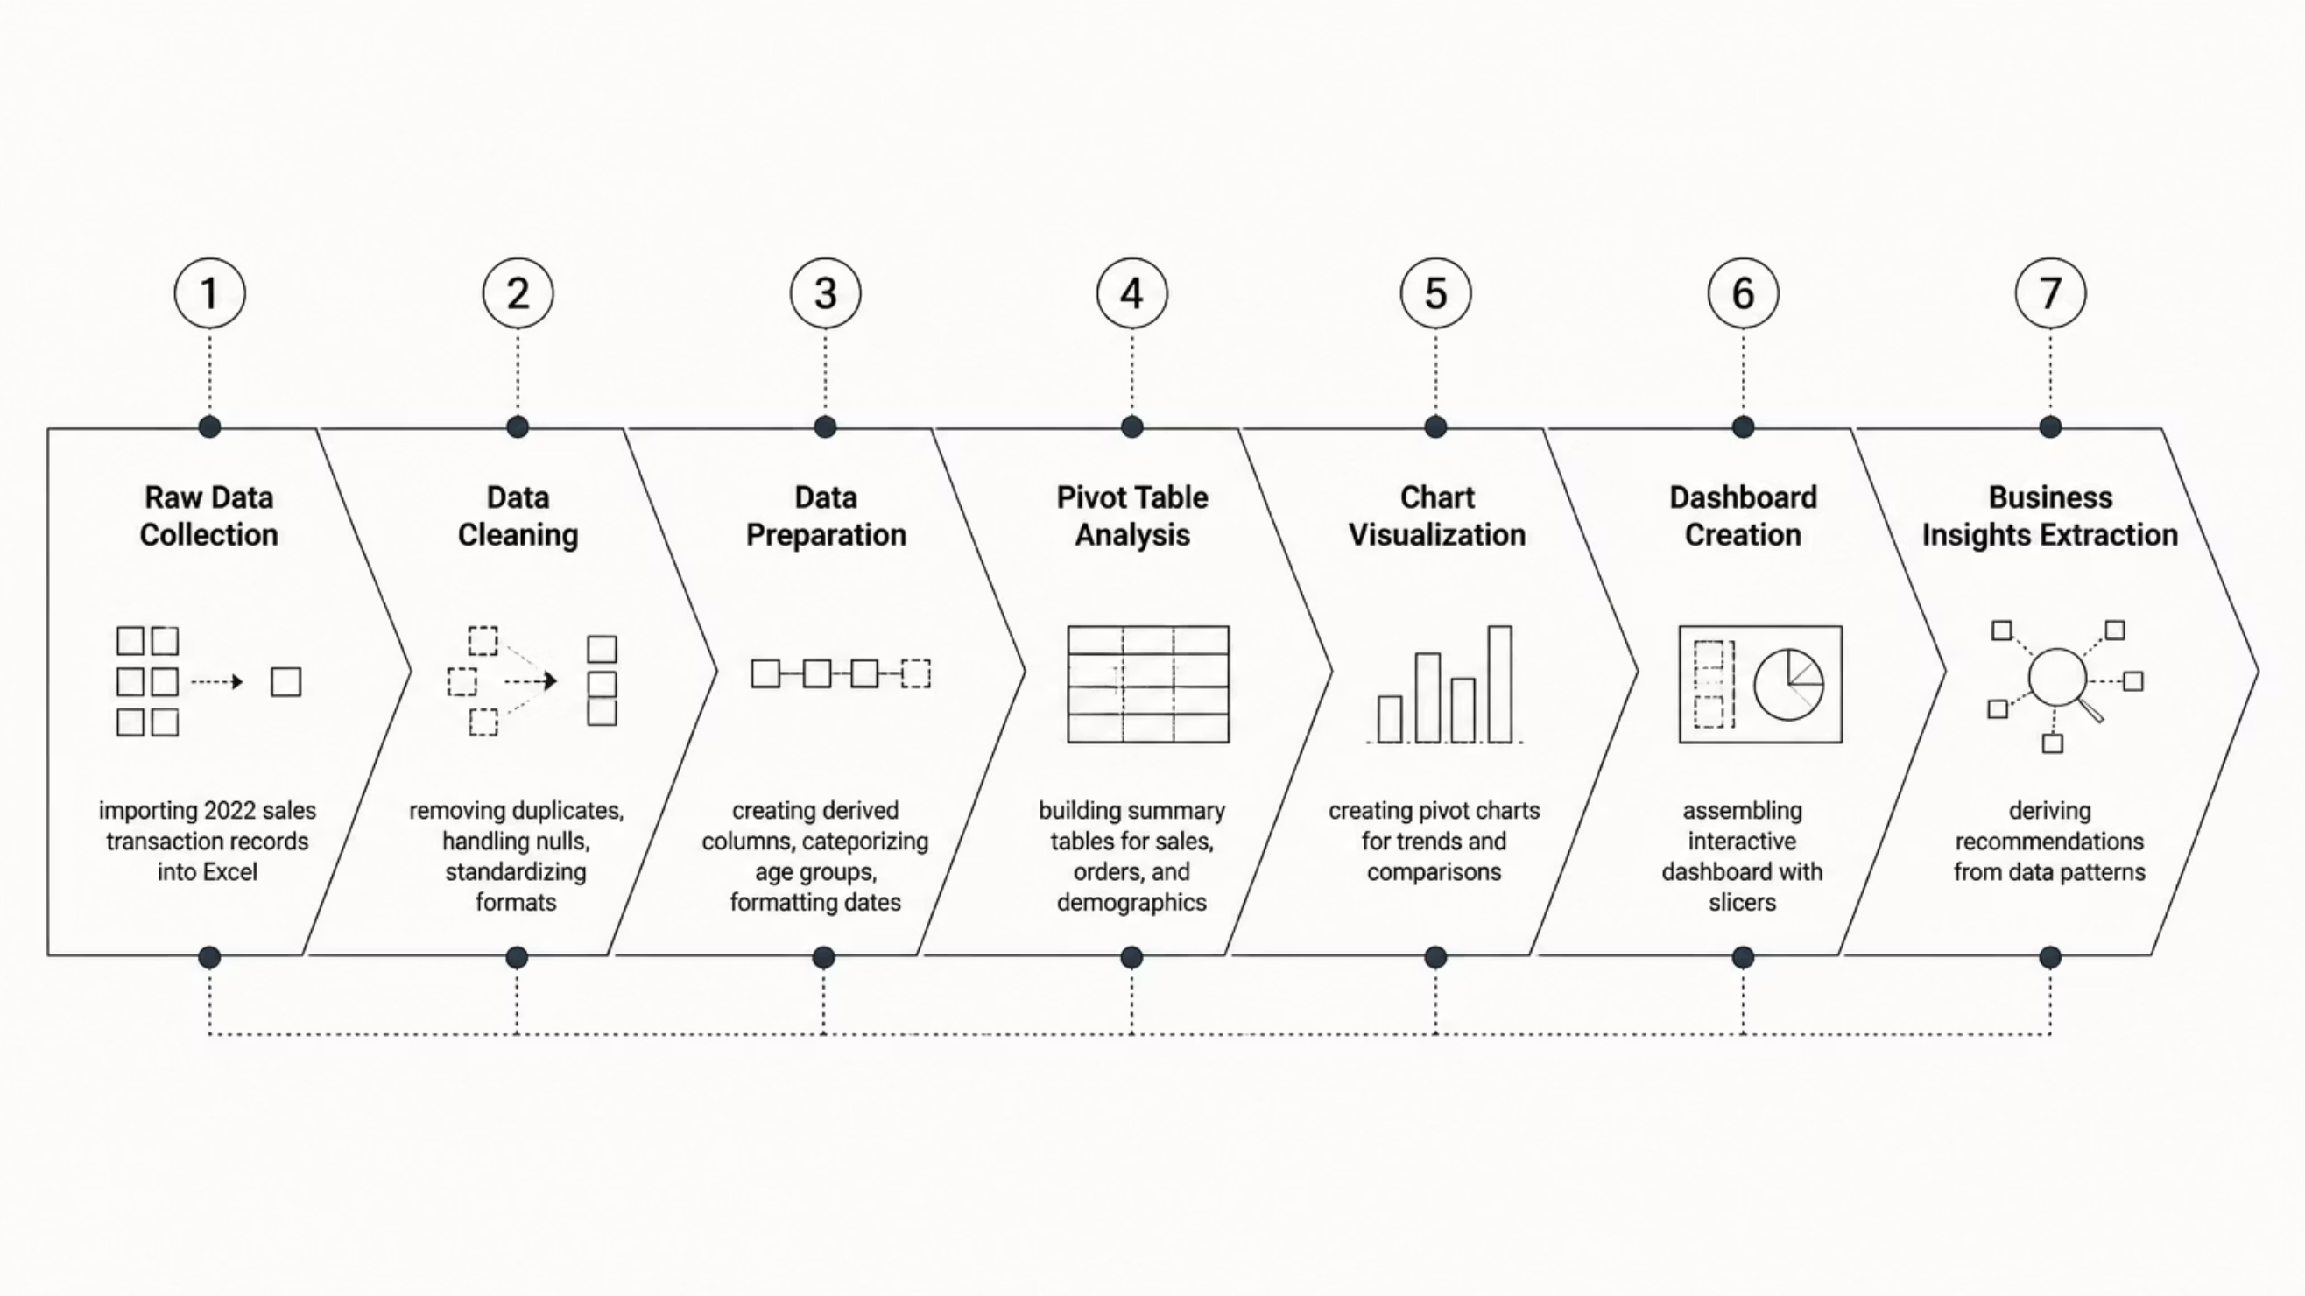
Data Analysis Workflow
A structured seven-step process ensured data quality and analytical rigor — from raw data ingestion through to actionable business recommendations. Each step built on the previous, creating a reliable and repeatable analysis pipeline.
This end-to-end workflow demonstrates a disciplined approach to data analysis — ensuring that every insight is grounded in clean, well-structured data and validated through multiple analytical layers before being presented as a business recommendation.

Slide 6


Excel Interactive Dashboard
The final deliverable is a fully interactive Excel dashboard that consolidates all key metrics into a single, filterable view. Slicers allow stakeholders to drill into specific time periods, states, or channels — making it a practical tool for ongoing business reviews.
Dashboard Components
Orders vs. Sales
Men vs. Women
Monthly revenue and order volume trend comparison
Gender-based purchase share and spend analysis
Order Status
Top 5 States
Delivered, cancelled, and returned order breakdown
Ranked state-level sales contribution chart
Age vs. Gender
Channel Analysis
Demographic cross-tabulation of buyer segments
Sales distribution across Amazon, Flipkart & Myntra

Slide 7



Key Insight 1: Women Customers Dominated Sales
Female customers were the overwhelming driver of Vrinda Store's 2022 revenue, accounting for approximately 64–65% of total sales — nearly twice the contribution of male customers. This pattern held consistently across product categories and sales channels throughout the year.
65%
35%
Women's Share
Men's Share
Of total sales revenue in 2022
Of total sales revenue in 2022
Business Conclusion: Women are the primary target audience for Vrinda Store. Marketing budgets, product assortments, and promotional campaigns should be designed primarily around female customer preferences and purchasing behavior.

Slide 8


Key Insight 2: Top-Performing States
Three Indian states accounted for the majority of Vrinda Store's 2022 sales volume. Maharashtra, Karnataka, and Uttar Pradesh emerged as the highest-revenue regions, reflecting strong urban purchasing power and high e-commerce penetration in these areas.
🥇 Maharashtra
🥈 Karnataka
Highest sales contribution — driven by Mumbai and Pune's strong urban consumer base and high digital adoption.
Second-largest contributor — Bengaluru's tech-savvy population and high disposable income fuel consistent demand.
🥉 Uttar Pradesh
Third in rankings — large population base and growing tier-2 city e-commerce adoption drive significant volume.
Recommendation: Prioritize these three states for targeted digital ad spend, localized promotions, and expanded product availability.

Slide 9
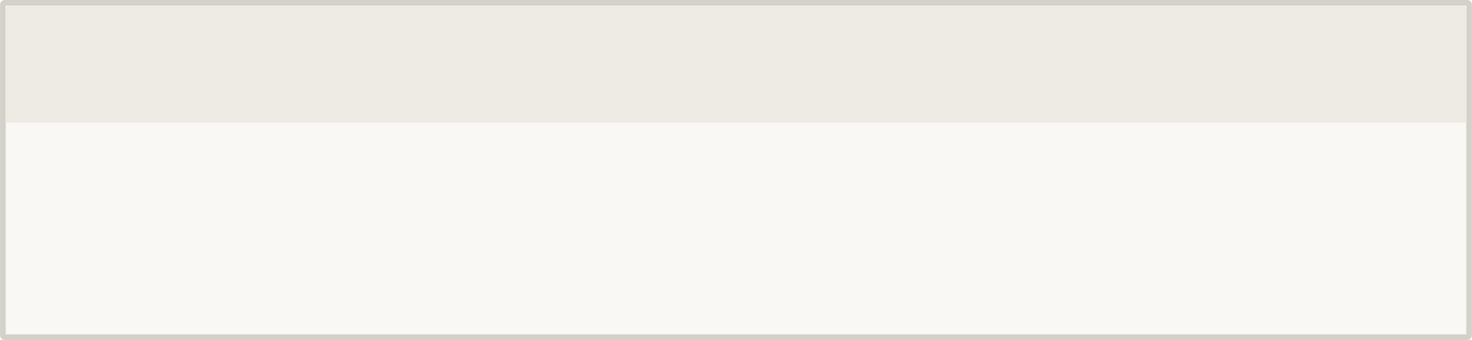
Key Insights 3 & 4: Age Group & Sales Channels
Two additional findings sharpen the customer profile and channel strategy: adults aged 30–49 represent the highest-value demographic, and sales are heavily concentrated on major e-commerce marketplaces.
Top Customer Age Group: 30–49 Years
Best Sales Channels: E-Commerce Platforms
Adults aged 30–49 contributed the maximum share of total sales in 2022. This segment typically has stable incomes, established purchasing habits, and higher average order values compared to younger demographics.
Vrinda Store's sales are highly dependent on third-party e-commerce marketplaces. The top three channels — Amazon, Flipkart, and Myntra — collectively dominate order volume and revenue.
Highest purchasing power among all age brackets
Consistent repeat-purchase behavior
Strong engagement across all product categories
1
Amazon
Largest channel by order volume and revenue
2
Flipkart
Strong second — especially in tier-2 cities
3
Myntra
Fashion-focused — high conversion among women

Slide 10






Final Recommendations & Conclusion
Based on the full analysis, a clear and actionable growth strategy emerges. Vrinda Store should concentrate resources on its highest-value customer segment and strongest channels to maximize return on marketing investment.
Target Audience
Women aged 30–49 in Maharashtra, Karnataka & Uttar Pradesh
Marketing Tactics
Discounts, coupons, targeted ads, and seasonal promotional campaigns
Primary Channels
Amazon, Flipkart, and Myntra — with emphasis on Myntra for women's fashion
Expected Outcome
Higher conversion rates, improved customer retention, and increased average order value
Project Achievement: Successfully transformed raw 2022 sales data into a fully interactive Excel dashboard with actionable business insights — demonstrating end-to-end data analysis capability from cleaning to strategic recommendation.
Thank You — Deepak Rathour

