Slide 1



Startup Success Prediction Using Machine Learning
Applying ML to forecast whether a startup will achieve an IPO, Acquisition, or Failure — empowering investors and entrepreneurs with data-driven insight.
Notes:
1

Slide 2


PROBLEM STATEMENT
Why Predicting Startup Outcomes Matters
The Challenge
Startups frequently fail due to poor decision-making, unfavorable market conditions, and insufficient planning. Investors and founders lack reliable tools to assess a venture's potential before committing resources.
The Objective
Build a Machine Learning model that predicts whether a startup will result in an IPO, Acquisition, or Failure — giving stakeholders an actionable, data-driven signal.
Notes:
2

Slide 3
DATASET OVERVIEW
Understanding the Data
100K
11
3
Records
Features
Outcomes
Startup entries in the dataset
Predictor variables per record
IPO, Acquisition, or Failure
Funding & Finance
Team & Leadership
Market & Product
Funding Rounds · Revenue · Burn Rate
Team Size · Founder Experience · Founder Background
Market Size · Product Traction · Sector · Investor Type
Notes:
3

Slide 4

DATA PREPROCESSING
Preparing the Data for Modeling
01
Missing Value Check
Full audit confirmed no missing values across all 100,000 records — dataset was clean and ready to use.
02
Categorical Encoding
Applied Label Encoding to convert categorical variables (Sector, Investor Type, Founder Background) into numeric form.
03
Train-Test Split
Data partitioned into 80% Training and 20% Testing to ensure unbiased model evaluation.
Notes:
4

Slide 5
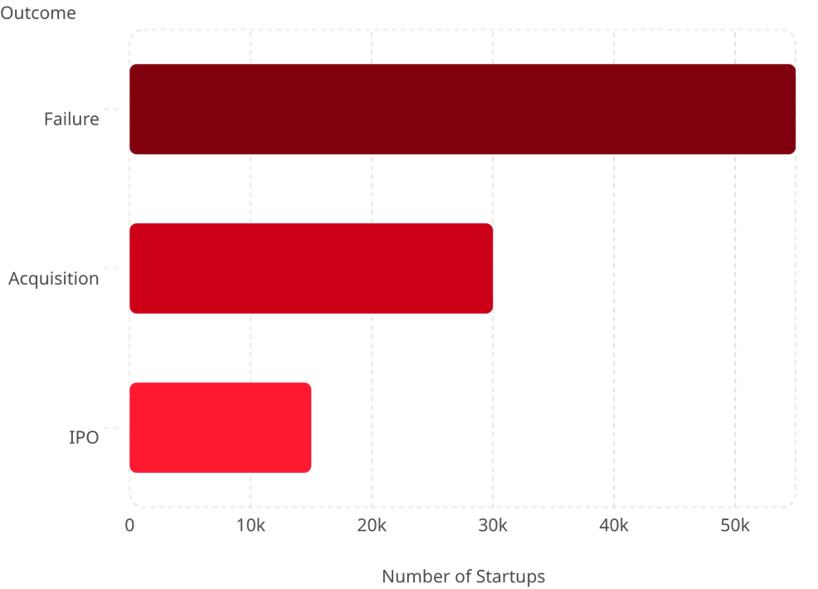
EXPLORATORY DATA ANALYSIS
Outcome Distribution Across Startups
Key Findings
The dataset reveals a clear imbalance in startup outcomes:
Failure is the dominant outcome — the majority of startups do not survive
Acquisition is the second most common path, reflecting moderate success
IPO is the rarest outcome, achieved by only a small fraction of ventures
Notes:
5

Slide 6
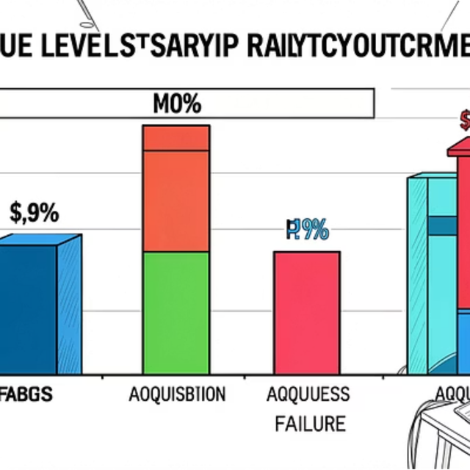
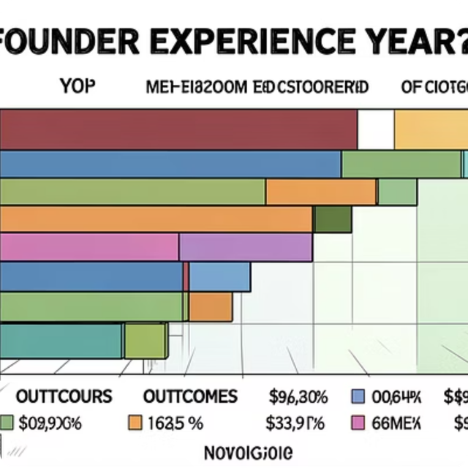
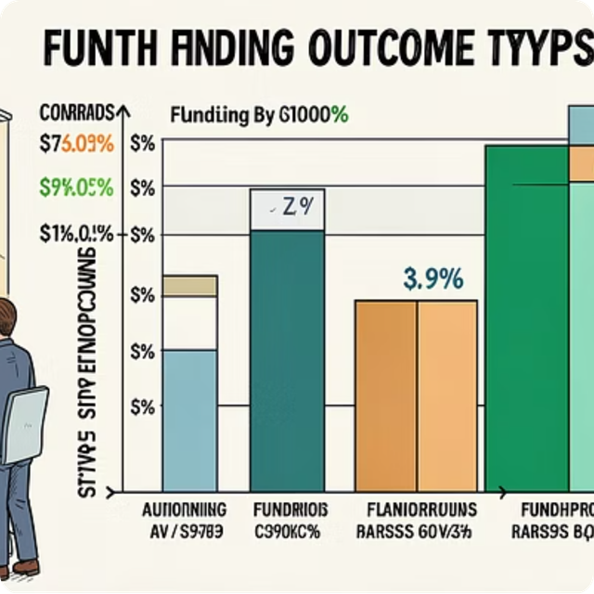
FEATURE ANALYSIS
What Drives Startup Outcomes?
💰 Revenue
👤 Founder Experience
📈 Funding Rounds
Higher revenue strongly correlates with IPO and Acquisition outcomes.
Experienced founders are significantly more likely to achieve successful exits.
More funding rounds indicate investor confidence and improve survival odds.
Notes:
6

Slide 7
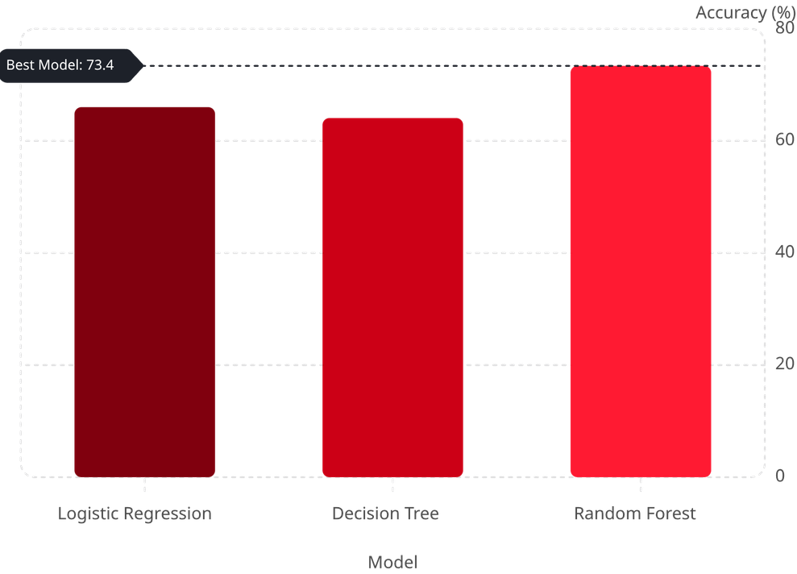


MODELING & RESULTS
Machine Learning Model Comparison
Models Evaluated
Logistic Regression — 66.02%
Solid baseline; interpretable but limited for non-linear patterns.
Decision Tree — 64.08%
Intuitive splits but prone to overfitting on complex data.
Random Forest — 73.39% ⭐
Best performer. Ensemble approach reduces variance and captures feature interactions.
Notes:
7

Slide 8





CONCLUSION
Key Takeaways & the Road Ahead
ML Predicts Startup Outcomes
Machine Learning reliably classifies startup trajectories, offering investors a quantifiable risk signal.
Random Forest Leads at 73.39%
Ensemble learning outperformed single-model approaches, confirming its strength for tabular business data.
Revenue, Funding & Experience Matter Most
These three features consistently drove prediction accuracy across all models tested.
Future Directions
Incorporate real-time market data, experiment with XGBoost or neural networks, and address class imbalance with SMOTE.
Notes:
8

