Slide 1
Internet of Things
Session 2 – Introduction to Cloud, IFTTT and Firebase

Slide 2
SESSION OBJECTIVES
.
What is a Cloud?
.
IFTTT
.
Firebase
Example to demonstrate the usage of Firebase Real-time Database
.

Slide 3
What is a Cloud?
Cloud servers are located in data centers all over the world. By using cloud computing, users and companies don't have to manage physical servers themselves or run software applications on their own machines.
3
The cloud enables users to access the same files and applications from almost any device, instead of locally on the user device. This is why a user can log into their Instagram account on a new phone after their old phone breaks and still find their old account in place, with all their photos, videos, and conversation history.
1
"The cloud" refers to servers that are accessed over the Internet, and the software and databases that run on those servers.
2

Slide 4
Difference between a Drive and a CloudD
Cloud
Drive
Users: Developers/project users
Usage: Personal / non-technical business users
1
Accessibility: Through VM or DNS
Accessibility: Through any browser or mobile app
2
Storage formats: Big data, small data, text, binary, regardless of format.
Storage formats: Photos, videos, documents, sheets or presentations
3

Slide 5
IFTTT- If This Then That
IFTT
Applets
Applets are specific things that can happen when you connect services - things your apps can't do on their own.
For instance : you could use an Applet to sync Amazon Alexa to-dos with your Google Calendar Or one that lets you create events in your iPhone Calendar via Google Assistant.
If This Then That, also known as IFTTT is a free web based service to create chains of simple conditional statements called applets.

Slide 6
IFTTT Example - Receiving message when you get a missed Call
Download IFTTT app
Create an account
Select the +This in the "If This Then That" logo toward the center-top of the page. This will allow you to look for the "trigger" that will tell your Applet when to run.
You can then search for and select a service. In this example, we'll use Calls. You'll need to connect to it.
Now select the +That in the "If This Then That" logo toward the center-top of the page. This is where you'll specify what you want to happen next.
Choose an action service. For instance, you can choose Android messaging. Enter the phone number to which you would want the message to be sent.
Review your Applet and click Finish when done.
It'll now be live. To view your Applet, select My Applets from the top of your IFTTT dashboard.

Slide 7

Firebase
Firebase is a Backend as A Service(BAAS) that allows you to create web applications.
The Firebase Real-time Database is a cloud-hosted database that uses data synchronization—every time data changes, any connected device to the cloud receives the update within milliseconds.
Features
Real Time Database
Authentication
Cloud Storage
ML Kit

Slide 8
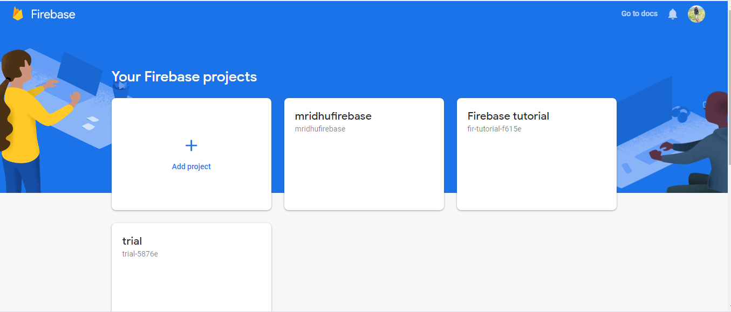
Sending Data from ESP8266 to Firebase Real Time Database
Step 1: Install the firebase library for ESP8266
Step 2: Enter your ssid and password in the example code
Step 3: Create an account in Firebase
Step 4: Create a new project

Slide 9
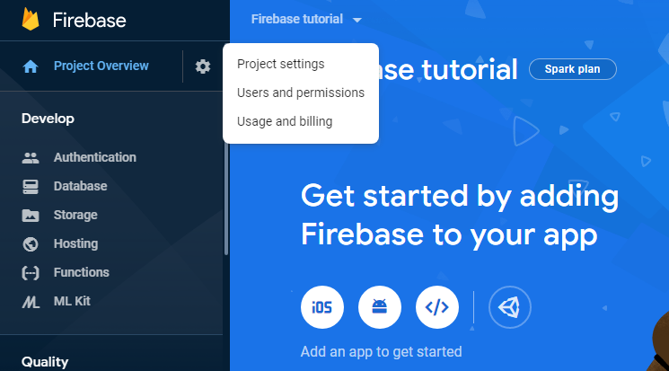
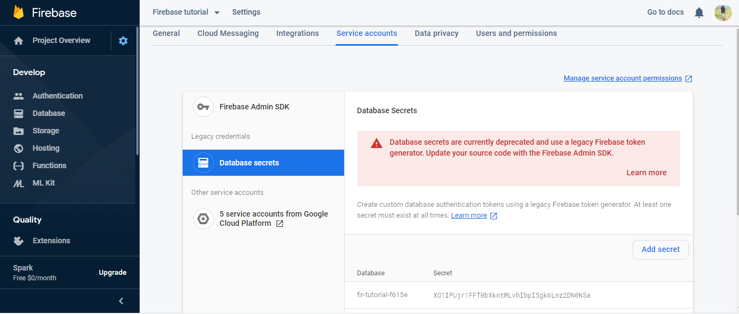
Step 5: Click on the settings icon present in project overview. Go to service accounts and copy the database secret. Paste this in the FIREBASE_AUTH variable in the example code

Slide 10
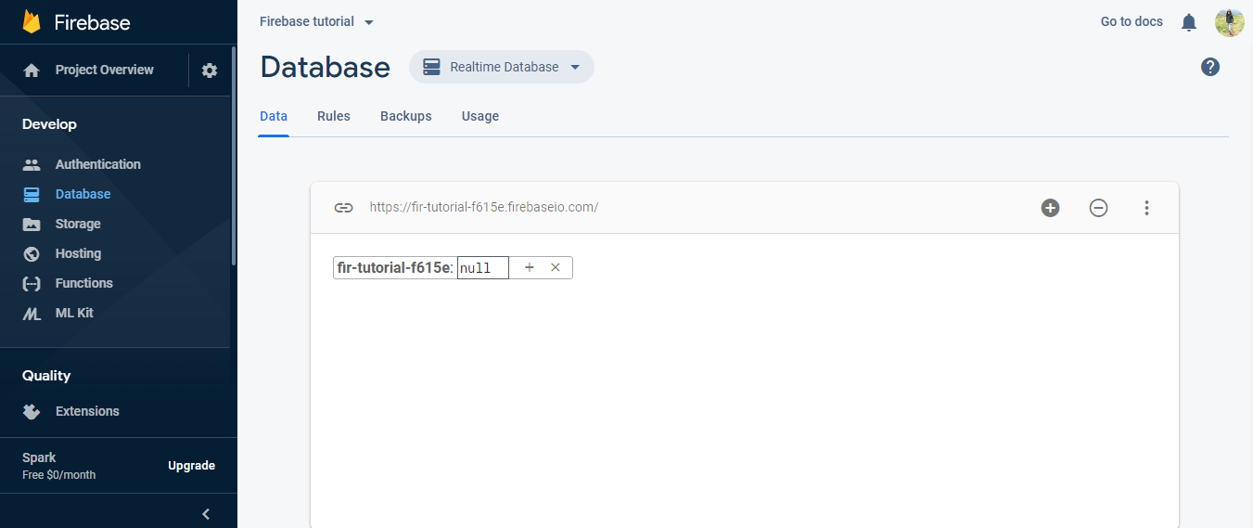
Step 6: Click on Database in firebase. Change the database from Cloud Firestore to Real time Database
Step 7: Copy the link that appears and paste it in FIREBASE_HOST variable in the example code
NOTE: Make sure to remove “https://” and trailing “/” while pasting in the code

Slide 11
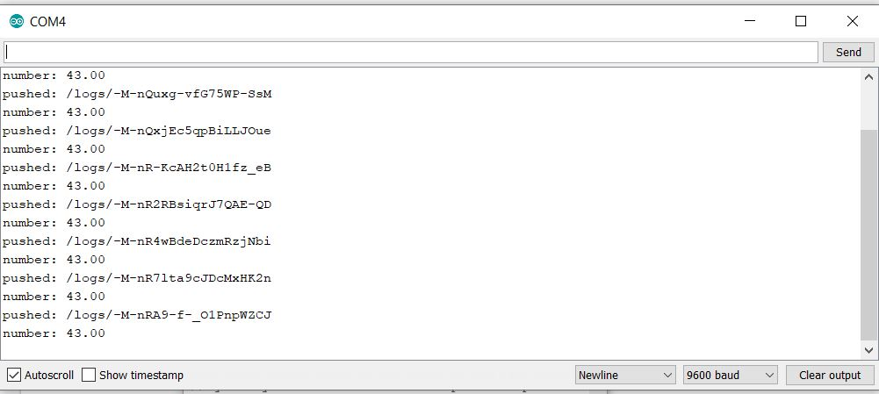
Step 8: Compile and Run the program
Sample Output: Serial Monitor of Arduino IDE

Slide 12
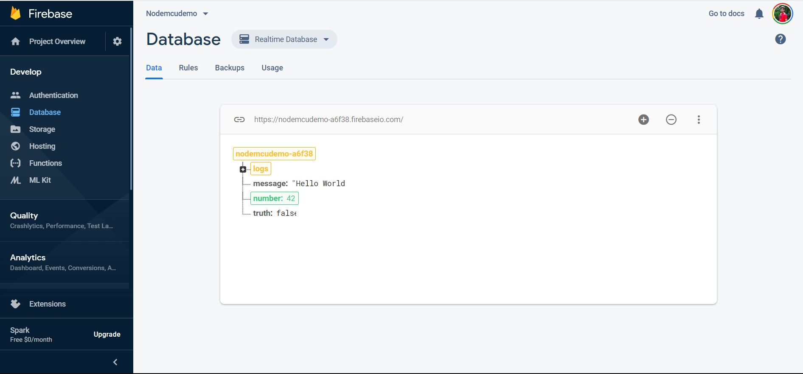
Step 9: Observe the real time value in the database
Sample Output:

Slide 13
Thank You

