Slide 1
DATAPATH AND Pipelining
By
Balaji S

Slide 2
DATA PROCESSING CIRCUITS
Flip-flops (memory elements) are used to store a single bit, and multiple bits can be stored using registers.
Data stored, can be of several types, say character, integer, floating point etc., with their corresponding sizes. Signed-2’s complement system is used for handling signed numbers.
Data processing digital circuits perform a certain operation on data operands. They include circuits such as Arithmetic and Logic Units (ALUs).
Reference: https://www.geeksforgeeks.org/ieee-standard-754-floating-point-numbers/, IEEE-754 Floating Point Standard

Slide 3
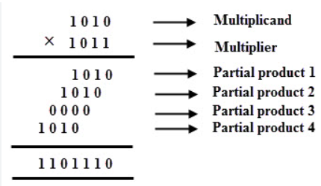
Binary multiplier
Lets see the case of a 4-bit x 4-bit binary multiplier, which is fed pair of inputs for a fixed interval using clock. For now let’s not consider signed numbers
We are going to design the multiplier in three different styles.
Image Courtesy: ElectronicsHub.org

Slide 4
Method 1
Circuit is sequential
Design the circuit such that it receives input every 4 clock cycles, (no input shall be given during processing, and of course, output comes out once in 4 clock cycles).

Slide 5
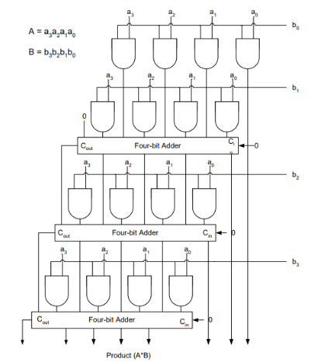
Method 2
Make the circuit entirely combinational, and feed inputs using external clock

Slide 6
Method 3
Follow method-1 but allow successive inputs to come inside the circuit
This approach is known as PIPELINING the circuit into stages, which are separated by intermediate registers (pipelining buffers).
Hence ideally for every clock cycle a valid output comes out.
What we infer from here is pipelining can increase the throughput (related to the frequency of extracting outputs) of the unit.
Also, from the other point of view, pipelining slices the total delay time of the circuit into several pieces, so that the maximum operating clock frequency of the circuit can be increased

Slide 7
Algorithmic state machines
The binary information stored in a digital system can be classified as either data or control information. The several data processing operations are addition, subtraction, logic operations etc., which are accomplished using digital circuits
The data processing path is known as datapath, which manipulates data in registers according to system requirements. The control unit issues a set of commands to the datapath

Slide 8
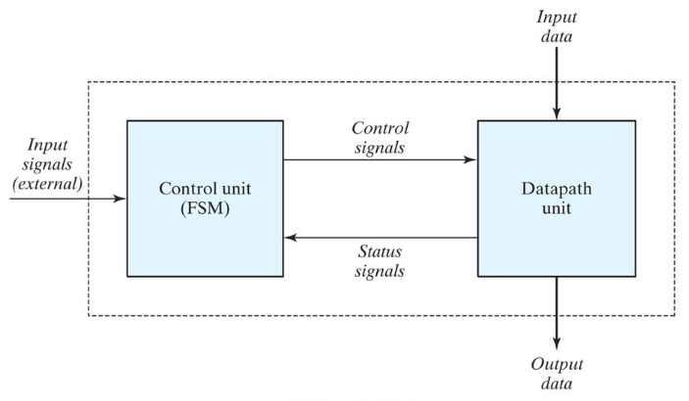
Control and datapath interaction
The control sequence and datapath tasks of a digital system are specified by means of a hardware algorithm

Slide 9
Pipelining in microprocessors
Functioning of a Microprocessor consists of several complex stages. A typical split is
Instruction Fetch
Instruction Decode
Execution
Memory Access
Write-Back
Pipelining is implemented in Microprocessors to increase system throughput

Slide 10
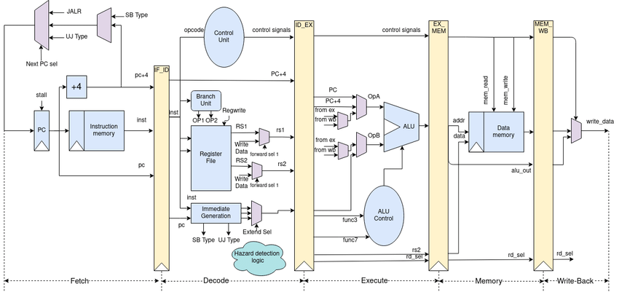
Five-stage pipeline
A typical five-stage pipeline
Courtesy: ResearchGate

Slide 11
Hazards in pipelining
Hazards in pipelining occur when there is a dependency across stages
Hazards in processor pipeline architectures are widely classified as
Structural Hazards
Data Hazards
Control Hazards
Hazards hamper the throughput of the processor system, by breaking the rule of “one instruction completely out of the pipeline every clock cycle”

Slide 12
Thank you

