Slide 1
Docker Introduction
Prepared By : Mahavir Teraiya

Slide 2
Agenda :
What is Docker ?
Why Docker ?
How Docker ?
Positive & Negative Of Docker Based Deployment.
Conclusion.

Slide 3
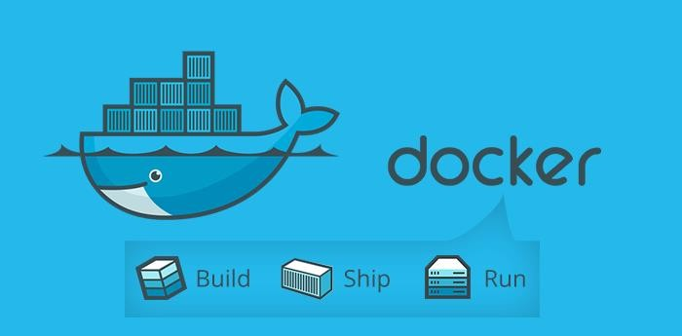
What is Docker ?
“Docker is an tool (open platform) for developers and system admins to build, ship, and run distributed applications”

Slide 4
Docker Terminology :
Docker file.
Docker Image.
Docker Container.
Public/Private Repository For Docker Images.

Slide 5
2) Why Docker ?
Other Possibility Without Docker.
Problems With The Other Techniques.
How Docker Can Be Better Choice ?

Slide 6
Other Possibility Without Docker.
VM/KVM
PaaS
Citrix Xen
Microsoft Hyper-V
Others

Slide 7
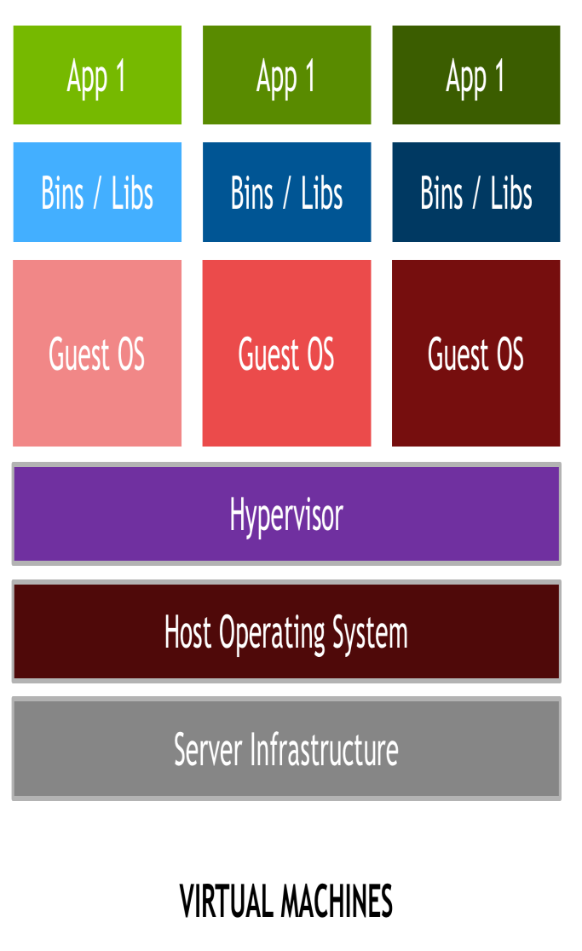
Problems With The Other Techniques.
Required Separate OS and Separate Resources Like RAM, Kernel, CPU, etc.
Inter Sharing & Other Inter Networking problems within the same host.
Not Proper Utilization Of Processor.
More Expensive.
Difficult to build & Manage.

Slide 8
Example :
5+ individual teams building “micro services” in Java and Scala
25+ separate “micro-services” deployed
25+ “micro-services” became nearly 150 AWS virtual machines
The Infrastructure bill goes too damn high!
We weren’t using the compute and memory resources purchased from AMZN!
Nearly all “micro-services” were at 1% CPU utilization.
150+ virtual machines essentially sitting idle.

Slide 9
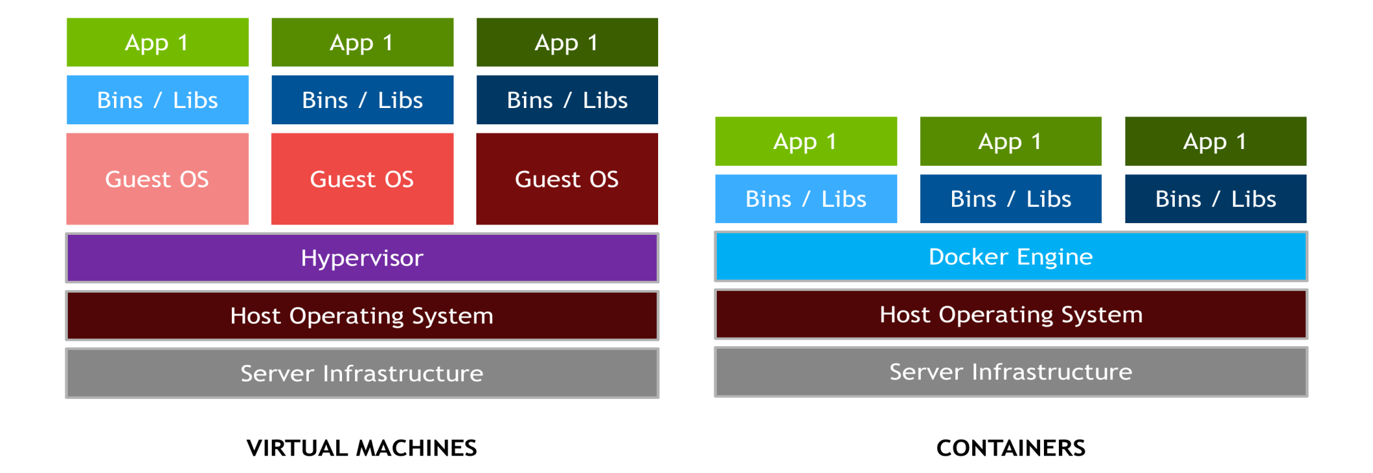
How Docker Can Be Better Choice ?
Use the same Kernel Of the Host (No Separate OS , No Separate Resources) Maximum Utilization Of Host resourses.
Light Weight Containers.
Open Source.
Run Anywhere (Independent to Host Environment )
Makes Deployment Easy & Flexible.

Slide 10
How Docker ?
Docker Based Deployment Steps.
Brief Idea About Docker Repository.
Brief Idea about AWS EC2 & ECS.
Demonstration & Discussion.

Slide 11
Demonstration

Slide 12
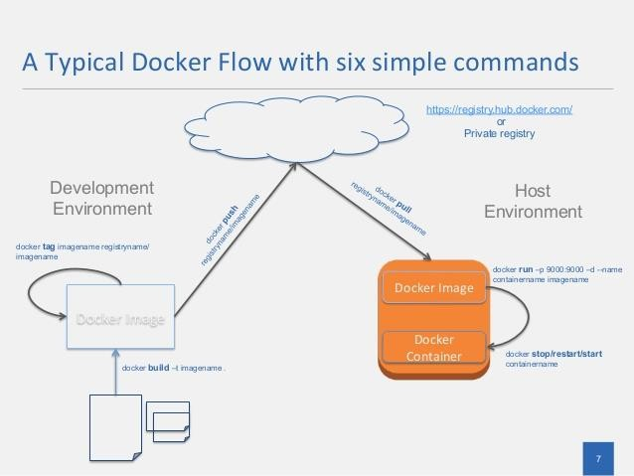
Docker Based Deployment Steps.

Slide 13
Brief Idea About Docker Repository.
Docker Hub Repository/Registry
Private
Public
AWS Repository
Private

Slide 14
Positive & Negative Of Docker Based Deployment.
Positives :
Scalability.
Easy & Flexibility in development and deployment.
Suits Best For Micro service and continuous deployment type of environment.(Agile)
Maximum utilization of allocated resources.
Independency to Host environment.
Less Cost.
No Matter what is inside.

Slide 15
Negatives:
Difficult to make Docker file and Docker Image for complex tasks.
Data is Tied to Host OS.
Special tool required for Monitoring of the container.
Learning Curve / Maturity
Containers not restarting on EC2 Restart.

Slide 16
Thank You….!!!!!!!!
For More Detail Or Questions Please Comment Below

