Slide 1
Support Vector Machine (SVM) Classification Algorithm
TechCoreEasy
Prepared By : Mahavir Teraiya

Slide 2
Agenda:
TechCoreEasy
What is SVM ?
How SVM works ?
What is Constrains ?
Pros/Cons of Decision Tree .
Applications.
Quick Recap

Slide 3
What is SVM ?
SVM stands for Support Vector Machines.
Its also called Maximum Margin Classifier.
It can also be called Linear Classification.
It divides data in to separate hyperplane and classify the new data points based on the hyperplane.

Slide 4
How SVM Works ?
Find a linear hyperplane (decision boundary) that will separate the data

Slide 5
One Possible Solution

Slide 6
Another possible solution

Slide 7
Other possible solutions

Slide 8
Which one is better? B1 or B2?
How do you define better?

Slide 9
TechCoreEasy
Find hyperplane maximizes the margin => B1 is better than B2

Slide 10
TechCoreEasy
We want to maximize:
Which is equivalent to minimizing:

Slide 11
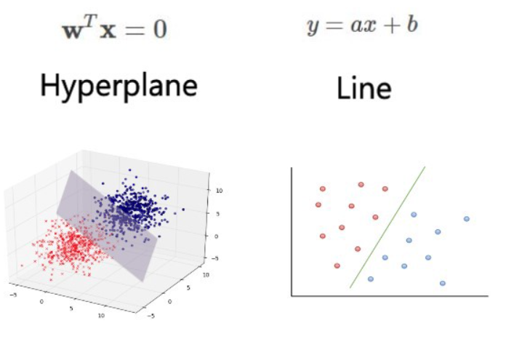
TechCoreEasy

Slide 12
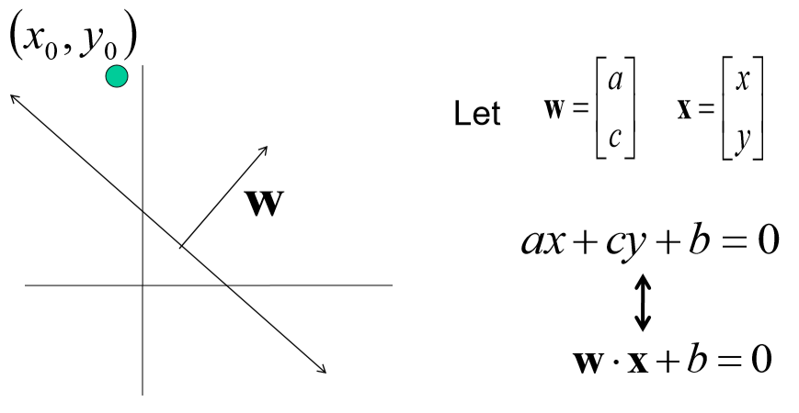
TechCoreEasy

Slide 13
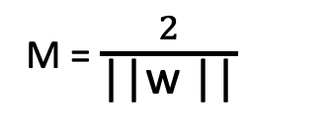
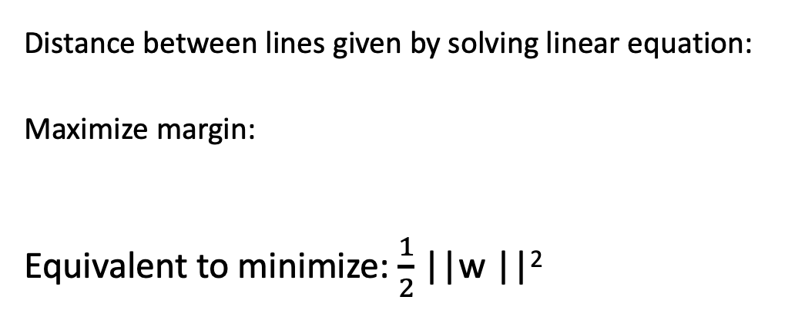
TechCoreEasy
x⁺
M=Margin Width
“Predict Class = +1” zone
X⁻
wx+b=1
“Predict Class = -1” zone
wx+b=0
wx+b=-1
Distance between lines given by solving linear equation:
Maximize margin:
Equivalent to minimize:$\frac{1}{2}$ ||w ||²
What we know:
w . x⁺ + b = +1
w . x⁻ + b = -1
M = $\frac{2}{\text{||}\text{w}\text{ ||}}$

Slide 14
TechCoreEasy
What is Constrains ?
R (H , S) = Maximum
C (H , S) = 10
Lagrange Multiplier helps to solve the constrain optimization problem ?

Slide 15
TechCoreEasy

Slide 16
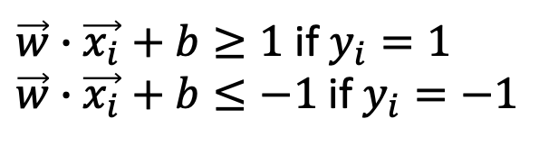
TechCoreEasy
We want to maximize:
Which is equivalent to minimizing:
But subjected to the following constraints:
This is a constrained optimization problem
Numerical approaches to solve it (e.g., quadratic programming)
$\vec{w}∙\vec{x_{i}}+b≥1$ if $y_{i}=1$
$\vec{w}∙\vec{x_{i}}+b≤−1$ if $y_{i}=−1$

Slide 17
TechCoreEasy
What if the problem is not linearly separable?

Slide 18
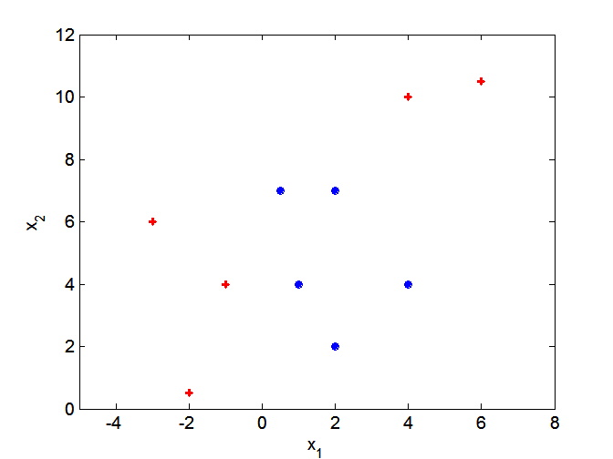
TechCoreEasy
What if decision boundary is not linear?

Slide 19
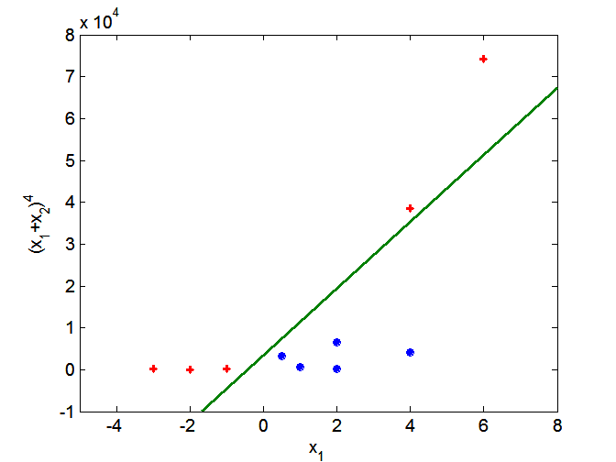
TechCoreEasy
Transform data into higher dimensional space
Use the Kernel Trick

Slide 20
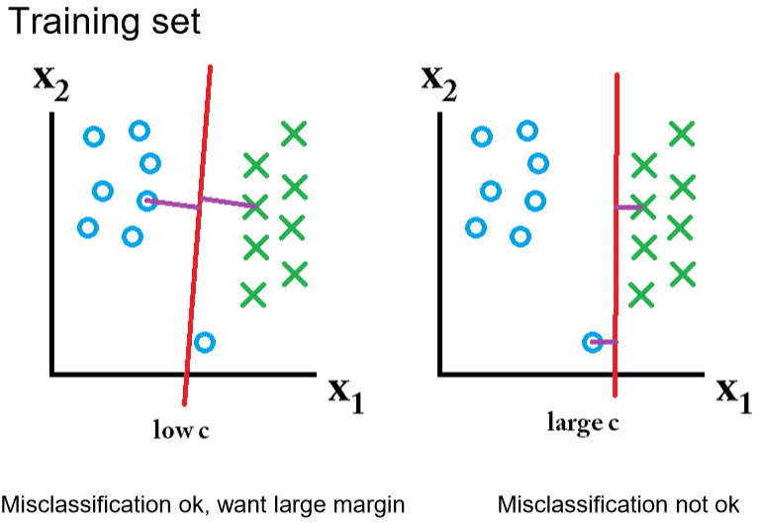
TechCoreEasy

Slide 21
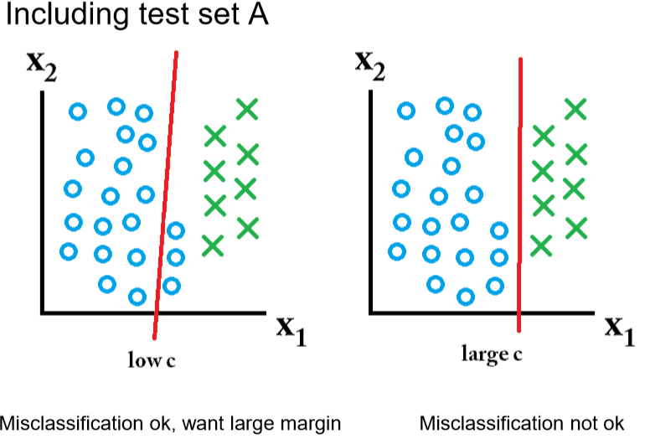
TechCoreEasy

Slide 22
TechCoreEasy
Advantages:
SVM works relatively well when there is clear margin of separation between classes.
SVM is more effective in high dimensional spaces.
SVM is effective in cases where number of dimensions is greater than the number of samples.
SVM is relatively memory efficient.

Slide 23
TechCoreEasy
Disadvantages:
SVM algorithm is not suitable for large data sets.
SVM does not perform very well, when the data set has more noise i.e. target classes are overlapping.
In cases where number of features for each data point exceeds the number of training data sample , the SVM will under perform.
As the support vector classifier works by putting data points, above and below the classifying hyper plane there is no probabilistic explanation for the classification.

Slide 24
TechCoreEasy
Applications :
Face detection
Text and hypertext categorization
Classification of images.
Bioinformatics .
Protein fold and remote homology detection.
Handwriting recognition
Generalized predictive control(GPC)

Slide 25
TechCoreEasy
Quick Recap

Slide 26

TechCoreEasy

