Slide 1
Decision Tree Classification Algorithm With Example
TechCoreEasy
Prepared By : Mahavir Teraiya

Slide 2
Agenda:
TechCoreEasy
What is Decision Tree ?
How to build Decision Tree ?
Practical Example & Calculation Behind.
What is Entropy ?
What is Information Gain ?
Pros/Cons of Decision Tree .
Applications.
Quick Recap

Slide 3

TechCoreEasy
What is Decision Tree ?
It is Tree Like representation of the training data like a flow chart.
Which helps in taking step wise decision and helps to read to the conclusion.
Classifies instances by sorting them down the tree from the root to some leaf node

Slide 4

TechCoreEasy
Buy Answering Below Question.
1.From where to start ?
2. How to proceed in order to reach to the final decision.
How to build Decision Tree ?

Slide 5
TechCoreEasy
Practical Example
id | outlook | temp | humidity | wind | play
1 | sunny | hot | high | weak | no
2 | sunny | hot | high | strong | no
3 | overcast | hot | high | weak | yes
4 | rainy | mild | high | weak | yes
5 | rainy | cool | normal | weak | yes
6 | rainy | cool | normal | strong | no
7 | overcast | cool | normal | strong | yes
8 | sunny | mild | high | weak | no
9 | sunny | cool | normal | weak | yes
10 | rainy | mild | normal | weak | yes
11 | sunny | mild | normal | strong | yes
12 | overcast | mild | high | strong | yes
13 | overcast | hot | normal | weak | yes
14 | rainy | mild | high | strong | no
15 | sunny | cool | high | weak | ?

Slide 6
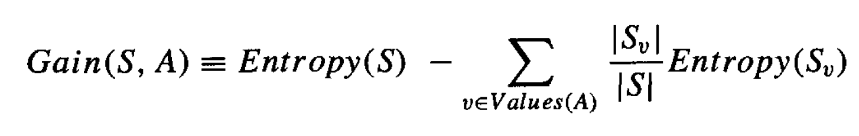
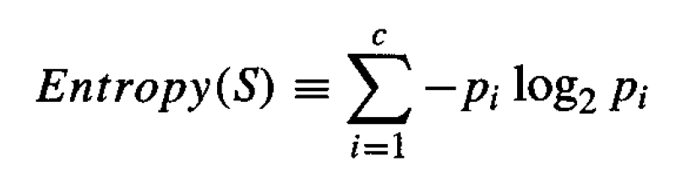
TechCoreEasy
What is Information Gain ?
Measure of the effectiveness of an attribute in classifying the training data

Slide 7
TechCoreEasy
id | outlook | temp | humidity | wind | play
1 | sunny | hot | high | weak | no
2 | sunny | hot | high | strong | no
3 | overcast | hot | high | weak | yes
4 | rainy | mild | high | weak | yes
5 | rainy | cool | normal | weak | yes
6 | rainy | cool | normal | strong | no
7 | overcast | cool | normal | strong | yes
8 | sunny | mild | high | weak | no
9 | sunny | cool | normal | weak | yes
10 | rainy | mild | normal | weak | yes
11 | sunny | mild | normal | strong | yes
12 | overcast | mild | high | strong | yes
13 | overcast | hot | normal | weak | yes
14 | rainy | mild | high | strong | no

Slide 8
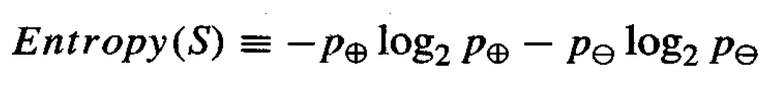
TechCoreEasy
What is Entropy?
Entropy is the measures of impurity, disorder or uncertainty in a bunch of examples.

Slide 9
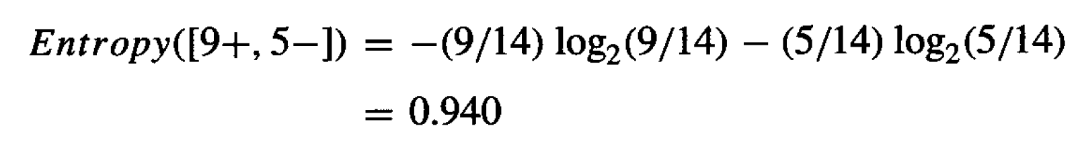
TechCoreEasy
id | outlook | temp | humidity | windy | play
1 | sunny | hot | high | FALSE | no
2 | sunny | hot | high | TRUE | no
3 | overcast | hot | high | FALSE | yes
4 | rainy | mild | high | FALSE | yes
5 | rainy | cool | normal | FALSE | yes
6 | rainy | cool | normal | TRUE | no
7 | overcast | cool | normal | TRUE | yes
8 | sunny | mild | high | FALSE | no
9 | sunny | cool | normal | FALSE | yes
10 | rainy | mild | normal | FALSE | yes
11 | sunny | mild | normal | TRUE | yes
12 | overcast | mild | high | TRUE | yes
13 | overcast | hot | normal | FALSE | yes
14 | rainy | mild | high | TRUE | no

Slide 10
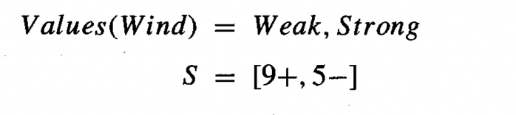
TechCoreEasy
id | outlook | temp | humidity | wind | play
1 | sunny | hot | high | weak | no
2 | sunny | hot | high | strong | no
3 | overcast | hot | high | weak | yes
4 | rainy | mild | high | weak | yes
5 | rainy | cool | normal | weak | yes
6 | rainy | cool | normal | strong | no
7 | overcast | cool | normal | strong | yes
8 | sunny | mild | high | weak | no
9 | sunny | cool | normal | weak | yes
10 | rainy | mild | normal | weak | yes
11 | sunny | mild | normal | strong | yes
12 | overcast | mild | high | strong | yes
13 | overcast | hot | normal | weak | yes
14 | rainy | mild | high | strong | no

Slide 11

TechCoreEasy
id | outlook | temp | humidity | wind | play
1 | sunny | hot | high | weak | no
2 | sunny | hot | high | strong | no
3 | overcast | hot | high | weak | yes
4 | rainy | mild | high | weak | yes
5 | rainy | cool | normal | weak | yes
6 | rainy | cool | normal | strong | no
7 | overcast | cool | normal | strong | yes
8 | sunny | mild | high | weak | no
9 | sunny | cool | normal | weak | yes
10 | rainy | mild | normal | weak | yes
11 | sunny | mild | normal | strong | yes
12 | overcast | mild | high | strong | yes
13 | overcast | hot | normal | weak | yes
14 | rainy | mild | high | strong | no

Slide 12

TechCoreEasy
id | outlook | temp | humidity | wind | play
1 | sunny | hot | high | weak | no
2 | sunny | hot | high | strong | no
3 | overcast | hot | high | weak | yes
4 | rainy | mild | high | weak | yes
5 | rainy | cool | normal | weak | yes
6 | rainy | cool | normal | strong | no
7 | overcast | cool | normal | strong | yes
8 | sunny | mild | high | weak | no
9 | sunny | cool | normal | weak | yes
10 | rainy | mild | normal | weak | yes
11 | sunny | mild | normal | strong | yes
12 | overcast | mild | high | strong | yes
13 | overcast | hot | normal | weak | yes
14 | rainy | mild | high | strong | no

Slide 13
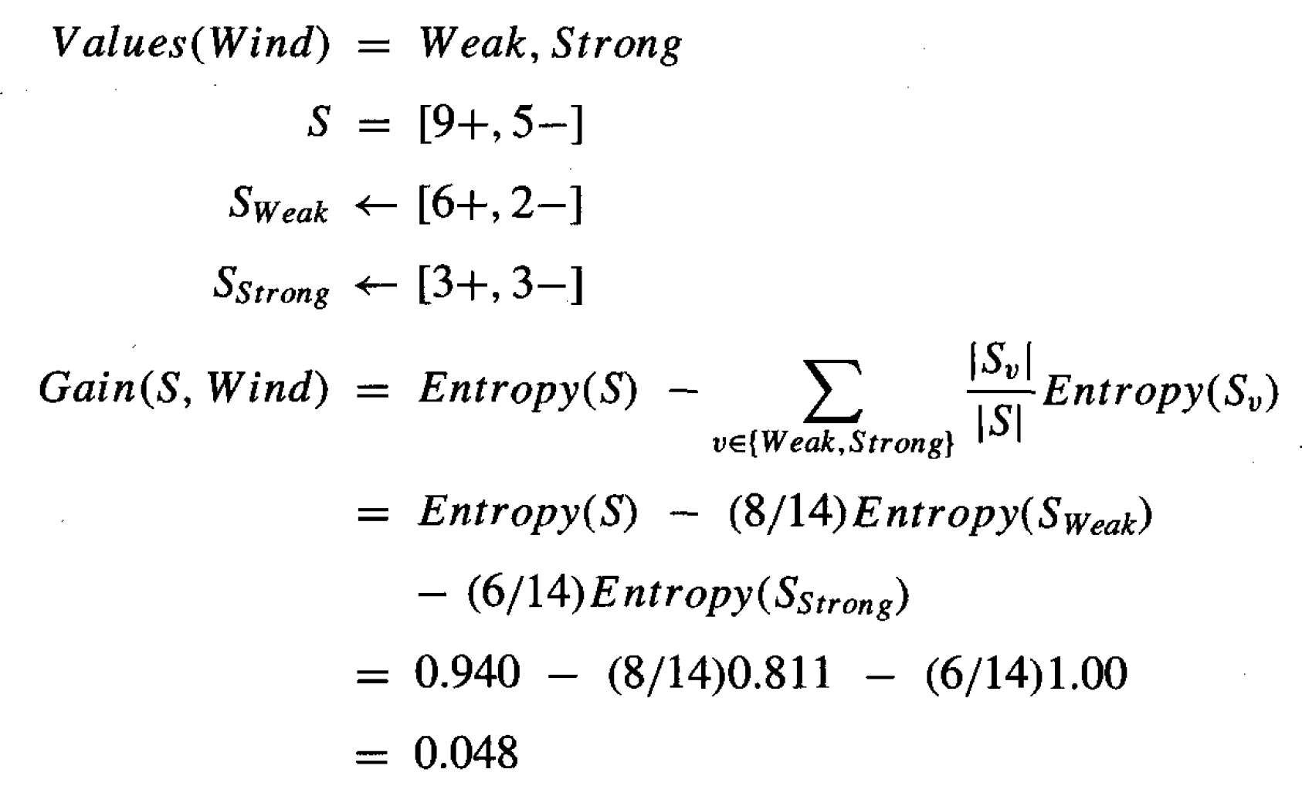
TechCoreEasy
id | outlook | temp | humidity | wind | play
1 | sunny | hot | high | weak | no
2 | sunny | hot | high | strong | no
3 | overcast | hot | high | weak | yes
4 | rainy | mild | high | weak | yes
5 | rainy | cool | normal | weak | yes
6 | rainy | cool | normal | strong | no
7 | overcast | cool | normal | strong | yes
8 | sunny | mild | high | weak | no
9 | sunny | cool | normal | weak | yes
10 | rainy | mild | normal | weak | yes
11 | sunny | mild | normal | strong | yes
12 | overcast | mild | high | strong | yes
13 | overcast | hot | normal | weak | yes
14 | rainy | mild | high | strong | no

Slide 14
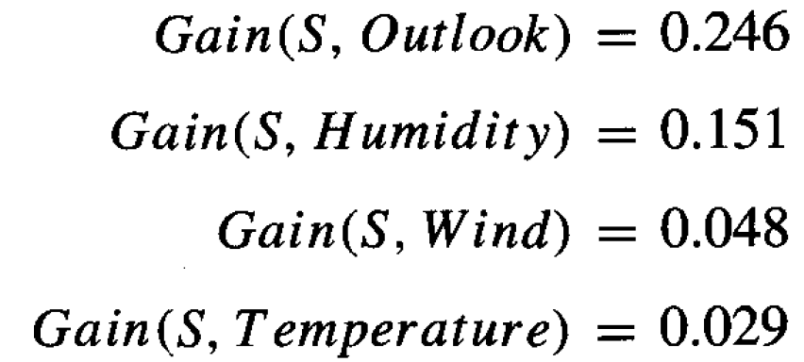
TechCoreEasy
id | outlook | temp | humidity | wind | play
1 | sunny | hot | high | weak | no
2 | sunny | hot | high | strong | no
3 | overcast | hot | high | weak | yes
4 | rainy | mild | high | weak | yes
5 | rainy | cool | normal | weak | yes
6 | rainy | cool | normal | strong | no
7 | overcast | cool | normal | strong | yes
8 | sunny | mild | high | weak | no
9 | sunny | cool | normal | weak | yes
10 | rainy | mild | normal | weak | yes
11 | sunny | mild | normal | strong | yes
12 | overcast | mild | high | strong | yes
13 | overcast | hot | normal | weak | yes
14 | rainy | mild | high | strong | no

Slide 15
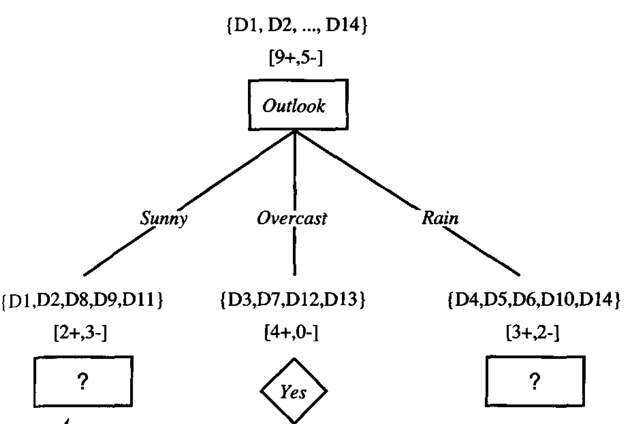
TechCoreEasy
id | outlook | temp | humidity | wind | play
1 | sunny | hot | high | weak | no
2 | sunny | hot | high | strong | no
3 | overcast | hot | high | weak | yes
4 | rainy | mild | high | weak | yes
5 | rainy | cool | normal | weak | yes
6 | rainy | cool | normal | strong | no
7 | overcast | cool | normal | strong | yes
8 | sunny | mild | high | weak | no
9 | sunny | cool | normal | weak | yes
10 | rainy | mild | normal | weak | yes
11 | sunny | mild | normal | strong | yes
12 | overcast | mild | high | strong | yes
13 | overcast | hot | normal | weak | yes
14 | rainy | mild | high | strong | no

Slide 16
TechCoreEasy
id | outlook | temp | humidity | wind | play
1 | sunny | hot | high | weak | no
2 | sunny | hot | high | strong | no
3 | overcast | hot | high | weak | yes
4 | rainy | mild | high | weak | yes
5 | rainy | cool | normal | weak | yes
6 | rainy | cool | normal | strong | no
7 | overcast | cool | normal | strong | yes
8 | sunny | mild | high | weak | no
9 | sunny | cool | normal | weak | yes
10 | rainy | mild | normal | weak | yes
11 | sunny | mild | normal | strong | yes
12 | overcast | mild | high | strong | yes
13 | overcast | hot | normal | weak | yes
14 | rainy | mild | high | strong | no

Slide 17
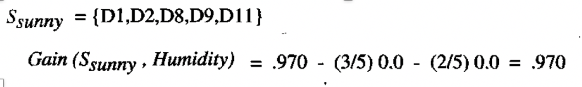
TechCoreEasy
id | outlook | temp | humidity | wind | play
1 | sunny | hot | high | weak | no
2 | sunny | hot | high | strong | no
3 | overcast | hot | high | weak | yes
4 | rainy | mild | high | weak | yes
5 | rainy | cool | normal | weak | yes
6 | rainy | cool | normal | strong | no
7 | overcast | cool | normal | strong | yes
8 | sunny | mild | high | weak | no
9 | sunny | cool | normal | weak | yes
10 | rainy | mild | normal | weak | yes
11 | sunny | mild | normal | strong | yes
12 | overcast | mild | high | strong | yes
13 | overcast | hot | normal | weak | yes
14 | rainy | mild | high | strong | no

Slide 18
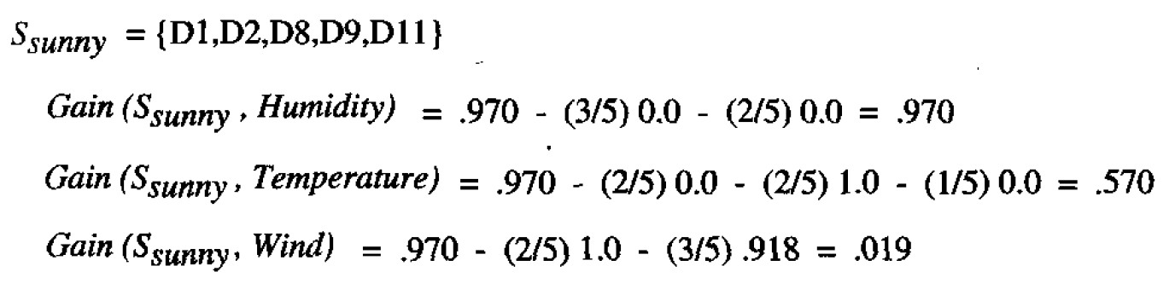
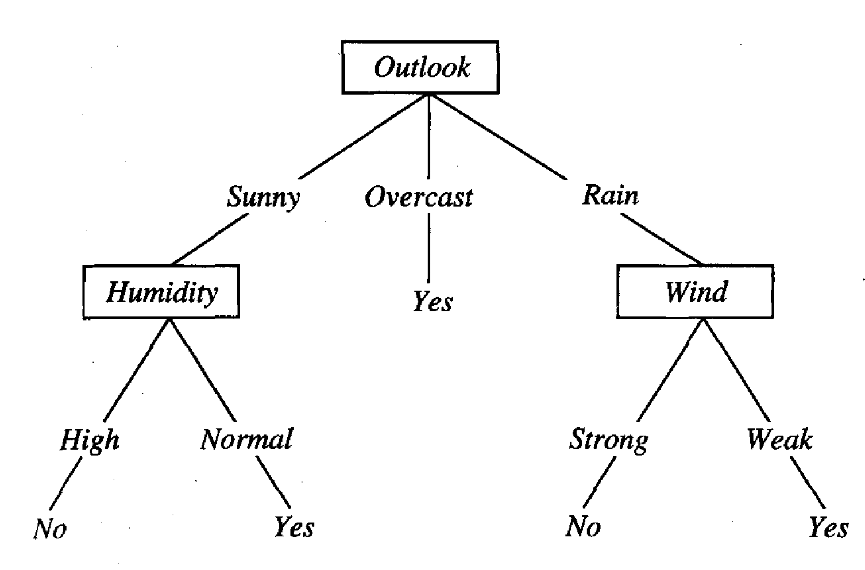
TechCoreEasy
id | outlook | temp | humidity | wind | play
1 | sunny | hot | high | weak | no
2 | sunny | hot | high | strong | no
3 | overcast | hot | high | weak | yes
4 | rainy | mild | high | weak | yes
5 | rainy | cool | normal | weak | yes
6 | rainy | cool | normal | strong | no
7 | overcast | cool | normal | strong | yes
8 | sunny | mild | high | weak | no
9 | sunny | cool | normal | weak | yes
10 | rainy | mild | normal | weak | yes
11 | sunny | mild | normal | strong | yes
12 | overcast | mild | high | strong | yes
13 | overcast | hot | normal | weak | yes
14 | rainy | mild | high | strong | no

Slide 19
TechCoreEasy
id | outlook | temp | humidity | wind | play
1 | sunny | hot | high | weak | no
2 | sunny | hot | high | strong | no
3 | overcast | hot | high | weak | yes
4 | rainy | mild | high | weak | yes
5 | rainy | cool | normal | weak | yes
6 | rainy | cool | normal | strong | no
7 | overcast | cool | normal | strong | yes
8 | sunny | mild | high | weak | no
9 | sunny | cool | normal | weak | yes
10 | rainy | mild | normal | weak | yes
11 | sunny | mild | normal | strong | yes
12 | overcast | mild | high | strong | yes
13 | overcast | hot | normal | weak | yes
14 | rainy | mild | high | strong | no
15 | sunny | cool | high | weak | ?

Slide 20
TechCoreEasy
id | outlook | temp | humidity | wind | play
1 | sunny | hot | high | weak | no
2 | sunny | hot | high | strong | no
3 | overcast | hot | high | weak | yes
4 | rainy | mild | high | weak | yes
5 | rainy | cool | normal | weak | yes
6 | rainy | cool | normal | strong | no
7 | overcast | cool | normal | strong | yes
8 | sunny | mild | high | weak | no
9 | sunny | cool | normal | weak | yes
10 | rainy | mild | normal | weak | yes
11 | sunny | mild | normal | strong | yes
12 | overcast | mild | high | strong | yes
13 | overcast | hot | normal | weak | yes
14 | rainy | mild | high | strong | no
15 | sunny | cool | high | weak | No

Slide 21
TechCoreEasy
Pros:
Compared to other algorithms decision trees requires less effort.
A decision tree does not require normalization of data.
A decision tree does not require scaling of data as well.
Missing values Handling.
Intuitive and easy to explain to technical teams as well as stakeholders.

Slide 22
TechCoreEasy
Cons:
A small change in the data can cause a large change in the structure of the decision tree causing instability.
For a Decision tree sometimes calculation can go far more complex compared to other algorithms.
Decision tree often involves higher time to train the model.
Decision tree training is relatively expensive as complexity and time taken is more.

Slide 23
TechCoreEasy
Applications :
Biomedical Engineering (decision trees for identifying features to be used in implantable devices).
Financial analysis (Customer Satisfaction with a product or service).
Astronomy (classify galaxies).
System Control.
Manufacturing and Production (Quality control, Semiconductor manufacturing, etc).
Medicines (diagnosis, cardiology, psychiatry).
Physics (Particle detection).

Slide 24
TechCoreEasy
Quick Recap

Slide 25

TechCoreEasy

