Slide 1
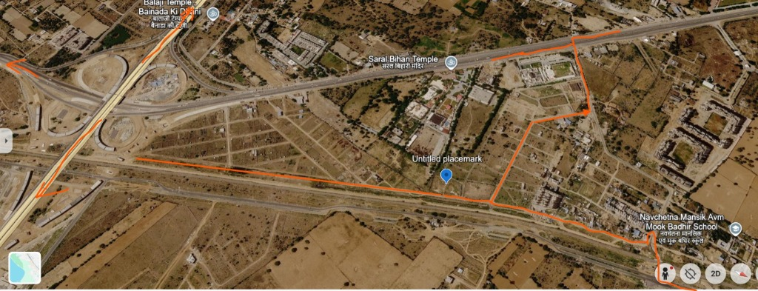
JAIPUR COMPLETE CORRIDOR ACCESS ANALYSIS
📍 Saral Bihari Corridor | Untitled Placemark | Navchetna School | Ring Road Interchange
CORRIDOR TELEMETRY
🛣️ Highway Ingress: Direct grade access off arterial corridor near Saral Bihari Temple
📍 Untitled Placemark: Prime development sector pinpointed at 26°44'10.69"N, 75°52'21.88"E
🏫 Educational Landmark: Navchetna Mansik Avm Mook Badhir School terminal junction
🔄 Multi-Directional: Seamless bi-directional circulation to Balaji Temple & Western Link

Slide 2
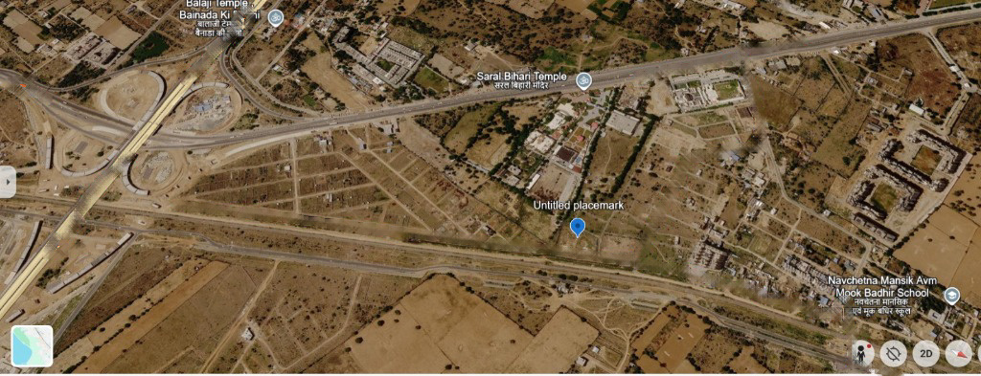
MASTER SITE ACCESS & ROUTE NETWORK PLAN

