Slide 1
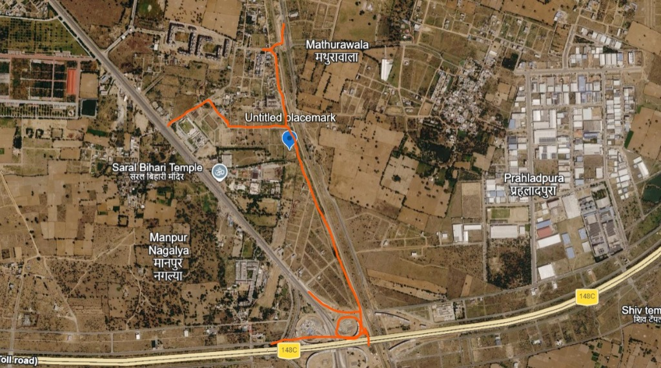
JAIPUR SITE COMPLETE CORRIDOR ACCESS & HIGHWAY CONNECTIVITY
📍 GPS: 26°44'10.69"N, 75°52'21.88"E | JAIPUR RING ROAD (148C / TOLL ROAD)
KEY ROUTE ANNOTATIONS
1️⃣ Highway Ingress (West):
Entry from west road corridor passing Saral Bihari Temple.
2️⃣ Untitled Placemark Pin:
Central survey base at 26°44'10.69"N, 75°52'21.88"E.
3️⃣ North Arm (Mathurawala):
Connecting north towards Mathurawala sector grid.
4️⃣ Southbound Corridor Link:
Straight linear bypass connecting south to Jaipur Ring Road.
5️⃣ Jaipur Ring Rd (148C / Toll):
Multi-lane high-speed expressway interchange loop.

