Slide 1
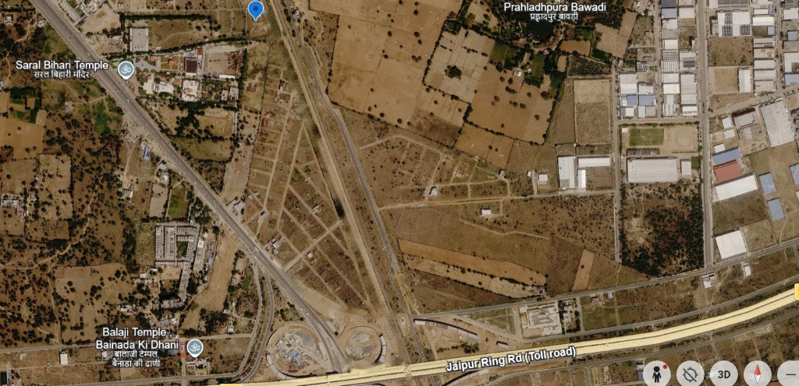
📍 GPS TARGET: 26°44'10.69"N, 75°52'21.88"E | ZONE: JAIPUR RING ROAD (TOLL ROAD) CORRIDOR
EXECUTIVE ROUTE NAVIGATION
Real-Time Route & Access Corridor Study
High-visibility geospatial tracking, turn-by-turn road alignment, and direct highway connectivity for the marked survey parcel.
▸ Target Coordinate: 26°44'10.69"N 75°52'21.88"E
▸ Expressway Access: Jaipur Ring Rd Direct Link
▸ Ingress Classification: Dual-Tier Arterial & Sector

Slide 2
SLIDE 02 // MACRO OVERVIEW - DIRECT ROUTE TO JAIPUR RING ROAD
GPS: 26°44'10.69"N, 75°52'21.88"E | CORRIDOR LENGTH: ~1.2 KM
CORRIDOR POINT-OUT
Key Road Elements Marked:
📍 Origin Pin: North sector starting point at 26°44'10.69"N, 75°52'21.88"E.
🛣️ Orange Main Corridor: High-capacity direct bypass path heading South-Southeast.
🔄 Secondary Ingress Loop: Curved orange feeder providing transit access to western residential/commercial plots.
🏁 Highway Terminal: Direct merging onto Jaipur Ring Road (Toll road).
🏛️ Nearby Landmarks: Saral Bihari Temple (NW), Balaji Temple (SW), Prahladhpura Bawadi (NE).

Slide 3
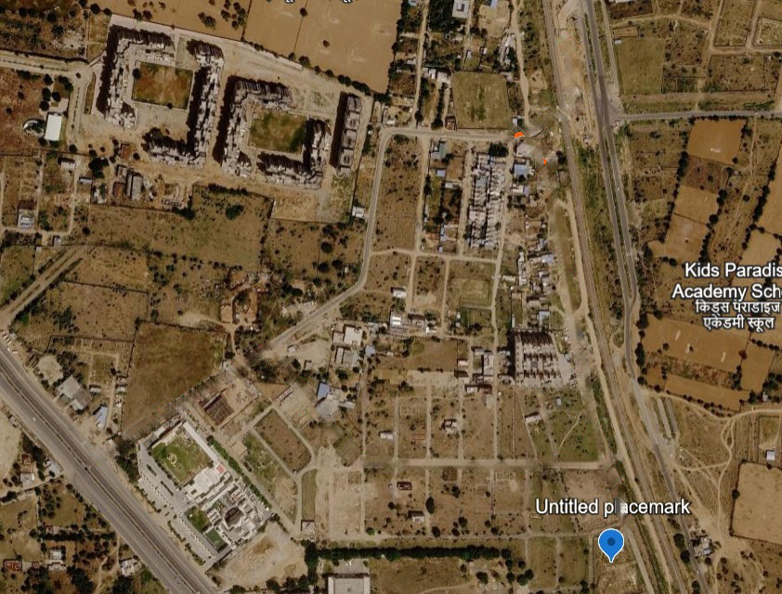
SLIDE 03 // MICRO NAVIGATION - TURN-BY-TURN INGRESS / EGRESS ROUTE
START: UNTITLED PLACEMARK ➔ END: ARTERIAL HIGHWAY ACCESS ROAD
TURN-BY-TURN MILESTONES
1️⃣ START POINT (Placemark):
Origin at 'Untitled placemark' pin at South-East sector base.
2️⃣ NORTHBOUND TRACK (Straight):
Traversing North along the paved sector boundary road past Kids Paradise Academy School.
3️⃣ 90° WESTWARD TURN (Checkpoint):
Sharp left turn onto the transverse cross-sector street.
4️⃣ SOUTHWEST DIAGONAL CUT:
Navigating down the diagonal connecting feeder lane.
5️⃣ HIGHWAY JUNCTION (Exit):
Direct entry merge onto the primary Arterial Access Highway.

Slide 4
EXECUTIVE ENGINEERING & INFRASTRUCTURE FEASIBILITY MATRIX
📍 GPS Positioning
🛣️ Expressway Proximity
Coordinates 26°44'10.69"N, 75°52'21.88"E verified against Google Earth survey data.
Direct feeder loop connecting into Jaipur Ring Road Toll Expressway in < 450 meters.
🚚 Logistics Clearance
⚡ Ingress Redundancy
Two-lane approach road with wide turning radius capable of heavy commercial vehicular transit.
Dual ingress paths prevent bottlenecks and allow separate passenger/commercial vehicle routing.

