Slide 1
Caching

Slide 2
What is Caching ?
Technique used for the performance improvement of a system
In computing, a cache is a high-speed data storage layer which stores a subset of data, typically transient in nature, so that future requests for that data are served up faster than is possible by accessing the data’s primary storage location.
Allows we to efficiently reuse previously retrieved or computed data.

Slide 3
How does Caching work?
The data in a cache is generally stored in fast access hardware such as RAM (Random-access memory) and may also be used in correlation with a software component.
A cache's primary purpose is to increase data retrieval performance by reducing the need to access the underlying slower storage layer.
Trading off capacity for speed, a cache typically stores a subset of data transiently, in contrast to databases whose data is usually complete and durable.

Slide 4
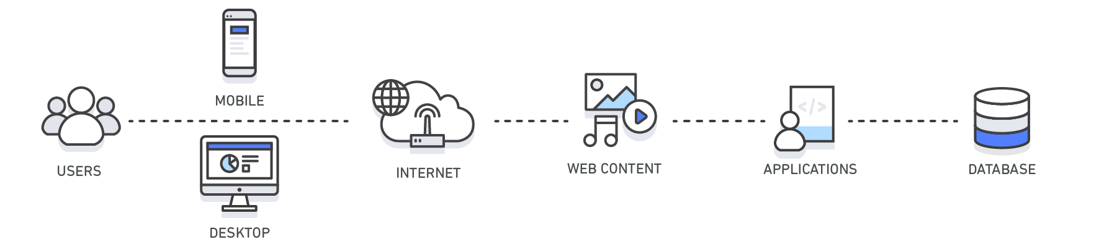
Working of caching
Layer | Client-Side | DNS | Web | App | Database
Use Case | Accelerate retrieval of web content from websites (browser or device) | Domain to IP Resolution | Accelerate retrieval of web content from web/app servers. Manage Web Sessions (server side) | Accelerate application performance and data access | Reduce latency associated with database query requests
Technologies | HTTP Cache Headers, Browsers | DNS Servers | HTTP Cache Headers, CDNs, Reverse Proxies, Web Accelerators, Key/Value Stores | Key/Value data stores, Local caches | Database buffers, Key/Value data stores
Solutions | Browser Specific | Amazon Route 53 | Amazon CloudFront, ElastiCache for Redis, ElastiCache for Memcached, Partner Solutions | Application Frameworks, ElastiCache for Redis, ElastiCache for Memcached, Partner Solutions | ElastiCache for Redis, ElastiCache for Memcached
Notes:
RAM and In-Memory Engines: Due to the high request rates or IOPS (Input/Output operations per second) supported by RAM and In-Memory engines, caching results in improved data retrieval performance and reduces cost at scale. To support the same scale with traditional databases and disk-based hardware, additional resources would be required. These additional resources drive up cost and still fail to achieve the low latency performance provided by an In-Memory cache.
Applications: Caches can be applied and leveraged throughout various layers of technology including Operating Systems, Networking layers including Content Delivery Networks (CDN) and DNS, web applications, and Databases. we can use caching to significantly reduce latency and improve IOPS for many read-heavy application workloads, such as Q&A portals, gaming, media sharing, and social networking. Cached information can include the results of database queries, computationally intensive calculations, API requests/responses and web artifacts such as HTML, JavaScript, and image files. Compute-intensive workloads that manipulate data sets, such as recommendation engines and high-performance computing simulations also benefit from an In-Memory data layer acting as a cache. In these applications, very large data sets must be accessed in real-time across clusters of machines that can span hundreds of nodes. Due to the speed of the underlying hardware, manipulating this data in a disk-based store is a significant bottleneck for these applications.
Design Patterns: In a distributed computing environment, a dedicated caching layer enables systems and applications to run independently from the cache with their own lifecycles without the risk of affecting the cache. The cache serves as a central layer that can be accessed from disparate systems with its own lifecycle and architectural topology. This is especially relevant in a system where application nodes can be dynamically scaled in and out. If the cache is resident on the same node as the application or systems utilizing it, scaling may affect the integrity of the cache. In addition, when local caches are used, they only benefit the local application consuming the data. In a distributed caching environment, the data can span multiple cache servers and be stored in a central location for the benefit of all the consumers of that data.
Caching Best Practices: When implementing a cache layer, it’s important to understand the validity of the data being cached. A successful cache results in a high hit rate which means the data was present when fetched. A cache miss occurs when the data fetched was not present in the cache. Controls such as TTLs (Time to live) can be applied to expire the data accordingly. Another consideration may be whether or not the cache environment needs to be Highly Available, which can be satisfied by In-Memory engines such as Redis. In some cases, an In-Memory layer can be used as a standalone data storage layer in contrast to caching data from a primary location. In this scenario, it’s important to define an appropriate RTO (Recovery Time Objective--the time it takes to recover from an outage) and RPO (Recovery Point Objective--the last point or transaction captured in the recovery) on the data resident in the In-Memory engine to determine whether or not this is suitable. Design strategies and characteristics of different In-Memory engines can be applied to meet most RTO and RPO requirements.

Slide 5
Types of Caching
Database Caching
Database caching allows we to dramatically increase throughput and lower the data retrieval latency associated with backend databases, which as a result, improves the overall performance of our applications.
The cache acts as an adjacent data access layer to our database that our applications can utilize in order to improve performance. A database cache layer can be applied in front of any type of database, including relational and NoSQL databases.
Common techniques used to load data into we’re a cache include lazy loading and write-through methods.
Notes:
https://aws.amazon.com/caching/database-caching/

Slide 6
Types of Caching
Content Delivery Network (CDN)
A CDN provides we the ability to utilize its global network of edge locations to deliver a cached copy of web content such as videos, webpages, images and so on to our customers.
To reduce response time, the CDN utilizes the nearest edge location to the customer or originating request location in order to reduce the response time.
Throughput is dramatically increased given that the web assets are delivered from cache. For dynamic data, many CDNs can be configured to retrieve data from the origin servers.
Notes:
https://aws.amazon.com/caching/cdn/
When our web traffic is geo-dispersed, it’s not always feasible and certainly not cost effective to replicate our entire infrastructure across the globe. A CDN provides we the ability to utilize its global network of edge locations to deliver a cached copy of web content such as videos, webpages, images and so on to our customers. To reduce response time, the CDN utilizes the nearest edge location to the customer or originating request location in order to reduce the response time. Throughput is dramatically increased given that the web assets are delivered from cache. For dynamic data, many CDNs can be configured to retrieve data from the origin servers.
Amazon CloudFront is a global CDN service that accelerates delivery of our websites, APIs, video content or other web assets. It integrates with other Amazon Web Services products to give developers and businesses an easy way to accelerate content to end users with no minimum usage commitments. To learn more about CDNs, click here.

Slide 7
Types of Caching
Session Management
HTTP sessions contain the user data exchanged between our site users and our web applications such as login information, shopping cart lists, previously viewed items and so on.
Critical to providing great user experiences on our website is managing our HTTP sessions effectively by remembering our user’s preferences and providing rich user context.
Domain Name System (DNS) Caching
Every domain request made on the internet essentially queries DNS cache servers in order to resolve the IP address associated with the domain name.
DNS caching can occur on many levels including on the OS, via ISPs and DNS servers.
Notes:
Session Management
HTTP sessions contain the user data exchanged between our site users and our web applications such as login information, shopping cart lists, previously viewed items and so on. Critical to providing great user experiences on our website is managing our HTTP sessions effectively by remembering our user’s preferences and providing rich user context. With modern application architectures, utilizing a centralized session management data store is the ideal solution for a number of reasons including providing, consistent user experiences across all web servers, better session durability when our fleet of web servers is elastic and higher availability when session data is replicated across cache servers.
Domain Name System (DNS) Caching
Every domain request made on the internet essentially queries DNS cache servers in order to resolve the IP address associated with the domain name. DNS caching can occur on many levels including on the OS, via ISPs and DNS servers.
Amazon Route 53 is a highly available and scalable cloud Domain Name System (DNS) web service.
Amazon Route 53 is a highly available and scalable cloud Domain Name System (DNS) web service.

Slide 8
Types of Caching
Application Programming Interfaces (APIs)
For example, we exposed a product listing API to our users and our product categories only change once per day.
Given that the response to a product category request will be identical throughout the day every time a call to our API is made, it would be sufficient to cache our API response for the day.
By caching our API response, we eliminate pressure to our infrastructure including our application servers and databases.
We also gain from faster response times and deliver a more performant API.
Notes:
Today, most web applications are built upon APIs. An API generally is a RESTful web service that can be accessed over HTTP and exposes resources that allow the user to interact with the application. When designing an API, it’s important to consider the expected load on the API, the authorization to it, the effects of version changes on the API consumers and most importantly the API’s ease of use, among other considerations. It’s not always the case that an API needs to instantiate business logic and/or make a backend requests to a database on every request. Sometimes serving a cached result of the API will deliver the most optimal and cost-effective response. This is especially true when we are able to cache the API response to match the rate of change of the underlying data. Say for example, we exposed a product listing API to our users and our product categories only change once per day. Given that the response to a product category request will be identical throughout the day every time a call to our API is made, it would be sufficient to cache our API response for the day. By caching our API response, we eliminate pressure to our infrastructure including our application servers and databases. we also gain from faster response times and deliver a more performant API.
Amazon API Gateway is a fully managed service that makes it easy for developers to create, publish, maintain, monitor, and secure APIs at any scale.

Slide 9
Types of Caching
Caching for Hybrid Environments
Web Caching
General Cache
Integrated Cache
Notes:
Caching for Hybrid Environments
In a hybrid cloud environment, we may have applications that live in the cloud and require frequent access to an on-premises database. There are many network topologies that can by employed to create connectivity between our cloud and on-premises environment including VPN and Direct Connect. And while latency from the VPC to our on-premises data center may be low, it may be optimal to cache our on-premises data in our cloud environment to speed up overall data retrieval performance.
Web Caching
When delivering web content to our viewers, much of the latency involved with retrieving web assets such as images, html documents, video, etc. can be greatly reduced by caching those artifacts and eliminating disk reads and server load. Various web caching techniques can be employed both on the server and on the client side. Server side web caching typically involves utilizing a web proxy which retains web responses from the web servers it sits in front of, effectively reducing their load and latency. Client side web caching can include browser based caching which retains a cached version of the previously visited web content. For more information on Web Caching, click here.
General Cache
Accessing data from memory is orders of magnitude faster than accessing data from disk or SSD, so leveraging data in cache has a lot of advantages. For many use-cases that do not require transactional data support or disk based durability, using an in-memory key-value store as a standalone database is a great way to build highly performant applications. In addition to speed, application benefits from high throughput at a cost-effective price point. Referenceable data such product groupings, category listings, profile information, and so on are great use cases for a general cache. For more information on general cache, click here.
Integrated Cache
An integrated cache is an in-memory layer that automatically caches frequently accessed data from the origin database. Most commonly, the underlying database will utilize the cache to serve the response to the inbound database request given the data is resident in the cache. This dramatically increases the performance of the database by lowering the request latency and reducing CPU and memory utilization on the database engine. An important characteristic of an integrated cache is that the data cached is consistent with the data stored on disk by the database engine.

Slide 10
Benefits of Caching
Improve Application Performance
Reduce Database Cost
Reduce the Load on the Backend
Predictable Performance
Eliminate Database Hotspots
Increase Read Throughput (IOPS)

Slide 11
Caching Best Practices
How to apply caching
Caching is applicable to a wide variety of use cases, but fully exploiting caching requires some planning. When deciding whether to cache a piece of data, consider the following questions:
Is it safe to use a cached value?
The same piece of data can have different consistency requirements in different contexts.
For example, during online checkout, we need the authoritative price of an item, so caching might not be appropriate. On other pages, however, the price might be a few minutes out of date without a negative impact on users.
Is caching effective for that data?
Some applications generate access patterns that are not suitable for caching—
for example, sweeping through the key space of a large dataset that is changing frequently. In this case, keeping the cache up to date could offset any advantage caching could offer.
Is the data structured well for caching?
Simply caching a database record can often be enough to offer significant performance advantages. However, other times, data is best cached in a format that combines multiple records together. Because caches are simple key-value stores, we might also need to cache a data record in multiple different formats, so we can access it by different attributes in the record.
We don’t need to make all of these decisions up front. As we expand our usage of caching, keep these guidelines in mind when deciding whether to cache a given piece of data.

Slide 12
Caching Best Practices
How to apply caching
Is the data structured well for caching?
Simply caching a database record can often be enough to offer significant performance advantages.
However, other times, data is best cached in a format that combines multiple records together.
Because caches are simple key-value stores, we might also need to cache a data record in multiple different formats, so we can access it by different attributes in the record.
We don’t need to make all of these decisions up front. As we expand our usage of caching, keep these guidelines in mind when deciding whether to cache a given piece of data.

Slide 13
Caching design patterns
Lazy caching
Write-through

Slide 14
Caching design patterns
Lazy caching
Lazy caching, also called lazy population or cache-aside, is the most prevalent form of caching. Laziness should serve as the foundation of any good caching strategy.
The basic idea is to populate the cache only when an object is actually requested by the application. The overall application flow goes like this:
Our app receives a query for data, for example the top 10 most recent news stories.
Our app checks the cache to see if the object is in cache.
If so (a cache hit), the cached object is returned, and the call flow ends.
If not (a cache miss), then the database is queried for the object. The cache is populated, and the object is returned.

Slide 15
Caching design patterns
Lazy caching
Advantages
The cache only contains objects that the application actually requests, which helps keep the cache size manageable. New objects are only added to the cache as needed. We can then manage our cache memory passively, by simply letting the engine we are using evict the least-accessed keys as our cache fills up, which it does by default.
As new cache nodes come online, for example as our application scales up, the lazy population method will automatically add objects to the new cache nodes when the application first requests them.
Cache expiration is easily handled by simply deleting the cached object. A new object will be fetched from the database the next time it is requested.
Lazy caching is widely understood, and many web and app frameworks include support out of the box.

Slide 16
Caching design patterns Lazy caching Example – pseudocode
# Python
def get_user(user_id):
# Check the cache
record = cache.get(user_id)
if record is None:
# Run a DB query
record = db.query("select * from users where id= ?",user_id)
# Populate the cache
cache.set(user_id, record)
return record
# App code
user = get_user(17)
Notes:
we can find libraries in many popular programming frameworks that encapsulate this pattern. But regardless of programming language, the overall approach is the same.
we should apply a lazy caching strategy anywhere in our app where we have data that is going to be read often, but written infrequently. In a typical web or mobile app, for example, a user's profile rarely changes, but is accessed throughout the app. A person might only update his or her profile a few times a year, but the profile might be accessed dozens or hundreds of times a day, depending on the user. Popular technologies that are used for caching like Memcached and Redis will automatically evict the less frequently used cache keys to free up memory if we set an eviction policy. Thus we can apply lazy caching liberally with little downside.

Slide 17
Caching design patterns
Write-through
In a write-through cache, the cache is updated in real time when the database is updated.
So, if a user updates his or her profile, the updated profile is also pushed into the cache
# Python
def save_user(user_id, values):
# Save to DB
record = db.query("update users ... where id = ?", user_id, values)
# Push into cache
cache.set(user_id, record)
return record
# App code
user = save_user(17, {"name": "Nate Dogg"}).
Notes:
In a write-through cache, the cache is updated in real time when the database is updated. So, if a user updates his or her profile, the updated profile is also pushed into the cache. we can think of this as being proactive to avoid unnecessary cache misses, in the case that we have data that we absolutely know is going to be accessed. A good example is any type of aggregate, such as a top 100 game leaderboard, or the top 10 most popular news stories, or even recommendations. Because this data is typically updated by a specific piece of application or background job code, it's straightforward to update the cache as well.
The write-through pattern is also easy to demonstrate in pseudocode:

Slide 18
Caching design patterns
Write Through
Advantages over lazy population:
It avoids cache misses, which can help the application perform better and feel snappier.
It shifts any application delay to the user updating data, which maps better to user expectations. By contrast, a series of cache misses can give a user the impression that our app is just slow.
It simplifies cache expiration. The cache is always up-to-date.
Disadvantages over lazy population:
The cache can be filled with unnecessary objects that aren't actually being accessed. Not only could this consume extra memory, but unused items can evict more useful items out of the cache.
It can result in lots of cache churn if certain records are updated repeatedly.
When (not if) cache nodes fail, those objects will no longer be in the cache. we need some way to repopulate the cache of missing objects, for example by lazy population.
Notes:
As might be obvious, we can combine lazy caching with write-through caching to help address these issues, because they are associated with opposite sides of the data flow. Lazy caching catches cache misses on reads, and write-through caching populates data on writes, so the two approaches complement each other. For this reason, it's often best to think of lazy caching as a foundation that we can use throughout our app, and write-through caching as a targeted optimization that we apply to specific situations.

Slide 19
Caching design patterns
Time-to-live
Cache expiration can get really complex really quickly. In our previous examples, we were only operating on a single user record. In a real app, a given page or screen often caches a whole bunch of different stuff at once—profile data, top news stories, recommendations, comments, and so forth, all of which are being updated by different methods.
Unfortunately, there is no silver bullet for this problem, and cache expiration is a whole arm of computer science. But there are a few simple strategies that we can use:
Always apply a time to live (TTL) to all of our cache keys, except those we are updating by write-through caching. we can use a long time, say hours or even days. This approach catches application bugs, where we forget to update or delete a given cache key when updating the underlying record. Eventually, the cache key will auto-expire and get refreshed.
For rapidly changing data such as comments, leaderboards, or activity streams, rather than adding write-through caching or complex expiration logic, just set a short TTL of a few seconds. If we have a database query that is getting hammered in production, it's just a few lines of code to add a cache key with a 5 second TTL around the query. This code can be a wonderful Band-Aid to keep our application up and running while we evaluate more elegant solutions.
A newer pattern, Russian doll caching, has come out of work done by the Ruby on Rails team. In this pattern, nested records are managed with their own cache keys, and then the top-level resource is a collection of those cache keys. Say we have a news webpage that contains users, stories, and comments. In this approach, each of those is its own cache key, and the page queries each of those keys respectively.
When in doubt, just delete a cache key if we're not sure whether it's affected by a given database update or not. our lazy caching foundation will refresh the key when needed. In the meantime, our database will be no worse off than it was without caching.

Slide 20
Caching design patterns
Evictions
Evictions occur when memory is over filled or greater than maxmemory setting in the cache, resulting into the engine to select keys to evict in order to manage its memory.
The keys that are chosen are based on the eviction policy that is selected.
A good strategy in selecting an appropriate eviction policy is to consider the data stored in our cluster and the outcome of keys being evicted.
Generally, Least Recently Used (LRU) based policies are more common for basic caching use-cases, but depending on our objectives, we may want to leverage a Time To Live (TTL) or Random based eviction policy if that better suits our requirements.
Notes:
By default, Amazon ElastiCache for Redis sets the volatile-lru eviction policy to our Redis cluster. This policy selects the least recently used keys that have an expiration (TTL) value set. Other eviction policies are available can be applied as configurable maxmemory-policy parameter. Eviction policies can be summarized as the following:
allkeys-lfu: The cache evicts the least frequently used (LFU) keys regardless of TTL set allkeys-lru: The cache evicts the least recently used (LRU) regardless of TTL set volatile-lfu: The cache evicts the least frequently used (LFU) keys from those that have a TTL set volatile-lru: The cache evicts the least recently used (LRU) from those that have a TTL set volatile-ttl: The cache evicts the keys with shortest TTL set volatile-random: The cache randomly evicts keys with a TTL set allkeys-random: The cache randomly evicts keys regardless of TTL set no-eviction: The cache doesn’t evict keys at all. This blocks future writes until memory frees up.
A good strategy in selecting an appropriate eviction policy is to consider the data stored in our cluster and the outcome of keys being evicted. Generally, LRU based policies are more common for basic caching use-cases, but depending on our objectives, we may want to leverage a TTL or Random based eviction policy if that better suits our requirements.
Also, if we are experiencing evictions with our cluster, it is usually a sign that we need to scale up (use a node that has a larger memory footprint) or scale out (add additional nodes to the cluster) in order to accommodate the additional data. An exception to this rule is if we are purposefully relying on the cache engine to manage our keys by means of eviction, also referred to an LRU cache.

Slide 21
Caching Design Patterns
The thundering herd
Also known as dog piling, the thundering herd effect is what happens when many different application processes simultaneously request a cache key, get a cache miss, and then each hits the same database query in parallel. The more expensive this query is, the bigger impact it has on the database. If the query involved is a top 10 query that requires ranking a large dataset, the impact can be a significant hit.
One problem with adding TTLs to all of our cache keys is that it can exacerbate this problem. For example, let's say millions of people are following a popular user on our site. That user hasn't updated his profile or published any new messages, yet his profile cache still expires due to a TTL. our database might suddenly be swamped with a series of identical queries.
Notes:
Also known as dog piling, the thundering herd effect is what happens when many different application processes simultaneously request a cache key, get a cache miss, and then each hits the same database query in parallel. The more expensive this query is, the bigger impact it has on the database. If the query involved is a top 10 query that requires ranking a large dataset, the impact can be a significant hit.
One problem with adding TTLs to all of our cache keys is that it can exacerbate this problem. For example, let's say millions of people are following a popular user on our site. That user hasn't updated his profile or published any new messages, yet his profile cache still expires due to a TTL. our database might suddenly be swamped with a series of identical queries.
TTLs aside, this effect is also common when adding a new cache node, because the new cache node's memory is empty. In both cases, the solution is to prewarm the cache by following these steps:
Write a script that performs the same requests that our application will. If it's a web app, this script can be a shell script that hits a set of URLs.
If our app is set up for lazy caching, cache misses will result in cache keys being populated, and the new cache node will fill up.
When we add new cache nodes, run our script before we attach the new node to our application. Because our application needs to be reconfigured to add a new node to the consistent hashing ring, insert this script as a step before triggering the app reconfiguration.
If we anticipate adding and removing cache nodes on a regular basis, prewarming can be automated by triggering the script to run whenever our app receives a cluster reconfiguration event through Amazon Simple Notification Service (Amazon SNS).
Finally, there is one last subtle side effect of using TTLs everywhere. If we use the same TTL length (say 60 minutes) consistently, then many of our cache keys might expire within the same time window, even after prewarming our cache. One strategy that's easy to implement is to add some randomness to our TTL:
ttl = 3600 + (rand() * 120) /* +/- 2 minutes */
Copy
The good news is that only sites at large scale typically have to worry about this level of scaling problem. It's good to be aware of, but it's also a good problem to have

Slide 22
Caching Design Patterns
The thundering herd
TTLs aside, this effect is also common when adding a new cache node, because the new cache node's memory is empty. In both cases, the solution is to prewarm the cache by following these steps:
Write a script that performs the same requests that our application will. If it's a web app, this script can be a shell script that hits a set of URLs.
If our app is set up for lazy caching, cache misses will result in cache keys being populated, and the new cache node will fill up.
When we add new cache nodes, run our script before we attach the new node to our application. Because our application needs to be reconfigured to add a new node to the consistent hashing ring, insert this script as a step before triggering the app reconfiguration.
If we anticipate adding and removing cache nodes on a regular basis, prewarming can be automated by triggering the script to run whenever our app receives a cluster reconfiguration event through Amazon Simple Notification Service (Amazon SNS).
Finally, there is one last subtle side effect of using TTLs everywhere. If we use the same TTL length (say 60 minutes) consistently, then many of our cache keys might expire within the same time window, even after prewarming our cache. One strategy that's easy to implement is to add some randomness to our TTL:
ttl = 3600 + (rand() * 120) /* +/- 2 minutes */
The good news is that only sites at large scale typically have to worry about this level of scaling problem. It's good to be aware of, but it's also a good problem to have
Notes:
Also known as dog piling, the thundering herd effect is what happens when many different application processes simultaneously request a cache key, get a cache miss, and then each hits the same database query in parallel. The more expensive this query is, the bigger impact it has on the database. If the query involved is a top 10 query that requires ranking a large dataset, the impact can be a significant hit.
One problem with adding TTLs to all of our cache keys is that it can exacerbate this problem. For example, let's say millions of people are following a popular user on our site. That user hasn't updated his profile or published any new messages, yet his profile cache still expires due to a TTL. our database might suddenly be swamped with a series of identical queries.
TTLs aside, this effect is also common when adding a new cache node, because the new cache node's memory is empty. In both cases, the solution is to prewarm the cache by following these steps:
Write a script that performs the same requests that our application will. If it's a web app, this script can be a shell script that hits a set of URLs.
If our app is set up for lazy caching, cache misses will result in cache keys being populated, and the new cache node will fill up.
When we add new cache nodes, run our script before we attach the new node to our application. Because our application needs to be reconfigured to add a new node to the consistent hashing ring, insert this script as a step before triggering the app reconfiguration.
If we anticipate adding and removing cache nodes on a regular basis, prewarming can be automated by triggering the script to run whenever our app receives a cluster reconfiguration event through Amazon Simple Notification Service (Amazon SNS).
Finally, there is one last subtle side effect of using TTLs everywhere. If we use the same TTL length (say 60 minutes) consistently, then many of our cache keys might expire within the same time window, even after prewarming our cache. One strategy that's easy to implement is to add some randomness to our TTL:
ttl = 3600 + (rand() * 120) /* +/- 2 minutes */
Copy
The good news is that only sites at large scale typically have to worry about this level of scaling problem. It's good to be aware of, but it's also a good problem to have

Slide 23
Caching technologies
The most popular caching technologies are in the in-memory Key-Value category of NoSQL databases.
An in-memory key-value store is a NoSQL database optimized for read-heavy application workloads (such as social networking, gaming, media sharing and Q&A portals) or compute-intensive workloads (such as a recommendation engine).
Two key benefits make in-memory key-value stores popular as caching solutions – speed and simplicity.
Key value stores don’t have complex query or aggregation logic, making queries fast. The in-memory key-value stores are especially fast due to them utilizing memory rather than slower disk.
In addition, their simplicity makes them easy to master and utilize. There are numerous key-value technologies available on the market, many of them could be used as caching solutions.
Two highly popular in-memory key-value stores are Memcached and Redis.
Notes:
AWS allows running both these engines in a fully managed fashion through Amazon ElastiCache.

Slide 24
Caching DEMO- Spring WebFlux Redis Integration
In the demo we will see that how we could improve the performance of our application with Spring WebFlux Redis Integration
Redis stands for Remote Dictionary Server. It is an in-memory, fastest NoSQL DB primarily used for caching the frequently used data. It also has so many other features which we talk.
In the Microservices architecture, we might some services and they talk to each other to get the tasks done! In some cases, some Microservices might receive a lot of GET requests to get specific information about a resource.
For example, a product-service might get frequent requests to get some product information. Instead of fetching the product information every time from DB, the Microservice might want to cache this information – so that we could avoid unnecessary DB calls which involves multiple table joins.
A microservice might cache this information in its local memory. But when we run multiple run instances of a same service, each and every instance has to store the information locally. But if the product information is updated, then we need to find a strategy to clear every instances local cache for the product. It is more challenging.
For microservices architecture, a distributed cache would be a better choice. This is where Spring Webflux Redis integration helps.

Slide 25
Caching DEMO- Spring WebFlux Redis Integration
Sample Application
Let’s consider a simple application, product-service which is responsible for providing product information based on the given id. Our underlying data source for the product service is a PostgreSQL DB. Our application will expose 2 APIs.
GET
API to provide the product info for the given product id
PATCH
API to update some product information.
Database Setup:
I use below docker-compose file to setup Postgres.
I have done volume-mapping to store the data on the disk under ‘data’ directory.
There is also a file called ‘init.sql‘ to create a table when the db server starts up.
See the init.sql and docker compose.yaml file for details

Slide 26

Caching DEMO- Spring WebFlux Redis Integration
Spring WebFlux Redis – Project Setup:
Let’s first create our application with the following dependencies.
Then create:
Product Entity
Product Repository
Product DTO
Entity to DTO convert util
Product Controller
application.properties
Product Service Interface
We are going to provide 2 different implementations for the above product service.
ProductServiceWithNoCache (An implementation which does not use Redis. Always talks to the DB)
ProductServiceWithRedisCache (An implementation which uses Redis Cache)
ProductServiceWithNoCache implementation
It is enabled when the property cache.enabled is set to false.

Slide 27
Caching DEMO- Spring WebFlux Redis Integration
ProductServiceWithRedisCache implementation
It is enabled when the property cache.enabled is set to true.
It simply extends the NoCache service.
When we receive the GET request, we would first check the cache, if it is present, we would simply return it. Otherwise, we would query the DB and store in the cache for future use.
When we receive any PUT/PATCH/DELETE request, we would update the DB first and then we clear the cache immediately. This is important. Otherwise we would serve stale data.
Run the application. Send a Get request and verify the response to see if everything works as expected.
// http://localhost:8080/product/2
{
"id":2,
"description":"Product2",
"price":1297,
"quantityAvailable":69
}

Slide 28
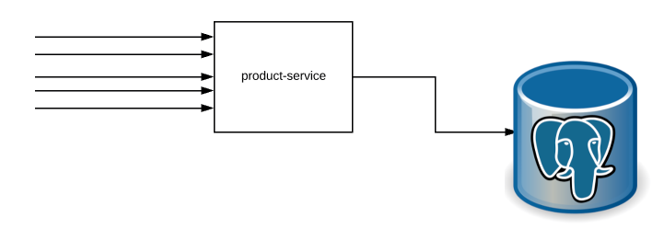
Caching DEMO- Spring WebFlux Redis Integration
Performance Run 1:
In our first performance test, We are not going to enable cache. So cache.enabled will be set to false. The application will talk to DB directly for all the GET/PATCH requests.
I created a simple performance test script using JMeter. I will be testing the application with below workload. There will be 200 concurrent users load.
180 concurrent users would be accessing the application – call the GET product request for a random product id.
20 concurrent requests would be made to the application to update the product available quantity (PATCH)

Slide 29
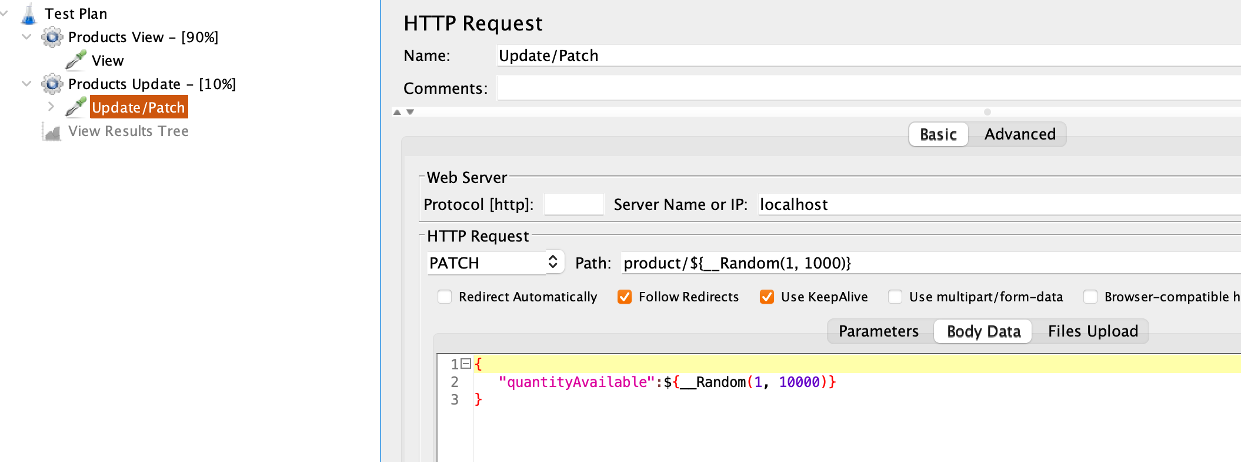
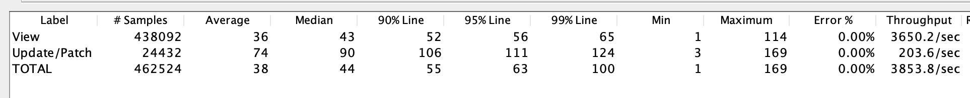
Caching DEMO- Spring WebFlux Redis Integration
Performance Run 1:
Results:
Without caching, our application was able to process ~3850 requests / second.

Slide 30
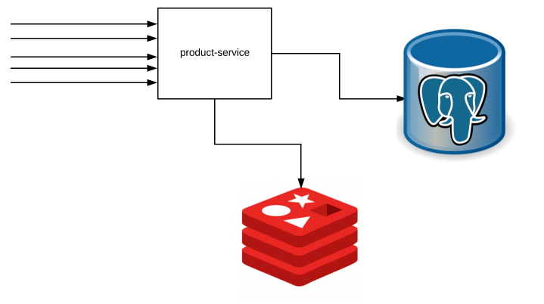
Caching DEMO- Spring WebFlux Redis Integration
Now let’s see how we can improve performance using Spring WebFlux Redis Integration!
Let’s bring Redis into our application by adding the redis container in our docker-compose yaml.
redis:
container_name: redis
image: redis
ports:
- 6379:6379
The idea here is – The app will check with Redis first before contacting the Postgres & if there is any product update, it would clear the cache to avoid serving stale data!
Restart the application by enabling the cache as shown here.
cache.enabled=true
Now at this point, Spring WebFlux is ready to use Redis for caching.

Slide 31
Caching DEMO- Spring WebFlux Redis Integration
Performance Run 2:
I reran the same performance test. If you see the result, The performance of our application has increased tremendously. Our application was able to process more than ~16000 requests / second just by adding Redis!

