Slide 1
Developing RESTful Services
Building RESTful Services

Slide 2
Chapter Overview
In this chapter, we will explore:
Understanding what a RESTful web service is
Building RESTful services with Spring Boot
Returning HTTP status codes

Slide 3
Chapter Concepts
RESTful Web Services
What Is Spring Boot?
Building RESTful Services with Spring Boot
HTTP Response Codes
Chapter Summary

Slide 4
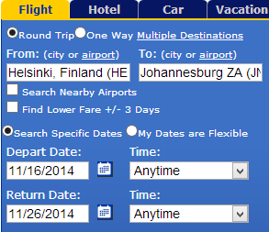
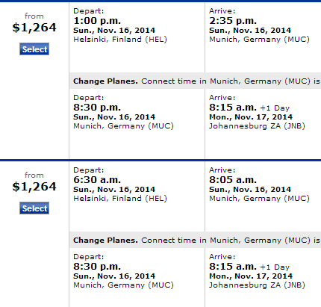
Web Application vs. Web Service
Web applications are meant for use by human users
Visual representation of information, interactive
Multiple steps (often stateful)

Slide 5
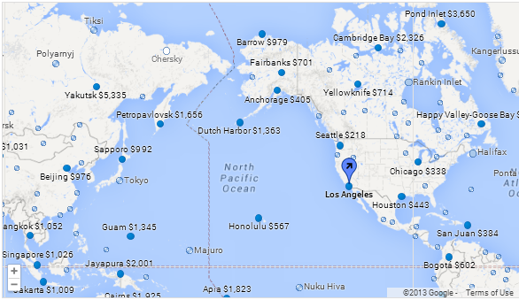
Web Application vs. Web Service (continued)
Web services are meant for use by automated applications
Machine-parseable representation of information
Often stateless
Web services are “behind the scenes” and are not readily apparent
How do you think this “mashup” at https://www.google.com/flights is created?
Notes:
The map shows fares to multiple cities from LAX on a specific date (try out the website).
Obviously, Google has built clients to multiple airline web services in order to monitor fares periodically. Point out that the scale is very different between web applications and web services.
The use cases are also very different.

Slide 6
SOAP Web Services
A SOAP-based web service
Advertises a WSDL interface
Contains everything needed to communicate with that service
All the request and response messages are in XML
Interoperable
Many different clients can communicate with the service
The data is wrapped inside of an XML SOAP message
Requests
Responses
Not the most convenient format for many clients
Ajax
JavaScript

Slide 7
A Simpler Web Service
REST-based web services
Communicate with a simpler format than SOAP-based web services
Simple XML
JavaScript Object Notation (JSON)
No Web Service Definition Language (WSDL) interface
Can provide a Web Application Definition Language (WADL) interface
Parameters often passed as part of the URL

Slide 8
REST-Based Web Services
Problem
Implementing a Service-Oriented Architecture requires:
Interoperable, loosely coupled ways of invoking services
Enterprise systems consist of many applications
Developed using many technologies
How to support communication between disparate systems?
Use HTTP as base protocol
Mature, standard protocol supported by all languages and operating systems
HTTP traffic is allowed through most firewalls
An SOA can be implemented with REST-based web services
Use HTTP as the network protocol
Use HTTP verbs to specify operations on resources
GET, POST, PUT, DELETE
Exchange simple text-based messages
In JSON, XML, etc.
Solution
Notes:
Answer: lower coupling.
The XML messages do not map so closely to the service methods. There are standards which serve to make things not so tightly coupled.

Slide 9
REST-Based Web Services (continued)
REST communication
Based on HTTP requests
Response can be in various formats
XML
JSON
REST Client
GET URL request
XML response
REST Web Service
POST URL request
JSON response
REST Client
Notes:
Answer: lower coupling.
The XML messages do not map so closely to the service methods. There are standards which serve to make things not so tightly coupled.

Slide 10
Exercise 1.1: Exploring the Time Service
30 min
Please refer to your Exercise Manual to complete this exercise

Slide 11
Chapter Concepts
RESTful Web Services
What Is Spring Boot?
Building RESTful Services with Spring Boot
HTTP Response Codes
Chapter Summary

Slide 12
Spring Boot
Provides “an opinionated view”¹ of how to build a Spring application
Minimizes Spring configuration for many applications
Makes it easy to create a stand-alone Spring-based application
That “just runs”
1. https://spring.io/projects/spring-boot

Slide 13
Spring Boot Features
Simplifies the creation of stand-alone Spring applications
Provides “opinionated” starter configuration options
Can embed a web server such as Tomcat
No need to deploy a war file to an external web server
Provides production features
Health checks
Application metrics
No code generation required
No XML configuration required

Slide 14
How Does Spring Boot Work?
It is opinionated
Makes reasonable default configuration settings
Example: a Spring Boot web application embeds the Tomcat web server
It is customizable
You can modify the Maven pom file
Override the “reasonable default” setting with your own setting value

Slide 15
Starters
Spring Boot Starter
A set of dependencies for a particular type of application
Some popular starters
spring-boot-starter-web
Used to build RESTful web services
Uses Spring MVC and embedded Tomcat
spring-boot-starter-jersey
Used to build RESTful web services
Uses Apache Jersey (JAX-RS) instead of Spring MVC
spring-boot-starter-jdbc
Used for JDBC connection pooling
Uses Tomcat’s JDBC connection pool implementation
There are many more starters available:
https://github.com/spring-projects/spring-boot/tree/master/spring-boot-project/spring-boot-starters

Slide 16
Spring Initializr
An even better approach to creating a Spring Boot project
https://start.spring.io/
The website lets you choose options to “bootstrap your application”
Creates a Maven (or Gradle) Spring Boot project
Includes a Maven pom.xml
Allows you to choose project dependencies
Developer tools
Web
Security
SQL/NO SQL
Testing
Cloud

Slide 17
AutoConfiguration
Spring Boot can automatically configure your application
Based on the jar files in the application’s classpath
And how the Spring managed beans are defined
Spring Boot will examine the jar files in the classpath
Forms an opinion on how to configure some behavior
Example: if the H2 database jar file is in the classpath, and no other DataSource beans are defined, the application will be configured with an in-memory database
Spring Boot will examine the Spring managed bean definitions
Example: if a JPA bean is annotated with @Entity, the application will be configured to use JPA without the need for a persistence.xml file
JPA: Java Persistence API

Slide 18
The All-in-One Jar File
Spring Boot aims to create an application that “just runs”
The application is packaged into a single, executable jar file
The “uber” jar file
All of the application dependencies are included in this jar file
The application is launched with a command like the following:
java –jar PATH_TO_EXECUTABLE/HelloWorld.jar
Notes:
1. https://docs.spring.io/spring-boot/docs/current/reference/htmlsingle/#executable-jar

Slide 19
Chapter Concepts
RESTful Web Services
What Is Spring Boot?
Building RESTful Services with Spring Boot
HTTP Response Codes
Chapter Summary

Slide 20
Configuration
Here is where the Spring Boot starters help us get jump started
A typical RESTful web service project has many dependencies
Spring MVC or JAX-RS
Tomcat
Jackson
Etc.
We can use the spring-boot-starter-web to simplify this

Slide 21
Maven Dependencies
<dependencies>
<dependency>
<groupId>org.springframework.boot</groupId>
<artifactId>spring-boot-starter-web</artifactId>
</dependency>
<dependency>
<groupId>org.springframework.boot</groupId>
<artifactId>spring-boot-starter-test</artifactId>
<scope>test</scope>
</dependency>
</dependencies>

Slide 22
The RestController
The RESTful service controller is a Java class
Annotated with Spring’s @RestController
Parameter to @RequestMapping is the first component of a URL path
Web service methods are annotated with Spring annotations
@GetMapping, @PostMapping, @PutMapping, @DeleteMapping, @PatchMapping
Parameters to annotations define remainder of URL that triggers each method
Example: return all Widgets for request GET http://…/warehouse/widgets
@RestController
@RequestMapping("/warehouse")
public class WarehouseService {
@GetMapping("/widgets")
public List<Widget> queryAllWidgets() {
…
}
}
First part of request URL
Last part of request URL

Slide 23
The RESTful Service GET Request
By default, Spring automatically converts return values to JSON
Throwing a Spring ServerErrorException sets HTTP response status to 500
Default content type of response is application/json
@GetMapping("/widgets")
public List<Widget> queryAllWidgets() {
List<Widget> widgets;
try {
widgets = dao.getAllWidgets();
}
catch (Exception ex) {
throw new ServerErrorException("Database error", ex);
}
if (widgets == null) {
throw new ServerErrorException("No widgets in database",
(Throwable) null);
}
return widgets;
}
Sets HTTP status 500
Sets HTTP status 500
Sets default HTTP status 200
Spring converts Java objects to JSON
[{"description": "Low Impact Widget", "id": 1, "price": 12.99, "gears": 2, "sprockets": 3}, …]
Notes:
Because ServerErrorException has two constructors each with two object parameters, the Throwable cast is required to resolve the call.

Slide 24
The RESTful Service POST Request
For POST and PUT requests, add a JavaBean parameter with @RequestBody
Default response content type is application/json
Wrap primitive return values in a JavaBean DTO to ensure response contains valid JSON
@PostMapping("/widgets")
public DatabaseRequestResult insertWidget(@RequestBody Widget widget) {
int count = 0;
try {
count = dao.insertWidget(widget);
}
catch (Exception ex) {
throw new ServerErrorException(
"Error communicating with the warehouse database", ex);
}
if (count == 0) {
throw new ServerWebInputException("can't insert widget " + widget);
}
return new DatabaseRequestResult(count);
}
Data Transfer Object (DTO) class
public class DatabaseRequestResult {
public DatabaseRequestResult(int rowCount) { … }
public int getRowCount() { … }
Sets HTTP status 400
Spring converts JavaBean DTO to valid JSON
{ "rowCount": 1 }

Slide 25
The Data Model
The Data Model is a POJO
Not a Spring managed bean
An instance of this class will be returned by the service
Converted to JSON format

Slide 26
The Data Model (continued)
public class Product {
private String description;
private Integer id;
private BigDecimal price;
// constructors
// getters & setters
}
public class Widget extends Product {
private int gears;
private int sprockets;
// constructors
// getters & setters
}

Slide 27
The Application
The application could be packaged as a Web Application Archive (WAR) file
And deployed to a web server
A simpler approach uses a stand-alone application
Everything is packaged into an executable jar file
All the Java source
All the resource files
All the libraries the application depends on
The application class uses the good old main() method
Calls the run() method of the SpringApplication class

Slide 28
The Application (continued)
Annotate your application class with @SpringBootApplication
Enables Spring Boot autoconfiguration
scanBasePackages tells Spring Boot which Java packages contain Spring beans
Can be omitted if application class is in a parent package of all other Spring beans
@SpringBootApplication(scanBasePackages={"com.techelly.productservice"})
public class Application {
public static void main(String[] args) {
SpringApplication.run(Application.class, args);
}
}
Can be a comma-separated list
Notes:
SpringBootApplication is a convenience annotation that adds all the following:
@Configuration
Tags the class as a source of bean definitions for the application context
@EnableAutoConfiguration
Tells Spring Boot to start adding beans based on classpath settings, other beans, and various property settings
@EnableWebMvc
Spring Boot adds it automatically when it sees spring-webmvc on the classpath
This flags the application as a web application and activates key behaviors such as setting up a DispatcherServlet
@ComponentScan
Tells Spring to look for other components, configurations, and services in the same package as the application
Allowing it to find the controllers

Slide 29
The application.properties File
At application startup, Spring Boot reads configuration from application.properties
application.properties is Spring Boot’s main configuration file
You can override default settings for Spring, Tomcat, SLF4J, etc.
server.port = 8082
spring.database.url=jdbc:oracle:thin:@roifmrwinvm:1521/XE
spring.database.username=scott
spring.database.password=TIGER
spring.database.driver-class-name=oracle.jdbc.OracleDriver
logging.level.root=warn
Tomcat port
Database connection settings
Logging settings

Slide 30
Running the Application
You can run the application from the command line:
Or you can run it using Maven:
Logging output will be displayed
The service should start quickly
java -jar target/warehouse-rest-service-0.1.0.jar
mvnw spring-boot:run

Slide 31
Communicating with the Service
Once the application has started:
The service will be listening for requests
Use Insomnia to send a GET request to the web service:
The body of the response will look like this:
Send a request with a path parameter:
Response body:
The port can be set in application.properties:
server.port = 8080
GET http://localhost:8080/warehouse/widgets
[ {"description":"Low Impact Widget", "id":1, "price":13, "gears":2, "sprockets":3}, ... ]
GET http://localhost:8080/warehouse/widgets/1
{"description":"Low Impact Widget", "id":1, "price":13, "gears":2, "sprockets":3}

Slide 32
Handling Path Parameters
Can inject variables in the URL path into a method parameter:
Example of path handled by the above method:
@GetMapping("/widgets/{id}")
public Widget queryForWidget(@PathVariable int id) {
...
http://localhost:8080/warehouse/widgets/42
Notes:
%20 is a space.

Slide 33
Query Parameters
Query parameters in the URL can be injected into method parameters:
Example of URL handled by the above method:
By default, query parameters are required
To make a parameter optional, add required=false
@GetMapping("/widgets")
public List<Widget> queryAllWidgets(@RequestParam String sortBy) {
...
}
http://localhost:8080/warehouse/widgets?sortBy=price
@GetMapping("/widgets")
public List<Widget> queryAllWidgets(
@RequestParam(required=false, defaultValue="price") String sortCol) {
Notes:
%20 is a space.

Slide 34
Allowed Parameter Types
Path and Query parameters can be used on:
String
All simple types (int, long, LocalDate, …)
Other types can be handled using a custom type converter

Slide 35
XML and JSON
JSON is the standard format used with REST services
Spring handles both JSON and XML data
Will marshal data to/from Java classes based on type of data
Client tells service the request data format by sending HTTP Content-Type header
Client says “This is the type of data I am sending to you”
Content-type: application/json
Content-type: application/xml
Client tells service desired response data format by sending HTTP Accept header
Client says “This is the type of data I want you to send to me”
Service will automatically send data in the correct format
Accept: application/json
Accept: application/xml

Slide 36
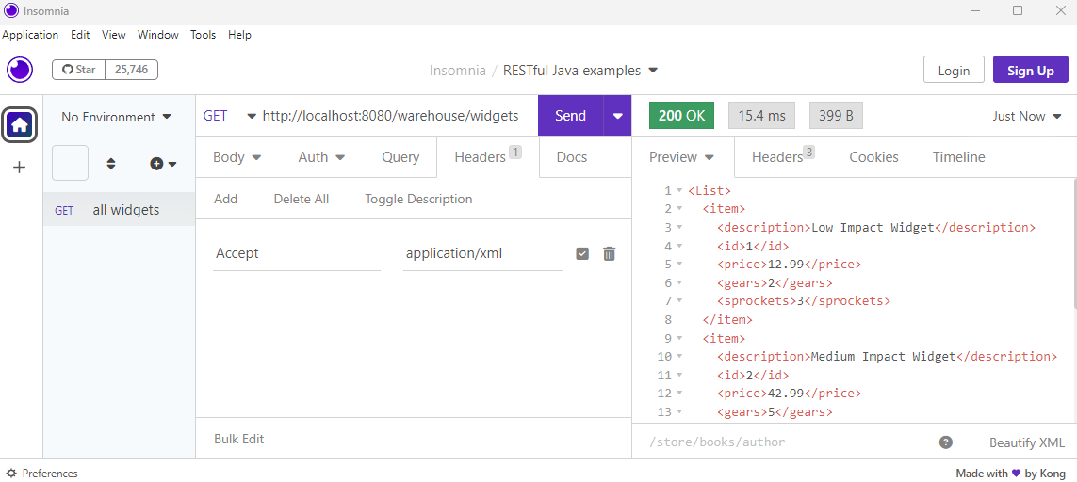
Setting the Accept Header in Insomnia

Slide 37
Producing JSON or XML Example
The following method will produce XML or JSON based on Accept header value
JavaBeans are converted to XML using the Jakarta XML Binding (JAXB) API
If you use Spring’s default JAXB implementation (the Jackson library), JavaBeans don’t require any modification
If you use a different JAXB implementation, you may need to add @XmlRootElement to JavaBeans
Converting JavaBeans to JSON doesn’t require any configuration: it just works
Not required for Jackson library
@GetMapping(value="/widgets/{id}",
produces={ MediaType.APPLICATION_JSON_VALUE,
MediaType.APPLICATION_XML_VALUE })
public Widget queryForWidget(@PathVariable int id) {
…
}
@XmlRootElement
public class Widget {
…
}
Notes:
Java EE 9: it was Java Architecture for XML Binding, now it's Jakarta XML Binding
Even if you don't specify "produces" in @GetMapping, Spring still produces XML or JSON based on the Accept header. But we'll be explicit to make it obvious.

Slide 38
Producing JSON or XML Example (continued)
The following method will accept JSON or XML based on Content-Type header:
@PostMapping(value="/widget",
consumes={ MediaType.APPLICATION_JSON_VALUE,
MediaType.APPLICATION_XML_VALUE }),
produces={ MediaType.APPLICATION_JSON_VALUE,
MediaType.APPLICATION_XML_VALUE })
public Widget addWidget (@RequestBody Widget widget) {
dao.insertWidget(widget);
return widget;
}
Widget parameter will be created from JSON or XML data in the body of the message

Slide 39
Exercise 1.2: Creating a RESTful API
30 min
Please refer to your Exercise Manual to complete this exercise

Slide 40
Chapter Concepts
RESTful Web Services
What Is Spring Boot?
Building RESTful Services with Spring Boot
HTTP Response Codes
Chapter Summary

Slide 41
HTTP Status Codes
The HTTP protocol defines meaningful status codes
Which can be returned from a RESTful service
Using status codes can help service consumers
Determine how to understand the service response
Especially when errors occur
What is status code 418?
https://en.wikipedia.org/wiki/List_of_HTTP_status_codes
Notes:
Http status code 418 – I am not a teapot!

Slide 42
HTTP Status Codes (continued)
200 OK Response to a successful request
201 Created Response to POST that results in a resource creation
204 No Content Response to a successful request that does not return a body
400 Bad Request The request was malformed
401 Unauthorized Either invalid or missing authentication details in request
403 Forbidden User does not have access to the requested resource
404 Not Found We’ve all been here before
405 Method Not Allowed The HTTP method is not allowed for this user
410 Gone The resource is no longer available
418 ?

Slide 43
Why Should I Use a Status Code?
They communicate to the RESTful client
When an exceptional event occurs
When some special behavior is required
Many status codes represent situations that are worth handling with a special response
Many widely used APIs are using them
A convention is being created
Following that convention makes it easier for users of your RESTful service
https://gist.github.com/vkostyukov/32c84c0c01789425c29a

Slide 44
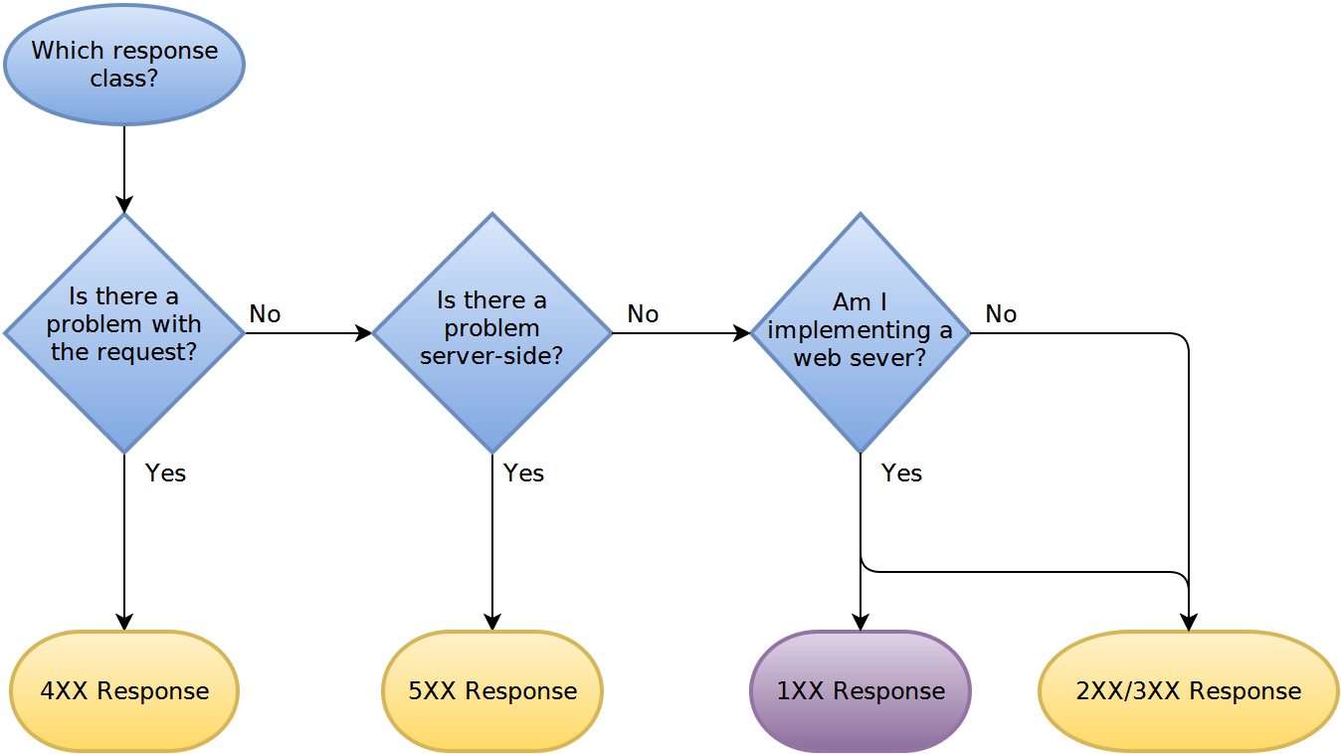
What Status Should I Return?
The following flowcharts answer this question
From https://www.codetinkerer.com/2015/12/04/choosing-an-http-status-code.html
The flowcharts for each category of response are too big to fit on these slides
Visit the above URL to see them

Slide 45
Exercise 1.3: Which Status Code to Use?
20 min
Please refer to your Exercise Manual to complete this exercise

Slide 46
How to Return a Status Code
Two main methods for returning an HTTP status code response
Return a ResponseEntity object that wraps the Java object being returned
Call ResponseEntity.status() to set the HTTP response status code
Throw a ResponseStatusException or one of its subclasses
All subclasses set the HTTP status code and provide an error message
ServerErrorException (code 500), ServerWebInputException (code 400)
ResponseEntity uses the Builder design pattern
Builder pattern allows the construction of complex objects step by step
Avoids constructors with long parameter lists
Can provide default values for an object’s properties

Slide 47
Example of Builder Design Pattern
Instead of a constructor with many parameters:
Use the Builder pattern:
class User {
public User(String name, String email, String addr) { … }
…
}
…
User lin = new User("Lin", "1 Oak St" , "lin@wxyz.me");
class UserBuilder {
private String name = "No name";
private String email = "No email";
private String address = "No address";
public UserBuilder setName(String name) {
this.name = name;
return this;
}
public UserBuilder setEmail(String email) { … }
public UserBuilder setAddress(String address) { … }
public User build() {
return new User(name, age, address);
}
Properties have default values
Oops! Arguments in wrong order.
Returns this so calls can be chained
UserBuilder builder = new UserBuilder();
User user = builder.setName("Lin")
.setAddress("1 Oak St")
.setEmail("lin@wxyz.me")
.build();
Order of setter calls doesn’t matter
Call build() instead of User constructor
build() creates a User object

Slide 48
Using the ResponseEntity Object
RESTful methods can return a ResponseEntity instead of a JavaBean
Allows you to set response’s HTTP status and headers
@GetMapping("/widgets")
public ResponseEntity<List<Widget>> queryAllWidgets() {
List<Widget> widgets = dao.getAllWidgets();
ResponseEntity<List<Widget>> response;
if (widgets != null) {
response = ResponseEntity.status(HttpStatus.OK)
.body(widgets);
}
else {
response = ResponseEntity.status(HttpStatus.NO_CONTENT)
.build();
}
return response;
}
Method returns ResponseEntity
Sets status and returns a BodyBuilder
Builds response body
Builds response with an empty body
Notes:
To add headers:
response = ResponseEntity.status(HttpStatus.OK)
.header("MyResponseHeader", "MyValue")
.body(widgets)
.build();
To add a cookie to the response, add an HttpServletResponse arg to the request method:
@PostMapping("/login")
public ResponseEntity<String> singleSignOn(@RequestBody String bodySso, HttpServletResponse response) {
response.addCookie(new Cookie("heroku-nav-data", navData));
HttpHeaders headers = new HttpHeaders();
…
String id = …;
return new ResponseEntity<String>(id, headers, HttpStatus.OK);
}

Slide 49
Using the ResponseEntity Object (continued)
ResponseEntity defines convenience methods for common use cases
ResponseEntity.ok(response-body) – sets response status 200
ResponseEntity.noContent() – sets status 204
ResponseEntity.notFound() – sets status 404
@GetMapping("/widgets")
public ResponseEntity<List<Widget>> queryAllWidgets() {
List<Widget> widgets = dao.getAllWidgets();
ResponseEntity<List<Widget>> response;
if (widgets != null) {
response = ResponseEntity.ok(widgets);
}
else {
response = ResponseEntity.noContent()
.build();
}
return response;
}

Slide 50
Exercise 1.4: Returning a Status Code
30 min
Please refer to your Exercise Manual to complete this exercise

Slide 51
Chapter Concepts
RESTful Web Services
What Is Spring Boot?
Building RESTful Services with Spring Boot
HTTP Response Codes
Chapter Summary

Slide 52
Chapter Summary
In this chapter, we have explored:
Understanding what a RESTful web service is
Building RESTful services with Spring Boot
Returning HTTP status codes

Slide 53
Further Readings
https://martinfowler.com/articles/richardsonMaturityModel.html

