Slide 1
Introduction to Docker
Docker

Slide 2
Chapter Objectives
In this chapter, we will discuss:
Virtualization
Docker architecture
Docker image
Docker container
Docker registry
Checking a Docker system

Slide 3
Chapter Concepts
Container Virtualization
Docker Architecture
Exercise: Checking Docker System
Chapter Summary

Slide 4
Problem Statement
If you attempted to run two or more copies of a database or web server on your machine, would it work?
Why or why not?
Have you ever installed an application only to find it wouldn’t run because your computer was missing a particular library?
Containers, specifically Docker Containers, were created to address these and other problems

Slide 5
Containers vs. Virtual Machines

Slide 6
Containers vs. Virtual Machines
VMs | Containers
Heavyweight | Lightweight
Limited performance | Native performance
Each VM runs in its own OS | All containers share the host OS
Hardware-level virtualization | OS virtualization
Startup time in minutes | Startup time in milliseconds
Allocates required memory | Requires less memory space
Fully isolated and hence more secure | Process-level isolation, possibly less secure

Slide 7
Container Virtualization
Software development and execution insulated from hardware
All software development and testing is done in the container
Time saved in not having to re-install and perhaps rework software when moving from development to test to production system—just move the container
Software is updated when needed by the application
When product is completed, container is moved to execution hardware where it is executed—no changes necessary because of the new hardware
Developers have a greater stake in testing and production as the container is not modified when moved to test or production
Since containers are completely isolated from other containers, multiple containers can be executed on the same hardware
Fewer security concerns
Better utilization of resources

Slide 8
Chapter Concepts
Container Virtualization
Docker Architecture
Exercise: Checking Docker System
Chapter Summary

Slide 9
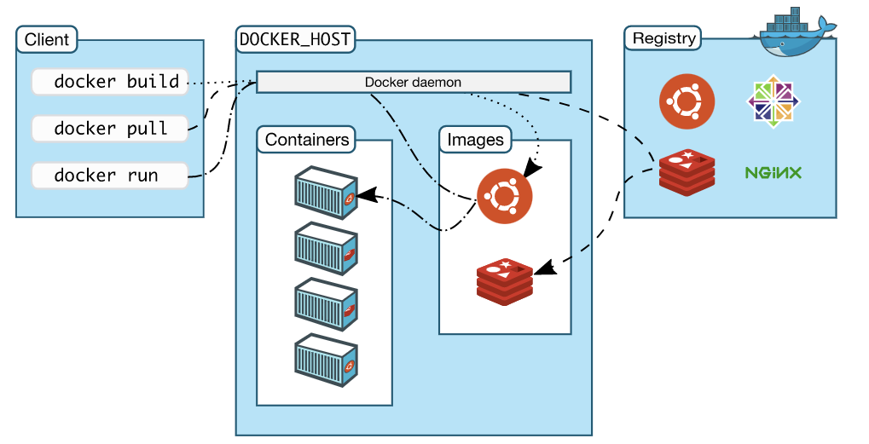
Docker Architecture
Source: https://docs.docker.com/engine/understanding-docker/

Slide 10
Architecture Notes
Client server architecture
Docker client talks to Docker Server (Daemon)
Client and server can run on the same machine
Or they can be on separate machines
Communication is through sockets or RESTful API
Docker Daemon does work of building, running, and distributing Docker containers

Slide 11
Images, Containers, and Registries
Docker Image
A read-only file that contains all the code to run a program
A Docker image is built in layers
Docker Container
A Docker container holds everything that is needed for an application to execute
A Docker container is created from a Docker image
Similar to a running process being created from a program file
Docker Registry
A public or private location to store images
Images are uploaded and downloaded from a registry

Slide 12
Chapter Concepts
Container Virtualization
Docker Architecture
Exercise: Checking Docker System
Chapter Summary

Slide 13
Exercise 1.1: Checking Docker System
Please refer to the Exercise Manual and work through the exercise with the instructor

Slide 14
Chapter Concepts
Container Virtualization
Docker Architecture
Exercise: Checking Docker System
Chapter Summary

Slide 15
Chapter Summary
In this chapter, we have discussed:
Virtualization
Docker architecture
Docker image
Docker container
Docker registry
Checking a Docker system

