Slide 1
Container Lifecycle
Docker

Slide 2
Chapter Objectives
In this chapter, we will discuss:
How to find an image to run in a container
Running the container in the foreground
Running the container in the background
Running an interactive container
A life cycle for a container
Looking inside a container

Slide 3
Chapter Concepts
docker Basics
Container Metadata
Chapter Exercises
Chapter Summary

Slide 4
The cowsay Program
Demonstration!
Opening a terminal window
Executing: cowsay boo
Docker doesn’t have a cowsay image—it does have a whalesay image
To find the whalesay image on the Docker public repositories, execute:
docker search whalesay | head -10
See next slide for details of command

Slide 5
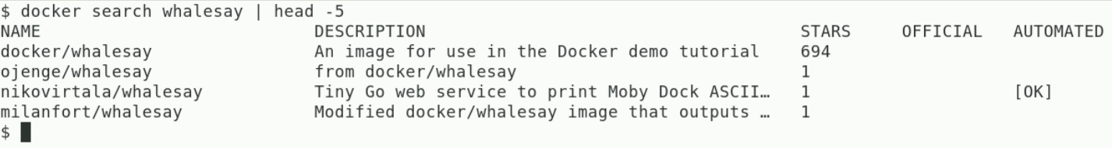
docker search
Name is of the form repository_name/image_name:tag
repository_name must be unique within Docker Hub repository
docker is the repository name for official images
image_name must be unique within repository
tag is used to identify different versions of an image with the same name

Slide 6
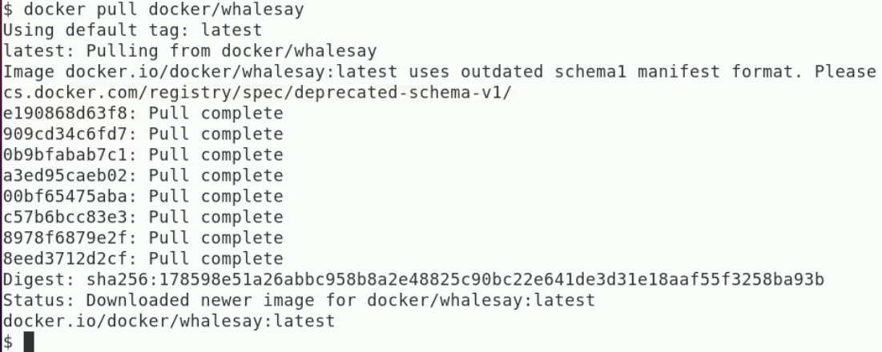
docker pull
docker pull
Pulls an image or repository from a registry down to local storage
Demonstration!
Pull from the Docker Hub repository
Execute: docker pull docker/whalesay
See:

Slide 7
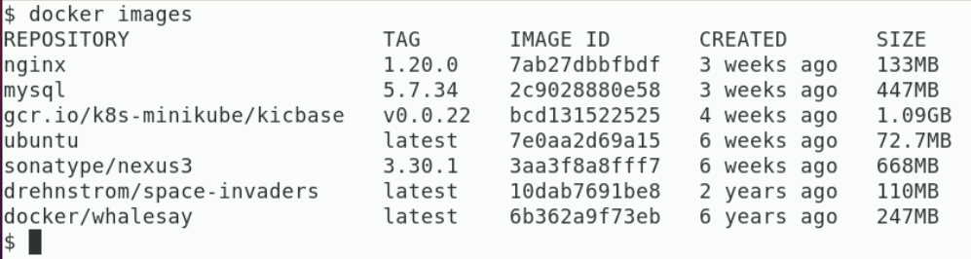
docker pull (continued)
Will learn about layers in Chapter 3: Docker Build
This could take some time—you have 5 minutes to get a cup of coffee
Execute: docker images
See something similar to:
This is a list of the images locally available to be run in a container
You may see different images

Slide 8
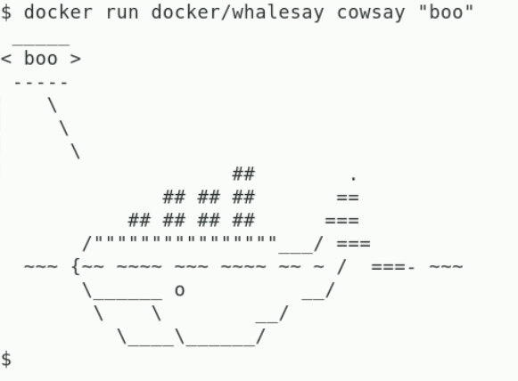
docker run
docker run [options] IMAGE [COMMAND] [ARG…]
Runs a program in a container
There are lots and lots of options (more soon)
Demonstration!
Execute: docker run docker/whalesay cowsay "boo"
See:

Slide 9
docker ps
docker ps [-a|--all]
Lists containers
-a or --all shows all containers running and not running
Demonstration!
Execute: docker ps --all
See something like:

Slide 10
docker rm
docker rm <name or container_id>
Removes the container from local repository
The container must be stopped (docker stop <name container id>)
Demonstration!
Execute: docker ps –a
Write down the NAME _________________________________
The CONTAINER ID is the first 12 characters of the container id. It can also be used as an identifier.
Write down CONTAINER ID ______________________________

Slide 11
docker rm (continued)
Demonstration!
Execute one of the following to remove docker/whalesay:
docker rm <Container ID>
docker rm <NAME>
Execute: docker ps -a
You should not see the docker/whalesay container

Slide 12
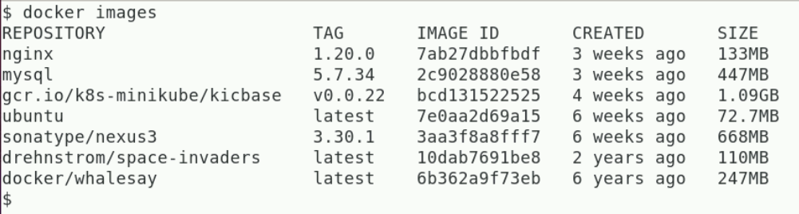
docker images
Demonstration!
Execute: docker images
See:
Deleting the container with docker rm does not delete the image
Use docker rmi <IMAGE ID> to remove the image
Use the option [-f|--force] to remove an image that is still being used by a container
Execute: docker images
Execute: docker rmi docker/whalesay:latest

Slide 13
docker rmi
docker rmi <IMAGE ID>
Removes the image from local repository
Use the option [-f|--force] to remove an image that is still being used by a container
Do Now!
Execute the following:
docker rmi docker/whalesay
docker images
The image whalesay should not appear

Slide 14
docker run Again
docker run [OPTIONS] IMAGE [COMMAND] [ARG…]
The OPTIONS are numerous
Execute docker run --help | less to see them all
Command will look for the IMAGE locally first and then download from repository
Do Now!
Execute: docker run docker/whalesay cowsay "boo"
run is the Docker command
There are no options
The IMAGE is docker/whalesay
The COMMAND is cowsay
The ARG is "boo"
See next slide for example output

Slide 15
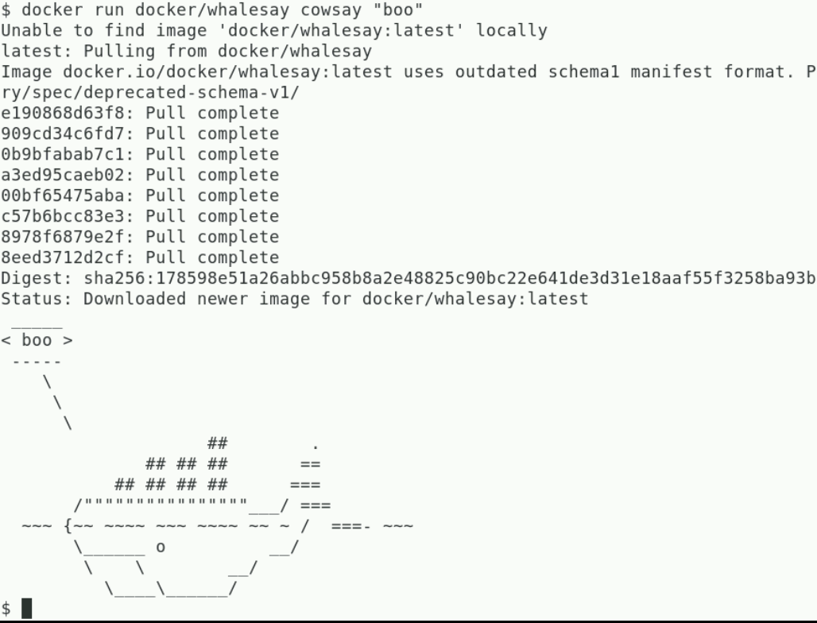
docker run (continued)
docker run [OPTIONS] IMAGE [COMMAND] [ARG…]

Slide 16
docker run Options
-i --interactive=true
The container will have an interactive action
-t --tty=true
Creates a tty interface
--rm
Removes the container when image exits
-u <user> --user=<user>
User used to log in to image when executing in container
-h <hostname> --hostname=<hostname>
Sets the hostname of the container
--name <name>
Gives a name to the container

Slide 17
docker run Options (continued)
-e <variableName=value> . . .
Makes variableName an environmental in the image for this run
-w <path to directory>
--workdir=<path to directory>
Starting directory for image for this run

Slide 18
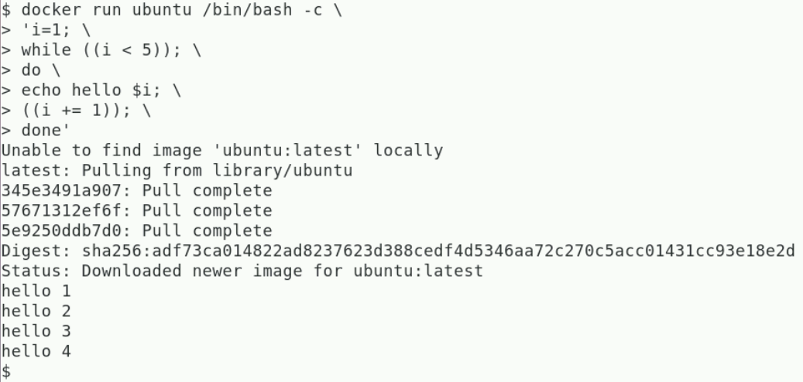
docker run
Do Now!
Execute: docker run ubuntu /bin/bash -c \
'i=1; while ((i < 5)); \
do echo hello $i; (( i += 1)); done'
See:

Slide 19
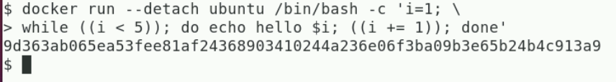
docker run --detach
Do Now!
Execute:
docker run --detach ubuntu /bin/bash \ -c 'i=1; while ((i < 5)); do echo hello $i; (( i += 1)); done'
See:
The return value is the id number for this container
--detach can be abbreviated to -d
To see the log file (standard out) for this container, execute: docker logs <container_id>
Execute: docker logs $(docker ps -ql)

Slide 20
docker pause / docker unpause
Do Now!
Execute: docker run --detach ubuntu \ /bin/bash -c 'i=1; while ((i < 5)); do echo hello \ $i; sleep 5; (( i += 1)); done'
Execute: docker pause $(docker ps -ql)
Execute: docker logs $(docker ps -ql)
Execute: docker unpause $(docker ps -ql)
Wait 30 seconds
Execute: docker ps -a
Execute: docker logs $(docker ps -ql)
The docker pause command uses the cgroups freezer to suspend all processes in a container
The process cannot trap this command
Use docker unpause to continue processing

Slide 21
Demonstration
Execute: docker run -it ubuntu
-i for an interactive component
-t for a tty connection
ubuntu is an image supplied and maintained as a base image
The default command is /bin/bash
Open a second terminal window and cd to: ~/ROI.Training/Docker/Command_docker
Execute: docker cp sayHello $(docker ps -ql):/root
Switch to the Ubuntu window
Execute: cd /root
Execute: ls -l

Slide 22
Demonstration (continued)
Execute: ./sayHello
Change to the other window
Execute: docker stop $(docker ps -ql)
Change to the Ubuntu window and see that the container is not running
Execute: docker ps -a
Notice that the container is not running at all, it has exited
Execute: docker start $(docker ps -ql)
Notice that there is no terminal interface to the command
Execute: docker attach $(docker ps -ql)
This will take 1 or 2 minutes
Execute: /root/sayHello

Slide 23
Demonstration (continued)
Change to the other window
Execute: docker exec $(docker ps -ql) /root/sayHello
Execute: docker stop $(docker ps -ql)
Execute: docker exec $(docker ps -ql) /root/sayHello
This should return an error about the container not running

Slide 24
docker stop Command
Pausing syntax:
docker stop <container> [<container]...
This command sends a SIGTERM signal to the container and if it does not shut down, then it sends a SIGKILL
The command does not remove the container; invoking the run command with the --rm option will cause the container to be removed when it is stopped

Slide 25
docker start Command
Syntax:
docker start [options] <container> [<container]...
Starts one or more containers
[options]
-a attaches both STDIN, STDERR, and signals are sent to the container
-i interactive with STDIN attached to container

Slide 26
docker cp Command
Syntax:
docker cp <localfile> <container>:<path>
docker cp <container>:<path> <localfile>
Copies to or from a container
<localfile> can be a file
<localfile> can be a datastream if the file name is “–” (minus sign) (used in a pipeline)
The data stream must be in tar file format
For example: cat some_file.tar | docker cp - container.name:/home/student

Slide 27
docker attach Command
Syntax:
docker attach [options] <container>
Attaches a tty to the container which allows seeing and executing commands on the container
Multiple attach options can be done
[options]
-i
Creates an interactive attachment

Slide 28
docker kill Command
Syntax:
docker kill [options] <Container> [<Container>]...
This sends SIGKILL by default
Better to use docker stop as it sends a SIGTERM and the a SIGKILL
[options]
With the option --signal="<signal>" any signal can be sent to the container
Alternative to --signal="<signal>" is -s "signal"

Slide 29
docker create Command
Syntax:
docker create [options] <image> [command]
The [command] is optional
There may be a default command to be executed when the image is built into the image
The [command] takes precedence over the built-in command
This is the same as docker run except:
Does not start the container (run the command)
Returns id of container
Container can be started with docker start <id>
The docker create command does not have a --rm option

Slide 30
Chapter Concepts
docker Basics
Container Metadata
Chapter Exercises
Chapter Summary

Slide 31
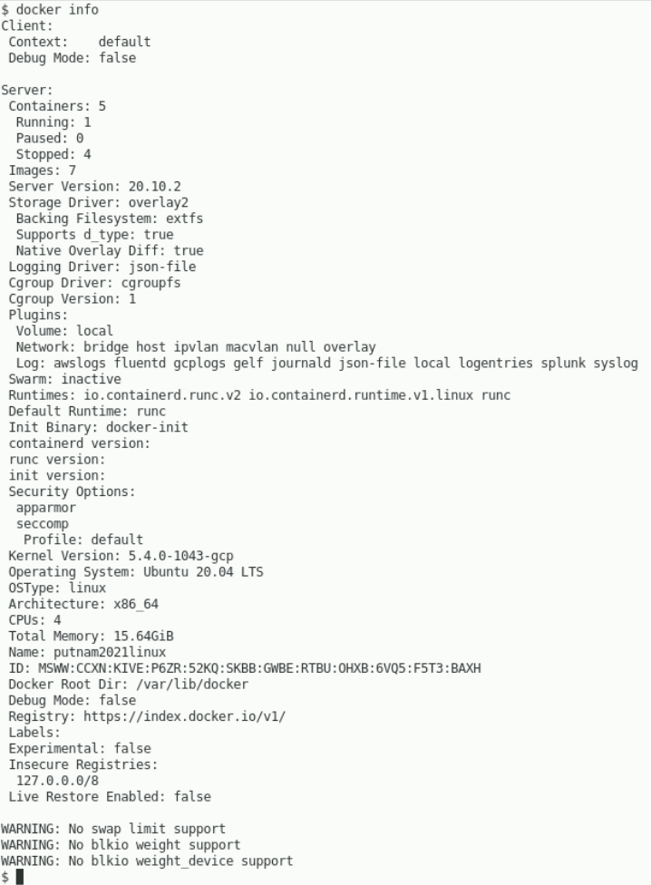
docker info Command Review

Slide 32
docker inspect Command
docker inspect <container>
Displays a live stream of container resource usage statistics
Execute:
docker inspect $(docker ps -ql) | less
Follow along with instructor

Slide 33
docker stats Command
docker stats <container>
Displays a live stream of container resource usage statistics
Example of report:
More detailed data currently requires using the programming interface

Slide 34
docker top Command
docker top <container> [ps options]
Only returns data on the processes running in the specified container
ps options are the options of the Linux ps command
Instructor demonstration
Below is the output of the demonstration

Slide 35
Chapter Concepts
docker Basics
Container Metadata
Chapter Exercises
Chapter Summary

Slide 36
Exercise 2.1: docker run Part I and Exercise 2.2: docker run Part II
Please refer to the Exercise Manual

Slide 37
Chapter Concepts
docker Basics
Container Metadata
Chapter Exercises
Chapter Summary

Slide 38
Chapter Summary
In this chapter, we have discussed:
How to find an image to run in a container
Running the container in the foreground
Running the container in the background
Running an interactive container
A life cycle for a container
Looking inside a container
docker search docker pull
docker images docker run
docker ps docker rm
docker rmi docker exec
docker cp docker attach
docker logs docker info
docker stats docker inspect

