Slide 1
Networking in Docker
Docker Networks

Slide 2
Chapter Objectives
Network drivers in Docker
List & Inspect Networks
CLI Commands
DNS

Slide 3
Networking in Docker
Docker has its own networking model to let containers speak to both each other and the outside world.
There are four basic ways that Docker supplies developers with networking for containers.
The first two, bridge and overlay networks, cover the most common use cases in production.
The other two, host and Macvlan networks, exist to cover less common cases.

Slide 4
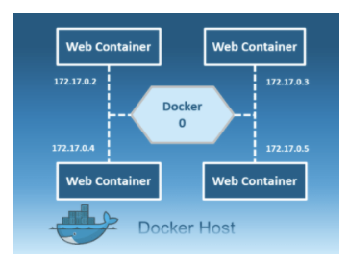
Bridge Driver
The bridge network is a private default internal network created by docker on the host.
So, all containers get an internal IP address and these containers can access each other, using this internal IP.
The Bridge networks are usually used when your applications run in standalone containers that need to communicate.

Slide 5
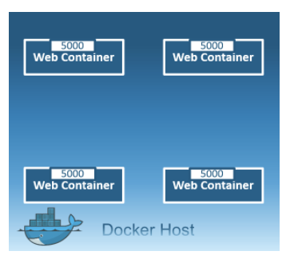
Host Driver
This driver removes the network isolation between the docker host and the docker containers to use the host’s networking directly.
So with this, you will not be able to run multiple web containers on the same host, on the same port as the port is now common to all containers in the host network.

Slide 6
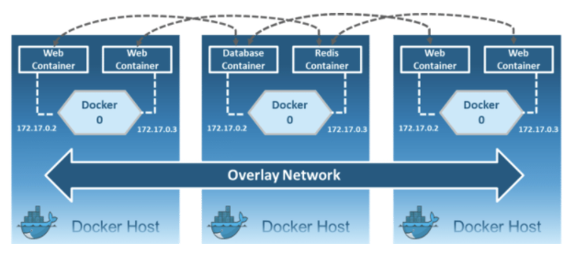
Overlay Driver
Creates an internal private network that spans across all the nodes participating in the swarm cluster.
So, Overlay networks facilitate communication between a swarm service and a standalone container, or between two standalone containers on different Docker Daemons.

Slide 7
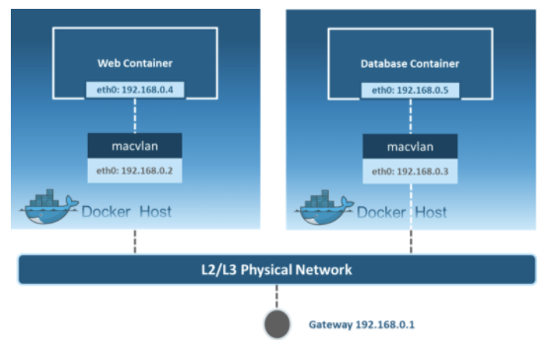
Macvlan Driver
Allows you to assign a MAC address to a container, making it appear as a physical device on your network.
Then, the Docker daemon routes traffic to containers by their MAC addresses.
Macvlan driver is the best choice when you are expected to be directly connected to the physical network, rather than routed through the Docker host’s network stack.

Slide 8
Docker Network Defaults
Each container is connected to a private virtual network “bridge”
Each virtual network routes through NAT firewall to host IP
All networks on a virtual network can talk to each other without –p
Best practice is to create a new virtual private network for each app
Network “my_web_app” for mysql and php/apache containers
Network “my_api” for mongo & Nodejs containers
The defaults can be customized
Possible to attach a container to more than one virtual network or none
Skip virtual networks and use host IP (--net= host)

Slide 9
List & Inspect Docker Networks
List Docker networks
docker network ls
This command can be used to list all the networks associated with Docker on the host.
Inspect Networks
docker network inspect <networkname>
If you want to see more details on the network associated with Docker, you can use the Docker network inspect command.

Slide 10
CLI commands
Create a Network – docker network create --driver
Attach a Network to a container – docker network connect
Detach a Network from container – docker network disconnect

Slide 11
Docker Networks - DNS
DNS
The Domain Name System (DNS) is the phonebook of the Internet.
A DNS is a service that contains a database of public IP addresses and their associated hostnames, and in most cases serves to resolve, or translate, those names to IP addresses as requested.
DNS Management for Containers
Static IP’s or using IP’s for talking to containers is an anti pattern. Because of the dynamic environment.
Docker daemon has a built-in DNS server that containers use by default
Custom networks by default have DNS built in to it

Slide 12
Chapter Summary
Network drivers in Docker
List & Inspect Networks
CLI Commands
DNS

