Slide 1
OOP
Object-Oriented Programming
Or Object-Oriented Design (OOD)

Slide 2
Objectives
Object-oriented programming
Classes
Objects
Attributes & Methods
Instantiation
Dog to a sidewalk
Create & use a class

Slide 3
We’ll learn how to
Think logically, so we can effectively approach almost any problem

Slide 4
Object-Oriented Programming (OOP)
One of the most effective approaches to writing software
GREAT for modeling real-world situations

Slide 5
In Object-Oriented Programming
Classes represent real-world things and situations,
and you create objects based on these classes.
Objects are defined by Classes.

Slide 6
We start by defining a Class()
When you you write a Class, you define the general behavior that whole category of Objects can have.
So, when you create individual objects from the class, each object is
automatically equipped with the general behavior
You can then give each object whatever unique traits you want

Slide 7
Instantiation
Is when we make an object from a class
We work with instances of that class

Slide 8
Examples of OOP

Slide 9
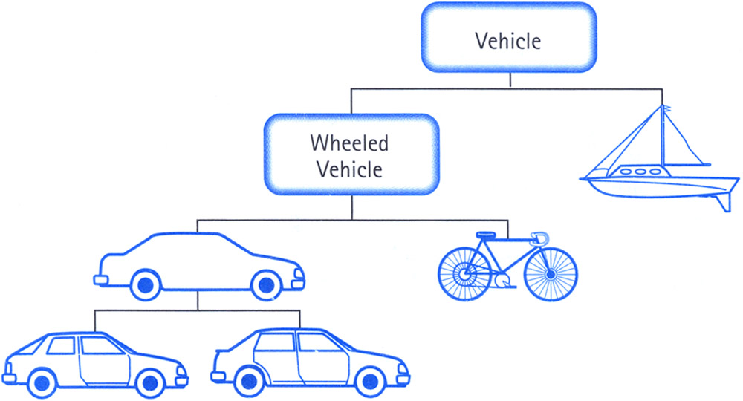
http://www.java67.com/2016/09/oops-concept-tutorial-in-java-object-oriented-programming.html

Slide 10
Class
car

Slide 11
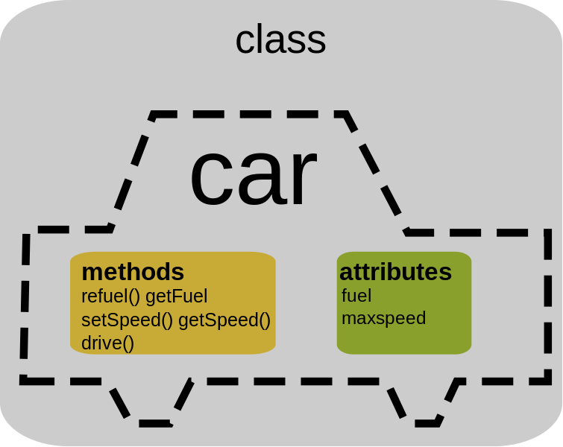

Slide 12
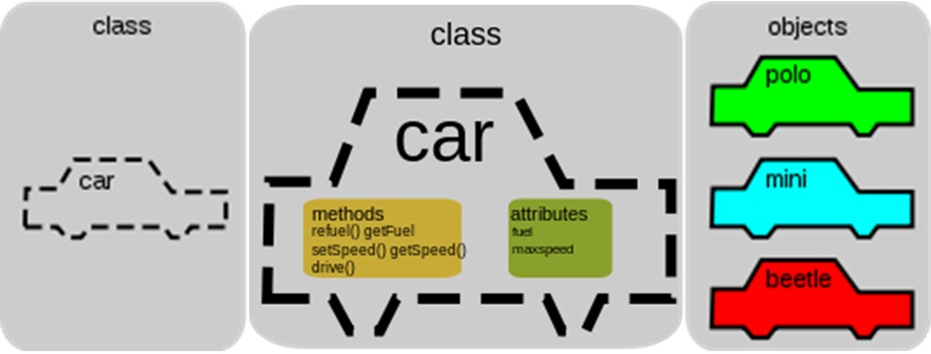
http://thebookisonthetable1.blogspot.com/

Slide 13
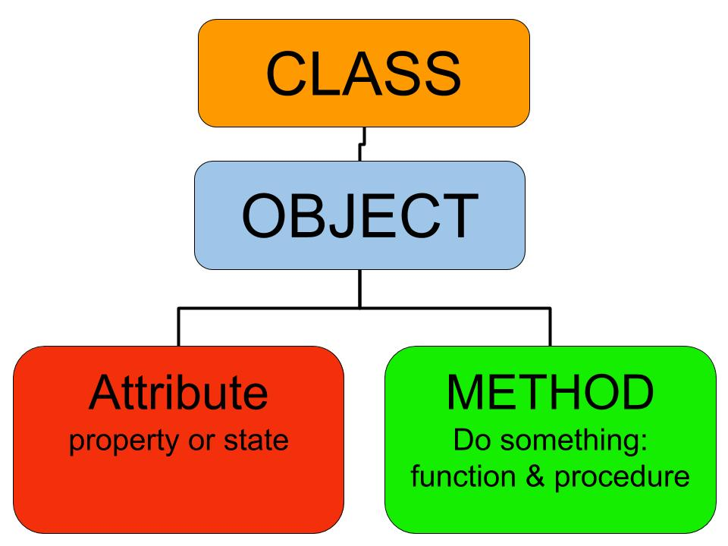

Slide 14
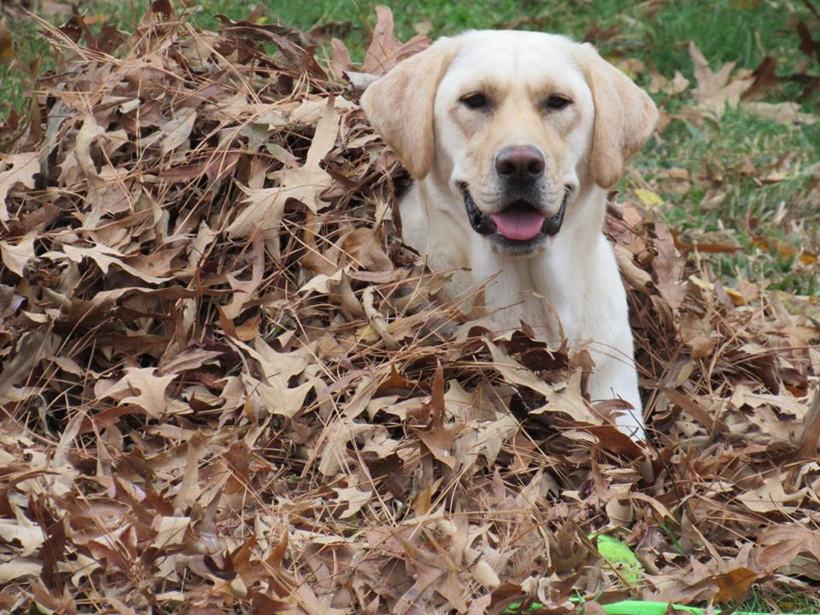

Slide 15
Why is a dog like a sidewalk?
-Because both are things, known in the English language as nouns and in Python as objects.

Slide 16

vs

Slide 17
Sidewalk
Dog
A thing
Non-living
Or inanimate
A thing
Alive
Or animate
Animal
Mammal

Slide 18
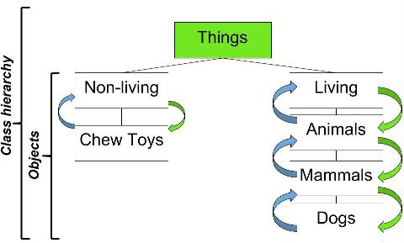
More classes

Slide 19
Creating and Using a Class in Python

Slide 20
GitHub Gist:
https://gist.github.com/joetechem/bcb7a0e6ccd33af82410962064298a6b

Slide 21
Storing Your Functions in Modules

Slide 22
Make a new folder in your directory called “modules”

Slide 23
pizza.py

Slide 24
pizza.py
def make_pizza(size, *toppings):
print(“\nMaking a “ + str(size) +
“-inch pizza with the following toppings:”)
for topping in toppings:
print(“- “ + topping)

Slide 25
making_pizzas.py

Slide 26
making_pizzas.py
import pizza
pizza.make_pizza(16, ‘pepperoni’)
pizza.make_pizza(12, ‘mushrooms’, ‘peppers’, ‘chocolate’)

Slide 27
Projects

Slide 28
Python Project
Pygame
Use the tools we have learned so far to create an awesome program!
Revisit the choose your own adventure (text adventure) game; use while loops, dictionaries, functions, and object-oriented tools!
Continue Pizza.py
Work on the Raspberry Pi Slackbot, “Sirexa”
We can use tools we’ve learned to create 2-D arcade games!
We’ll start with examples
Using the pygame module

Slide 29
Text Adventure Project Guidelines
Your Text Adventure/Choose Your Own Adventure Game must have the following:
Your own functions
While Loops
Nesting: Dictionary in a list, list in a dictionary, dictionary in a dictionary (any of those)
The following go without saying (but I’ll say it!)
User input
Conditionals

Slide 30
Pygame
Replace the missing code
Customize it, to make it your own
Change the speed of the game, FPS (Frames Per Second)
Change the player properties
Import your own images
Create your own colors (R, G, B) or (RED, GREEN, BLUE)
After the snake game, you can move on to Tetris or Pong

Slide 31
Final Day of Code Em!
April 4th 2017

Slide 32
What we’ve learned

Slide 33
What we’ve learned!
How to solve a problem -Computational Thinking
Working with the random module
Data Structures
Dictionaries
Nesting
Lists in lists, lists in dictionaries, dictionaries in dictionaries
Tuples
Dimensions of an object
User Input
While Loops & how techniques to stop them
Object-Oriented Programming
Classify

Slide 34
Projects
Order a laptop program
Pizza program
Snake game and Tetris game using pygame

