Slide 1
Control Structures
Temperature warnings

Slide 2
Objectives
To understand simple, two-way, and multi-way decision programming patterns.
To understand the concept of Boolean expressions and the bool data type.

Slide 3
Control Structures.
What are they?

Slide 4
Control Structures
Though sequencing (instructions followed one after the other) is a fundamental concept of programming, it is not sufficient to solve EVERY problem.
It is often necessary to alter the sequential flow of a program to meet the needs of a certain situation.
This is done with special statements known as CONTROL STRUCTURES
For now, we’ll take a look at DECISION STRUCTURES

Slide 5
Decision Programming Patterns
Simple → if statement
Two-way → if-else
Multi-way → if-elif-else

Slide 6
Getting the computer to make a simple decision

Slide 7
Make a new file called
temp_convert.py

Slide 8
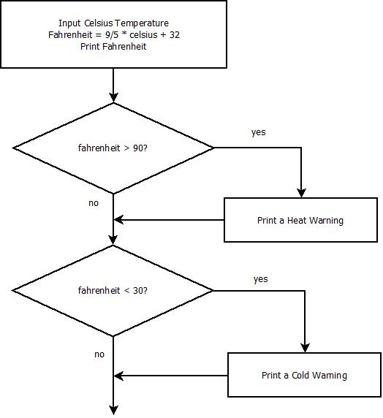
Flow chart of temperature conversion program with warnings
Program Flow

Slide 9
The main function
1 def main():
2 celsius = int(raw_input("What is the Celsius
temperature? "))
3 fahrenheit = 9/5 * celsius + 32
4 print("The temperature is "+ str(fahrenheit)+ " degrees
fahrenheit.")

Slide 10
Add
main()
to call the function, then...
Run it!

Slide 11
Now add the code to control the flow
Use the Python if statement to enact the decision
Try this on your own first!

Slide 12
A one-way decision, or simple decision
if fahrenheit > 90:
print("It's really hot in there. Be careful!")
if fahrenheit < 30:
print("Brrrr. Be sure to layer up!")

Slide 13
There are six relational operators in Python
Python | Mathematics | Meaning
< | < | Less than
> | > | Greater than
<= | ≤ | Less than or equal to
>= | ≥ | Greater than or equal to
== | = | Equal to
!= | ≠ | Not Equal to

