Slide 1
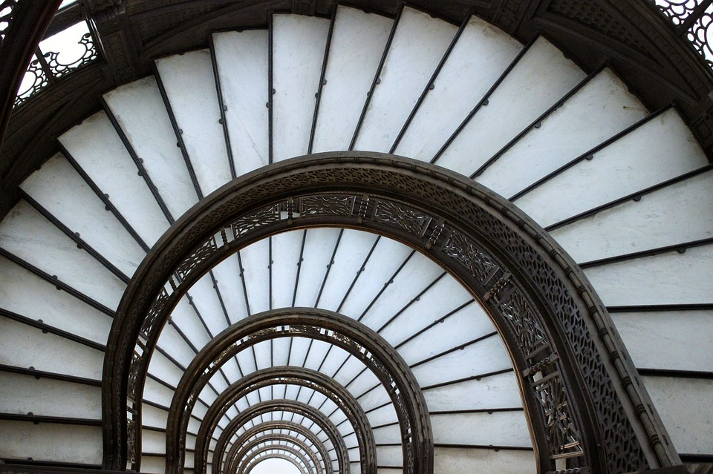
Fibonacci Sequence
0, 1, 1, 2, 3, 5, __, __, __, __, __, ...

Slide 2
Objectives
Complete a Fibonacci sequence on paper
Make a logarithmic spiral (a “Golden Spiral”)
Python program that prints out the Fibonacci Sequence

Slide 3
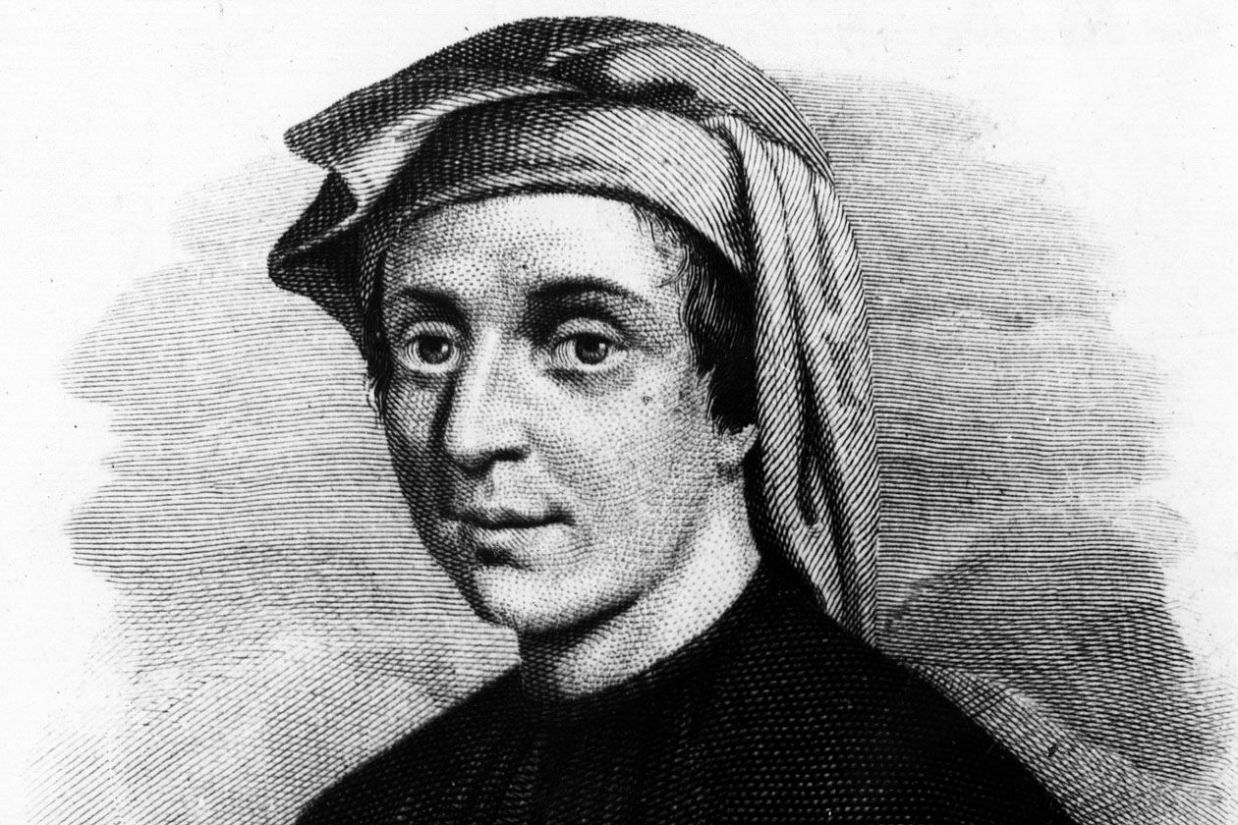

Slide 4
Leonardo Pisano a.k.a. Fibonacci
1170 - 1250
Italian mathematician
Created the Fibonacci Sequence

Slide 5
0, 1, 1, 2, __, __, __, __, ...
Write these numbers down on a sheet of paper.
What number comes next?
Do you see the pattern?
Add the following numbers on your sheet of paper

Slide 6
0, 1,
1,
2,
3,
5,
8,
13,
21,
0 + 1 = 1
2 + 3 = 5
8 + 13 = 21
1 + 1 = 2
3 + 5 = 8
1 + 2 = 3
5 + 8 = 13
The first two items are 0 and 1
We obtain the other items by adding the preceding items:
And on, and on, infinitely!

Slide 7
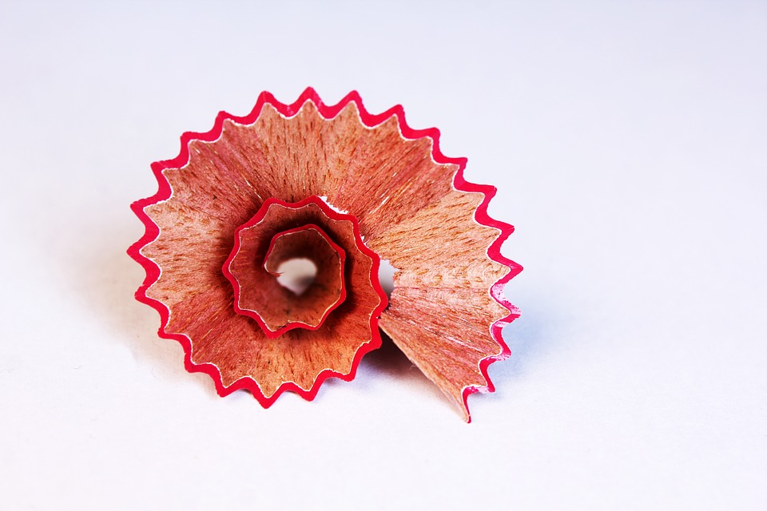
We can use this sequence of integers to draw a logarithmic spiral (a.k.a. Golden Spiral)

Slide 8
Logarithmic Spiral Instructions
Draw two squares side by side. Use your ruler to make them 0.5 cm square
Now make a 2 × 2 square on top of the first square. So if the first square was 0.5 cm, the 2 × 2 square would be 1 cm square, right?
Continue this pattern, making each square the next size in the Fibonacci sequence.
So after the 2 × 2 square, you would make a 3 × 3 square (1.5 cm × 1.5 cm), then a 5 × 5 (2.5 cm × 2.5 cm), and so on

Slide 9
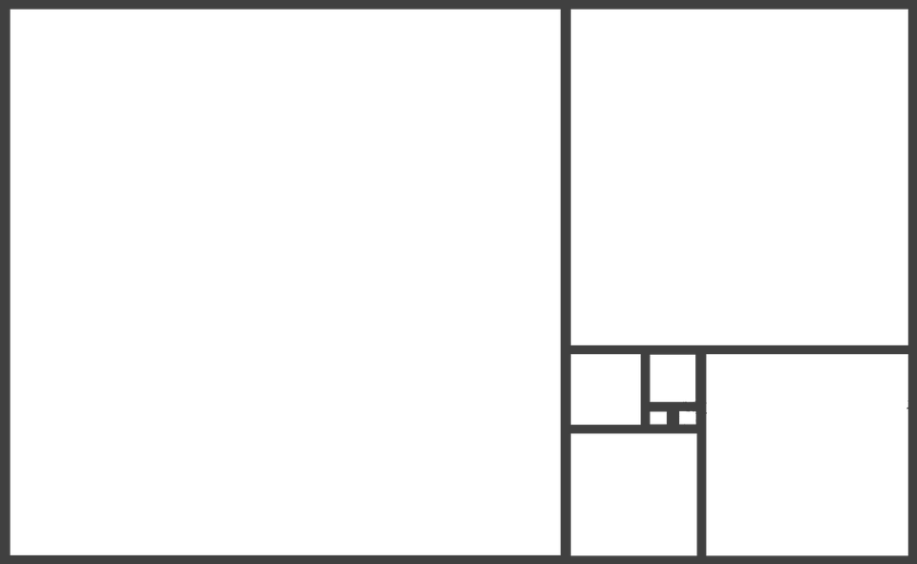
You should end up with something like this...

Slide 10
To visualize our Logarithmic Spiral...

Slide 11
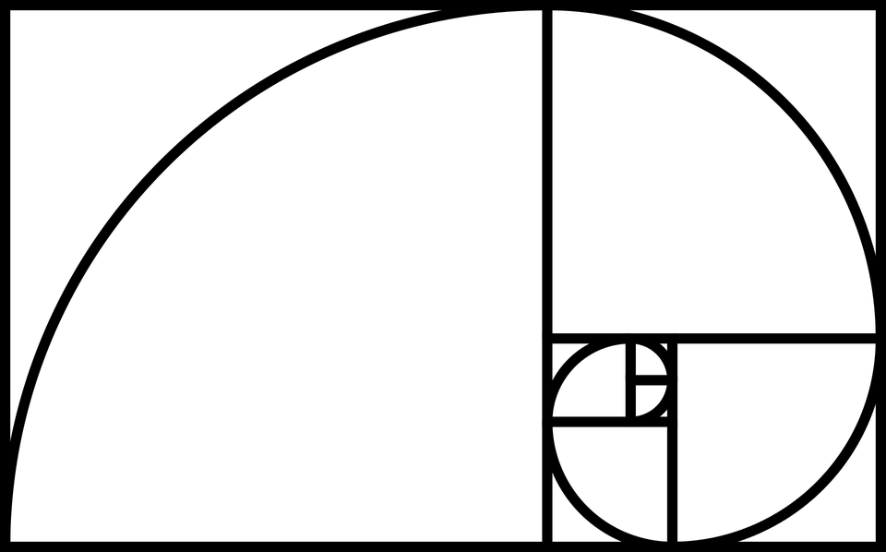
Logarithmic Spiral

Slide 12
Have you seen this spiral before?
-YES

Slide 13
Can Be Found in Nature.
… All around us!
Have you ever pulled the petals off of a daisy?

Slide 14
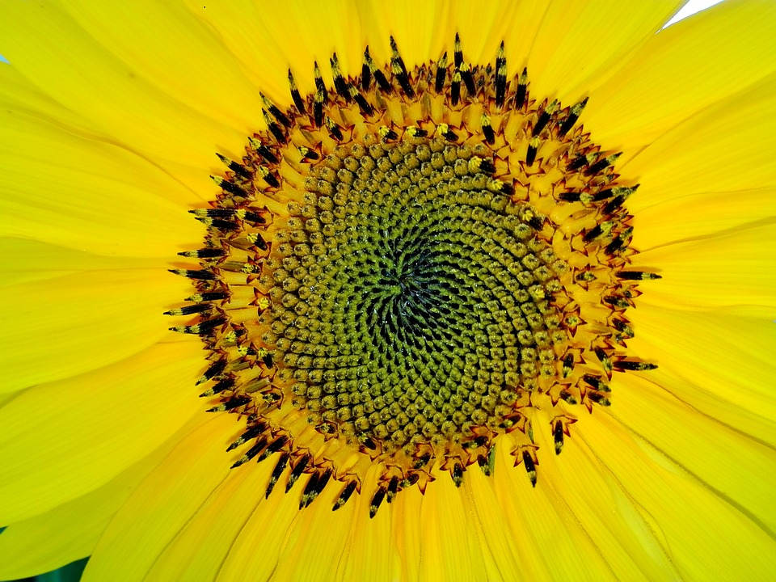

Slide 15
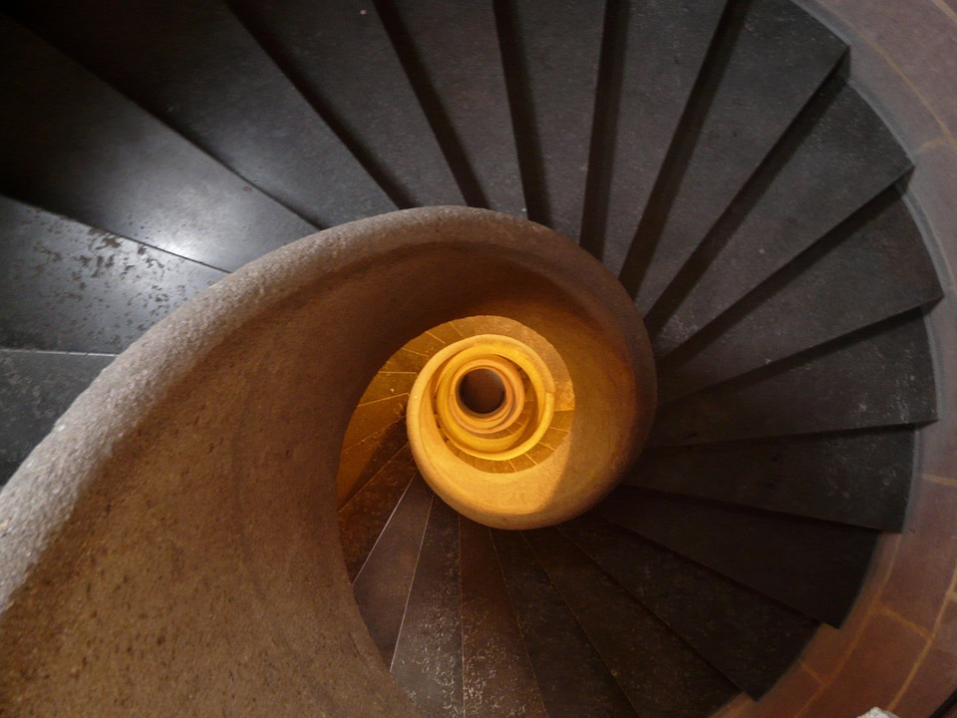
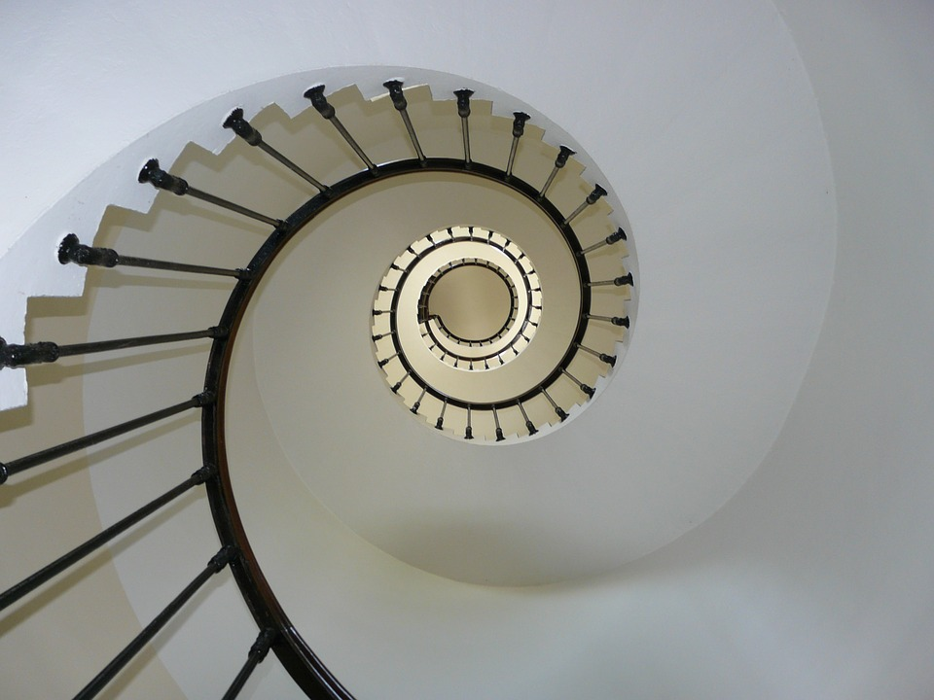
Staircases

Slide 16
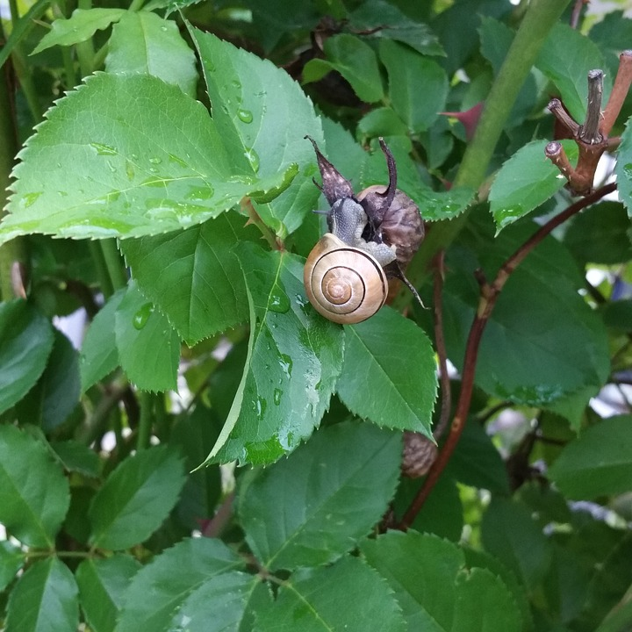
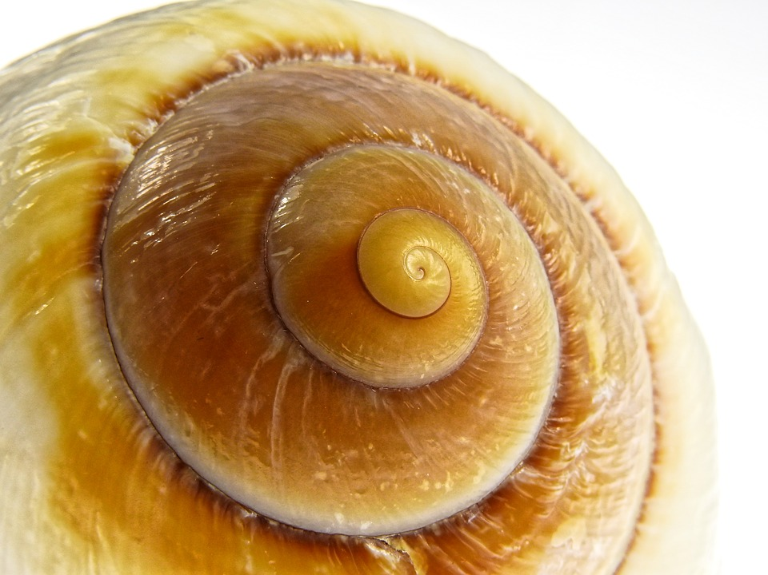
Snails

Slide 17
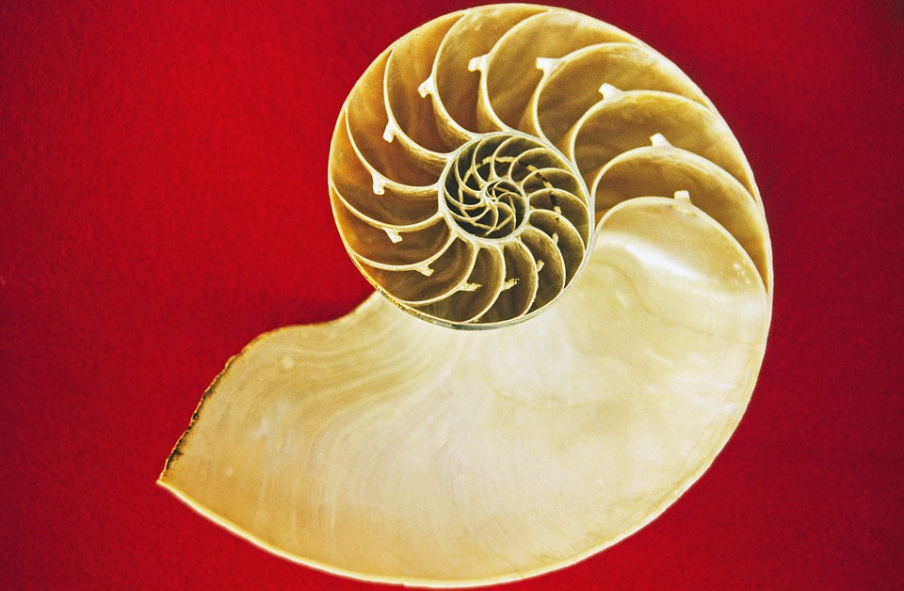
Inside of a Nautilus Shell

Slide 18
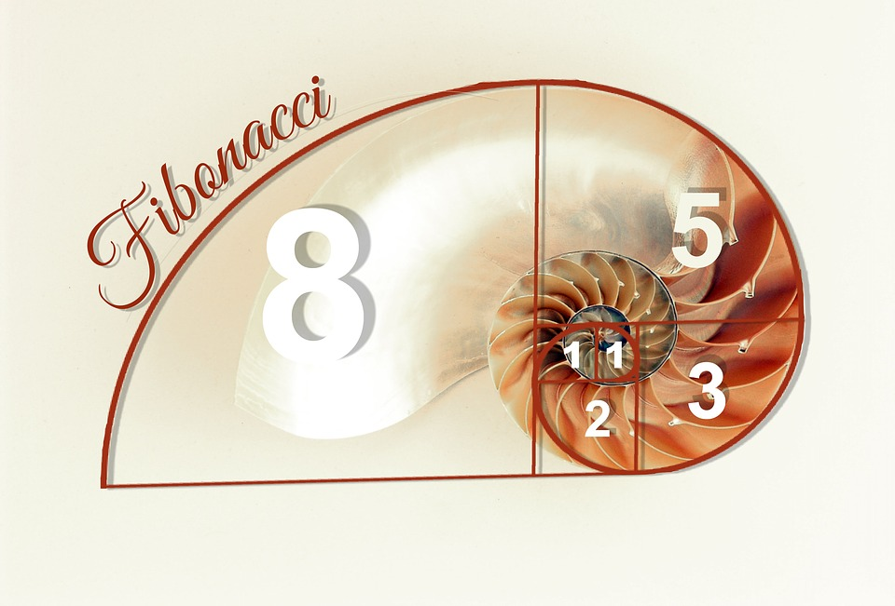

Slide 19

Python Program to Print the Fibonacci Sequence

Slide 20
Prereques
Python lists
For loop

Slide 21
How the Program Needs to Perform
We need the program to ask the user for input on how many fibonacci numbers they want to display.
We need to set up a starting list.
Then we need to have the program add the two preceding numbers to get the next number in the sequence, add that number to the list.
Then, repeat that operation, however many times the user specified.

Slide 22
Make a new file named fibonacci.py

Slide 23
What do we need for the program?
A Python list
A Python for loop

Slide 24
fibonacci.py
Variable to get how many fibonacci numbers the user want to display:
howMany = int(raw_input(“How many numbers should I create?”))
Our starting list:
nums = [1, 1]
print(1)
print(1)

Slide 25
for i in range(2, howMany):
nextFib = nums[-1] + nums[-2]
nums.append(nextFib)
print(nextFib)

